Slide 1

NetSim
Cognitive Radio Simulation
Code Walkthrough in 10 steps
This presentation is for those who are expected to
Understand basics of 802.22-2011 standard and the MAC and PHY operations
Be familiar with the Cognitive Radio experiment (present in experiment manual) and “Hello World” program (present in user manual) in NetSim
Know debugging of code NetSim (present in the user manual)

Slide 2
Step 1 - Event Programming in NetSim
The entire source code of NetSim is based on Event Programming since NetSim is a Discrete Event Simulator (DES)
Event-driven programming is a programming paradigm where flow of program is determined by different events. In NetSim there are different layer specific events and its sub-events
In NetSim, the kernel does the entire event handling. While, inserting an event into the kernel its event time(dEventTime) should also mentioned and this event time decides the order of execution of events.
Events are executed in increasing order of their event time.
NetSim does not use any scripting language and all codes are in C

Slide 3
Step 2 - What is Cognitive Radio ?
Cognitive radio is a wireless communication system which is aware of the environment and its changes and can adapt its transmission parameters accordingly
It has the ability to sense the unused spectrum at a specific time and location
The ability to receive and transmit at different frequency band enables the cognitive radio to reconfigure its parameters and select the best band
This operates in 54 MHz to 862 MHz band
CR networks can use the spectrum efficiently by allowing secondary (unlicensed) systems to opportunistically utilize the unused primary (licensed) bands, commonly referred to as white spaces
The TV Bands have been chosen by IEEE for Cognitive radio networks due to their great propagation characteristics and their relatively predictable spatiotemporal usage characteristics.

Slide 4
Devices and Spectrum management
Cognitive Radio Devices in NetSim
Base Station : Generalized equipment set providing connectivity, management and control of the customer premise equipment (CPE)
Primary User (Incumbent) : Licensed transmission systems operating in the TV bands (They are inbuilt within Base Station in NetSim)
Secondary Users (CPE) exploit CR techniques, to ensure non-interfering co-existence with the primary users
Spectrum Management
Spectrum sensing is to observe the allowed spectrum bands and then detect available spectrums
Spectrum decision is to select the spectrum to access from available spectrums
Spectrum sharing is to allocate available spectrums fairly to SUs
Spectrum handoff means that SU has to find the new spectrum quickly to transmit data continually when PU is appeared

Slide 5
Step 3 - Important Assumptions
NetSim simulation incorporates the following assumptions.These may be changed by making appropriate modifications in the code.
No co-channel interference and no co-existance mechanisms
No errors due to fading and noise. This effect is modeled via "Keep out distance". If the PU is beyond the keep out distance and NetSim assumes it cannot be sensed by the SU
The sub channel throughput is constant and synchrony between SU and PU
The false alarm and detection probabilities are the same for all SU's
SU transmits data through only one channel even if other channels are idle
All subchannels within a channel are excluded (blocked) from SU transmission is a PU comes active in any of the sub channels
Channel sensing time is Zero i.e instantaneous
The SU (not BS) decides on the presence of a PU based on detection & false alarm probabilities
The BS tries to find an idle channel for the SU if the PU comes on. If no channel is found, data is buffered at both the SU as well as the BS
SU only senses operating channel during operation, and BS checks the status of all channels throughout the simulation

Slide 6
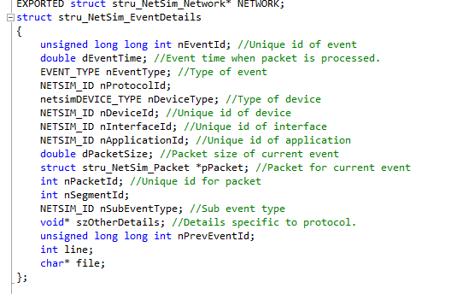
Step 4 - Important Structures in NetSim EVENT STRUCTURE (stack.h)
Line number and name of the file where the event was added through fnpAddEvent(pstruEventDetails);

Slide 7
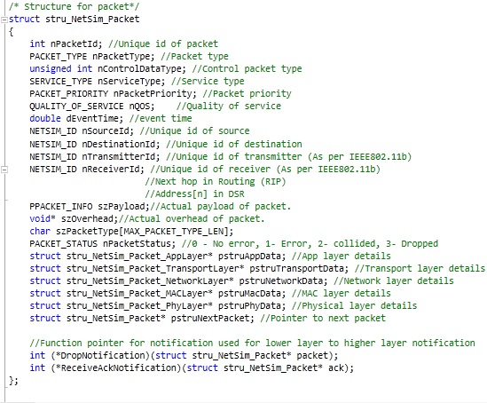
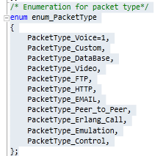
PACKET STRUCTURE (Packet.h)
Used in SCH packet
Control packet type
Id’s of devices involved
Structs for each layer

Slide 8
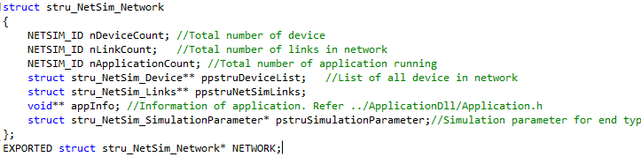
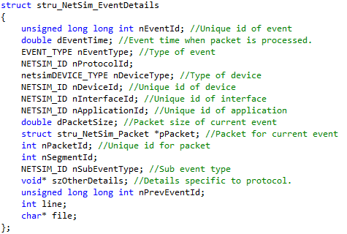
stru_NetSim_Network
stru_NetSim_EventDetails

Slide 9
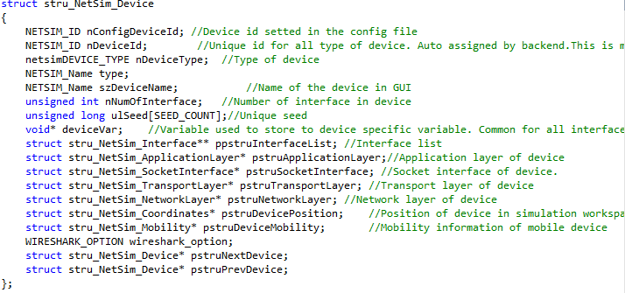
stru_NetSim_Device

Slide 10
Step 5 - Events in CR Simulation
Events can add other events for later execution.
There are 5 types of events in CR protocol in NetSim:
PHY_OUT
PHY_IN
MAC_OUT
MAC_IN
TIMER
TIMER Events are further classified into the following subevents:
The order of TIMER subevents closely matches the Superframe and
Frame structure shown in coming slides
INCUMBENT_OPERATION_START | INCUMBENT_OPERATION_END
TRANSMIT_SCH | FORM_DS_BURST
TRANSMIT_DS_BURST | FORM_US_BURST
TRANSMIT_US_BURST | QUITE_PERIOD
SM_UPDATECHANNEL

Slide 11
Step 6 - General Event Processing
Transmission of any packet follows the following sequence of events:
The PHY_OUT of SCH is scheduled by TRANSMIT_SCH
All other PHY_OUTS are scheduled by TRANSMIT_BURST (DS/US) events
Any processing of the packet can be done at the receiver after MAC_IN
If during TRANSMIT_SCH event, if the operating channel is NULL, then it will shedule a SM_UPDATECHANNEL event zero seconds later
No transmission from BS will occur after that until an operating channel is found
PHY_OUT from transmitter/source
Transmission Time
PHY_IN into receiver
No delay
MAC_IN into receiver

Slide 12
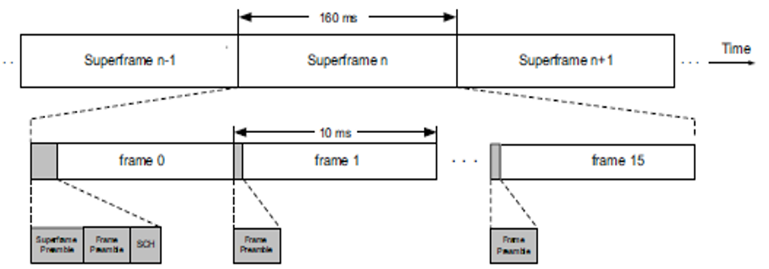
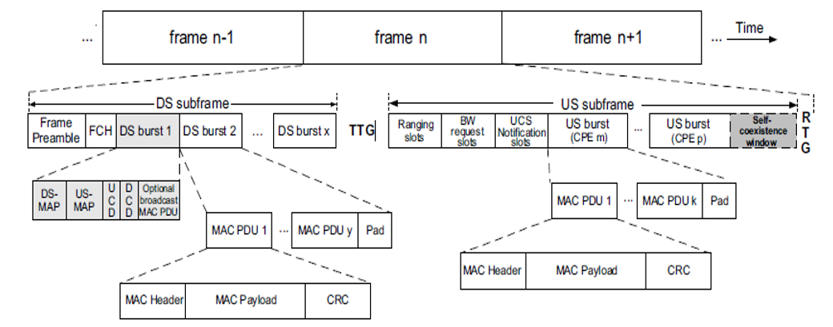
Step 7 - SUPERFRAME and FRAME

Slide 13
Step 8 - DS TIMER EVENTS
Transmission of any packet follows the following sequence of events:
The PHY_OUT of SCH is scheduled by TRANSMIT_SCH
All other PHY_OUTS are scheduled by TRANSMIT_BURST (DS/US) events
Any processing of the packet can be done at the receiver after MAC_IN
The operation of Incumbent is governed by INCUMBENT_OPERATION_START and INCUMBENT_OPERATION_END events
Incumbent is OFF for OperationIntervalTime & ON for OperationIntervalTime. This cycle keeps on repeating
PHY_OUT from transmitter/source
Transmission Time
PHY_IN into receiver
No delay
MAC_IN into receiver

Slide 14
Transfer of SCH
SCH is transferred in the beginning of every superframe
SCH packet has some fields related to QUIET PERIOD including cycle length, cycle duration, cycle offset and cycle bitmap
MAC_IN of SCH copies the information about IntraFrameQuietPeriod length, bitmap and the duration from the SCH packet to the CPE
The transfer process is similar to that of other control packets transmitted in DS_BURST
Transmit SCH
2* symbol
duration
PHY_OUT from BS
Transmission
Time
PHY_IN into each node
No
delay
MAC_IN into each node

Slide 15
DS_BURST
FORM_DS_BURST occurs in the beginning of every frame
It generates all the control packets of DS Subframe including FCH, DS-MAP, US-MAP, UCD, DCD
After the control packets, non-broadcasting packets & then the packets to be broadcasted are added to the subframe
Then PHY_OUT of each packet occurs sequentially
NetSim transmits one burst in one symbol duration. To know more about symbol, see OFDMA.c and the standard
After MAC_IN of packet, any processing can be done if required
If the control packet is FCH, then the control will decide if a Quite Period will occur in the later part of the current frame based on the SCH bitmap
DCD, UCD & DS_MAP are used for timing and channel synchronization
Transmit DS Burst
No
Delay
PHY_OUT from BS
Transmission
Time
PHY_IN into each node
No
delay
MAC_IN into each node

Slide 16
Step 9 - US TIMER EVENTS
US_MAP holds information about the allocation of upstream slots to various CPEs
The control will allocate the first 6 subchannels for BW Request transmission
US_MAP is processed when its MAC_IN occurs in a CPE
Then slots will be allocated to each CPE in the upstream subframe of the current frame as dictated by the IE’s in the US_MAP
The slots are allocated in increasing order of SID’s
NetSim keeps track of how many slots have been booked for other CPE’s, which have a lesser SID, in the variable nslot
Based on nslot, NetSim calculates dStartTime , which marks the beginning of time reserved for this CPE
NetSim also calculates the number of bytes allocated to the CPE based on its US_IE

Slide 17
FORM_US_BURST
MAC_IN of US_MAP leads to FORM_US_BURST event
Each CPE has a list of queues of packets which need to be sent, called pstruQueuedPacketList
This list has queues of packets classified into various categories based on type of packet.(The queues are related with QOS ; see the Applications - Priority and QoS section in the user manual for more help)
NetSim then scans the size of the queues sequentially
If some queue ‘q’ is larger than the remaining portion of allocated bandwidth , then separate BW_REQUEST packets are created and transmitted immediately for queues ‘q’, ‘q+1’,…. containing the required bandwidth
If some bytes are already allocated to the CPE, NetSim scans the size of each packet of each queue and add all the packets which can be sent to pstruUSBurst list of that CPE
The pstruUSBurst list of CPE is checked for a packet at dStartTime. If a packet is present, then it is transmitted
The service flow is also terminated if the ApplicationEndFlag in the packet is 1

Slide 18
Processing BW_REQUEST
This will occur when MAC_IN of the BW_REQUEST packet in the BS takes place
It will calculate the number of slots required for the CPE based on the nBR field of the packet
It will then increase the number of slots allocated to the CPE if required

Slide 19
STEP 10 - QUIET PERIOD EVENT
QUIET PERIOD is the time reserved for sensing within a frame
Whenever MAC_IN of FCH occurs in a node, the control will decide if a Quiet Period will occur in the later part of the current frame based on the SCH bitmap
If the bit for that frame is 1, then a quite period event is added a symbol duration before the actual period should start
Then a sensing function will be called, which will tell if any incumbent(s) are operational on that channel
Probability of false alarm and that of detection are also implemented in NetSim
NOTE: If channel n is being used by an incumbent, then n-1,n,n+1 can’t be used by the CPE’s

Slide 20
QUITE PERIOD: UCS
If any interferrence is detected on the operating channel, then it will create a packet with the UCS bit set as 1 in the GMH (Generic Mac header)
UCS (Urgent Coexistence Situation) bit (pg 36 Std): Used by the CPE to alert the BS about an UCS with incumbents in the channel currently being used by the BS or either of its adjacent channels :
0: no incumbent (default)
1: incumbent detected
Finally the packet is added to the MAC Queue pstruQueuedPacketList[0], and will be transferred in the US subframe of the next frame
Now the MAC_IN of the UCS packet will occur in the next frame in the base-station
Then the GMH will be obtained from the MAC overhead of the packet

Slide 21
QUIET PERIOD: CHS_REQ
NetSim has a nCHSREQFlag & a variable chsFrameCount. Together they ensure that only one CHS_REQ packet is sent in any 2 consecutive frames
The control will proceed only if the flag is 0 and will be changed to 1
The operating channel status will be converted to PROTECTED
Then the control will scan all the channels in the channel list for a BACK_UP CHANNELS
As soon as one is found, it will create a CHS_REQ packet and add it to broadcast packet list of the base station
This packet will be transferred in the next frame
If no BACK_UP channel is found, then it will set the operating channel as null
When the MAC_IN of CHS_REQ packet occurs in the node, the operating channel of that BS will be made the operating channel of that CPE also

Slide 22

THANK YOU
You can email technical queries to support@tetcos.com

