Slide 1

NetSim UWAN Library Depth Based Routing (DBR)
Applicable Release: NetSim v14.3 or higher
Applicable Version(s): NetSim Standard and NetSim Pro
Project download link: ____link will be uploaded soon___...
The URL has the configuration files (scenario, settings, and other related files) of the examples discussed in this analysis for users to import and run in NetSim
Reference: DBR: Depth-Based Routing for Underwater Sensor Networks, Hai Yan, Zhijie Jerry Shi, and Jun-Hong Cuia, NETWORKING 2008, LNCS

Slide 2
How to set up the DBR project in NetSim?
Download the project from Github link provided in slide 1.
Follow the instructions provided in the following link to setup the project in NetSim
https://support.tetcos.com/support/solutions/articles/14000128666-downloading-and-setting-up-netsim-file-exchange-projects
Go to <NetSim_Install_Directory>\Docs\UI_xml\Validators path and rename the already existing Logs.xml file to Logs_original.xml as a backup.
Copy and paste the Logs.xml file from the downloaded project folder in the <NetSim_Install_Directory>\Docs\UI_xml\Validators path.
The modified xml file adds DBR Log to the GUI logs option.
Go to <NetSim_Install_Directory>\Docs\UI_xml\Calculator path and rename the already existing selectAll.xlsx file to selectAll_original.xlsx as a backup.
Copy and paste the selectAll.xlsx file from the downloaded project folder in the <NetSim_Install_Directory>\Docs\UI_xml\Calculator path.
Go to <NetSim_Install_Directory>\Docs\UI_xml\Device_Properties path and rename the already existing Underwater_device.xml file to Underwater_device_original.xml as a backup.
Copy and paste the Underwater_device.xml file from the downloaded project folder in the <NetSim_Install_Directory>\Docs\UI_xml\Device_Properties.
The modified xml file adds Dynamic Source Routing (DSR) protocol to Network layer of UWAN devices.
The code modifications are done to DSR project to implement Depth Based Routing (DBR) protocol.

Slide 3
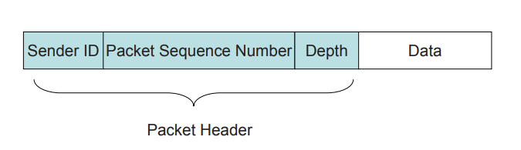
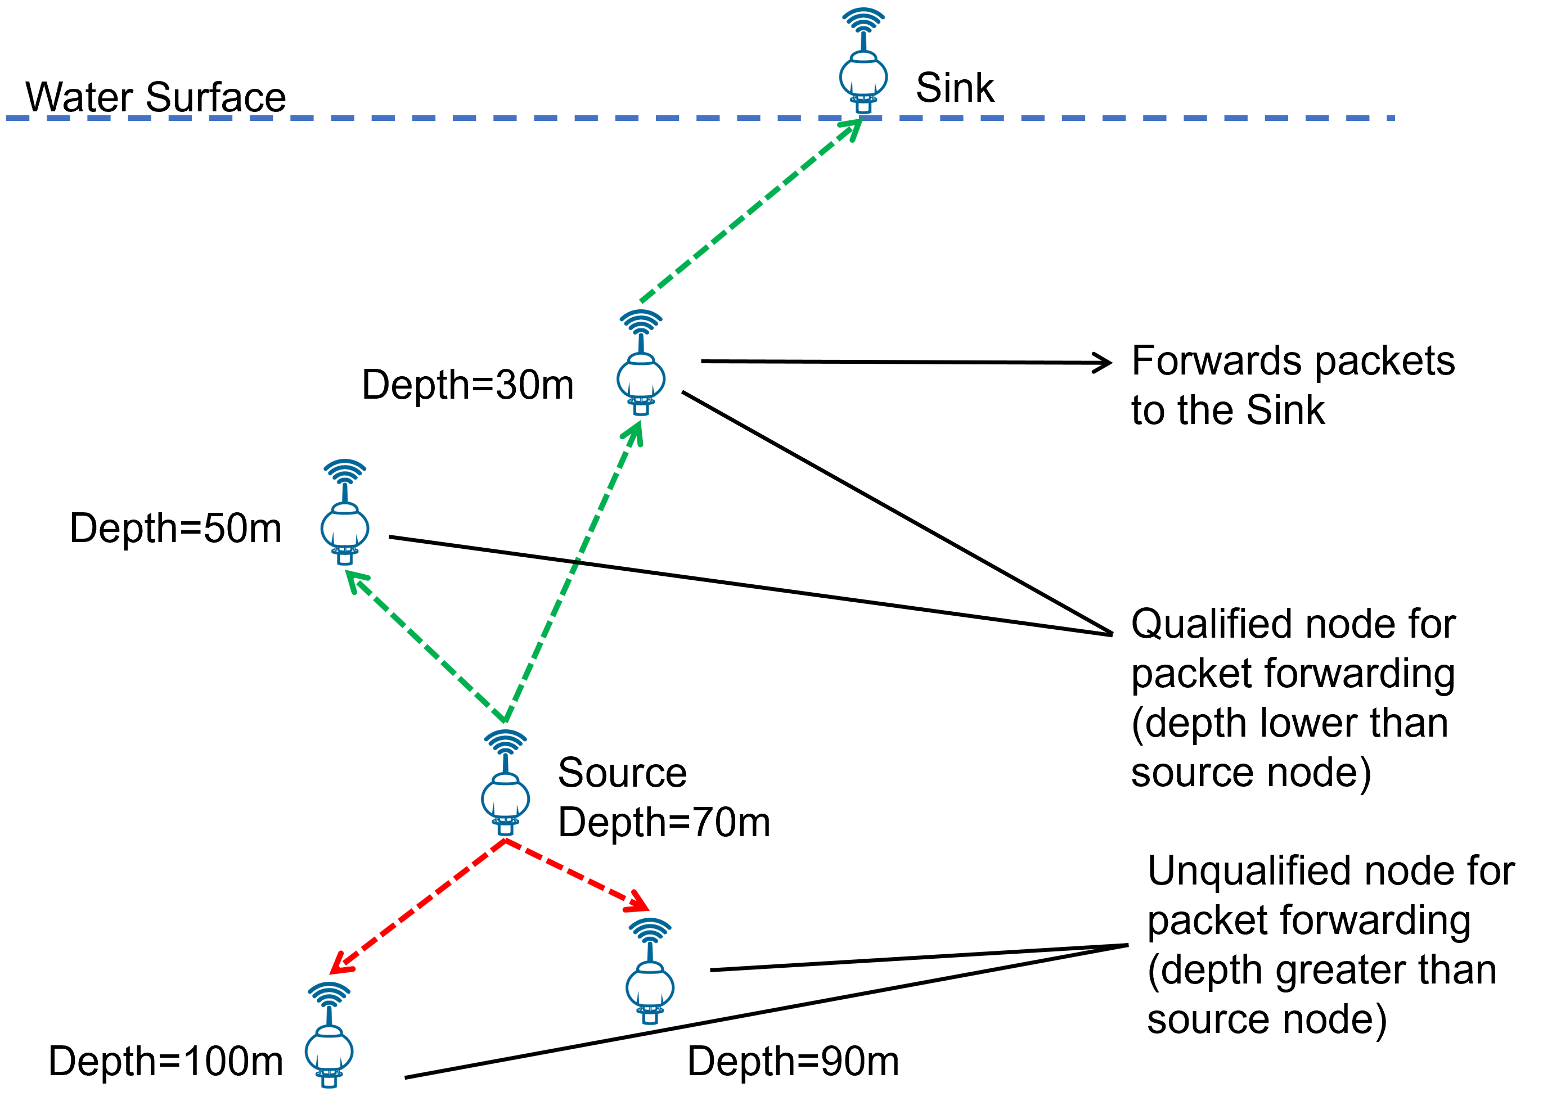
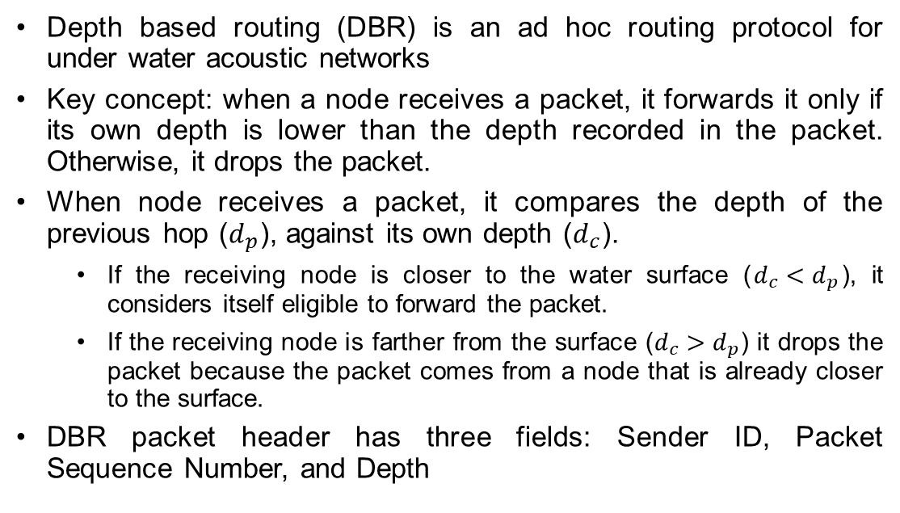
DBR: Introduction
Depth based routing (DBR) is an ad hoc routing protocol for under water acoustic networks
Key concept: when a node receives a packet, it forwards it only if its own depth is lower than the depth recorded in the packet. Otherwise, it drops the packet.
When node receives a packet, it compares the depth of the previous hop ($d_{p}$), against its own depth ($d_{c}$).
If the receiving node is closer to the water surface ($d_{c}<d_{p}$), it considers itself eligible to forward the packet.
If the receiving node is farther from the surface ($d_{c}>d_{p}$) it drops the packet because the packet comes from a node that is already closer to the surface.
DBR packet header has three fields: Sender ID, Packet Sequence Number, and Depth

Slide 4
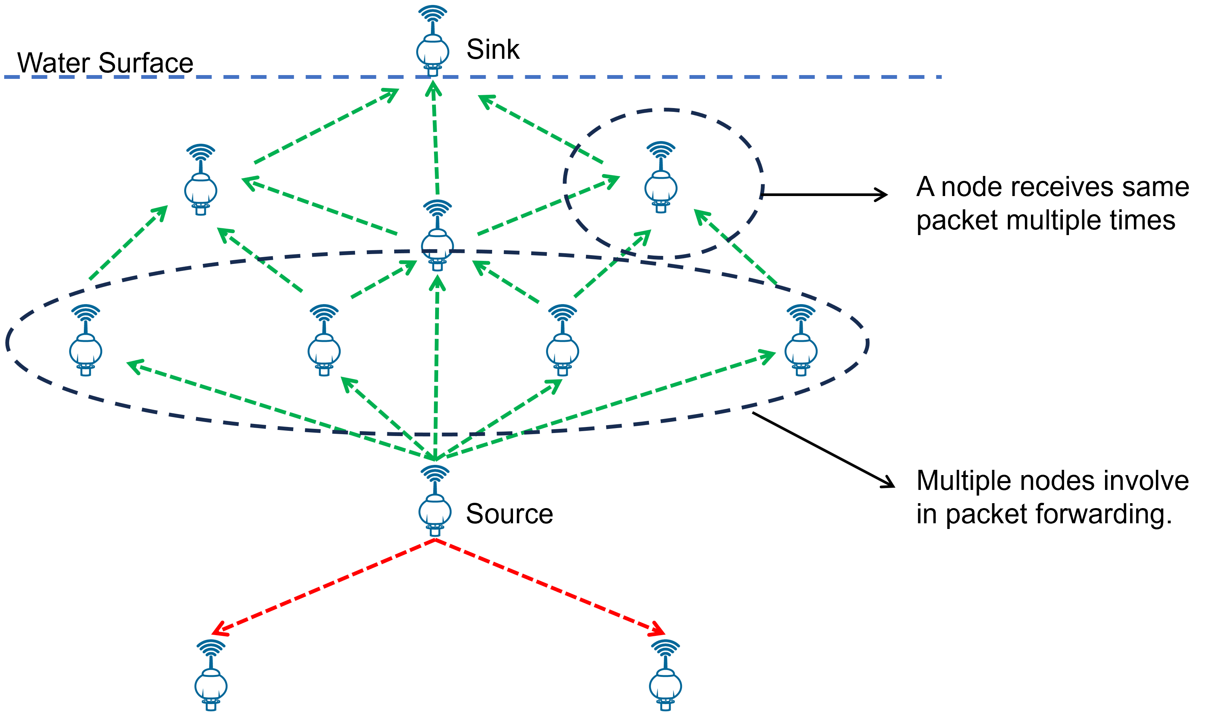
DBR: Packet forwarding
When a node forwards a packet
There may be several nearby nodes that can also forward it. If all these nodes simultaneously broadcast the packet, it can cause collisions. This also leads to more energy consumption.
Since packets are broadcast, a node may receive the same packet multiple times.
To avoid this
The number of forwarding nodes need to be controlled.
A node receiving redundant packets should be suppressed.
Solution:
Priority Queue Q1 is used for controlling number of forwarding nodes.
Packet History Buffer Q2 ensures a node receives same packet only once.
Priority Queue (Q1):
Q1 contains two items: Packet and scheduled Sending Time for the packet.
Packet History Buffer (Q2):
Q2 contains two items: Packet Sequence Number and Sender ID (source ID)

Slide 5
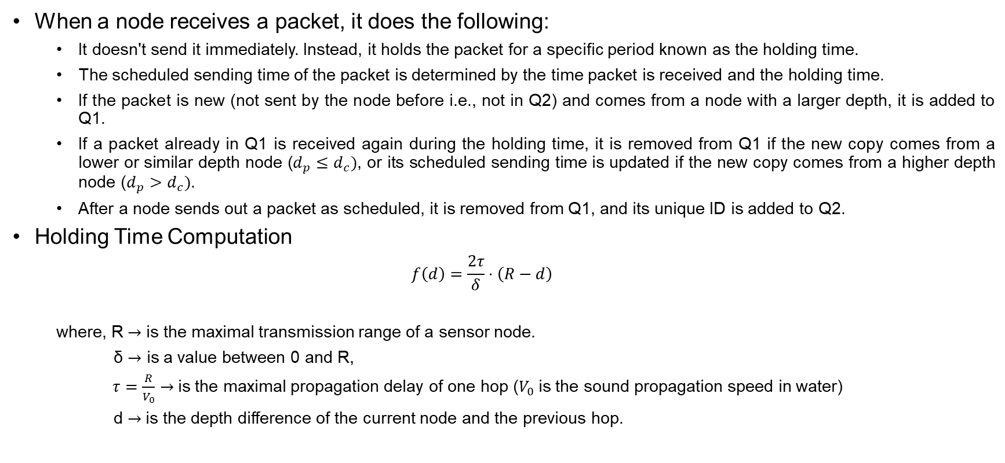
DBR: Holding Time
When a node receives a packet, it does the following:
It doesn't send it immediately. Instead, it holds the packet for a specific period known as the holding time.
The scheduled sending time of the packet is determined by the time packet is received and the holding time.
If the packet is new (not sent by the node before i.e., not in Q2) and comes from a node with a larger depth, it is added to Q1.
If a packet already in Q1 is received again during the holding time, it is removed from Q1 if the new copy comes from a lower or similar depth node ($d_{p}≤d_{c})$, or its scheduled sending time is updated if the new copy comes from a higher depth node ($d_{p}>d_{c})$.
After a node sends out a packet as scheduled, it is removed from Q1, and its unique ID is added to Q2.
Holding Time Computation
$$f\left(d\right)=\frac{2τ}{δ}⋅\left(R−d\right)$$
where, R$→$ is the maximal transmission range of a sensor node.
δ $→$ is a value between 0 and R,
$τ=\frac{R}{V_{0}}$ $→$is the maximal propagation delay of one hop ($V_{0}$is the sound propagation speed in water)
d $→$is the depth difference of the current node and the previous hop.

Slide 6
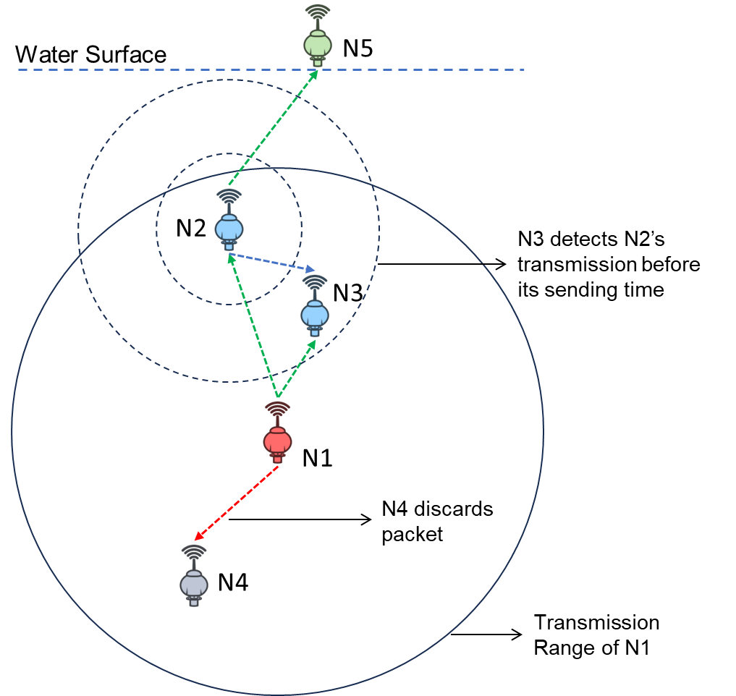
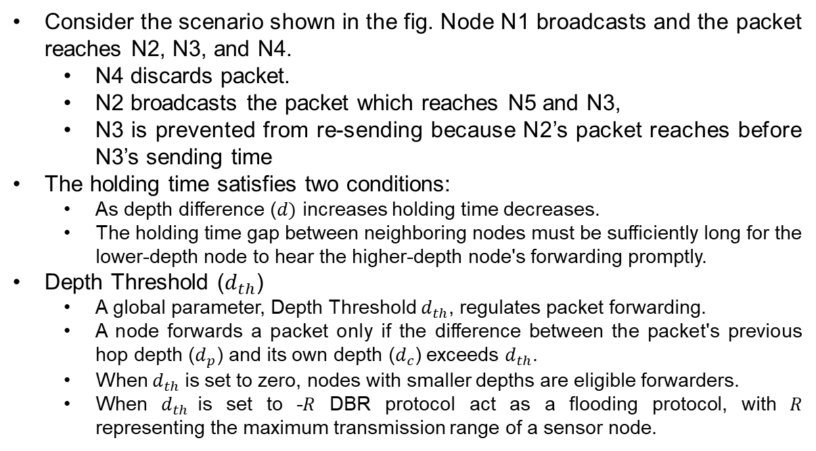
DBR: Depth Threshold
Consider the scenario shown in the fig. Node N1 broadcasts and the packet reaches N2, N3, and N4.
N4 discards packet.
N2 broadcasts the packet which reaches N5 and N3,
N3 is prevented from re-sending because N2’s packet reaches before N3’s sending time
The holding time satisfies two conditions:
As depth difference ($d)$ increases holding time decreases.
The holding time gap between neighboring nodes must be sufficiently long for the lower-depth node to hear the higher-depth node's forwarding promptly.
Depth Threshold ($d_{th}$)
A global parameter, Depth Threshold $d_{th}$, regulates packet forwarding.
A node forwards a packet only if the difference between the packet's previous hop depth ($d_{p}$) and its own depth ($d_{c}$) exceeds $d_{th}$.
When $d_{th}$is set to zero, nodes with smaller depths are eligible forwarders.
When $d_{th}$is set to -𝑅 DBR protocol act as a flooding protocol, with 𝑅 representing the maximum transmission range of a sensor node.

Slide 7
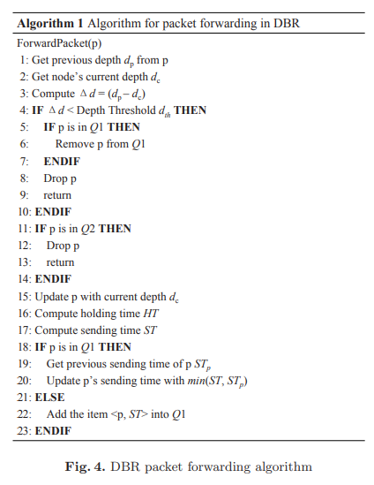
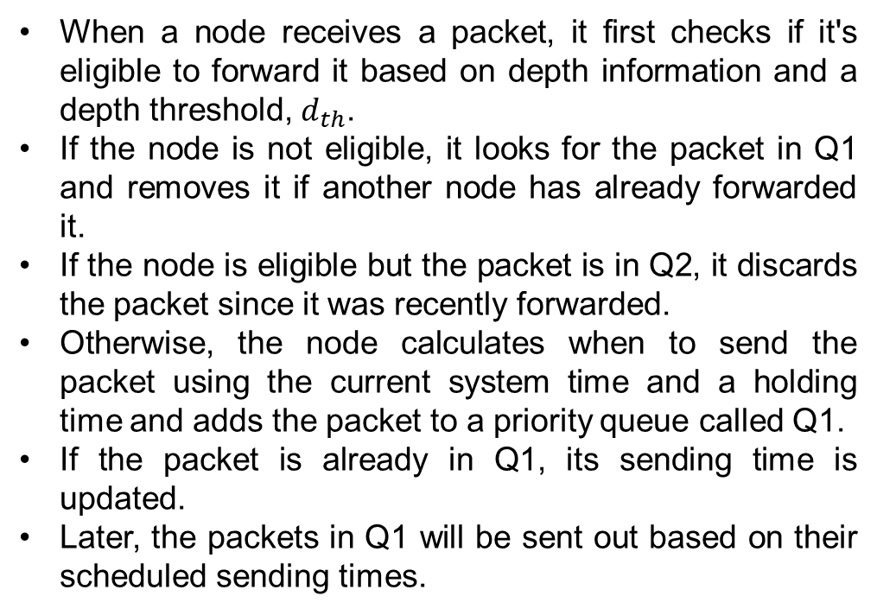
DBR: Algorithm
When a node receives a packet, it first checks if it's eligible to forward it based on depth information and a depth threshold, $d_{th}$.
If the node is not eligible, it looks for the packet in Q1 and removes it if another node has already forwarded it.
If the node is eligible but the packet is in Q2, it discards the packet since it was recently forwarded.
Otherwise, the node calculates when to send the packet using the current system time and a holding time and adds the packet to a priority queue called Q1.
If the packet is already in Q1, its sending time is updated.
Later, the packets in Q1 will be sent out based on their scheduled sending times.

Slide 8
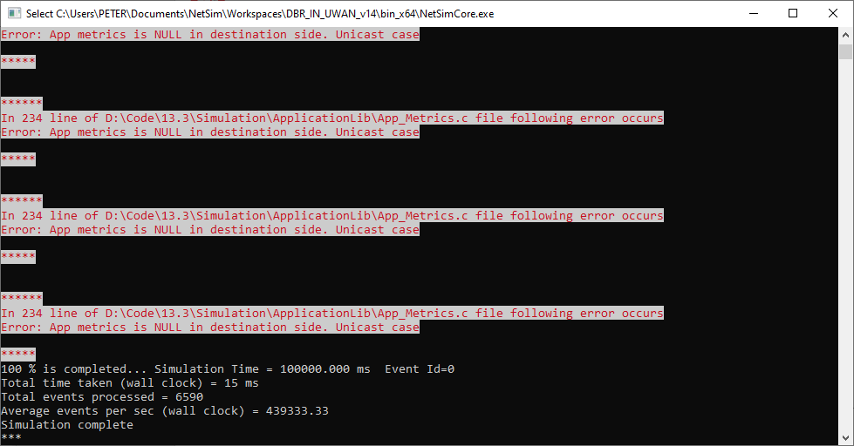
Ignore this warning
Users will notice the following warning when running simulation
This is shown because of the DBR code modifications carried out.
These warnings can be ignored.

Slide 9
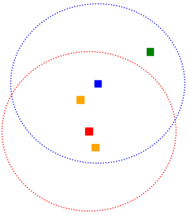
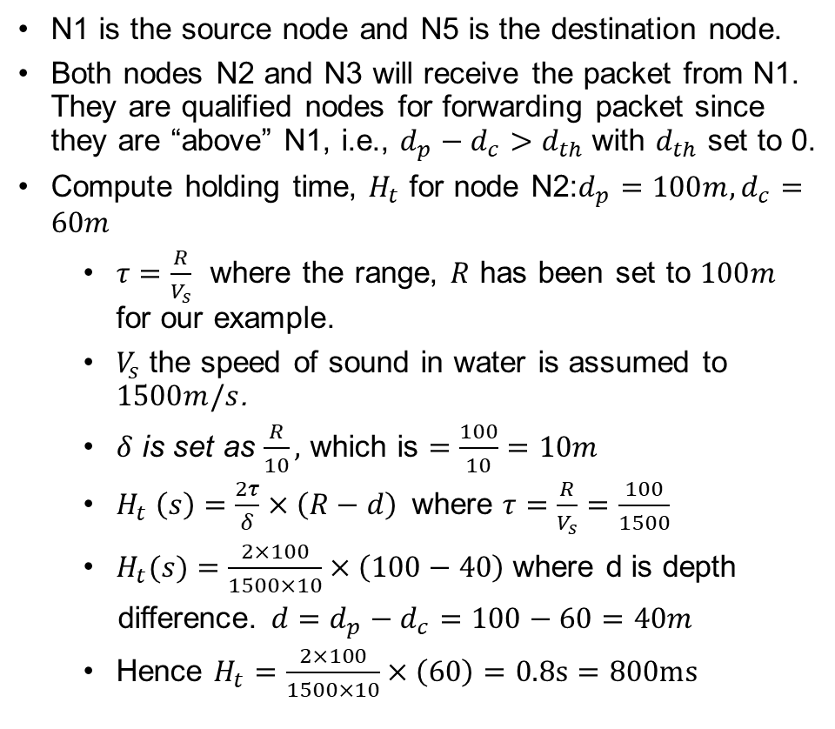

DBR: An Example
N1 is the source node and N5 is the destination node.
Both nodes N2 and N3 will receive the packet from N1. They are qualified nodes for forwarding packet since they are “above” N1, i.e., $d_{p}−d_{c}>d_{th}$with $d_{th}$ set to 0.
Compute holding time, $H_{t}$ for node N2:$d_{p}=100m,d_{c}=60m$
$τ=\frac{R}{V_{s}}$ where the range, $R$ has been set to $100m$ for our example.
$V_{s}$ the speed of sound in water is assumed to $1500m/s$.
$δ$ is set as $\frac{R}{10},$ which is $=\frac{100}{10}=10m$
$H_{t} \left(s\right)=\frac{2τ}{δ}×\left(R−d\right)$ where $τ=\frac{R}{V_{s}}=\frac{100}{1500}$
$H_{t}(s)=\frac{2×100}{1500×10}×\left(100−40\right)$where d is depth
difference.$d=d_{p}−d_{c}=100−60=40m$
Hence $H_{t}=\frac{2×100}{1500×10}×\left(60\right)=0.8s=800ms$
N5(90,0,0)
N3(30,30,-40)
N2(10,40,-60)
N1(20,60,-100)
N4(27,70,-120)
$$R=100m$$
$$d_{th}=0$$

Slide 10
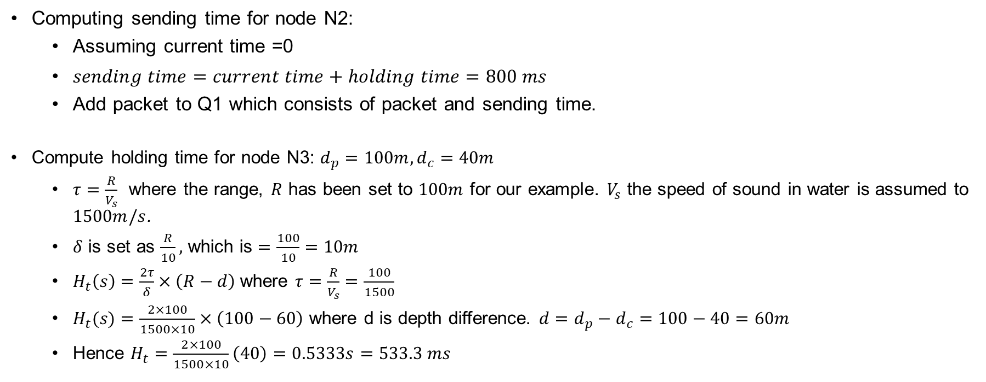
DBR: An Example (contd.)
Computing sending time for node N2:
Assuming current time =0
$sending time=current time+holding time=800 ms$
Add packet to Q1 which consists of packet and sending time.
Compute holding time for node N3: $d_{p}=100m, d_{c}=40m$
$τ=\frac{R}{V_{s}}$ where the range, $R$ has been set to $100m$ for our example. $V_{s}$ the speed of sound in water is assumed to $1500m/s$.
$δ$ is set as $\frac{R}{10},$ which is $=\frac{100}{10}=10m$
$H_{t}\left(s\right)=\frac{2τ}{δ}×\left(R−d\right)$where $τ=\frac{R}{V_{s}}=\frac{100}{1500}$
$H_{t}(s)=\frac{2×100}{1500×10}×\left(100−60\right)$ where d is depth difference. $d=d_{p}−d_{c}=100−40=60m$
Hence $H_{t}=\frac{2×100}{1500×10}\left(40\right)=0.5333s=533.3 ms$

Slide 11
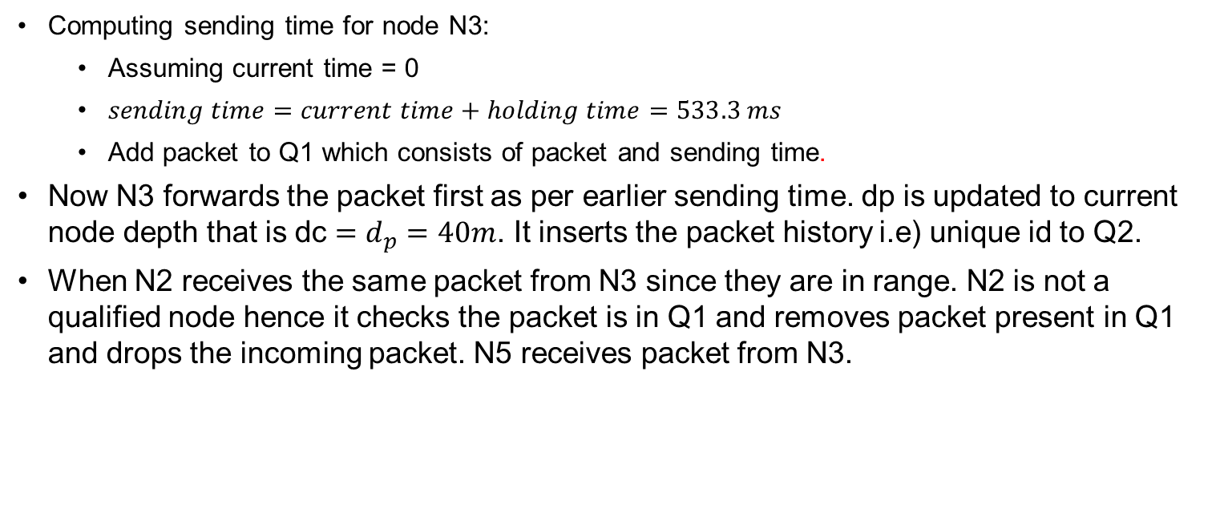
DBR: An Example (contd.)
Computing sending time for node N3:
Assuming current time = 0
$sending time=current time+holding time=533.3 ms$
Add packet to Q1 which consists of packet and sending time.
Now N3 forwards the packet first as per earlier sending time. dp is updated to current node depth that is dc $=d_{p}=40m$. It inserts the packet history i.e) unique id to Q2.
When N2 receives the same packet from N3 since they are in range. N2 is not a qualified node hence it checks the packet is in Q1 and removes packet present in Q1 and drops the incoming packet. N5 receives packet from N3.

Slide 12
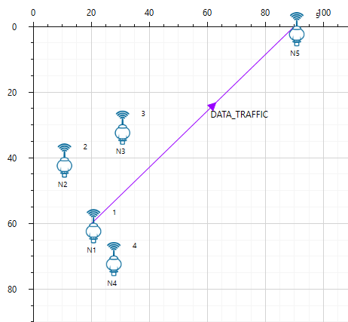
Case 1: Single Hop Transmission
N5(90,0,0)
N3(30,30,-40)
N2(10,40,-60)
N1(20,60,-100)
N4(27,70,-120)
Scenario of interest
N1 is the source node, N5 is the destination Node. N2 and N3 are qualified node for forwarding packets. N4 has a higher depth than source node hence it is unqualified node. N3 forwards the packet to destination node N5 since it has lower depth.
Scenario created in NetSim

Slide 13
Simulation Parameters in NetSim
Application Properties
Packet Size (Bytes) | 50
Inter Arrival Time (µs) | 1000000 µs
Generation Rate | 1 packet / sec
Simulation Time (s) | 100
Adhoc Link Properties
Number of temperature zones | 1
Temp Zone (max) depth (m) | 120
Channel Characteristics | PATHLOSS_ONLY
Path Loss Model | RANGE_BASED
Range (m) | 100
These are a set of common simulation parameters used in all cases.
All other properties are either
Kept at default, or
Varied in each case. The modifications are explained in the respective simulation example.

Slide 14
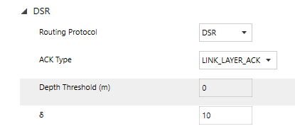
DBR: Depth Threshold and Delta
Depth Threshold (m)is a parameter in DBR Routing protocol. It is a parameter used in DBR routing protocol to control the forwarding of qualified nodes based on depth difference between transmitter and receiver.
Default depth threshold is set 0 indicates all the nodes with depth lower than source node is qualified node for forwarding packets.
DBR Delta (δ) is a parameter used in holding time computation.
Users can vary the Delta value between 0 to R represented in fractional value. Where R is the maximal transmission range.
For Example:
If Delta=10, it indicates Delta = R/10 for holding time computation.

Slide 15
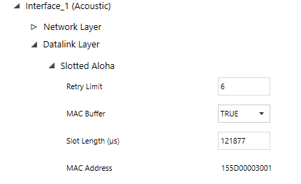
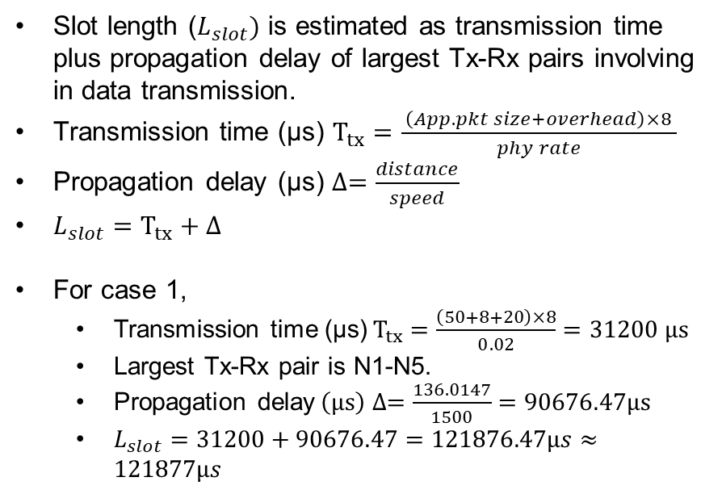
Slot length computation
Slot length ($L_{slot})$ is estimated as transmission time plus propagation delay of largest Tx-Rx pairs involving in data transmission.
Transmission time (µs) $T_{tx}=\frac{ \left(App.pkt size+overhead\right)×8 }{phy rate}$
Propagation delay (µs) $∆=\frac{distance}{speed}$
$L_{slot}=T_{tx}+∆$
For case 1,
Transmission time (μs)$T_{tx}=\frac{\left(50+8+20\right)×8}{0.02}=31200 μs$
Largest Tx-Rx pair is N1-N5.
Propagation delay$\left(µs\right) ∆=\frac{136.0147}{1500}=90676.47µs$
$L_{slot}=31200+90676.47=121876.47µs≈121877µs$

Slide 16
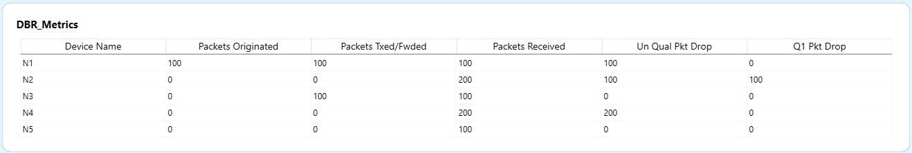
DBR Metrics Table in NetSim
Go to Additional Metrics tab > DBR_Metrics section from the results dashboard.
Source node N1 generates 100 packets which are transmitted to N2, N3 and N4.
N2 receives 200 packets from neighboring nodes. 100 packets are dropped which are consider as unqualified packet dropped and 100 packets are dropped from q1.
N3 forwards 100 packets which has the lowest depth to destination. It receives 100 packets from source N1.
N4 receives 200 packets and drops the packets since its unqualified node in packet transmission.
N5 is the destination node and receives 100 packets from N3.

Slide 17
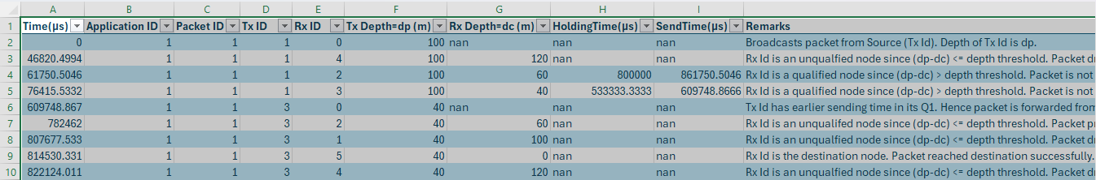
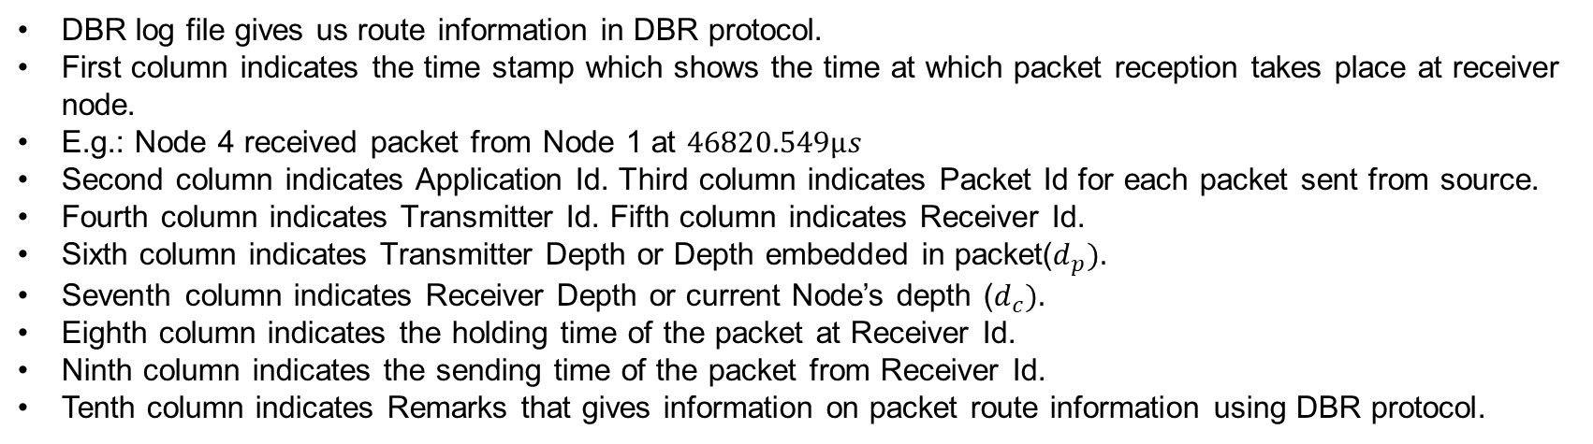
DBR log file in NetSim
DBR log file gives us route information in DBR protocol.
First column indicates the time stamp which shows the time at which packet reception takes place at receiver node.
E.g.: Node 4 received packet from Node 1 at $46820.549µs$
Second column indicates Application Id. Third column indicates Packet Id for each packet sent from source.
Fourth column indicates Transmitter Id. Fifth column indicates Receiver Id.
Sixth column indicates Transmitter Depth or Depth embedded in packet($d_{p}).$
Seventh column indicates Receiver Depth or current Node’s depth ($d_{c}).$
Eighth column indicates the holding time of the packet at Receiver Id.
Ninth column indicates the sending time of the packet from Receiver Id.
Tenth column indicates Remarks that gives information on packet route information using DBR protocol.

Slide 18
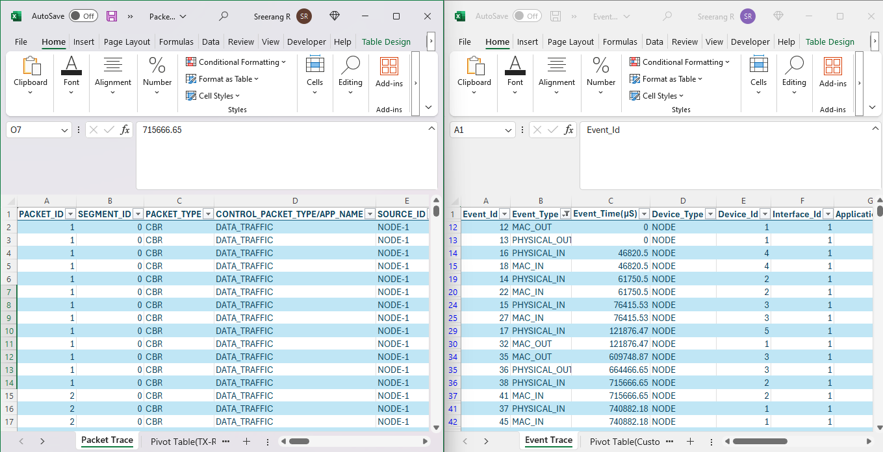
NetSim Results
Packet Trace
Event Trace
Packet trace gives us detail packet flow information. Event trace gives us information on event occurring at each layer in IP stack.

Slide 19
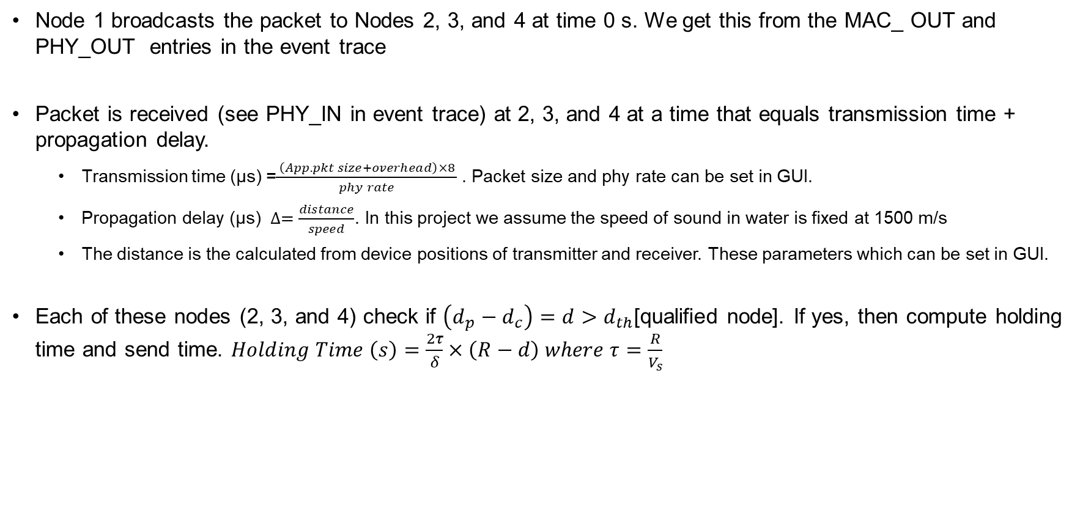
Observations
Node 1 broadcasts the packet to Nodes 2, 3, and 4 at time 0 s. We get this from the MAC_ OUT and PHY_OUT entries in the event trace
Packet is received (see PHY_IN in event trace) at 2, 3, and 4 at a time that equals transmission time + propagation delay.
Transmission time (µs) =$\frac{ \left(App.pkt size+overhead\right)×8 }{phy rate}$. Packet size and phy rate can be set in GUI.
Propagation delay (µs) $∆=\frac{distance}{speed}$. In this project we assume the speed of sound in water is fixed at 1500 m/s
The distance is the calculated from device positions of transmitter and receiver. These parameters which can be set in GUI.
Each of these nodes (2, 3, and 4) check if $\left(d_{p}−d_{c}\right)=d>d_{th}$[qualified node]. If yes, then compute holding time and send time. $Holding Time \left(s\right)=\frac{2τ}{δ}×\left(R−d\right) where τ=\frac{R}{V_{s}}$

Slide 20
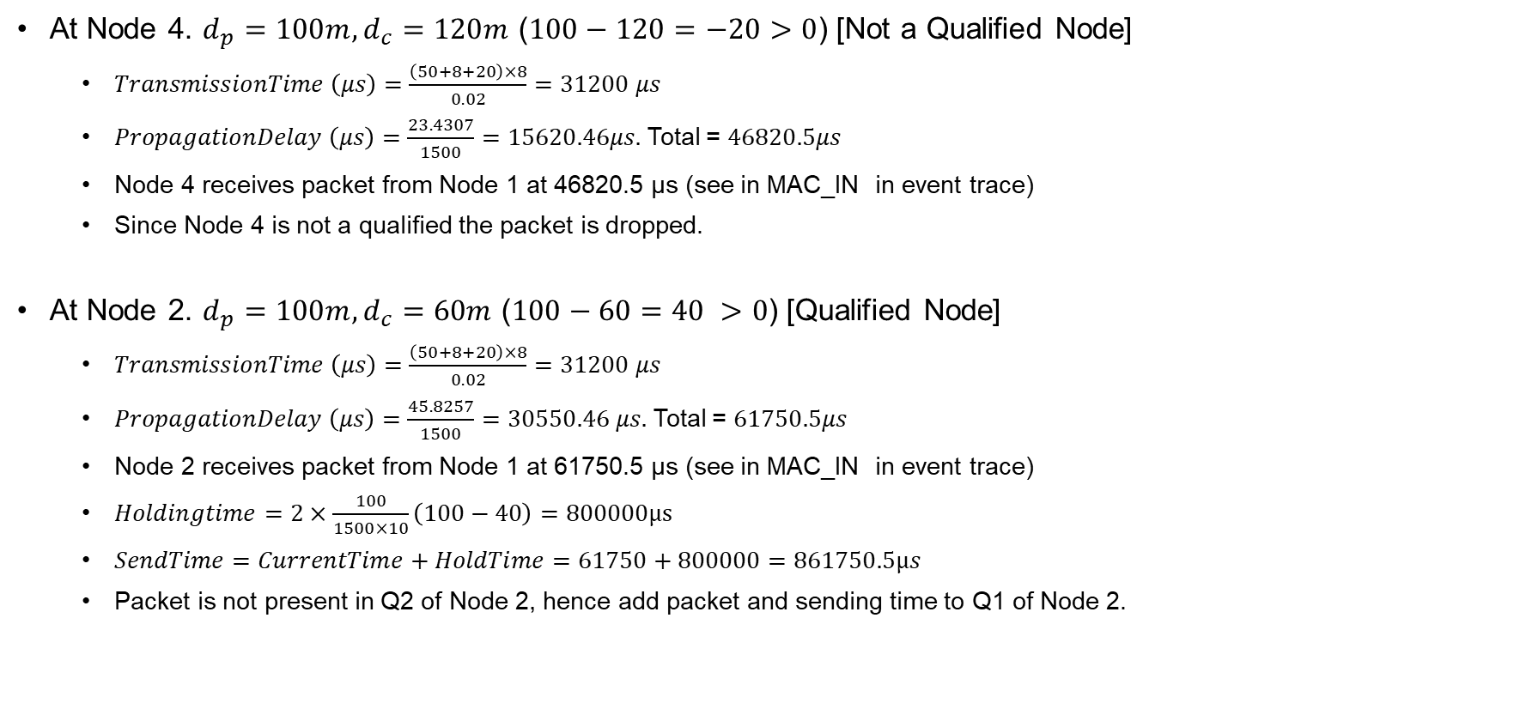
Observations
At Node 4. $d_{p}=100m, d_{c}=120m$ ($100−120=−20>0$) [Not a Qualified Node]
$TransmissionTime \left(μs\right)=\frac{\left(50+8+20\right)×8}{0.02}=31200 μs$
$PropagationDelay \left(μs\right)=\frac{23.4307}{1500}=15620.46μs.$Total = $46820.5μs$
Node 4 receives packet from Node 1 at 46820.5 µs (see in MAC_IN in event trace)
Since Node 4 is not a qualified the packet is dropped.
At Node 2. $d_{p}=100m, d_{c}=60m$ ($100−60=40 >0$) [Qualified Node]
$TransmissionTime \left(μs\right)=\frac{\left(50+8+20\right)×8}{0.02}=31200 μs$
$PropagationDelay \left(μs\right)=\frac{45.8257}{1500}=30550.46 μs.$Total = $61750.5μs$
Node 2 receives packet from Node 1 at 61750.5 µs (see in MAC_IN in event trace)
$Holdingtime=2×\frac{100}{1500×10}\left(100−40\right)=800000µs$
$SendTime=CurrentTime+HoldTime=61750+800000=861750.5µs$
Packet is not present in Q2 of Node 2, hence add packet and sending time to Q1 of Node 2.

Slide 21
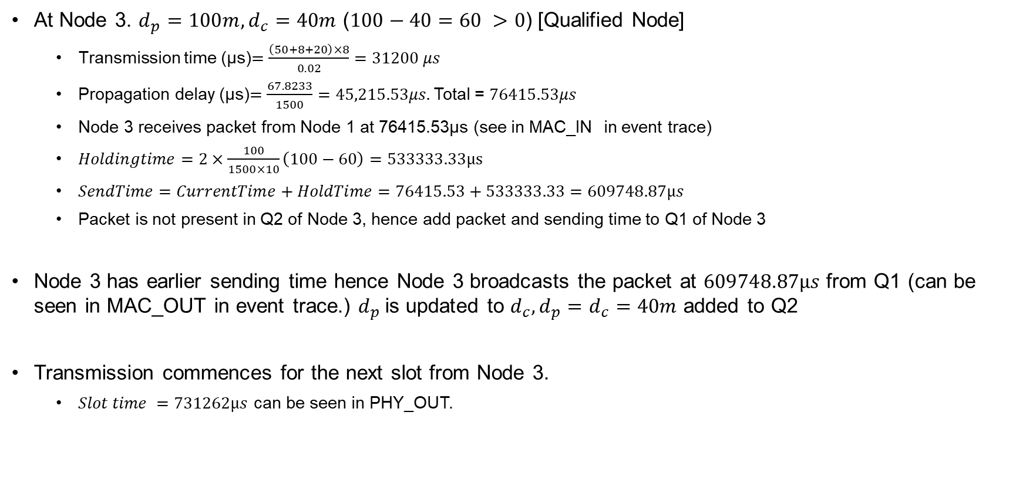
Observations
At Node 3. $d_{p}=100m, d_{c}=40m$ ($100−40=60 >0$) [Qualified Node]
Transmission time (μs)$=\frac{\left(50+8+20\right)×8}{0.02}=31200 μs$
Propagation delay (μs)$=\frac{67.8233}{1500}=45,215.53μs.$Total = $76415.53μs$
Node 3 receives packet from Node 1 at 76415.53µs (see in MAC_IN in event trace)
$Holdingtime=2×\frac{100}{1500×10}\left(100−60\right)=533333.33µs$
$SendTime=CurrentTime+HoldTime=76415.53+533333.33=609748.87µs$
Packet is not present in Q2 of Node 3, hence add packet and sending time to Q1 of Node 3
Node 3 has earlier sending time hence Node 3 broadcasts the packet at $609748.87µs$ from Q1 (can be seen in MAC_OUT in event trace.) $d_{p}$is updated to $d_{c}, d_{p}=d_{c}=40m$ added to Q2
Transmission commences for the next slot from Node 3.
$Slot time =731262µs$ can be seen in PHY_OUT.

Slide 22
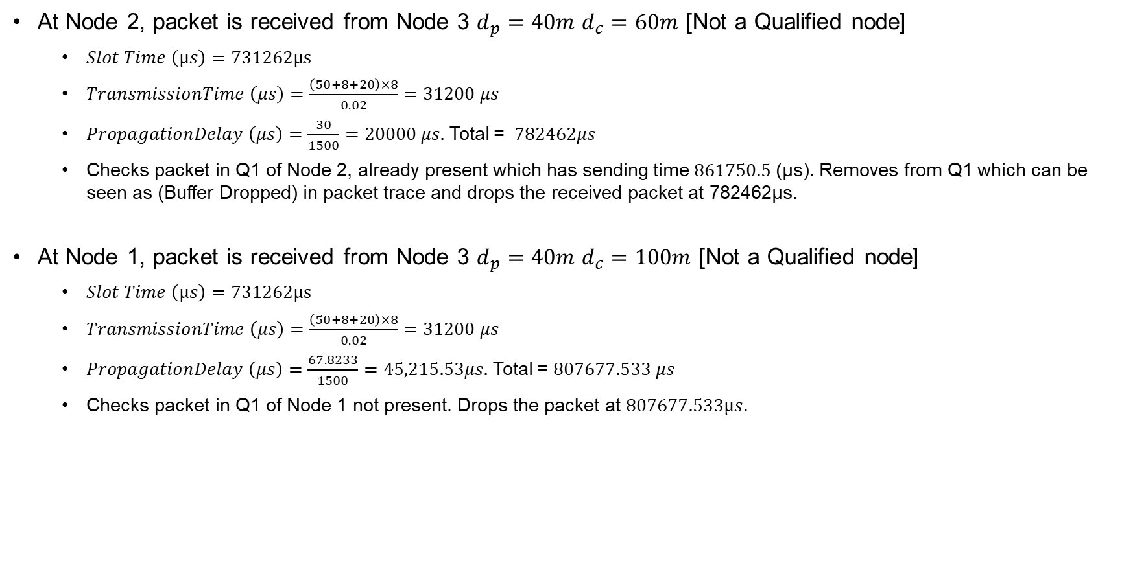
Observations
At Node 2, packet is received from Node 3 $d_{p}=40m d_{c}=60m$ [Not a Qualified node]
$Slot Time \left(µs\right)=731262µs$
$TransmissionTime \left(μs\right)=\frac{\left(50+8+20\right)×8}{0.02}=31200 μs$
$PropagationDelay \left(μs\right)=\frac{30}{1500}=20000 μs.$Total = $782462μs$
Checks packet in Q1 of Node 2, already present which has sending time $861750.5$(µs). Removes from Q1 which can be seen as (Buffer Dropped) in packet trace and drops the received packet at 782462µs.
At Node 1, packet is received from Node 3 $d_{p}=40m d_{c}=100m$ [Not a Qualified node]
$Slot Time \left(µs\right)=731262µs$
$TransmissionTime \left(μs\right)=\frac{\left(50+8+20\right)×8}{0.02}=31200 μs$
$PropagationDelay \left(μs\right)=\frac{67.8233}{1500}=45,215.53μs.$Total = $807677.533 μs$
Checks packet in Q1 of Node 1 not present. Drops the packet at $807677.533µs$.

Slide 23
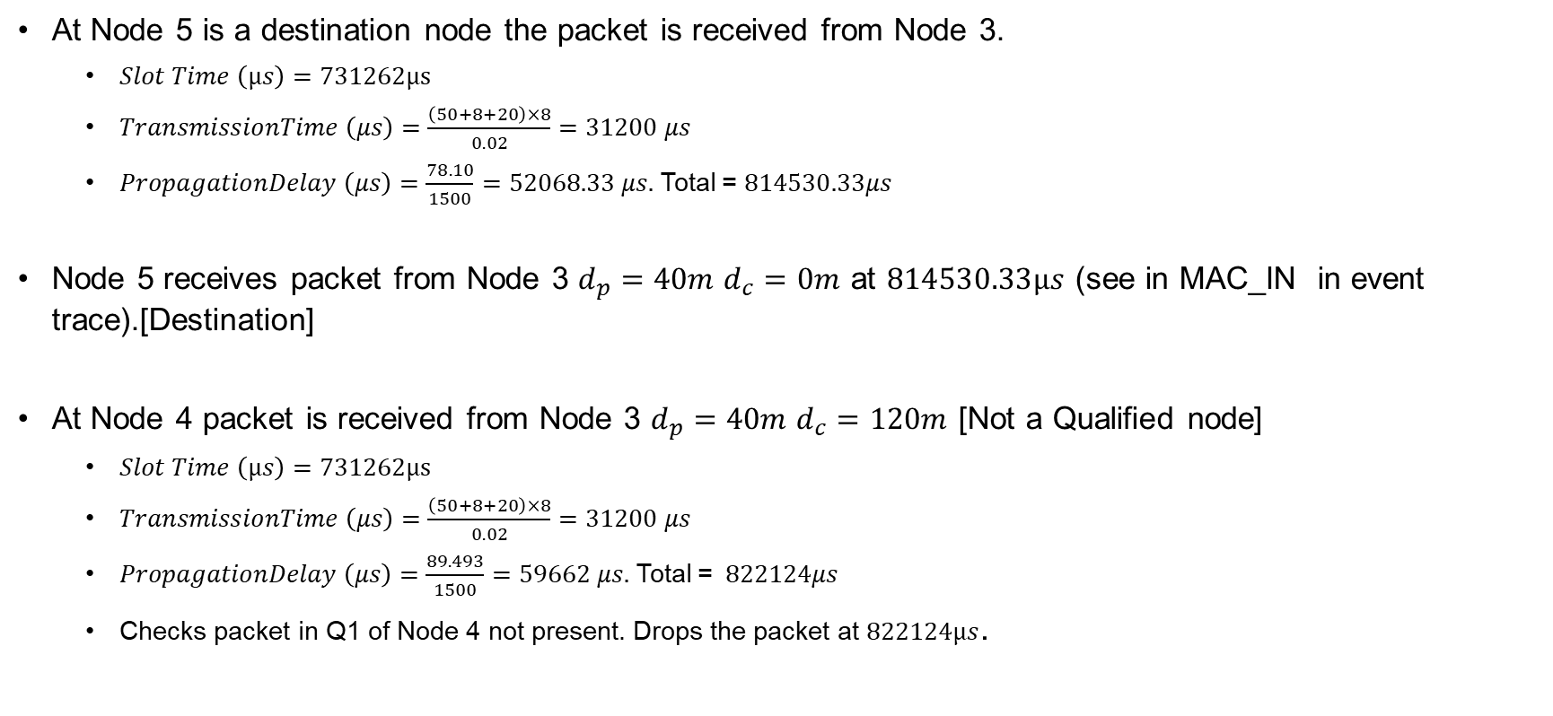
Observations
At Node 5 is a destination node the packet is received from Node 3.
$Slot Time \left(µs\right)=731262µs$
$TransmissionTime \left(μs\right)=\frac{\left(50+8+20\right)×8}{0.02}=31200 μs$
$PropagationDelay \left(μs\right)=\frac{78.10}{1500}=52068.33 μs.$Total = $814530.33μs$
Node 5 receives packet from Node 3 $d_{p}=40m d_{c}=0m$ at $814530.33µs$ (see in MAC_IN in event trace).[Destination]
At Node 4 packet is received from Node 3 $d_{p}=40m d_{c}=120m$ [Not a Qualified node]
$Slot Time \left(µs\right)=731262µs$
$TransmissionTime \left(μs\right)=\frac{\left(50+8+20\right)×8}{0.02}=31200 μs$
$PropagationDelay \left(μs\right)=\frac{89.493}{1500}=59662 μs.$Total = $822124μs$
Checks packet in Q1 of Node 4 not present. Drops the packet at $822124µs$.

Slide 24
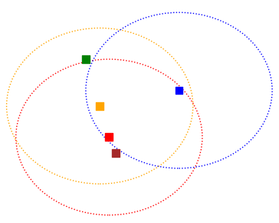
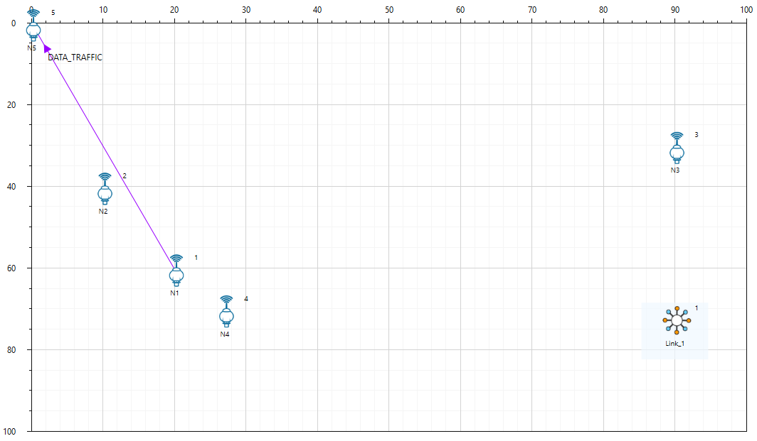
Case 2: Next hop is a void zone
N5 (0,0,0)
N3 (90,30,-40)
N2 (10,40,-60)
N1 (20,60,-100)
N4 (27,70,-120)
Scenario of interest
N1 is the source node. N5 is the destination node which is not in range with forwarding node N3 but is in range with other qualified node N2. Since next hop from N3 is a void zone, packets do not reach destination N5, from N3. Also, the sending time of N2 is larger such that N2 hears the ongoing transmission from N3 and stops its own transmission.
Scenario created in NetSim
Largest Tx-Rx pair is (N1,N5)
Slot length = 110082 µs

Slide 25
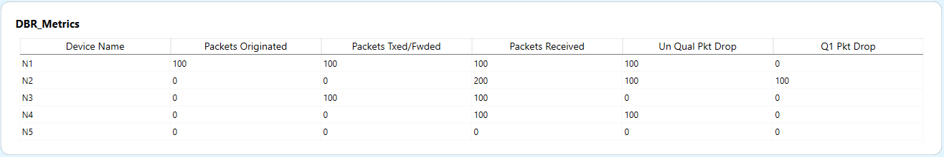
NetSim Results
N1 is the source node which generates 100 packets. It receives 100 packets from neighboring nodes and discards the packets since it is an unqualified node.
N3 has the lower depth which is the qualified node, it receives 100 packets and forwards 100 packets received from N1.
N2 receives 200 packets, 100 packets are unqualified node drop which are received from higher depth nodes,100 packets dropped from Q1.

Slide 26
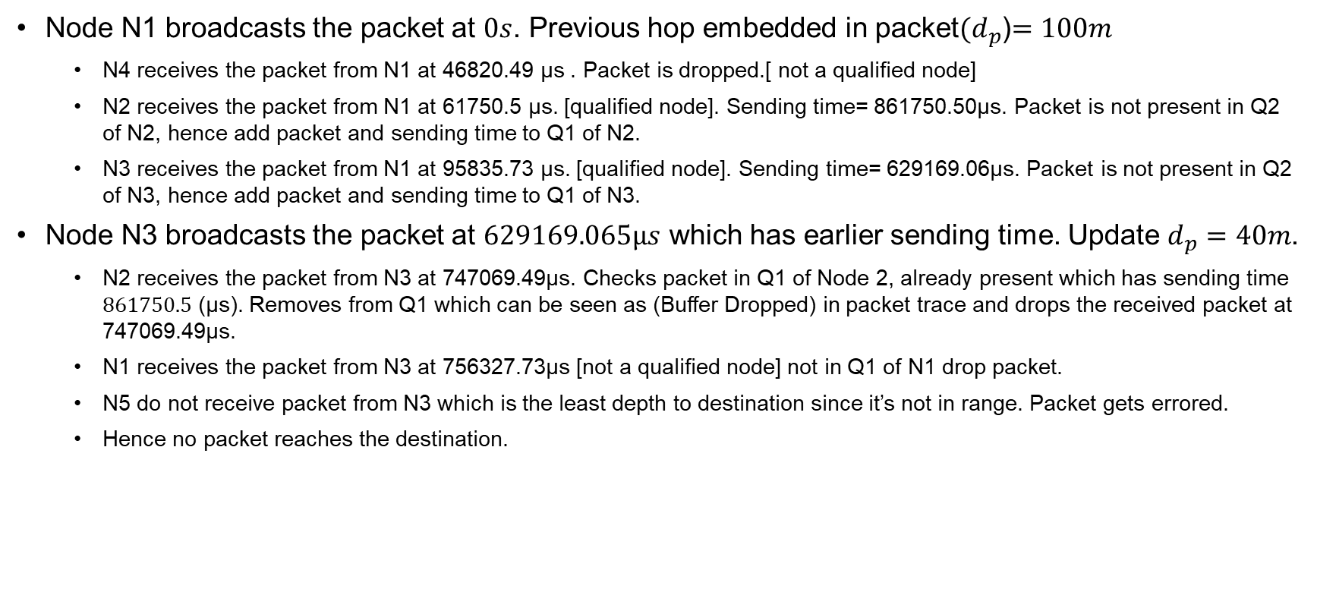
Observations
Node N1 broadcasts the packet at $0s$. Previous hop embedded in packet${(d}_{p}$)$=100m$
N4 receives the packet from N1 at 46820.49 µs . Packet is dropped.[ not a qualified node]
N2 receives the packet from N1 at 61750.5 µs. [qualified node]. Sending time= 861750.50µs. Packet is not present in Q2 of N2, hence add packet and sending time to Q1 of N2.
N3 receives the packet from N1 at 95835.73 µs. [qualified node]. Sending time= 629169.06µs. Packet is not present in Q2 of N3, hence add packet and sending time to Q1 of N3.
Node N3 broadcasts the packet at $629169.065µs$ which has earlier sending time. Update $d_{p}=40m$.
N2 receives the packet from N3 at 747069.49µs. Checks packet in Q1 of Node 2, already present which has sending time $861750.5$(µs). Removes from Q1 which can be seen as (Buffer Dropped) in packet trace and drops the received packet at 747069.49µs.
N1 receives the packet from N3 at 756327.73µs [not a qualified node] not in Q1 of N1 drop packet.
N5 do not receive packet from N3 which is the least depth to destination since it’s not in range. Packet gets errored.
Hence no packet reaches the destination.

Slide 27
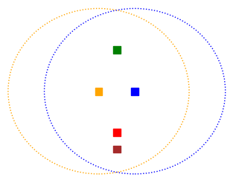
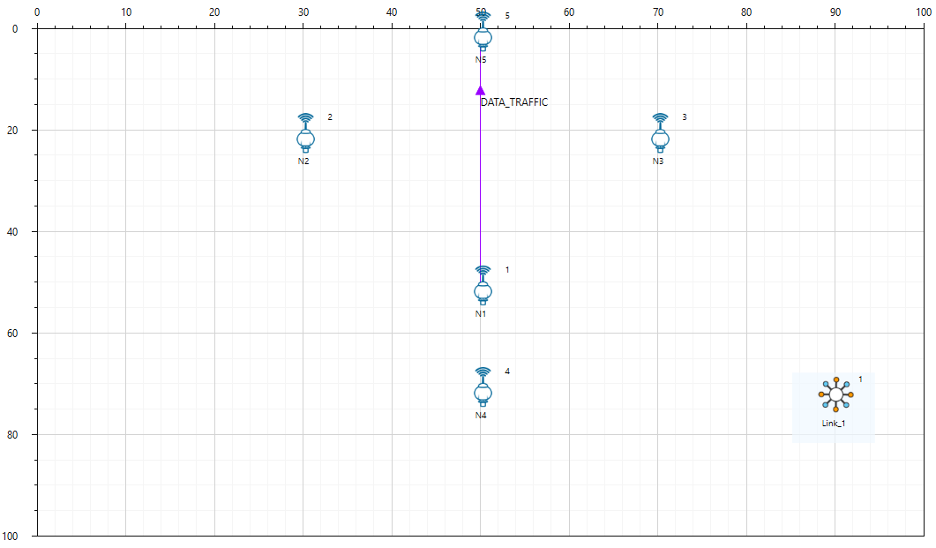
Case 3: If nodes are at same depth and equidistant from source node
N5 (50,0,0)
N2 (30,20,-50)
N3 (70,20,-50)
N1 (50,50,-100)
N4 (50,70,-120)
Scenario of interest
Scenario created in NetSim
N2 and N3 are at same depth 50m from N1 source node. Both have the same holding time.
Largest Tx-Rx pair is (N1,N5)
Slot length = 105736 µs

Slide 28

NetSim Results
N1 is the source node which generates 100 packets. It receives 100 packets from neighboring nodes and discards the packets since it is an unqualified node.
N2 and N3 receives 100 packets from N1. Since both have same holding time, they broadcast the packets at same time. The packets collide at destination.

Slide 29

Observations
Node N1 broadcasts the packet at $0s$. Previous hop embedded in packet${(d}_{p}$)$=100m$
N2 and N3 receives the packet from N1 at 72296.0934µs. [qualified node]. Sending time= 738962.76µs. Packet is not present in Q2 of N2 and N3, hence add packet and sending time to Q1 of N2 and N3.
N4 receives the packet from N1 at 50056.18µs . Packet is dropped.[ not a qualified node]
Both N2 & N3 broadcasts the packet at $738962.76µs$ which has earlier sending time. Update $d_{p}=50m$.
All the packets get collided at destination N5. There is no retransmission in broadcast application.

Slide 30
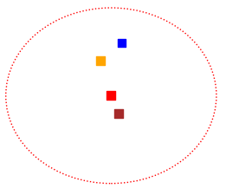
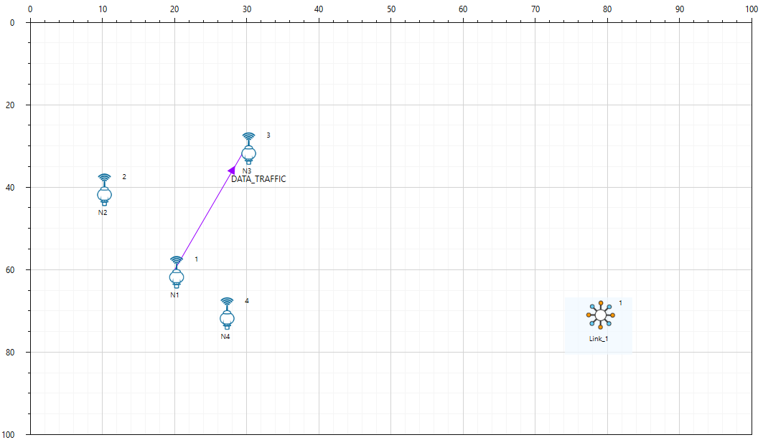
Case 4: If next hop is destination
N3(30,30,-40)
N2(10,40,-60)
N1(20,60,-100)
N4(27,70,-120)
Scenario of interest
Scenario created in NetSim
N3 is the destination which is in range with source node N1 and is the next hop.
N2 is qualified node for forwarding packets. Hence it forwards packets as per its sending time
Largest Tx-Rx pair is (N2,N4)
Slot length = 77336 µs

Slide 31
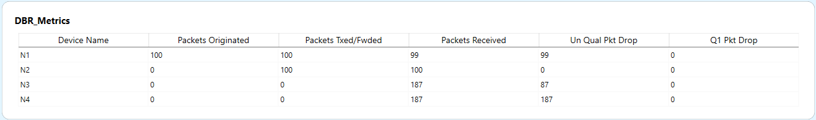
NetSim Results
N1 transmits 100 packets. Receives 99 packets from neighbor nodes and drops 99 packets which is an unqualified node drop.
N3 is the destination which receives 187 packets, and 87 packets are duplicate packets received which are dropped.
Since N2 is a qualified node from transmission it transmits packets as per scheduled sending time. It receives 100 packets and forwards 100 packets.
N4 receives 187 packets and drops all the packet since it is an unqualified node.

Slide 32
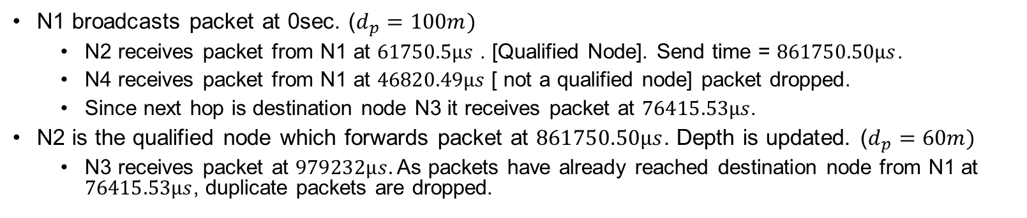
Observation
N1 broadcasts packet at 0sec. ($d_{p}=100m)$
N2 receives packet from N1 at $61750.5µs$ . [Qualified Node]. Send time = $861750.50µs$.
N4 receives packet from N1 at $46820.49µs$ [ not a qualified node] packet dropped.
Since next hop is destination node N3 it receives packet at $76415.53µs$.
N2 is the qualified node which forwards packet at $861750.50µs$. Depth is updated. ($d_{p}=60m)$
N3 receives packet at $979232µs.$ As packets have already reached destination node from N1 at $76415.53µs$, duplicate packets are dropped.

Slide 33
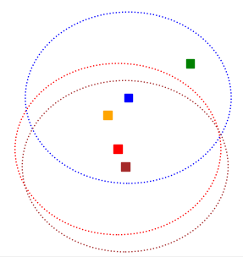
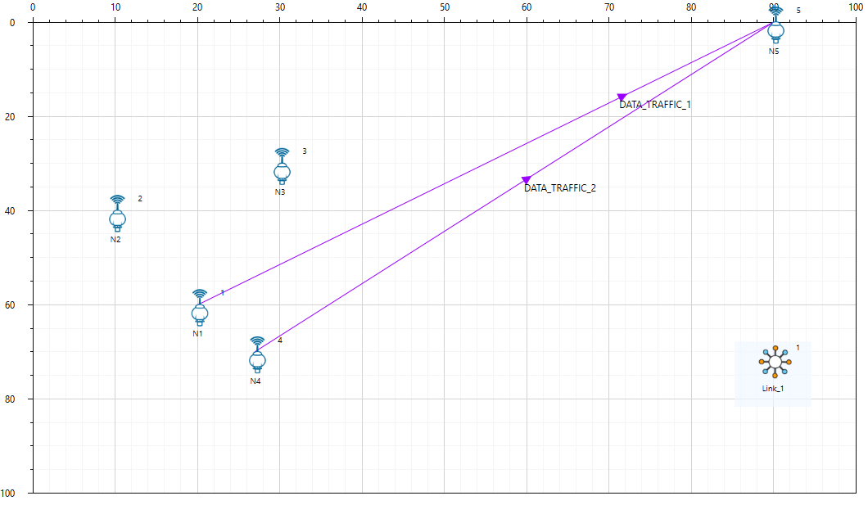
Case 5: Two Applications
N5(90,0,0)
N3(30,30,-40)
N2(10,40,-60)
N1(20,60,-100)
N4(27,70,-120)
Scenario created in NetSim
Largest Tx-Rx pair is (N4,N5)
Slot length = 132895 µs
Scenario of interest

Slide 34
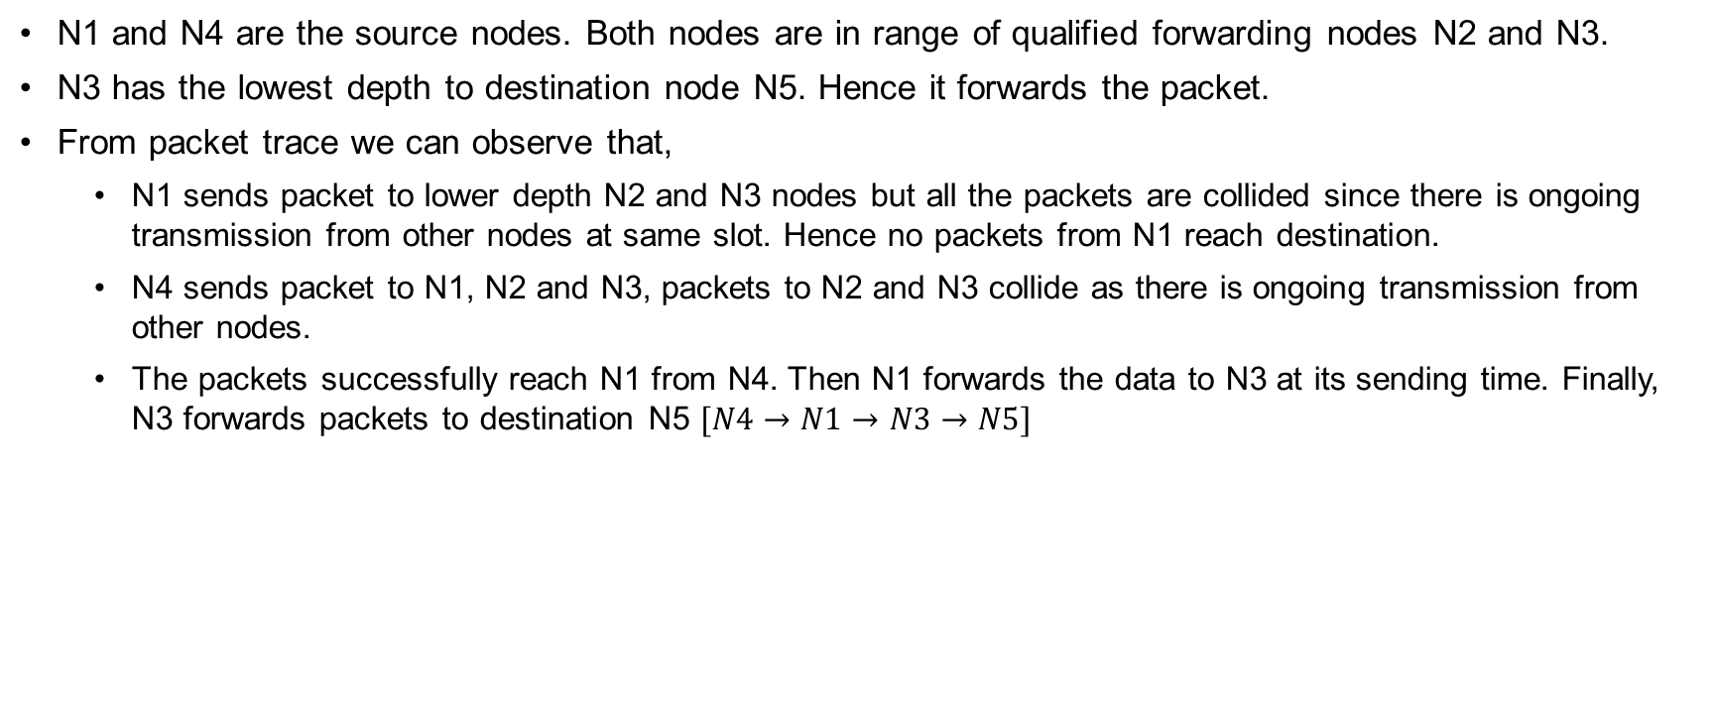
Observations
N1 and N4 are the source nodes. Both nodes are in range of qualified forwarding nodes N2 and N3.
N3 has the lowest depth to destination node N5. Hence it forwards the packet.
From packet trace we can observe that,
N1 sends packet to lower depth N2 and N3 nodes but all the packets are collided since there is ongoing transmission from other nodes at same slot. Hence no packets from N1 reach destination.
N4 sends packet to N1, N2 and N3, packets to N2 and N3 collide as there is ongoing transmission from other nodes.
The packets successfully reach N1 from N4. Then N1 forwards the data to N3 at its sending time. Finally, N3 forwards packets to destination N5 $[N4→N1→N3→N5]$

Slide 35
Insights from NetSim simulations
On simulating different DBR cases we observe the following issues with the protocol design:
If the next hop from source node is destination, the neighboring nodes that don’t have the packet history, broadcast the same packet as per scheduled sending time.
If two nodes, N2 and N3, are positioned nearly equidistant vertically but are widely separated horizontally, their holding times for packets are nearly equal.
When a lower-depth node like N2 receives a packet from N1, it will rebroadcast it. However, due to the substantial horizontal distance between N2 and N3, there will be a delay in the packet reaching N3.
Since N3 is positioned at nearly the same depth as N2, it may end up rebroadcasting the received packet from N1 before receiving the packet from N2.

Slide 36
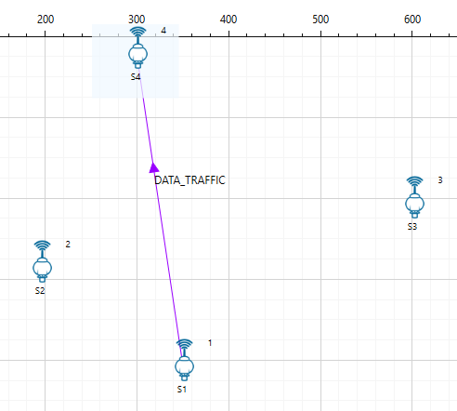
Insights from NetSim simulations (contd…)
The holding time in DBR only takes into account the difference in depth (vertical height) between sensors.
In DBR, the holding time accounts solely for vertical height differences between sensors. Yet, in scenarios with extensive spread along the X or Y axis, significant transmitter-receiver distances may lead to propagation delays surpassing the holding time.
Consider four sensors S1, S2, S3 and S4, as shown in the figure.
S1 sends to S2 and S3 which are within its range.
As per DBR protocol S3 sends to S4
However, the propagation delay to S3 exceeds the holding time at S2.
This causes S2 to transmit before S3 in violation of DBR's working principle

Slide 37
Insights from NetSim simulations (contd…)
The reference paper lacks an explanation of the MAC protocol's operation and fails to provide any references.
NetSim UWAN utilizes the Slotted Aloha protocol in its MAC layer.
Slotted Aloha doesn't incorporate a back-off mechanism before the first transmission.
In Slotted Aloha, collided packets are not retransmitted when broadcasting, and retransmissions occur exclusively for unicast packets.
Consequently, when employing DBR over Slotted Aloha in NetSim UWAN, transmission rates are expected to be notably low, particularly with multiple transmitters. High transmission rates could result in excessive collisions, potentially leading to negligible throughput.

Slide 38
References
DBR: Depth-Based Routing for Underwater Sensor Networks, Hai Yan, Zhijie Jerry Shi, and Jun-Hong Cuia, NETWORKING 2008, LNCS

