Slide 1

NetSim ZigBee Simulation Code Walkthrough in 10 steps
NetSim Version 8.3

Slide 2
Step 1 - Event Programming in NetSim
The entire source code of NetSim is based on Event Programming since NetSim is a Discrete Event Simulator (DES)
Event-driven programming is a programming paradigm where flow of program is determined by different events. In NetSim there are different layer specific events and its sub-events
In NetSim, the kernel does the entire event handling. While, inserting an event into the kernel its event time(dEventTime) should also mentioned and this event time decides the order of execution of events.
Events are executed in increasing order of their event time.
NetSim does not use any scripting language and all codes are in C

Slide 3
Step 2 - ZigBee Standard 802.15.4
IEEE 802.15.4 is a standard which specifies the PHY layer and MAC layer for low-rate wireless personal area networks
This presentation is intended for those who know the basics of 802.15.4 MAC and PHY
The reader is expected to have completed / know
ZigBee experiment (present in experiment manual)
“Hello World” program (present in user manual) in NetSim
Debugging of a code via GUI in NetSim (present in the user manual)

Slide 4
Step 3 - NetSim APIs
A quick look at following APIs provided by the NetSim’s kernel, stack and metric engines
fn_NetSim_GetBufferStatus( ) – Returns if buffer is empty or not
fn_NetSim_Packet_GetPacketFromBuffer( ) – Returns the first packet in the buffer
fn_NetSim_Utilities_GenerateRandomNo( ) – Used to generate a random number. Used instead of C rand function to ensure repeatability of results
fnpAddEvent( ) – Adds an event to the stack
fnpAllocateMemory( ) – Allocates memory. This is used to avoid problems when user codes is compiled using a compiler different from what NetSim was compiled with
fn_NetSim_Packet_FreePacket( ) – Deletes a packet from the simulation
fn_NetSim_Stack_GetConnectedDevice( ) – Return ID of device connected
fn_NetSim_WritePacketTrace( ) – Writes packet trace and animation files
fn_NetSim_Metrics_Add( ) – Calculates default metrics like throughput, delay etc

Slide 5
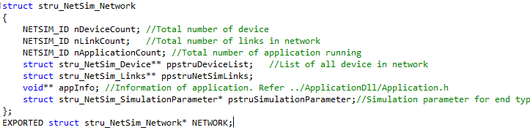
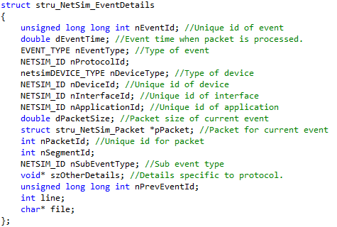
Step 4 - Important Data Structures
stru_NetSim_Network: This structure defines the entire network configuration.
stru_NetSim_EventDetails: This structure defines the specification of an event. It is usually related to the current event

Slide 6
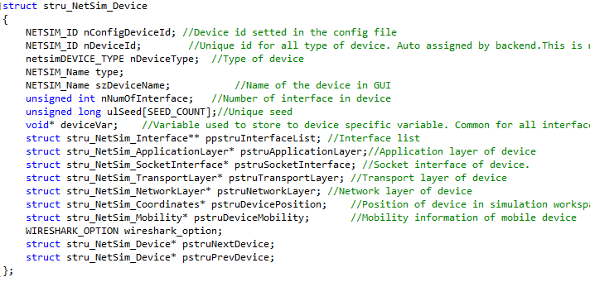
Important Data Structures
stru_NetSim_Device: This structure defines the specifications of each device broken down into components like network layer, transport layer, application layer, list of its interfaces etc.

Slide 7
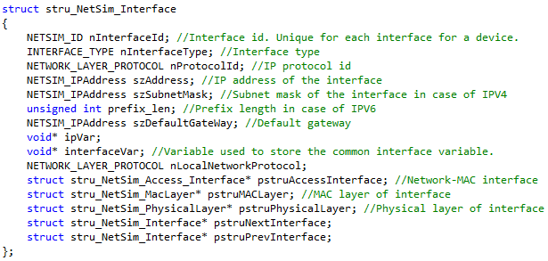
Important Data Structures
stru_NetSim_Interface: This structure mainly has the MAC and Physical layer specifications.

Slide 8
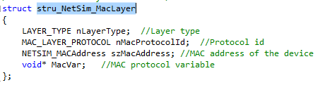
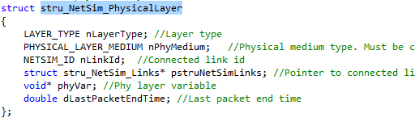
Important Data Structures
stru_NetSim_MacLayer: This structure is used to store the specifications and the variables used by the MAC layer of the device.
stru_NetSim_PhysicalLayer: This structure is used to store the specifications and the variables used by the Physical layer of the device.

Slide 9
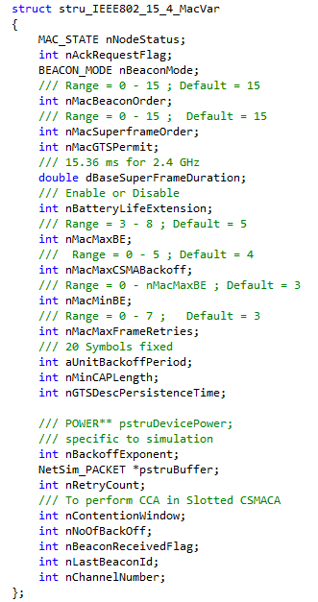
Important Data Structures
stru_IEEE802_15_4_MacVar:
This structure is typecasted over the void* MacVar
This structure exactly matches the 802.15.4 standard
These are the main variables used to implement the CSMA-CA algorithm.

Slide 10
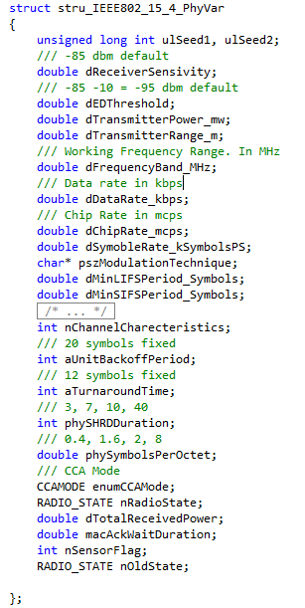
Important Data Structures
stru_IEEE802_15_4_PhyVar:
This structure is typecasted over the void* phyVar so
This structure exactly matches the 802.15.4 standard
The variables like dReceiverSensitivity, dEDThreshold, dTotalReceivedPower are used for Clear channel assessment of the medium
Various state variables (eg. enumCCAMode, nRadioState, nOldState) are used to keep track of the control flow

Slide 11
Step 5 - Events Handled By ZigBee Protocol (Non-Beacon enabled PAN)
MAC_OUT_EVENT
TIMER_EVENT :
CARRIERSENSE_START
CARRIERSENSE_END
UPDATE_MEDIUM
ACK_TIMEOUT
PHYSICAL_OUT_EVENT
PHYSICAL_IN_EVENT
MAC_IN_EVENT

Slide 12
Step 6 - MAC_OUT_EVENT
MAC_OUT_EVENT is added when the packet being sent reaches the MAC layer
Firstly, MAC retransmission buffer is checked if it has any packets. If the buffer is not empty, the first packet is transmitted.
If the re-transmission buffer is empty it checks the NW_MAC interface buffer. If its non-empty, first packet in the list is transmitted. The function used to do so is fn_NetSim_Packet_GetPacketFromBuffer( )
Next, it calls the function ZIGBEE_UNSLOTTED() which is macro for function fn_NetSim_Zigbee_UnslottedCSMACA(pstruMetrics,pstruDevicePower,pstruEventDetails ). Note that this function is called instead of ZIGBEE_SLOTTED() as we running the simulation with beacon mode disabled
Finally TIMER_EVENT with sub event CARRIERSENSE_START is added to the stack. The API used to add events into the stack is fnpAddEvent (pstruEventDetails). This is only available as an API and the source code is not open to user

Slide 13
Step 7 - TIMER_EVENT: CARRIERSENSE_START
This event starts the CSMA-CA by first calling the function ZIGBEE_UNSLOTED( ) which inturn calls ZIGBEE_CCA( )
ZIGBEE_CCA( ) is the macro for fn_NetSim_Zigbee_CCA() and returns CHANNEL_IDLE(0) or CHANNEL_BUSY(1)
This function uses dTotalReceivedPower, dEDThreshold,
dReceiverSensitivity to conclude if the channel is idle or busy
If CCA is successful, nSuccessfulCCAAttempt variable in metric will be
incremented, else if CCA is a failure, nFailedCCA variable in metric will be incremented
If CCA is a success, next TIMER_EVENT with sub-event
CARRIERSENSE_END will be added to the kernel

Slide 14
TIMER_EVENT: CARRIERSENSE_START
If CCA is a failure, it will increment nNoOfBackOff and update the value of
nBackOffExponent
If nNoOfBackOff > nMacMaxCSMABackOff, the packet is deleted using
the API fn_NetSim_Packet_FreePacket( ).
Hence, it will take the next packet from the accessbuffer and will start the CARRIERSENSE_START for that packet by adding the event TIMER_EVENT, subevent CARRIERSENSE_START
If nNoOfBackOff has not crossed nMacMaxCSMABackOff, it will repeat the CSMA for the same packet by adding the event TIMER_EVENT, subevent CARRIERSENSE_START

Slide 15
TIMER_EVENT: CARRIERSENSE_END
If the channel has been found idle the same is reconfirmed by conducting CCA once again using ZIGBEE_CCA( ). If channel is busy, it will add the
CARRIERSENSE_START event
If channel is still idle, packet is prepared to be sent from MAC to PHY.
Necessary MAC overhead is added per pstruEventDetails-> pPacket->
pstruMacData-> Packet_MACProtocol
Finally it will modify the dEventTime and will add the Event
PHYSICAL_OUT_EVENT to the stack using the function fnpAddEvent()

Slide 16
TIMER_EVENT: UPDATE_MEDIUM
This sub-event of the TIMER_EVENT is added by the PHYSICAL_OUT_EVENT of the transmitter device
Its function is to update the medium after transmission of data from one device to another is over ie, packet has reached the MAC_IN_EVENT for the end device
dTotalReceivedPower of a device is the total power received as a result of all the transmissions going on in the network
This updation of medium is done by running a loop where all devices in the NETWORK are traversed.
Next for each device it checks if its NW_MAC interface access buffer is non-empty and accordingly adds the MAC_OUT_EVENT for each one of them

Slide 17
TIMER_EVENT: ACK_TIMEOUT
This sub-event of TIMER_EVENT is added by the PHYSICAL_OUT_EVENT of the transmitter device
This event is triggered to check whether the MAC layer retransmission buffer is empty. If its not empty means that it has to retransmit the packet again.
Hence, it will increment the nRetryCount variable present in the MAC layer variable
If nRetryCount exceeds the nMacMaxFrameRetries value, it will drop the existing packet by using the function fn_NetSim_Packet_FreePacket( ) from MAC layer retransmission buffer.
It will then take the next packet from NW_MAC interface accessbuffer and will start retransmitting it by adding a MAC_OUT_EVENT for the corresponding
If nRetryCount is within the limit of nMacMaxFrameRetries value, it will retransmit by simply adding a MAC_OUT_EVENT

Slide 18
Step 8 - PHYSICAL_OUT_EVENT
First, this event adds a PHY_IN event for each device where packets are being sent
dDataRate is initialized by taking the value from the structure ppstruNetSimLinks which inturns gets the info from values are written into the config.xml file by the GUI
dTxTime(transmission time) is calculated to determine the dEndTime of the pstruPacket
nLink_Id is got via the API fn_NetSim_Stack_GetConnectedDevice()
Then PHYSICAL_IN_EVENT is added for each device where this packet is being sent using a loop
After PHY_IN event is added to the kernel either nPacketTransmitted or nAckTransmitted is incremented based on the kind of packet that has been sent.
Second, it adds a TIMER_EVENT (sub-event UPDATE_MEDIUM) which is timed to occur after the packet has reached the MAC_IN_EVENT of all the receiver device(s)
Third, it adds a TIMER_EVENT (subevent ACK_TIMEOUT) after the checking variable nAckRequestFlag present in the MAC header

Slide 19
Step 9 - PHYSICAL_IN_EVENT
This event examines the packet first and
Adds a MAC_IN Event it has reached the correct device
Drops the packet if it has suffered any path loss or collision
To check path loss, some temporary variable are initialized which are SNR, dBER, dErrorRange. Function ZIGBEE_SINR() is used to calculate SNR which in turn is used to calculate dBER using the function ZIGBEE_BER() (this function also calculates the value of dErrorRange) Finally dErrorRange, dBER and packetsize are used by the function
Packet trace is written using the function
fn_NetSim_WritePacketTrace(pstruPacket). Packet is striped of its physical layer headers and packet size is updated henceforth
If packet status is PacketStatus_Error or PacketStatus_Collided, metrics are updated using the function fn_NetSim_Metrics_Add(pstruPacket)
Else, time variables are updated and Metrics are updated using function mentioned above. Finally MAC_IN_EVENT is added to the stack

Slide 20
Step 10 - MAC_IN_EVENT
This EVENT determines the type of packet sent by the transmitter device and accordingly add the next EVENT into the kernel
Initially arrival, start and end times in pstruMacData of Packet are initialized. All the values are kept same hence since there is no inter-layer communication delay
If a acknowledgement request is required by the transmitter device, a
PHYSICAL_OUT_EVENT is added with the required modification to the packet and pstruEventDetails to send a acknowledgement
Else, preparation are made to send the packet to Network layer. For this MAC overhead is striped off and packet size is updated. Finally, a
NETWORK_IN_EVENT is added to the kernel.

Slide 21
THANK YOU

