Slide 1

5G Down Link Power Control to Maximize Sum Throughput Using Reinforcement Learning
Implementation in NetSim
Applicable Release: NetSim v15.0
Applicable Version(s): NetSim Standard
Project download link:
The URL has the exported NetSim scenario for the example used in this document and the python script to run the reinforcement learning simulation
Please refer to slide 19 for the steps to run the reinforcement learning (RL) algorithm.

Slide 2
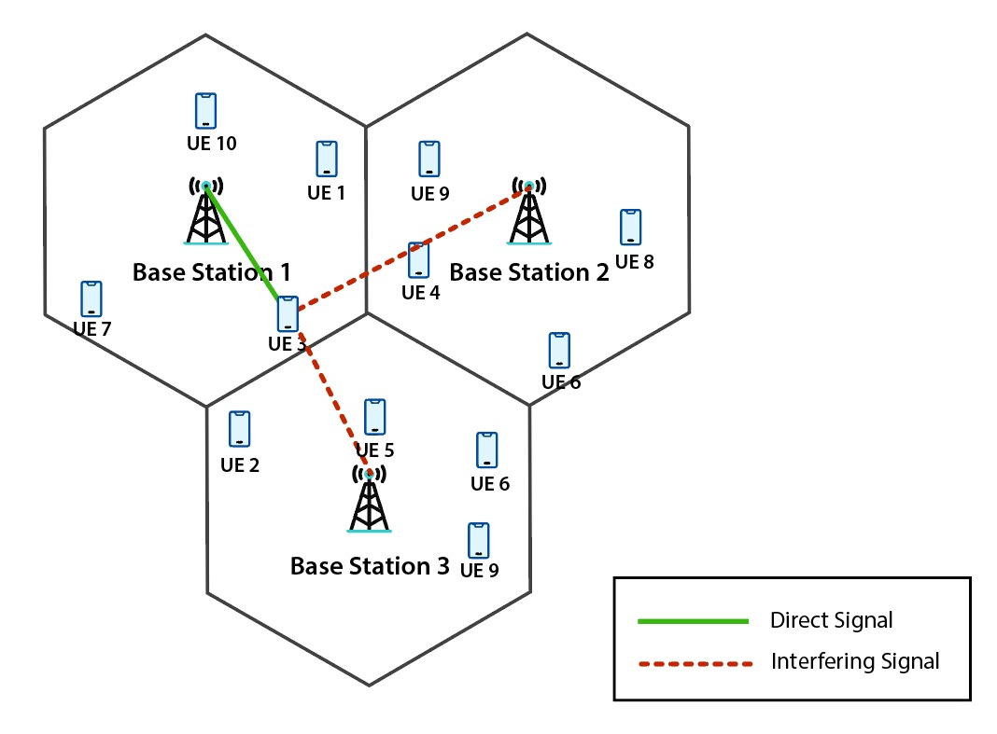
Power Control: Introduction
Due to the broadcast nature of wireless communication, signals interfere with each other.
Interference can degrade the performance of the 5G RAN
DL power control can be used to mitigate interference, ensure spectral reuse and improve user experience
However, direct application to practical systems is impaired by the dependency on various simplifying assumptions
  Knowledge of channel gains from all BSs to all UEs,
  Full buffer traffic,
  Knowledge of user positions, number of users, resources allocated to each user etc.
In this project, we use reinforcement learning (RL) for downlink (DL) power control to mitigate interference, boost SINR and maximize sum throughput
Ghadimi et al, “A Reinforcement Learning Approach to Power Control and Rate Adaptation in Cellular Networks”, arXiv:1611.06497v1 [math.OC] 20 Nov 2016

Slide 3
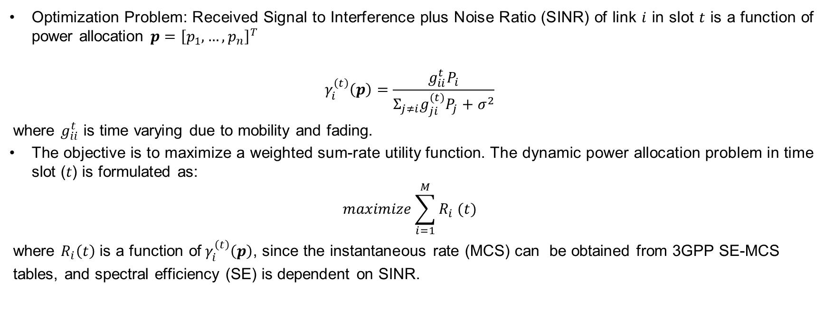
The Optimization Problem
Optimization Problem: Received Signal to Interference plus Noise Ratio (SINR) of link $i$ in slot $t$ is a function of power allocation $p={\left[p_{1}, …, p_{n}\right]}^{T}$
$$γ_{i}^{\left(t\right)}\left(p\right)=\frac{g_{ii}^{t}P_{i}}{Σ_{j≠i}g_{ji}^{(t)}P_{j}+σ^{2}}$$
where $g_{ii}^{t}$ is time varying due to mobility and fading.
The objective is to maximize a weighted sum-rate utility function. The dynamic power allocation problem in time slot (𝑡) is formulated as:
$$maximize\sum_{i=1}^{M}{R_{i} (t)}$$
where $R_{i}\left(t\right)$ is a function of${ γ}_{i}^{\left(t\right)}\left(p\right)$, since the instantaneous rate (MCS) can be obtained from 3GPP SE-MCS
tables, and spectral efficiency (SE) is dependent on SINR.

Slide 4
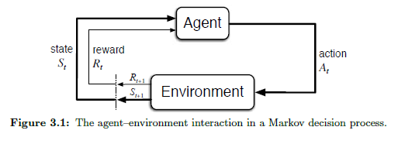
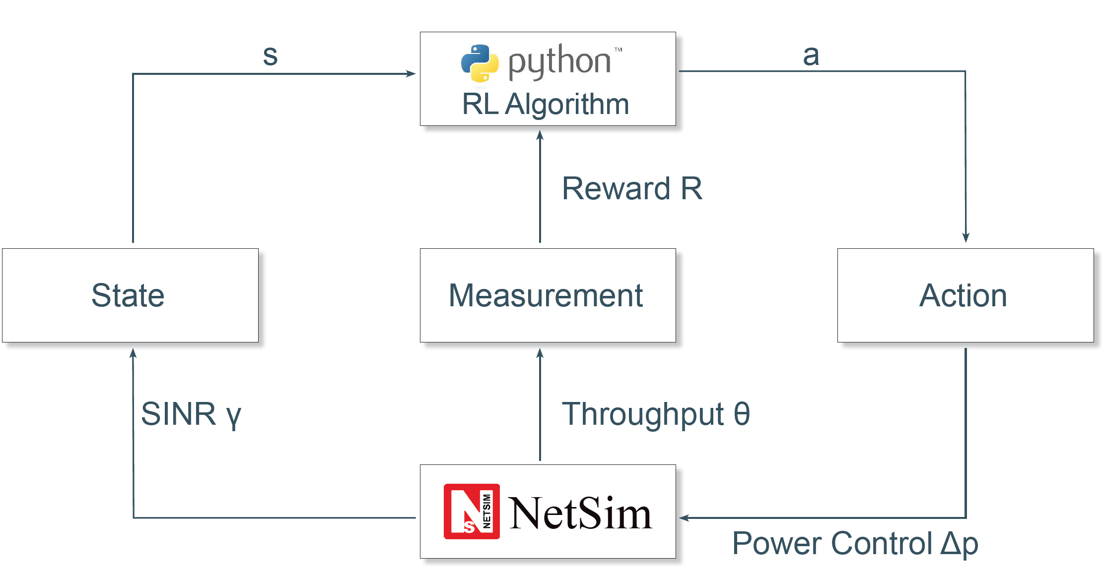
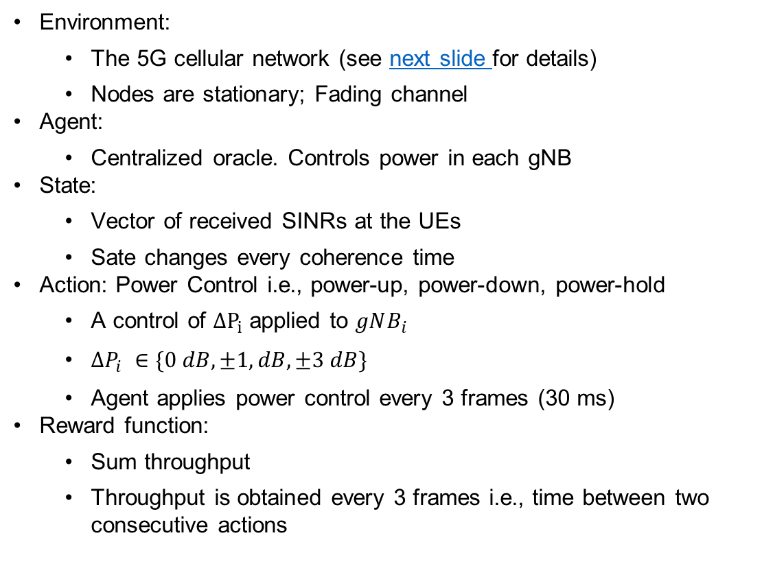
Reinforcement Learning
Environment:
  The 5G cellular network (see next slide for details)
  Nodes are stationary; Fading channel
Agent:
  Centralized oracle. Controls power in each gNB
State:
  Vector of received SINRs at the UEs
  Sate changes every coherence time
Action: Power Control i.e., power-up, power-down, power-hold
  A control of $ΔP_{i}$ applied to $gNB_{i}$
  $∆P_{i} ∈\{0 dB,±1, dB, ±3 dB\}$
  Agent applies power control every 3 frames (30 ms)
Reward function:
  Sum throughput
  Throughput is obtained every 3 frames i.e., time between two consecutive actions
The agent can be a “basic” user developed RL algorithm or an “advanced” Open AI Gym linked RL algorithm

Slide 5
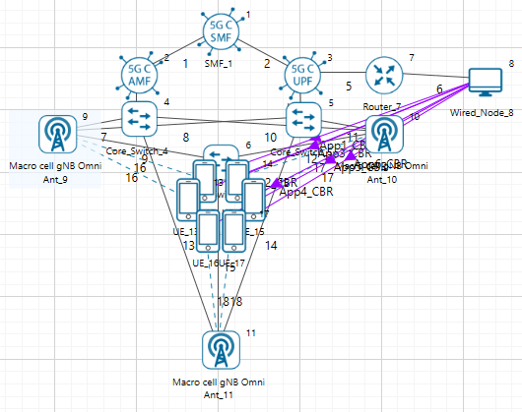
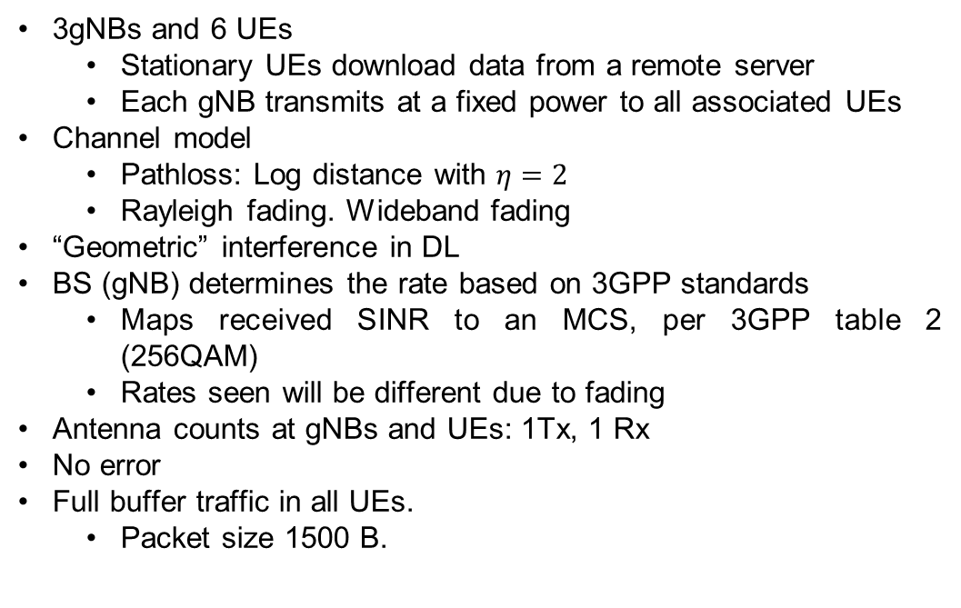
NetSim Model
3gNBs and 6 UEs
  Stationary UEs download data from a remote server
  Each gNB transmits at a fixed power to all associated UEs
Channel model
  Pathloss: Log distance with $η=2$
  Rayleigh fading. Wideband fading
“Geometric” interference in DL
BS (gNB) determines the rate based on 3GPP standards
  Maps received SINR to an MCS, per 3GPP table 2 (256QAM)
  Rates seen will be different due to fading
Antenna counts at gNBs and UEs: 1Tx, 1 Rx
No error
Full buffer traffic in all UEs.
  Packet size 1500 B.

Slide 6
Agent Environment Interactions
NetSim (environment) provides a TCP socket with which a socket program/application written in any programming language can establish a connection.
In this example, a client program (agent) written in Python connects to the NetSim process at the specified port using a TCP connection for exchanging data.
The following is executed when the user runs a simulation:
  Initialize a listening socket in NetSim, that binds to any vacant port, say 12345
  For each episode
    Initiate a new NetSim simulation and then create a client socket at Python that binds to the same port
    For each iteration
      Form an array of gNB powers in python, serialize the data into bytes and send the serialized data to Netsim
      Receive the serialized data in Netsim, deserialize the data and convert the bytes into an array of gNB powers
      Update the gNB powers in NetSim, and send back an array of SINRs and the sum throughput over to python after serializing the data into bytes
      Receive the SINRs and the reward (sum throughput) from Netsim and take necessary action after updating the Q table (or model in case of A2C, PPO)
    End
    Terminate the client connection on the Python side
  End

Slide 7
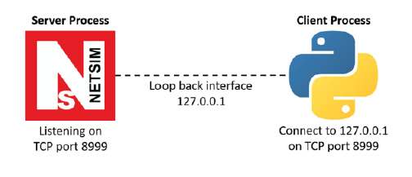
NetSim Python Interfacing
Python C Socket Interfacing:
  Python facilitates seamless integration with C for socket programming tasks.
  Python uses the socket module to interact with C side functions.
Python Code:
  Python creates a client socket in the host machine and connects with the C side server
Key function:
  def NETSIM_interface(gNB_powers):
    Sends the gNB powers to NetSim with a header
    Receives acknowledgement from NetSim
    Sends a request value to NetSim to receive the updated SINR values and the reward
    Receives the next state and the reward from NetSim

Slide 8
NetSim Python Interfacing
NetSim C code
Key functions include:
  void init_waiting_struct_socket1() :
    Initializes the Winsock library and calls the listenForPython() function
  bool listenForPython() :
    Resolves the server address and port
    Creates a socket for connecting to the server
    Sets up the TCP listening socket
    Waits for client socket connection
  void handle_Send_Receive(struct SINR_Values_Reward* Param1, struct gNB_Powers* Param2)
    Receives the message type from Python
    If message type is to “receive gNB powers”, receives the powers from Python and sends back an acknowledgement message
    If message type is to “send SINRS and rewards”, sends back the state and reward back to Python using the send_SINRS_Rewards_at_Time_Step() function
  void send_SINRS_Rewards_at_Time_Step() :
    sends the list of updated SINRs and the sum throughput received from the LTENR project in NetSim back to python

Slide 9
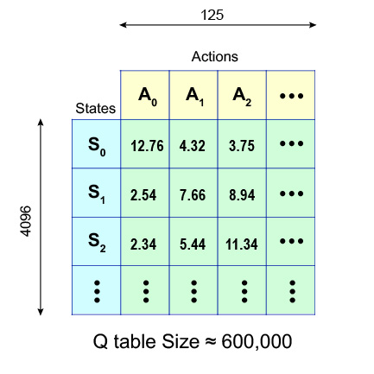
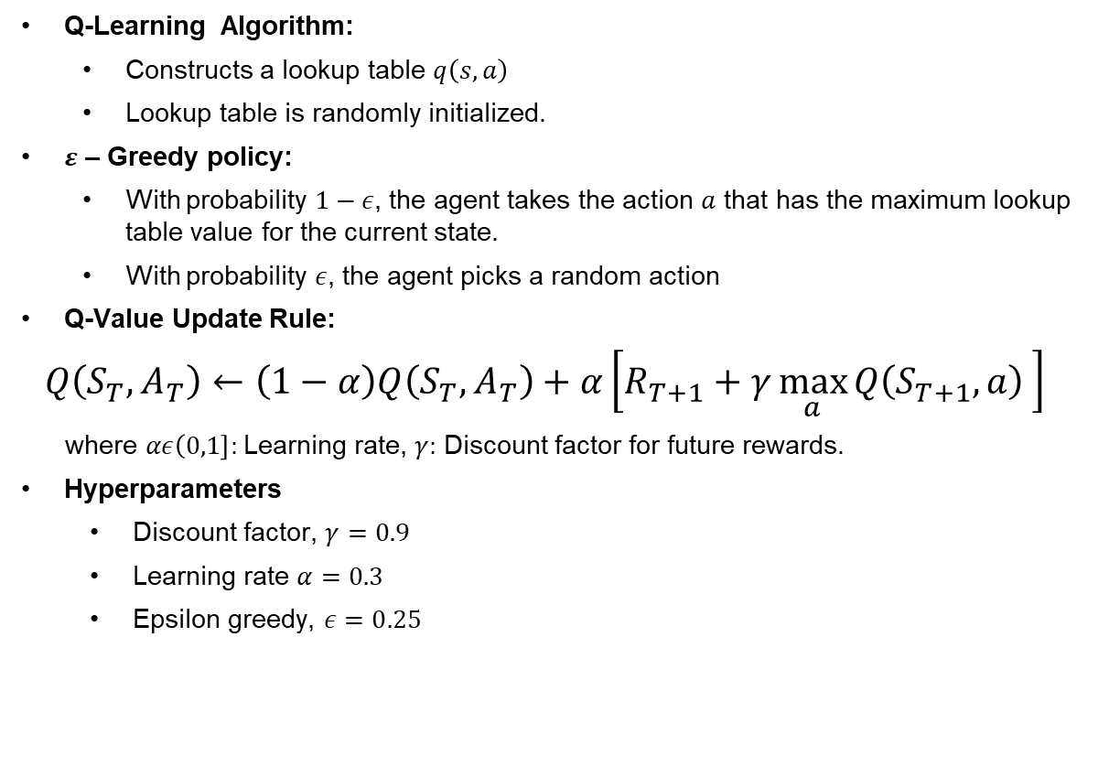
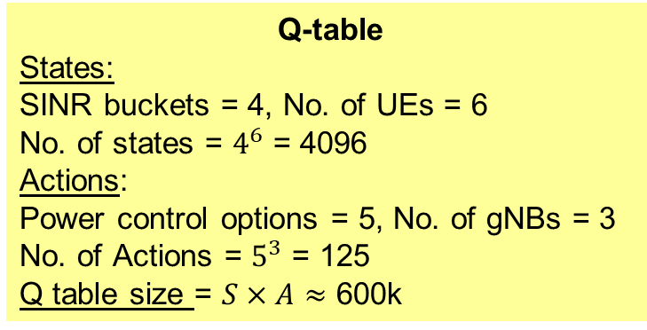
Tabular Q-Learning Algorithm
Q-Learning Algorithm:
  Constructs a lookup table $q\left(s,a\right)$
  Lookup table is randomly initialized.
$ε$ – Greedy policy:
  With probability $1−ε$, the agent takes the action $a$ that has the maximum lookup table value for the current state.
  With probability $ε$, the agent picks a random action
Q-Value Update Rule:
$$Q\left(S_{T},A_{T}\right)←\left(1−α\right)Q\left(S_{T},A_{T}\right)+α\left[R_{T+1}+γ\max_{a}{Q\left(S_{T+1},a\right)} \right]$$
where $αε\left(0,1\right]:$Learning rate, $γ:$ Discount factor for future rewards.
Hyperparameters
  Discount factor, $γ=0.9$
  Learning rate $α=0.3$
  Epsilon greedy, $ε=0.25$
Q-table
States:
SINR buckets = 4, No. of UEs = 6
No. of states = $4^{6}$ = 4096
Actions:
Power control options = 5, No. of gNBs = 3
No. of Actions = $5^{3}$ = 125
Q table size = $S×A$ $≈$ 600k

Slide 10
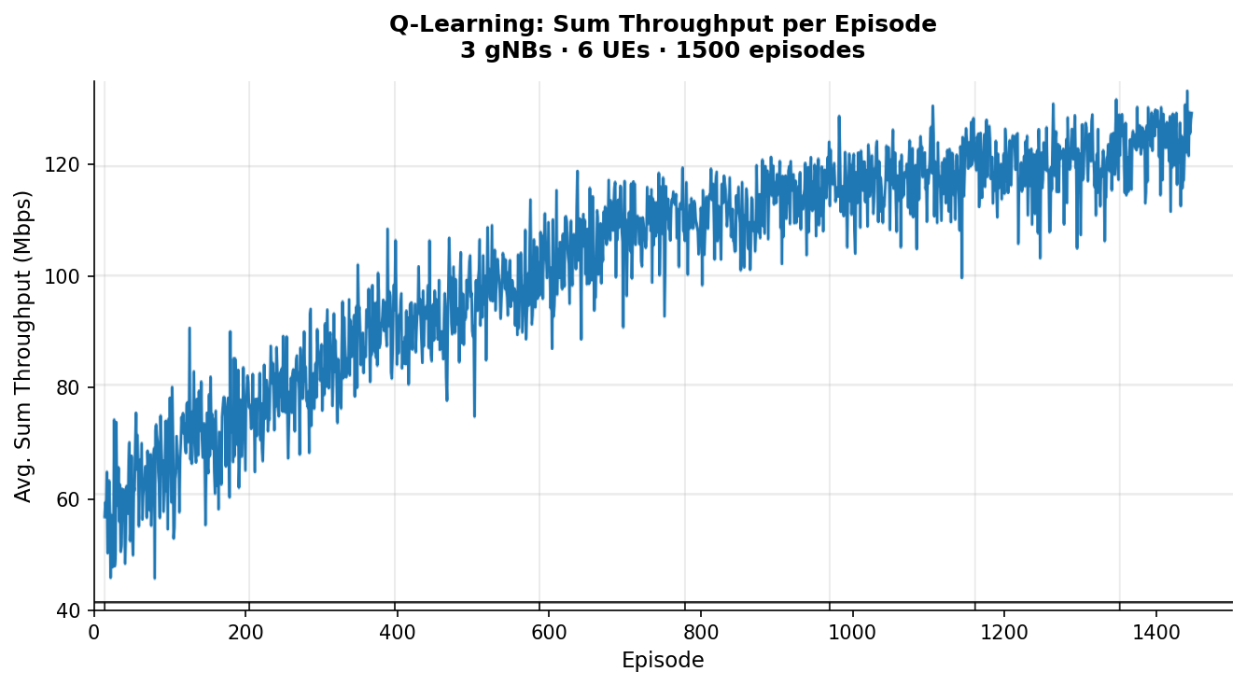
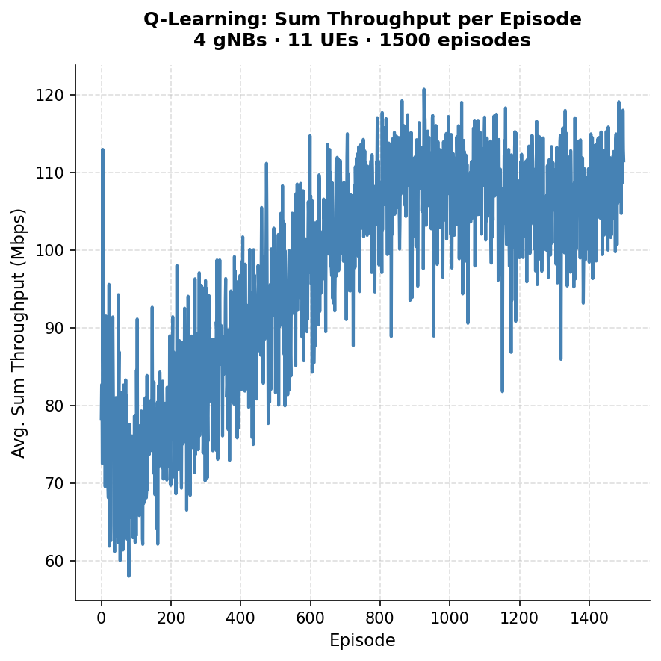
Q- Learning tabular results
Scenario 1: 3 gNBs · 6 UEs | Scenario 2: 4 gNBs · 11 UEs
Average rewards vs episode count
Average Sum throughput (Mbps) | Without RL | With RL
 | 61.8 | 129.75
RL gives an 109.95 % improvement

Slide 11
Interfacing with OpenAI Gymnasium for advanced RL algorithms
OpenAI Gymnasium is a toolkit developed by OpenAI for developing and comparing reinforcement learning algorithms
Allows to make a custom environment that will be used by the agent during learning.
Custom environment framework includes:
  reset(): to reset environment to the initial starting position, in our case [40,40,40] gNB
  step(a): to take action a and return next state, reward, termination to agent.
Allows use of different agents as DQN, PPO, A2C automatically vectorized for speed and making the environment a blackbox-like object for these to learn.
  We show an example using the PPO algortihm
The agents and environment are completely independent; we do not need to change anything in env to facilitate the agent.

Slide 12
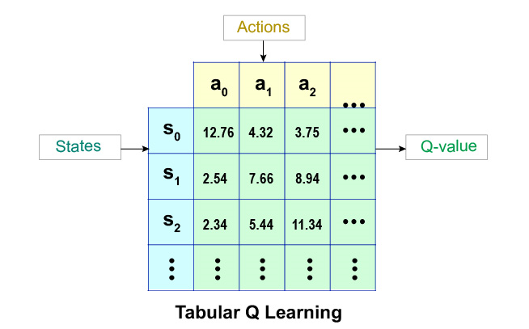
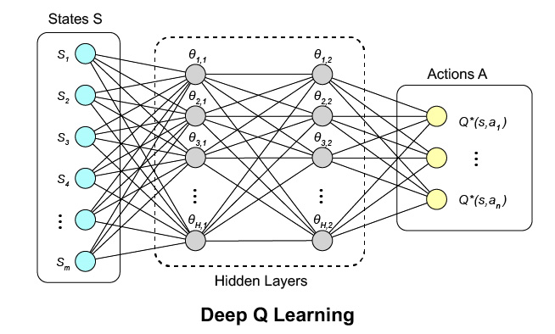
Deep Reinforcement Learning
Deep RL
  Q-table replaced by neural network
  Approximates q-value for each (state, action) pair
Neural Net structure
  Input layer is equal to the number of states |S|.
  Output layer is equal to the number of actions |A|.
Neural Net Advantages
  Handles large/continuous environments
  Transfers learning to similar states
  Estimates q-values for unvisited states

Slide 13
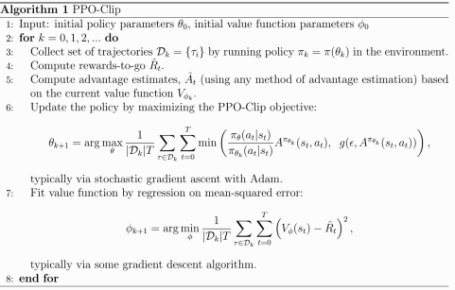
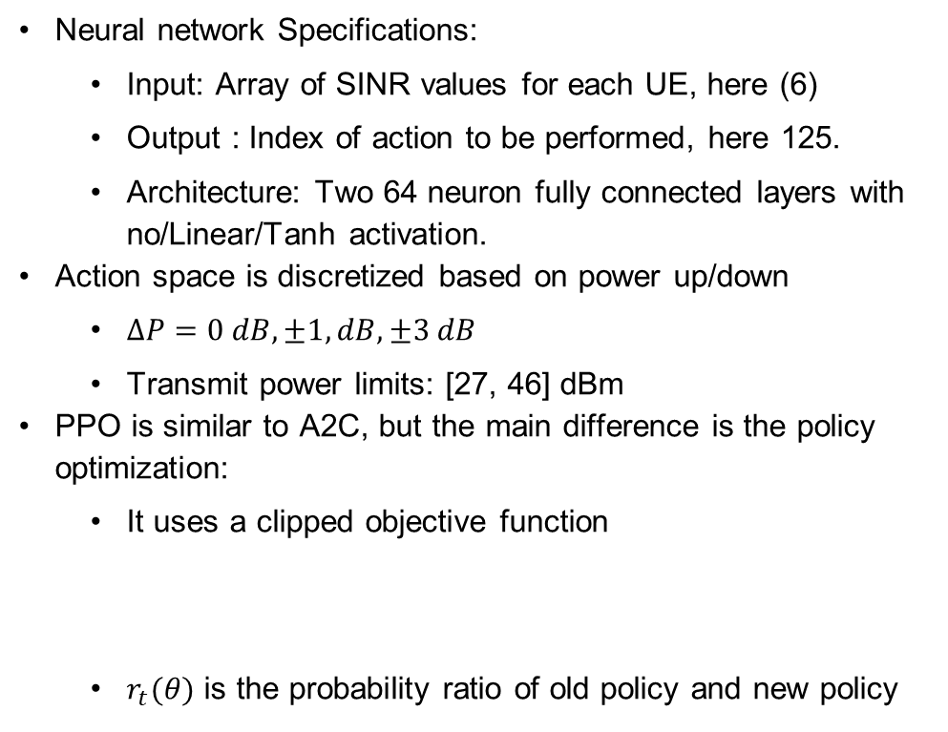
Proximal Policy Optimization: Algorithm
Neural network Specifications:
  Input: Array of SINR values for each UE, here (6)
  Output : Index of action to be performed, here 125.
  Architecture: Two 64 neuron fully connected layers with no/Linear/Tanh activation.
Action space is discretized based on power up/down
  $∆P=0 dB,±1, dB, ±3 dB$
  Transmit power limits: [27, 46] dBm
PPO is similar to A2C, but the main difference is the policy optimization:
  It uses a clipped objective function
  $r_{t}(θ)$ is the probability ratio of old policy and new policy
$$L^{CLIP}\left(θ\right)=E_{t}\left[\min_{}\left(r_{t}\left(θ\right)\hat{A_{t}},clip\left(r_{t}\left(θ\right),1−ε,1+ε\right)\hat{A_{t}}\right)\right]$$

Slide 14
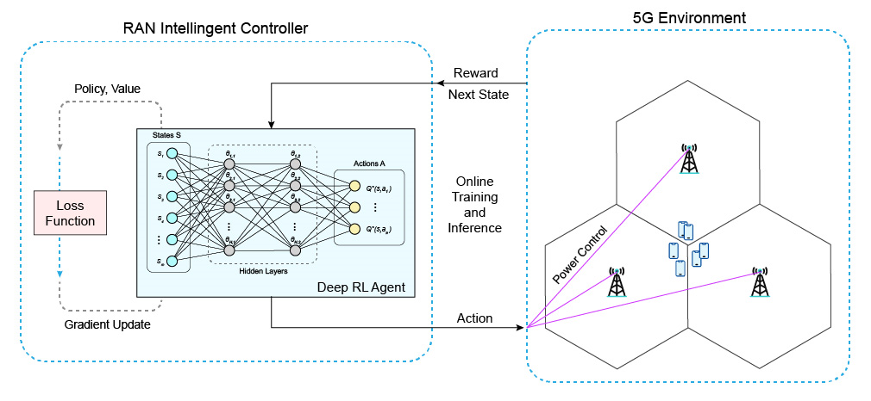
RIC – gNBs Interaction

Slide 15


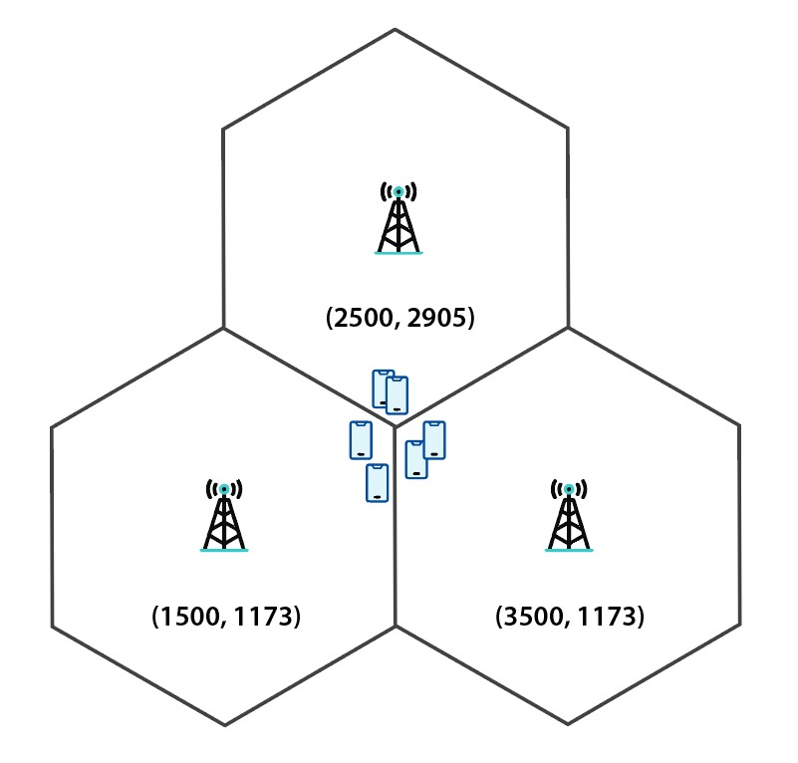
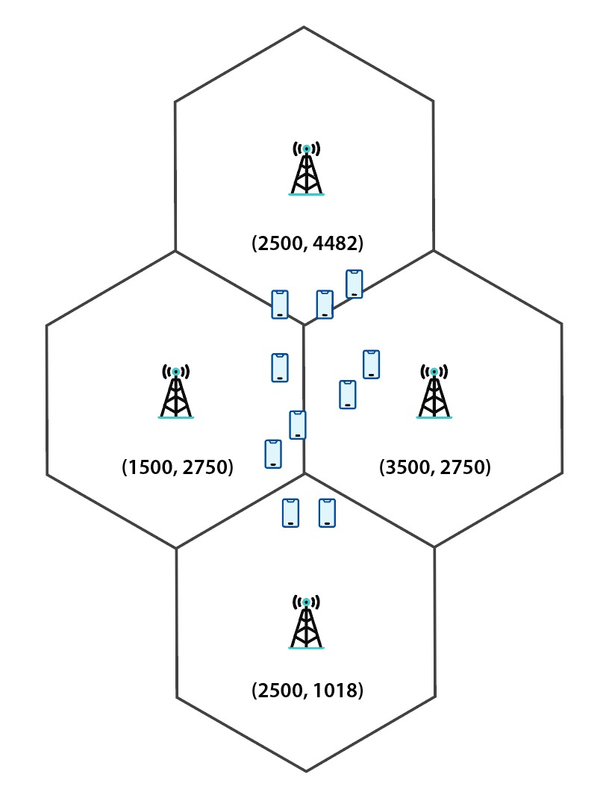
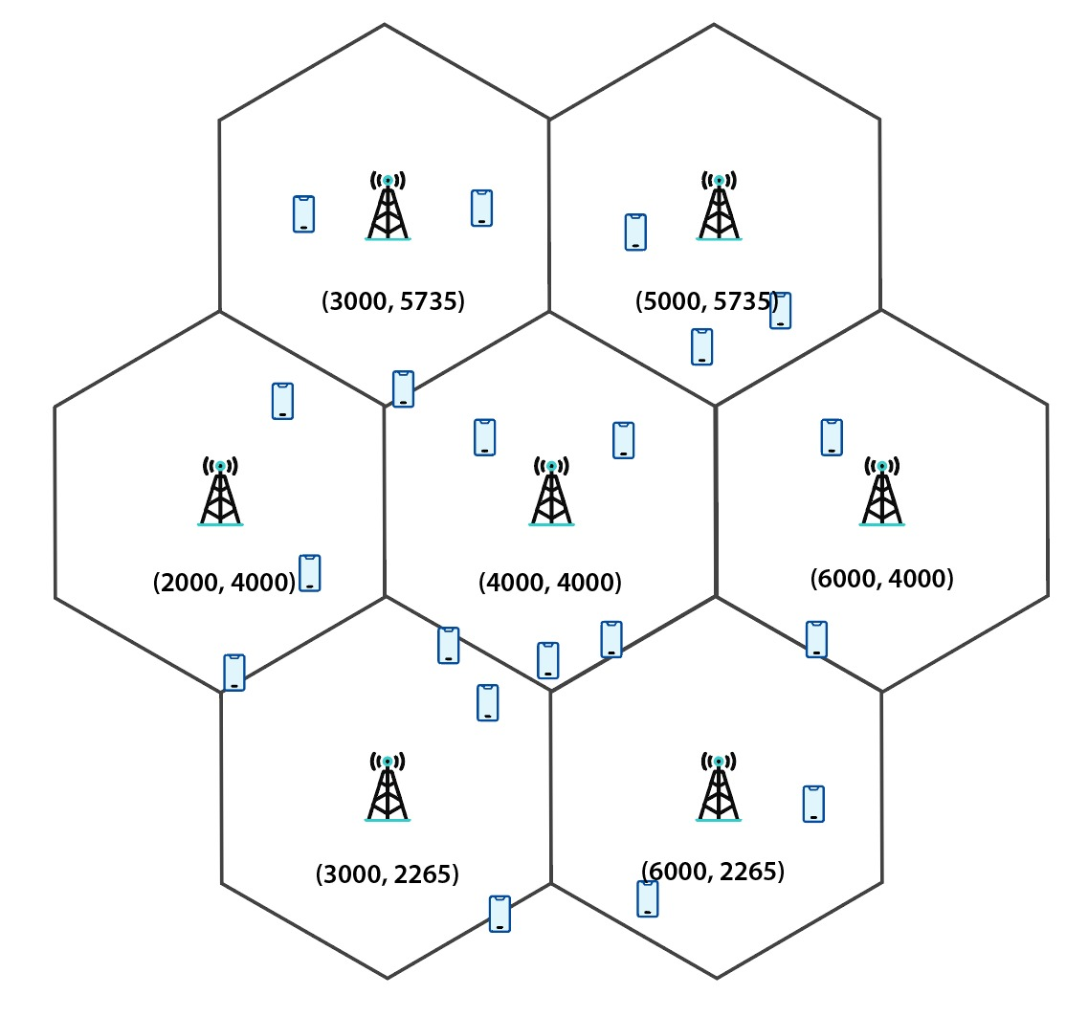
Example Scenarios
User Equipment (UE)
Base station (gNB)
3 gNBs 6 UEs
Tabular Q learning & PPO
4 gNBs 11 UEs
Tabular Q learning and PPO
7 gNBs 20 UEs
PPO only
State space is too large for tabular Q learning
PPO only

Slide 16
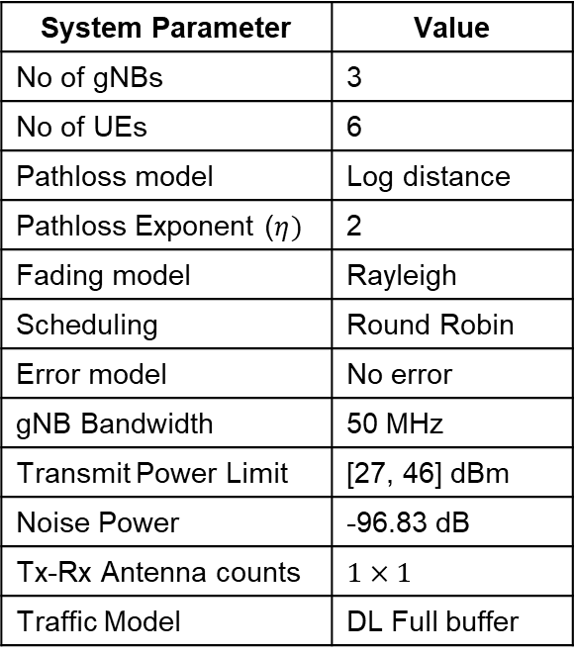
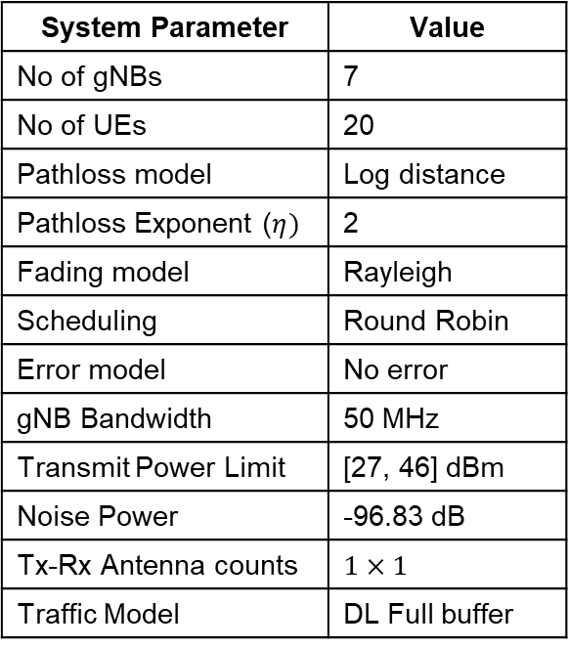
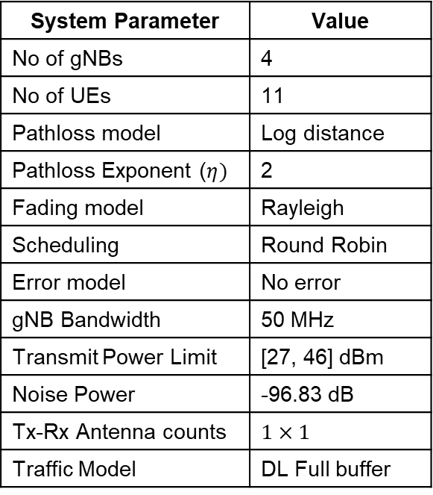
System parameters for different scenarios
Scenario 1: 3gNBs and 6 UEs
Scenario 2: 4 gNBs and 11 UEs
Scenario 3: 7 gNBs and 20 UEs
System Parameter | Value
No of gNBs | 3
No of UEs | 6
Pathloss model | Log distance
Pathloss Exponent ($η)$ | 2
Fading model | Rayleigh
Scheduling | Round Robin
Error model | No error
gNB Bandwidth | 50 MHz
Transmit Power Limit | [27, 46] dBm
Noise Power | -96.83 dB
Tx-Rx Antenna counts | $$1×1$$
Traffic Model | DL Full buffer
System Parameter | Value
No of gNBs | 4
No of UEs | 11
Pathloss model | Log distance
Pathloss Exponent ($η)$ | 2
Fading model | Rayleigh
Scheduling | Round Robin
Error model | No error
gNB Bandwidth | 50 MHz
Transmit Power Limit | [27, 46] dBm
Noise Power | -96.83 dB
Tx-Rx Antenna counts | $$1×1$$
Traffic Model | DL Full buffer
System Parameter | Value
No of gNBs | 7
No of UEs | 20
Pathloss model | Log distance
Pathloss Exponent ($η)$ | 2
Fading model | Rayleigh
Scheduling | Round Robin
Error model | No error
gNB Bandwidth | 50 MHz
Transmit Power Limit | [27, 46] dBm
Noise Power | -96.83 dB
Tx-Rx Antenna counts | $$1×1$$
Traffic Model | DL Full buffer

Slide 17

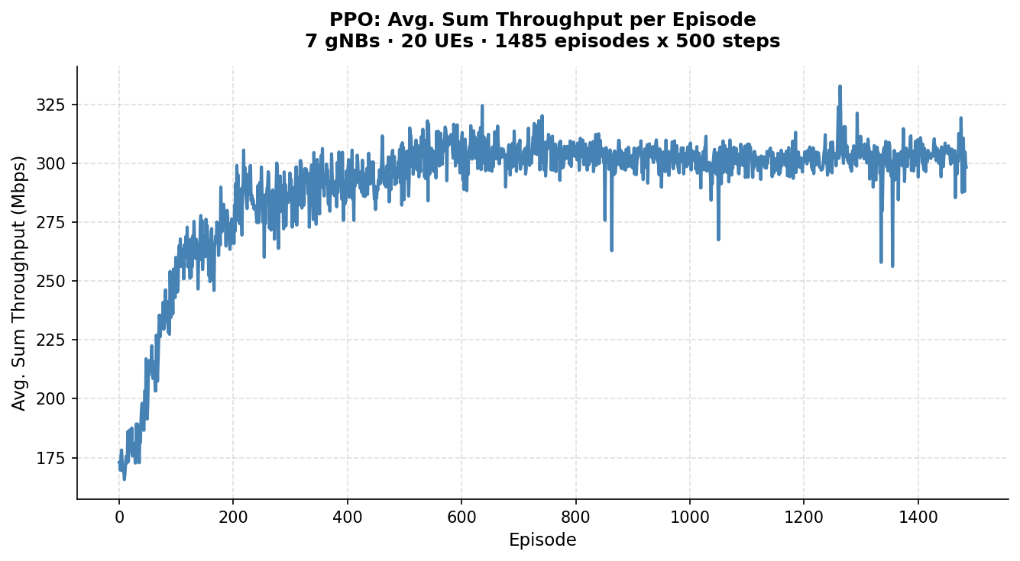
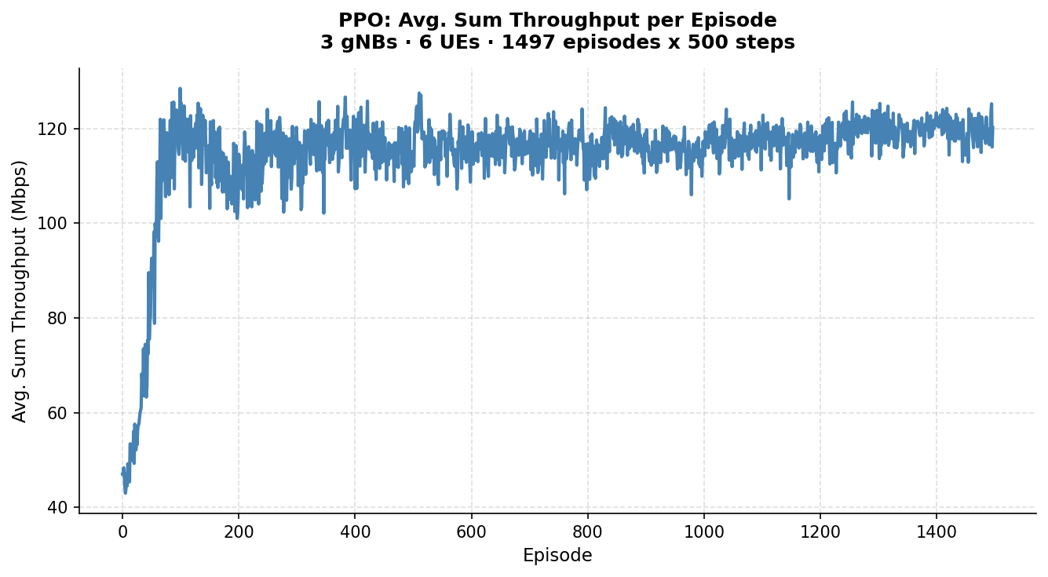
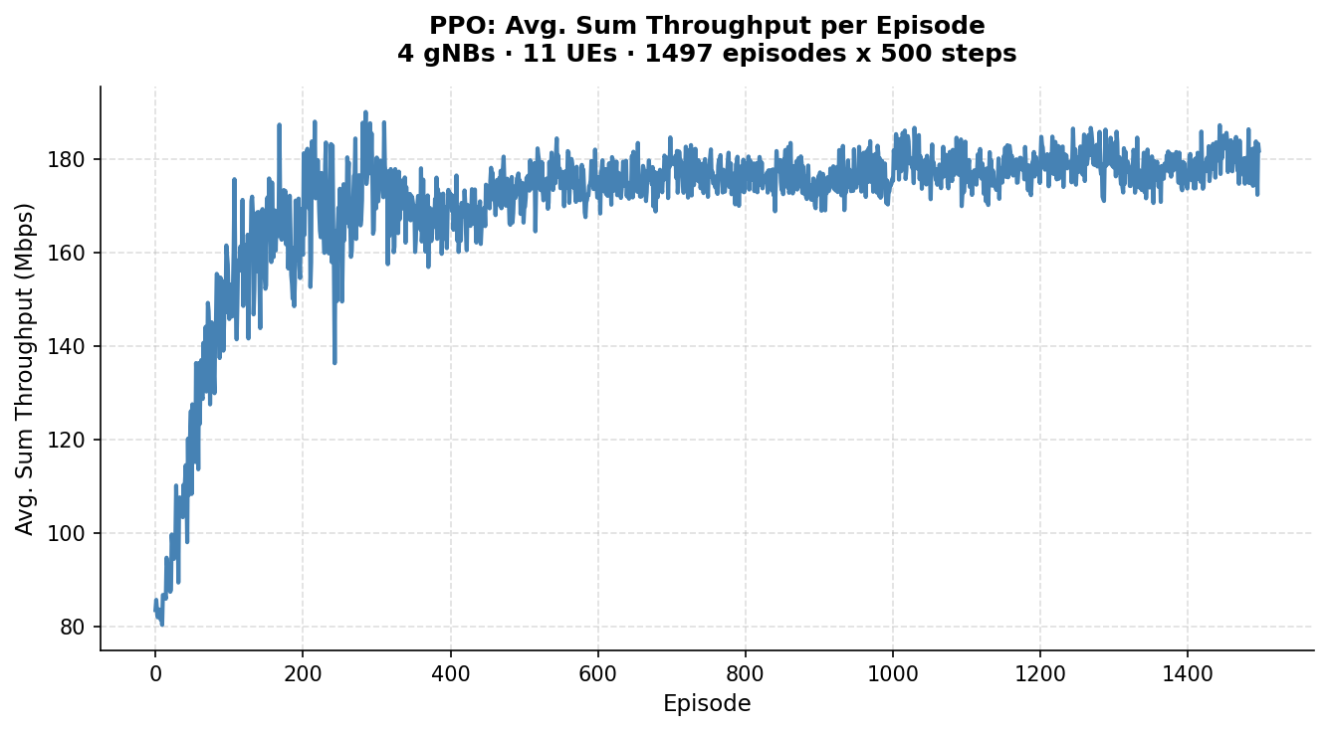
RL Training curves
3 gNBs 6 UEs; RL algorithm: Q learning
4 gNBs 11 UEs; RL algorithm: Q learning
7 gNBs 20 UEs; RL algorithm: PPO
Note: Q-Learning matches PPO at 3×6 as the small state space (3⁶ × 5³ ≈ 91K entries) allows exact tabular convergence. PPO’s advantage emerges at 4×11 and 7×20 where the Q-table becomes intractable.
3 gNBs 6 UEs; RL algorithm: PPO
4 gNBs 11 UEs; RL algorithm: PPO
Notes:
Note on 3 gNBs x 6 UEs results: Q-Learning achieves comparable throughput to PPO at this scale because the state-action space is small enough (3^6 = 729 states x 5^3 = 125 actions = ~91,000 Q-table entries) for the tabular method to converge exactly with zero approximation error over 1500 episodes. PPO uses a neural network to approximate the policy, which introduces a small error at this scale. Both algorithms reach the same throughput ceiling (~129 Mbps), confirming the network is near-optimal. As the scenario scales to 4x11 and 7x20, the Q-table becomes intractable (110M and 3.5B entries respectively), and PPO outperforms significantly — converging to 186 Mbps (4x11) and 312 Mbps (7x20) where Q-Learning either underperforms or cannot run.

Slide 18
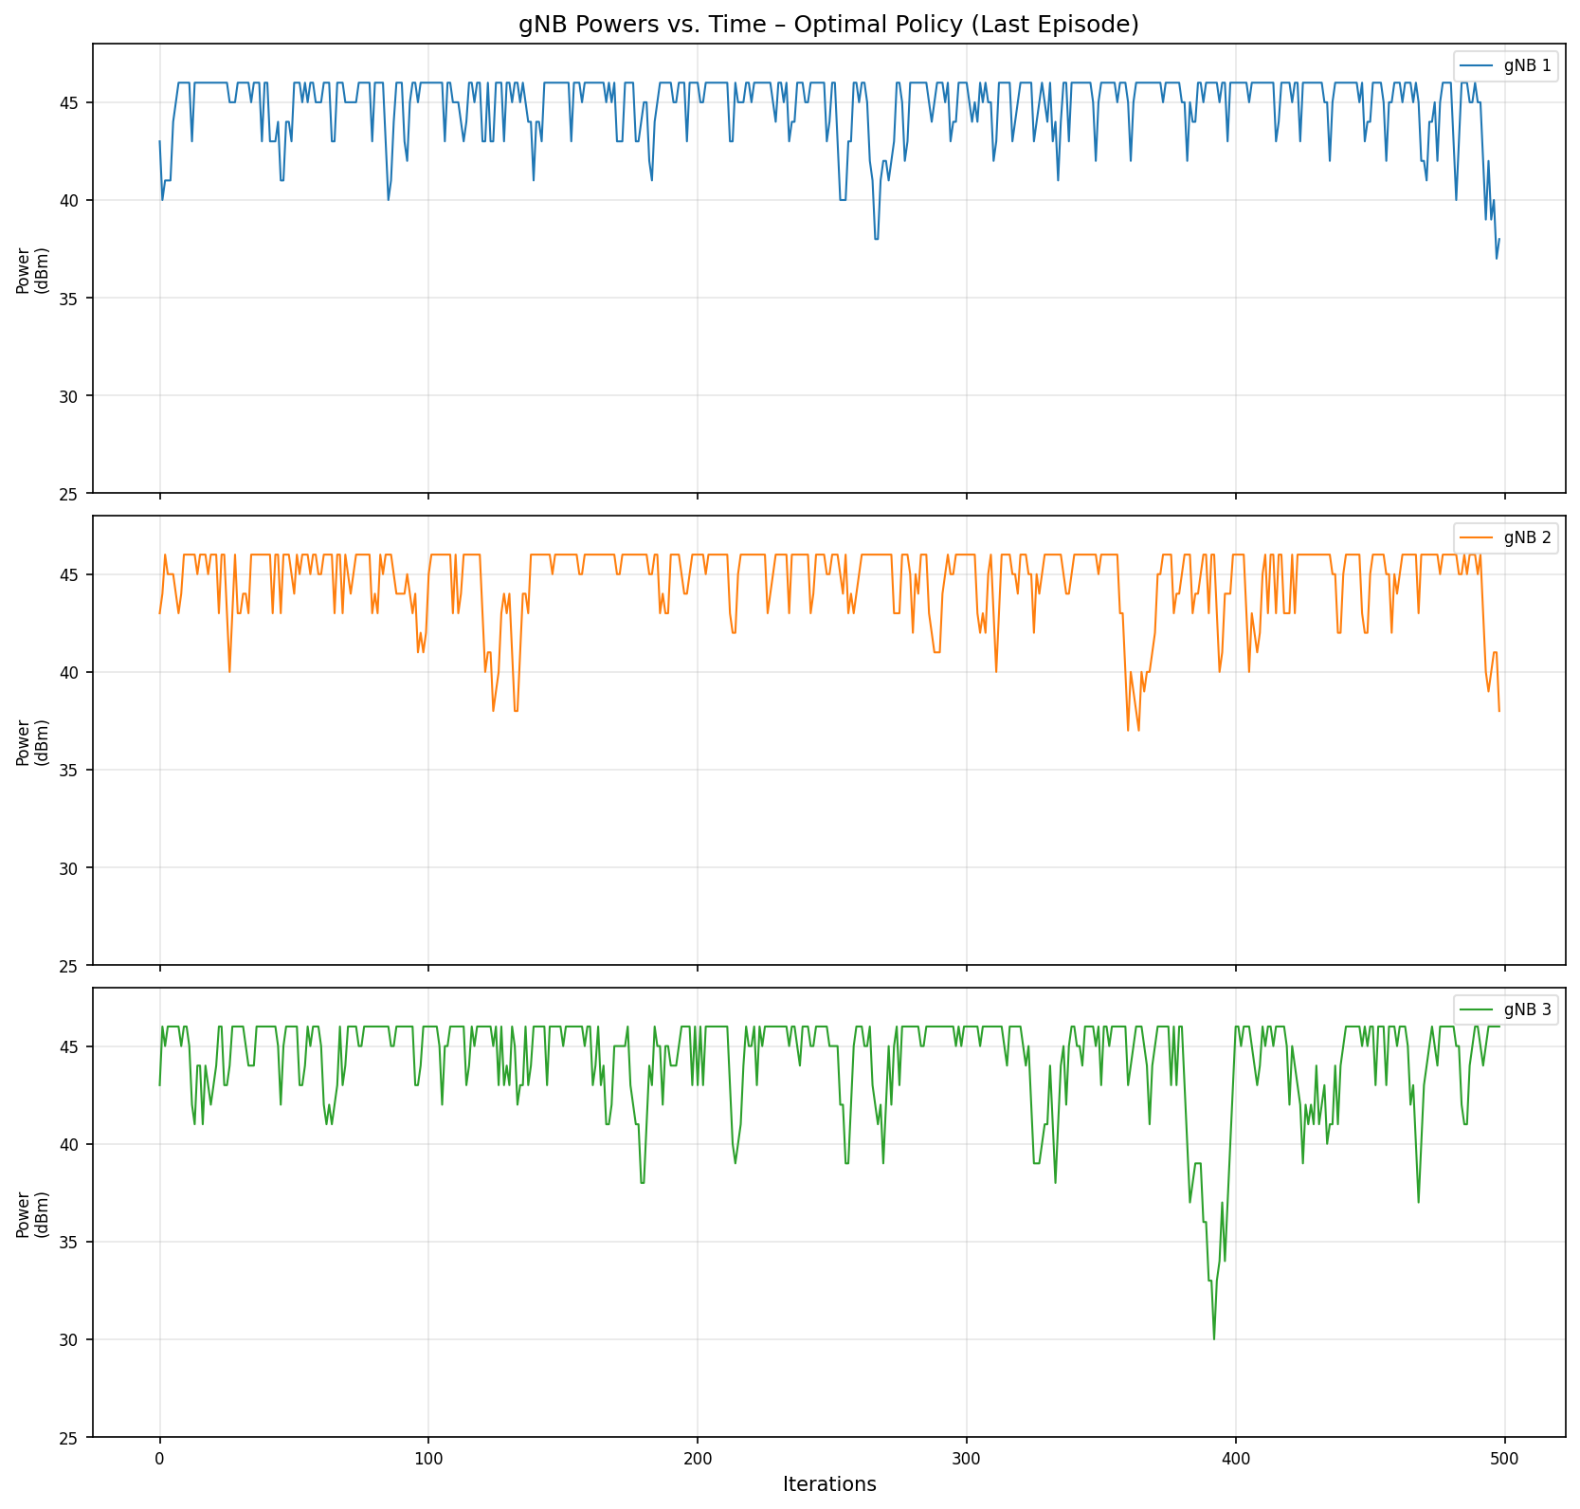
PPO: Avg. Sum Throughput vs Fixed-Power Baseline (v15.0)thput. improvements
Scenario | Avg. Sum Thput. (Mbps)
 | Without RL | With RL (PPO)
3 gNBs · 6 UEs | 62 | 126
4 gNBs · 11 UEs | 96 | 186
7 gNBs · 20 UEs | 207 | 312

Slide 19
Appendix: How to Guide.

Slide 20
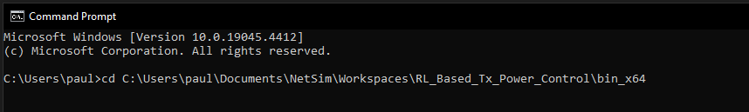
How to run the RL simulation ?
Download the project from Github link provided in slide 1.
Follow the instructions provided in the following link to setup the project in NetSim
  https://support.tetcos.com/support/solutions/articles/14000128666-downloading-and-setting-up-netsim-file-exchange-projects
For the RL simulation, we first need to run NetSim using the command line interface(CLI)
Open the Run menu with Windows Key + R, then type "cmd." Press "Enter" to open Command Prompt
Note the application path. Application path is the current workspace location of the NetSim that you want to run. The default application path will be something like "C:\Users\PC\Documents\NetSim\Workspaces\\<Your default workspace>\bin_x64" for 64-bit.
Change the directory to the application path using the following command, below is an example command >cd \<app path>

Slide 21
How to run the RL simulation ?
Type the following in the command prompt
FOR /L %i IN (1,1,<NUM_EPISODES>) DO NetSimCore.exe<space>-iopath<space><io path><space>-license<space>5053@<Server IP Address>
or
FOR /L %i IN (1,1,<NUM_EPISODES>) DO NetSimCore.exe<space>-iopath<space><io path><space>-license<space><license path>
  <iopath> is the path to the current scenario which needs to be run, which in this case is “RL_based_Power_Control_Sample”
  <Server IP Address> is the IP address of the system where NetSim license server is running.
  <NUM_EPISODES> is the number of episodes the simulation will run for; default value is 1500, below is an example command
  <license file path> path where the license file is present. This is generally the <NetSim_Installation_Directory>/bin folder
Open another command prompt window and change the directory to where the python file and requirements.txt is saved
To run Tabular Q Learning:
  Type python <filename>, in this case, filename is “RL_Power_Control” and hit enter to run the python file
  The python script will ask for the number of episodes as input, enter the default value, 1500 and hit enter to start the simulation

Slide 22
How to run the RL simulation ?
For PPO Algorithm
  Using a Virtual environment:
    Open the folder containing requirements.txt in command prompt
    Create Environment: >python -m venv netsim_power_control
    Activate Environment:
      Windows: >netsim_power_control\Scripts\activate
      Mac/Linux : >source netsim_power_control/bin/activate
    Install dependencies. : >pip install -r requirements.txt
  Type >python <filename>, in this case, filename is “agents_netsim” and hit enter to run the python file.
  The default Simulation will run for 1500 episodes with 500 steps.
  To deactivate the environment after use: >deactivate
  To use GPU for training:
    Make sure CUDA 11.8 and cuDNN 8.7.0.x are installed to support Pytorch 2.3
    use >pip install -r requirements-gpu.txt

Slide 23
How to run the RL simulation ?
To change the number of episodes, we need to make two changes. First, we need to change the input we give to the python script. Second, we need to edit the looping command which we use to run NetSim. Edit the <NUM_EPISODES> variable in the command
For Tabular Q Learning:
  Upon running the simulation, the python script will create two folders, named “plots” and “logs” where it will save the result plots and log files, respectively. These folders will be created in the same working directory as the python script
  Close the plots after viewing them, to allow them to be saved.
  In the “logs” folder, all the log files will be saved which can be used for debugging
For Proximal Policy Optimization (PPO) Algorithm:
  Configure NUM_GNBs, NUM_UEs, EPISODES and hyperparameters (learning_rate, clip_range, ent_coef) in agents_netsim.py before running.
  Upon Running the simulation, a <name>.zip file will be saved which has the trained model and weights saved for future use and a plot for the average rewards per episode.

Slide 24
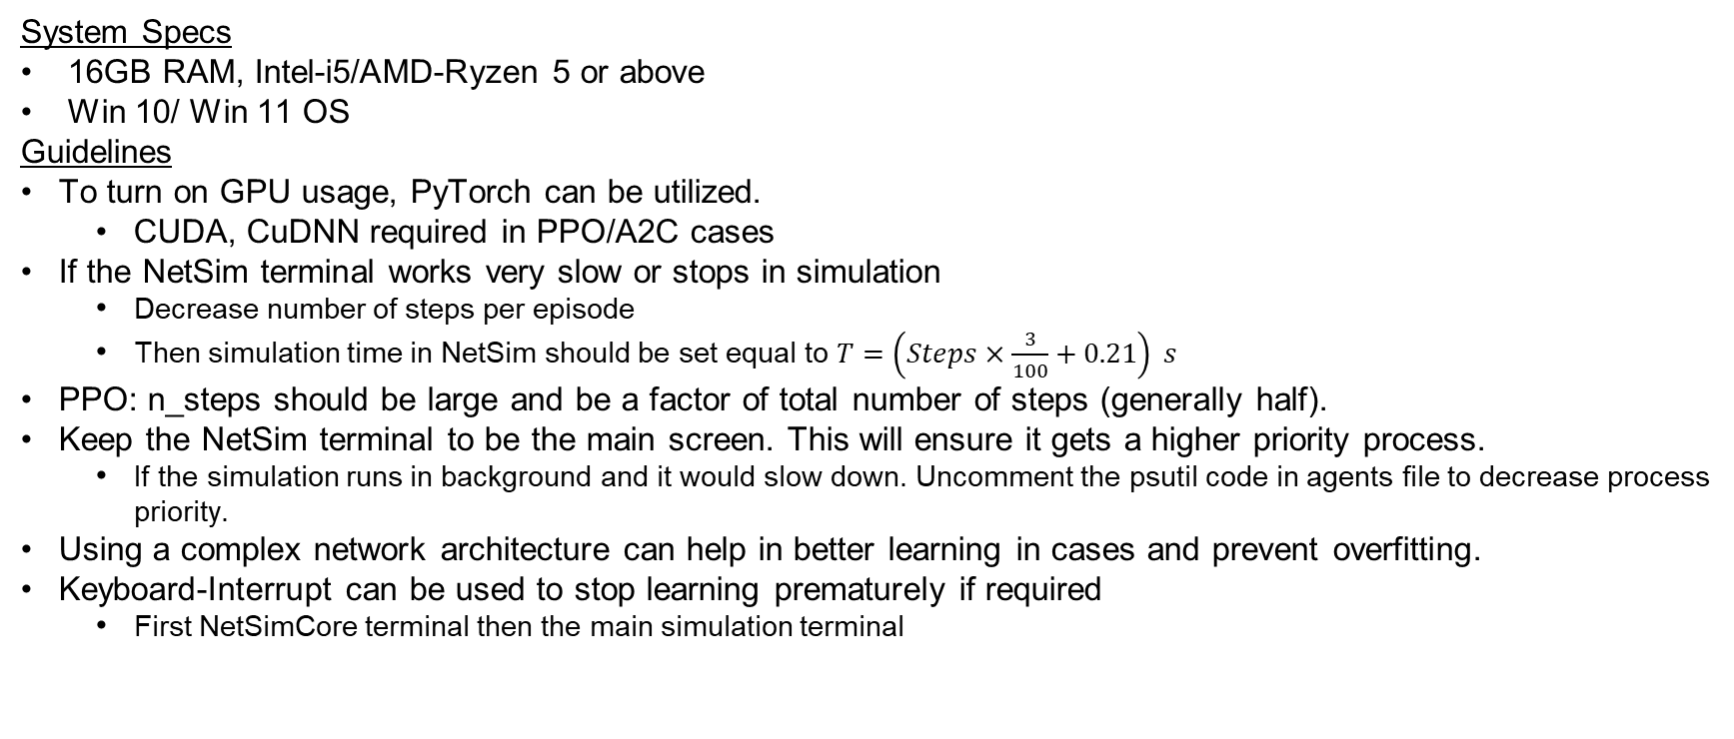
System requirements and execution guidelines
System Specs
16GB RAM, Intel-i5/AMD-Ryzen 5 or above
Win 10/ Win 11 OS
Guidelines
To turn on GPU usage, PyTorch can be utilized.
  CUDA, CuDNN required in PPO/A2C cases
If the NetSim terminal works very slow or stops in simulation
  Decrease number of steps per episode
  Then simulation time in NetSim should be set equal to $T=\left(Steps×\frac{3}{100}+0.21\right) s$
PPO: n_steps should be large and be a factor of total number of steps (generally half).
Keep the NetSim terminal to be the main screen. This will ensure it gets a higher priority process.
  If the simulation runs in background and it would slow down. Uncomment the psutil code in agents file to decrease process priority.
Using a complex network architecture can help in better learning in cases and prevent overfitting.
Keyboard-Interrupt can be used to stop learning prematurely if required
  First NetSimCore terminal then the main simulation terminal

