Slide 1

Implementing 5G Down Link Power Control Using Reinforcement Learning via NetSim-Python Interfacing
Applicable Release: NetSim v14.1 or higher
Applicable Version(s): NetSim Standard
Project download link: https://github.com/NetSim-TETCOS/RL_Based_Tx_Power_Control_v14.1/archive/refs/heads/main.zip
The URL has the exported NetSim scenario for the example used in this document and the python script to run the reinforcement learning simulation

Slide 2
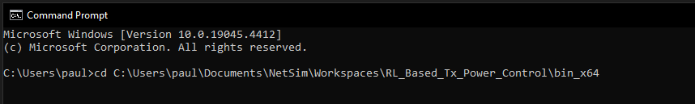
How to run this project?
Download the project from Github link provided in slide 1.
There are two NetSim workspaces in the link provided, one for without RL results and one for the RL simulation
Follow the instructions provided in the following link to setup both the projects in NetSim
https://support.tetcos.com/support/solutions/articles/14000128666-downloading-and-setting-up-netsim-file-exchange-projects
For the RL simulation, we first need to run NetSim using the command line interface(CLI)
Open the Run menu with Windows Key + R, then type "cmd." Press "Enter" to open Command Prompt
Note the application path. Application path is the current workspace location of the NetSim that you want to run. The default application path will be something like "C:\Users\PC\Documents\NetSim\Workspaces\\<Your default workspace>\bin_x64" for 64-bit.
Change the directory to the application path using the following command, below is an example command
>cd \<app path>

Slide 3
How to run this project? (contd.)
Type the following in the command prompt
FOR /L %i IN (1,1,<NUM_EPISODES>) DO NetSimCore.exe\<space>-iopath\<space>\<io path>\ <space>-license\<space>5053@\<Server IP Address>
\<iopath> is the path to the current scenario which needs to be run, which in this case is “RL_based_Power_Control_Sample”
\<Server IP Address> is the IP address of the system where NetSim license server is running.
<NUM_EPISODES> is the number of episodes the simulation will run for; default value is 500, below is an example command
Now, open another command prompt window and change the directory to where the python file “RL_Power_Control” is saved
Type python <filename>, in this case, filename is “RL_Power_Control” and hit enter to run the python file
The python script will ask for the number of episodes as input, enter the default value, 500 and hit enter to start the simulation

Slide 4
How to run this project? (contd.)
To change the number of episodes, we need to make two changes. First, we need to change the input we give to the python script. Second, we need to edit the looping command which we use to run NetSim. Edit the <NUM_EPISODES> variable in the command
Upon running the simulation, the python script will create two folders, named “plots” and “logs” where it will save the result plots and log files, respectively. These folders will be created in the same working directory as the python script
After the simulation, we will get 3 different plots, which will be saved in the “plots” folder. Before saving the plots, python will display the plots in separate windows for each plot. Close the individual plots after viewing them, to allow them to be saved.
In the “logs” folder, all the log files will be saved which can be used for debugging

Slide 5
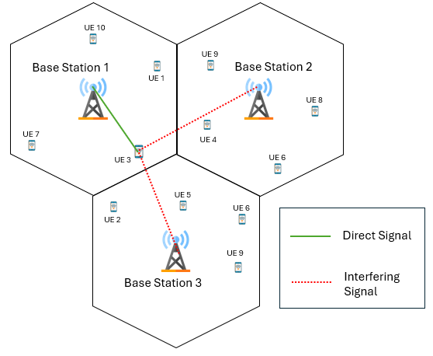
Power Control: Introduction
Due to the broadcast nature of wireless communication, signals interfere with each other.
Interference can degrade the performance of the 5G RAN
DL power control can be used to mitigate interference, ensure spectral reuse and improve user experience
However, direct application to practical systems is impaired by the dependency on various simplifying assumptions
Knowledge of user positions, number of users, channel gains, resources allocated to each user etc.
In this project, we use reinforcement learning (RL) for downlink (DL) power control to mitigate interference, boost SINR and maximize sum throughput
Ghadimi et al, “A Reinforcement Learning Approach to Power Control and Rate Adaptation in Cellular Networks”, arXiv:1611.06497v1 [math.OC] 20 Nov 2016

Slide 6
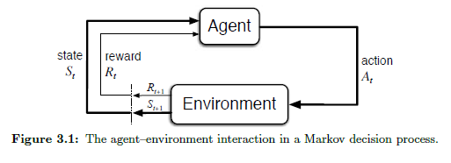
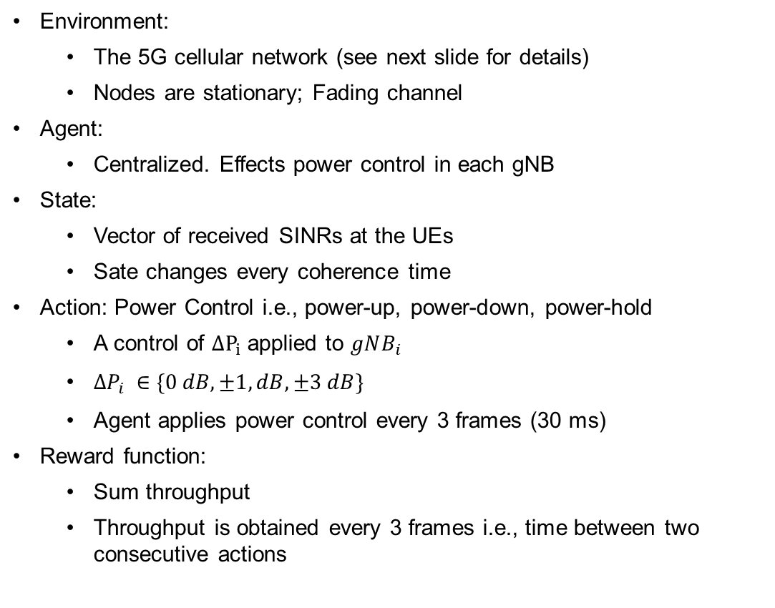
Reinforcement Learning
Environment:
The 5G cellular network (see next slide for details)
Nodes are stationary; Fading channel
Agent:
Centralized. Effects power control in each gNB
State:
Vector of received SINRs at the UEs
Sate changes every coherence time
Action: Power Control i.e., power-up, power-down, power-hold
A control of $ΔP_{i}$ applied to $gNB_{i}$
$∆P_{i} ∈\{0 dB,±1, dB, ±3 dB\}$
Agent applies power control every 3 frames (30 ms)
Reward function:
Sum throughput
Throughput is obtained every 3 frames i.e., time between two consecutive actions
Agent: RL (Q learning) algorithm is in Python.
Environment: NetSim 5G
NetSim passes States and Rewards, Python returns Actions

Slide 7
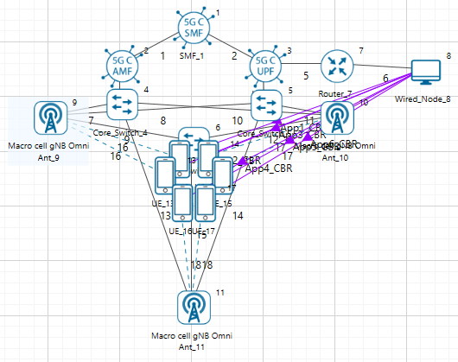
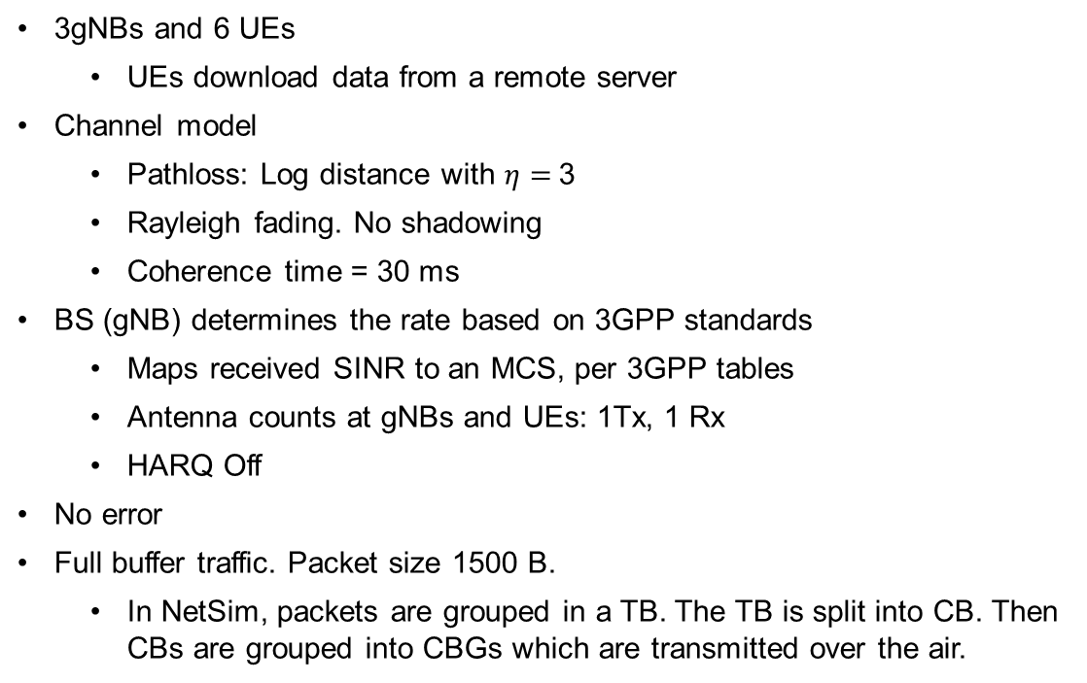
Cellular network model
3gNBs and 6 UEs
UEs download data from a remote server
Channel model
Pathloss: Log distance with $η=$3
Rayleigh fading. No shadowing
Coherence time = 30 ms
BS (gNB) determines the rate based on 3GPP standards
Maps received SINR to an MCS, per 3GPP tables
Antenna counts at gNBs and UEs: 1Tx, 1 Rx
HARQ Off
No error
Full buffer traffic. Packet size 1500 B.
In NetSim, packets are grouped in a TB. The TB is split into CB. Then CBs are grouped into CBGs which are transmitted over the air.
Scenario in NetSim

Slide 8
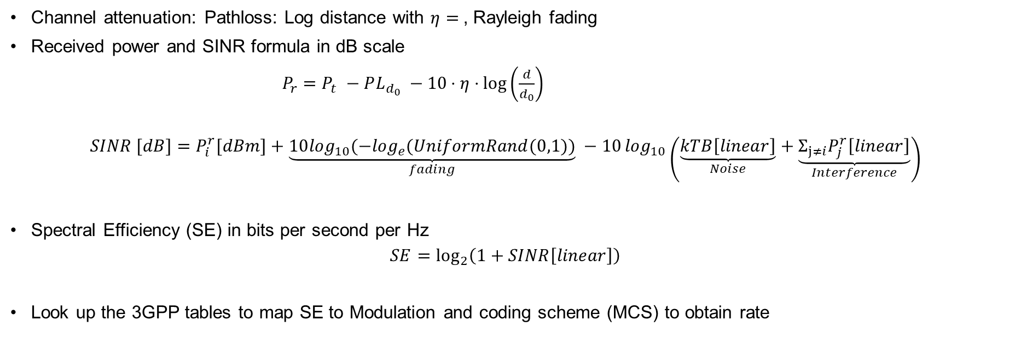
SINR and Rate
Channel attenuation: Pathloss: Log distance with $η=$, Rayleigh fading
Received power and SINR formula in dB scale
$P_{r}=P_{t} −PL_{d_{0}} −10⋅η⋅log\left(\frac{d}{d_{0}}\right)$
$$SINR [dB]=P_{i}^{r}[dBm]+\underset{fading}{\underbrace{10\log_{10}(−\log_{e}(UniformRand(0,1))}} −10\log_{10}\left(\underset{Noise}{\underbrace{kTB\left[linear\right]}}+\underset{Interference}{\underbrace{{Σ_{j≠i}P}_{j}^{r}\left[linear\right]}}\right)$$
Spectral Efficiency (SE) in bits per second per Hz
$$SE=\log_{2}\left(1+SINR\left[linear\right]\right)$$
Look up the 3GPP tables to map SE to Modulation and coding scheme (MCS) to obtain rate

Slide 9
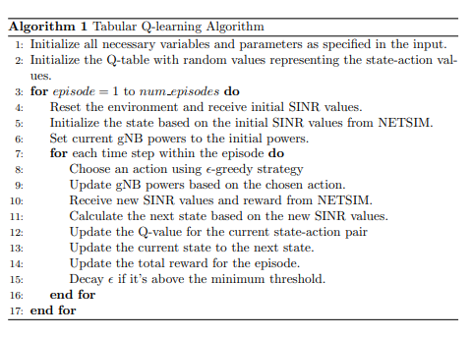

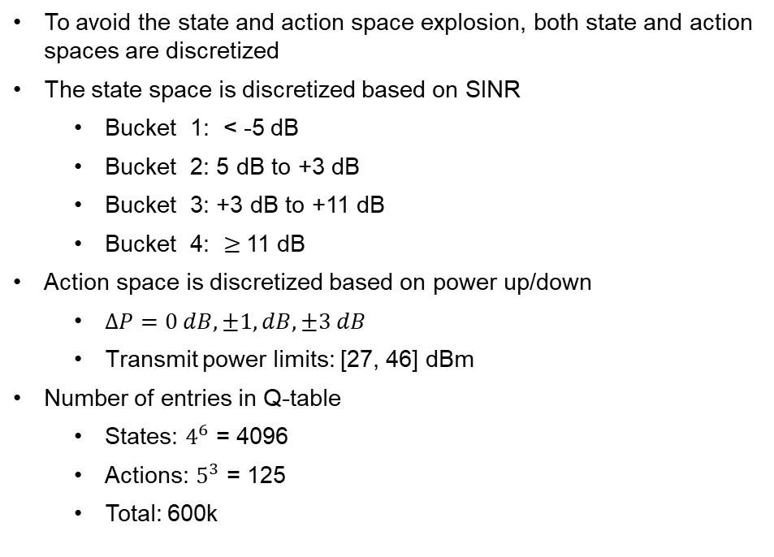
RL Algorithm: Tabular Q Learning
To avoid the state and action space explosion, both state and action spaces are discretized
The state space is discretized based on SINR
Bucket 1: < -5 dB
Bucket 2: 5 dB to +3 dB
Bucket 3: +3 dB to +11 dB
Bucket 4: $≥$11 dB
Action space is discretized based on power up/down
$∆P=0 dB,±1, dB, ±3 dB$
Transmit power limits: [27, 46] dBm
Number of entries in Q-table
States: $4^{6}$ = 4096
Actions: $5^{3}$ = 125
Total: 600k

Slide 10
NetSim Python Interfacing
Introduction to Python C Socket Interfacing:
Python facilitates seamless integration with C for socket programming tasks.
Python uses the socket module to interact with C side functions.
Python Code
Python creates a client socket in the host machine and connects with the C side server
Key functions include:
def NETSIM_interface(gNB_powers):
Sends the gNB powers to NetSim with a header
Receives acknowledgement integer value from NetSim
Sends a request value to NetSim to receive the updated SINR values and the reward
Receives the next state and the reward from NetSim

Slide 11
NetSim Python Interfacing (contd.)
NetSim C code
Key functions include:
void init_waiting_struct_socket1() : Initializes the Winsock library and calls the listenForPython() function bool listenForPython() : Resolves the server address and port Creates a socket for connecting to the server Sets up the TCP listening socket Waits for client socket connection void handle_Send_Receive(struct SINR_Values_Reward* Param1, struct gNB_Powers* Param2)

Slide 12
NetSim Python Interfacing (contd.)
NetSim C code
Key functions include:
void handle_Send_Receive(struct SINR_Values_Reward* Param1, struct gNB_Powers* Param2) Receives the message type from Python If message type is to “receive gNB powers”, receives the powers from Python and sends back an acknowledgement message If message type is to “send SINRS and rewards”, sends back the state and reward back to Python using the send_SINRS_Rewards_at_Time_Step() function void send_SINRS_Rewards_at_Time_Step() : sends the list of updated SINRs and the sum throughput received from the LTENR project in NetSim back to python

Slide 13
Running custom simulations
There are two simulations in the Github link provided
Without RL: To get the results for the without RL case, run the scenario titled “without_RL.netsimexp” and use the python script provided in the link
With RL: To get the results for the with RL case, run the scenario titled “RL_Based_Tx_Power_Control.nestimexp” and use the python script provided in the link
Both the simulations will make use of the same python script, the only difference between the simulations will be that in the without RL scenario, the code implementing the updating of Tx powers of the gNBs will be commented out implying that the Tx power will remain constant at the default value of 40 dBM
While creating a custom scenario, the user must keep in mind the following points
number of gNBs should be within 5 and number of UEs should be within 16 due to memory limitations
each gNB should at least be connected to one UE
for each newly added gNB,
coherence time = 30ms
shadowing should be off
log distance pathloss model with 3 as the exponent
HARQ should be off
fading should be Rayleigh with eigen beamforming

Slide 14
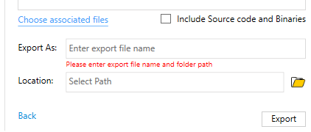
Running custom simulations
Create a new scenario in the RL workspace keeping in mind the points in the previous slide
Export the same scenario, while unchecking the “Include Source code and Binaries” option and import it in the without RL workspace given in the link
Run both the simulations for the desired number of episodes which should be at least 5000 to get proper results
Both the simulations will make use of the same python script

Slide 15
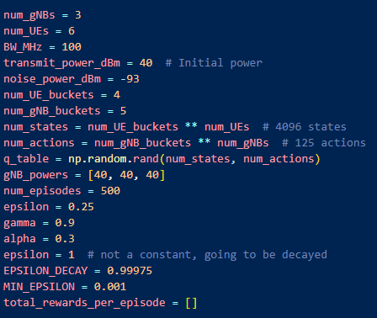
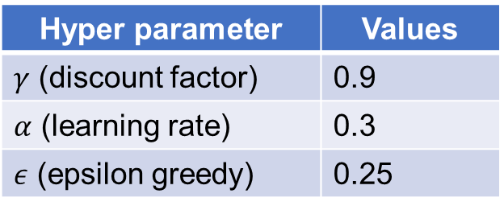
Parameters
Parameter | Value
Bandwidth | 50 MHz
Transmit Power | 40 dB
Noise Power | -96.38 dB
Path-loss exponent | 3
Hyper parameter | Values
$γ$ (discount factor) | 0.9
$α$ (learning rate) | 0.3
$ε$ (epsilon greedy) | 0.25
One-episode of 1000 iterations takes 15s to complete.

Slide 16
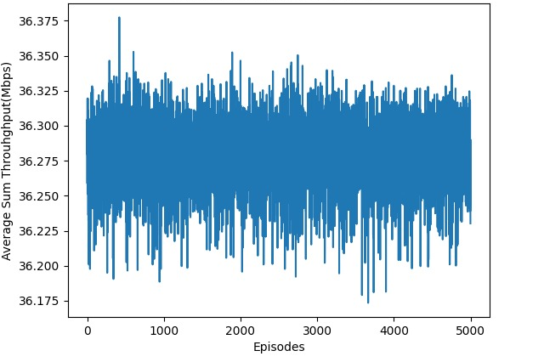
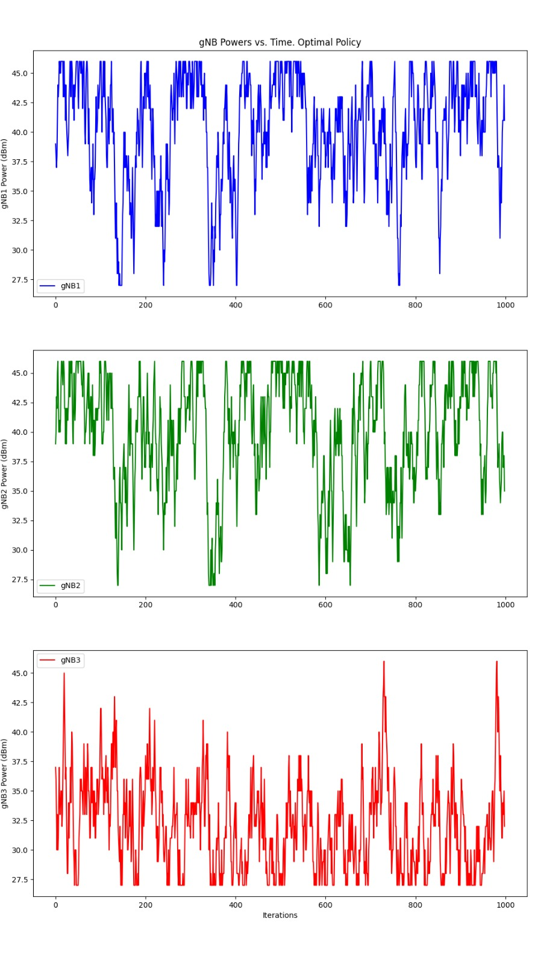
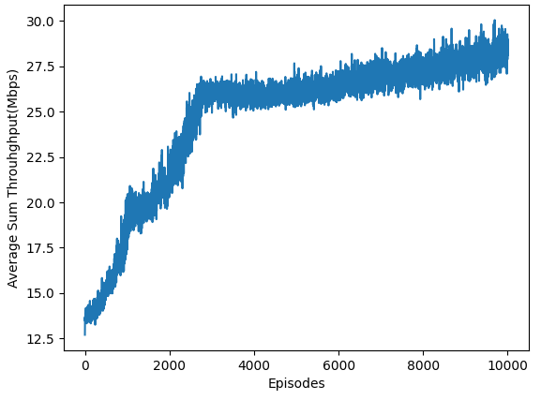
Results
gNB 1
gNB 3
gNB 2
gNB powers vs. iterations (within 1 episode) for optimal policy
Sum throughput vs. episode count.
Top: Without RL; bottom: With RL
The RL algorithm is able to “learn” the optimal power control for each state

