Slide 1

Implementing 5G Down Link Power Control Using Reinforcement Learning via NetSim-Python Interfacing
Applicable Release: NetSim v14.1 or higher
Applicable Version(s): NetSim Pro
Project download link: https://github.com/NetSim-TETCOS/RL_Based_Tx_Power_Control_v14.1/archive/refs/heads/main.zip
The URL has the configuration files (scenario, settings, and other related files) of the examples discussed in this analysis for users to import and run in NetSim

Slide 2
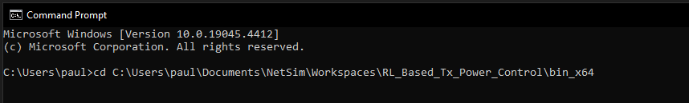
How to run the RL simulation ?
Download the project from Github link provided in slide 1.
Follow the instructions provided in the following link to setup the project in NetSim
https://support.tetcos.com/support/solutions/articles/14000128666-downloading-and-setting-up-netsim-file-exchange-projects
For the RL simulation, we first need to run NetSim using the command line interface(CLI)
Open the Run menu with Windows Key + R, then type "cmd." Press "Enter" to open Command Prompt
Note the application path. Application path is the current workspace location of the NetSim that you want to run. The default application path will be something like "C:\Users\PC\Documents\NetSim\Workspaces\\<Your default workspace>\bin_x64" for 64-bit.
Change the directory to the application path using the following command, below is an example command
>cd \<app path>

Slide 3
How to run the RL simulation ?
Type the following in the command prompt
FOR /L %i IN (1,1,<NUM_EPISODES>) DO NetSimCore.exe\<space>-iopath\<space>\<io path>\ <space>-license\<space>5053@\<Server IP Address>
\<iopath> is the path to the current scenario which needs to be run, which in this case is “RL_based_Power_Control_Sample”
\<Server IP Address> is the IP address of the system where NetSim license server is running.
<NUM_EPISODES> is the number of episodes the simulation will run for; default value is 500, below is an example command
Now, open another command prompt window and change the directory to where the python file “RL_Power_Control” is saved
Type python <filename>, in this case, filename is “RL_Power_Control” and hit enter to run the python file
The python script will ask for the number of episodes as input, enter the default value, 500 and hit enter to start the simulation

Slide 4
How to run the RL simulation ?
To change the number of episodes, we need to make two changes. First, we need to change the input we give to the python script. Second, we need to edit the looping command which we use to run NetSim. Edit the <NUM_EPISODES> variable in the command
Upon running the simulation, the python script will create two folders, named “plots” and “logs” where it will save the result plots and log files, respectively. These folders will be created in the same working directory as the python script
After the simulation, we will get 3 different plots, which will be saved in the “plots” folder. Before saving the plots, python will display the plots in separate windows for each plot. Close the individual plots after viewing them, to allow them to be saved.
In the “logs” folder, all the log files will be saved which can be used for debugging

Slide 5
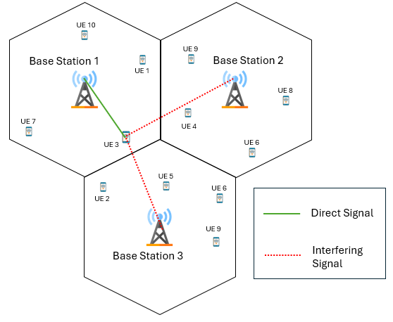
Power Control: Introduction
Due to the broadcast nature of wireless communication, signals interfere with each other.
Interference can degrade the performance of the 5G RAN
DL power control can be used to mitigate interference, ensure spectral reuse and improve user experience
However, direct application to practical systems is impaired by the dependency on various simplifying assumptions
Knowledge of channel gains from all BSs to all UEs,
Full buffer traffic,
Knowledge of user positions, number of users, resources allocated to each user etc.
In this project, we use reinforcement learning (RL) for downlink (DL) power control to mitigate interference, boost SINR and maximize sum throughput

Slide 6
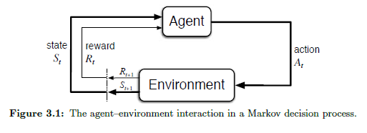
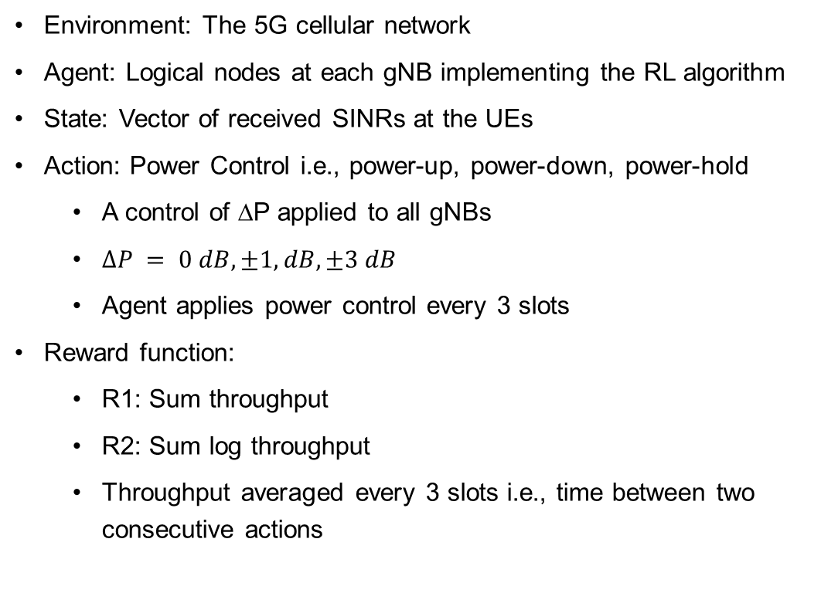
Reinforcement Learning: Tabular
Environment: The 5G cellular network
Agent: Logical nodes at each gNB implementing the RL algorithm
State: Vector of received SINRs at the UEs
Action: Power Control i.e., power-up, power-down, power-hold
A control of ∆P applied to all gNBs
$∆P = 0 dB,±1, dB, ±3 dB$
Agent applies power control every 3 slots
Reward function:
R1: Sum throughput
R2: Sum log throughput
Throughput averaged every 3 slots i.e., time between two consecutive actions

Slide 7
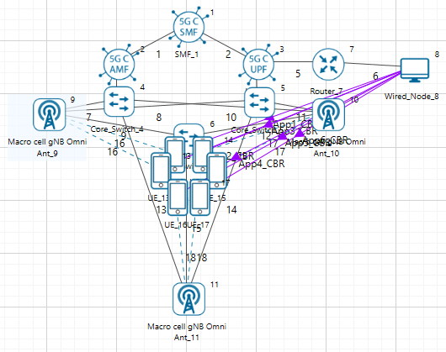
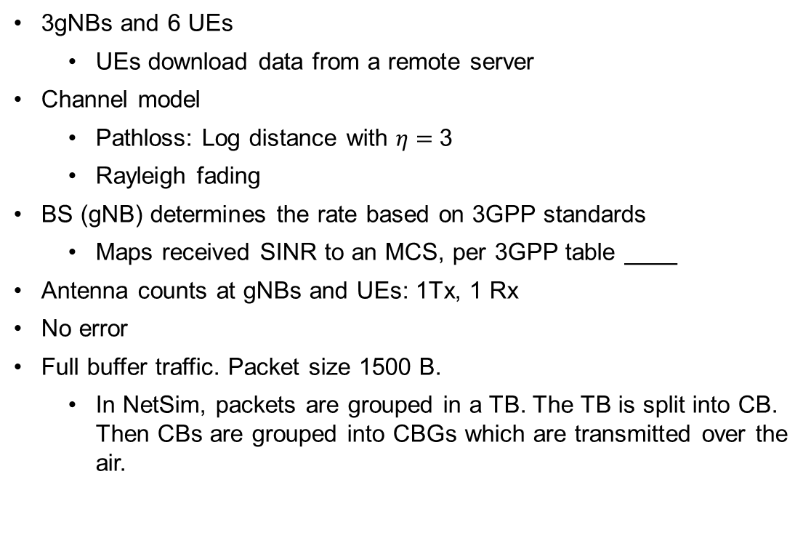
NetSim Model
3gNBs and 6 UEs
UEs download data from a remote server
Channel model
Pathloss: Log distance with $η=$3
Rayleigh fading
BS (gNB) determines the rate based on 3GPP standards
Maps received SINR to an MCS, per 3GPP table ____
Antenna counts at gNBs and UEs: 1Tx, 1 Rx
No error
Full buffer traffic. Packet size 1500 B.
In NetSim, packets are grouped in a TB. The TB is split into CB. Then CBs are grouped into CBGs which are transmitted over the air.

Slide 8
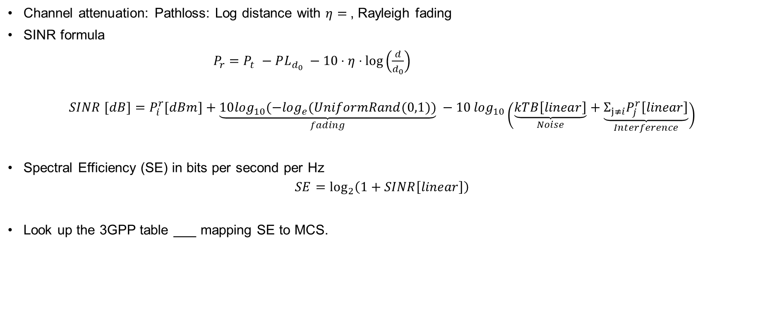
SINR and Rate
Channel attenuation: Pathloss: Log distance with $η=$, Rayleigh fading
SINR formula
$P_{r}=P_{t} −PL_{d_{0}} −10⋅η⋅log\left(\frac{d}{d_{0}}\right)$
$$SINR [dB]=P_{i}^{r}[dBm]+\underset{fading}{\underbrace{10\log_{10}(−\log_{e}(UniformRand(0,1))}} −10\log_{10}\left(\underset{Noise}{\underbrace{kTB\left[linear\right]}}+\underset{Interference}{\underbrace{{Σ_{j≠i}P}_{j}^{r}\left[linear\right]}}\right)$$
Spectral Efficiency (SE) in bits per second per Hz
$$SE=\log_{2}\left(1+SINR\left[linear\right]\right)$$
Look up the 3GPP table ___ mapping SE to MCS.

Slide 9
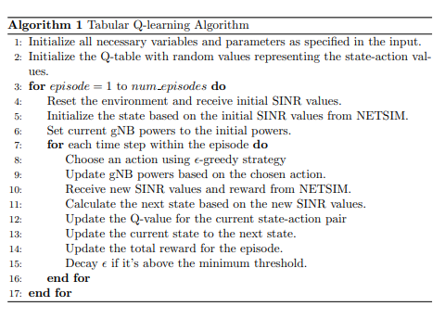
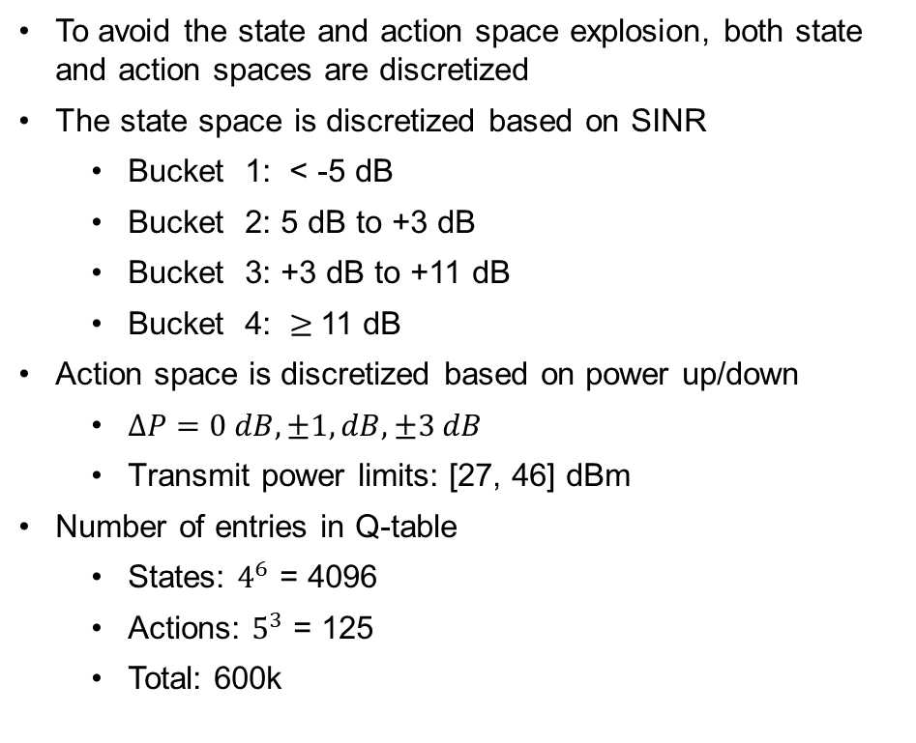
Tabular Q Learning: Algorithm
To avoid the state and action space explosion, both state and action spaces are discretized
The state space is discretized based on SINR
Bucket 1: < -5 dB
Bucket 2: 5 dB to +3 dB
Bucket 3: +3 dB to +11 dB
Bucket 4: $≥$11 dB
Action space is discretized based on power up/down
$∆P=0 dB,±1, dB, ±3 dB$
Transmit power limits: [27, 46] dBm
Number of entries in Q-table
States: $4^{6}$ = 4096
Actions: $5^{3}$ = 125
Total: 600k

Slide 10
NetSim Python Interfacing
1. Introduction to Python C Socket Interfacing:
Python facilitates seamless integration with C for socket programming tasks.
Python uses the socket module to interact with C side functions.
2. Python Code:
Python creates a client socket in the host machine and connects with the C side server
Key functions include:
def NETSIM_interface(gNB_powers):
Sends the gNB powers to NetSim with a header
Receives acknowledgement integer value from NetSim
Sends a request value to NetSim to receive the updated SINR values and the reward
Receives the next state and the reward from NetSim

Slide 11
NetSim Python Interfacing (Contd.)
C side code
Key functions include:
void init_waiting_struct_socket1() : Initializes the Winsock library and calls the listenForPython() function bool listenForPython() : Resolves the server address and port Creates a socket for connecting to the server Sets up the TCP listening socket Waits for client socket connection void handle_Send_Receive(struct SINR_Values_Reward* Param1, struct gNB_Powers* Param2)

Slide 12
NetSim Python Interfacing (Contd.)
C side code
Key functions include:
void handle_Send_Receive(struct SINR_Values_Reward* Param1, struct gNB_Powers* Param2) Receives the message type from Python If message type is to “receive gNB powers”, receives the powers from Python and sends back an acknowledgement message If message type is to “send SINRS and rewards”, sends back the state and reward back to Python using the send_SINRS_Rewards_at_Time_Step() function void send_SINRS_Rewards_at_Time_Step() : sends the list of updated SINRs and the sum throughput received from the LTENR project in NetSim back to python

Slide 13
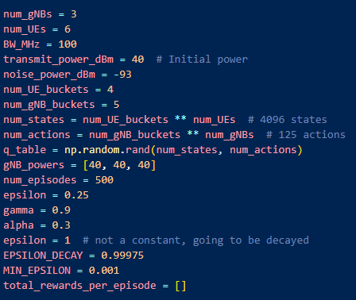
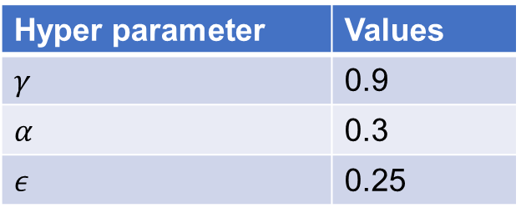
Parameters
Parameter | Value
Bandwidth | 50 MHz
Transmit Power | 40 dB
Noise Power | -96.38 dB
Path-loss exponent | 3
Hyper parameter | Values
$$γ$$ | 0.9
$$α$$ | 0.3
$$ε$$ | 0.25

Slide 14
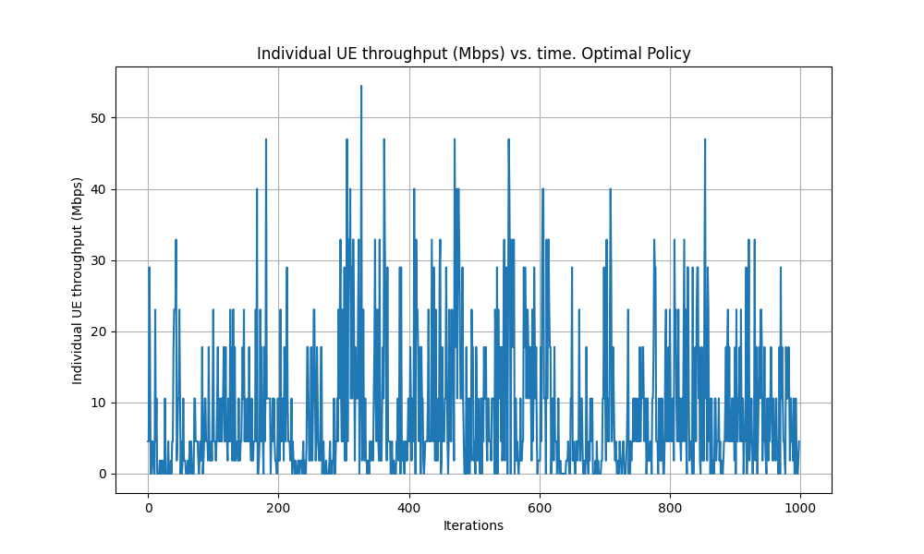
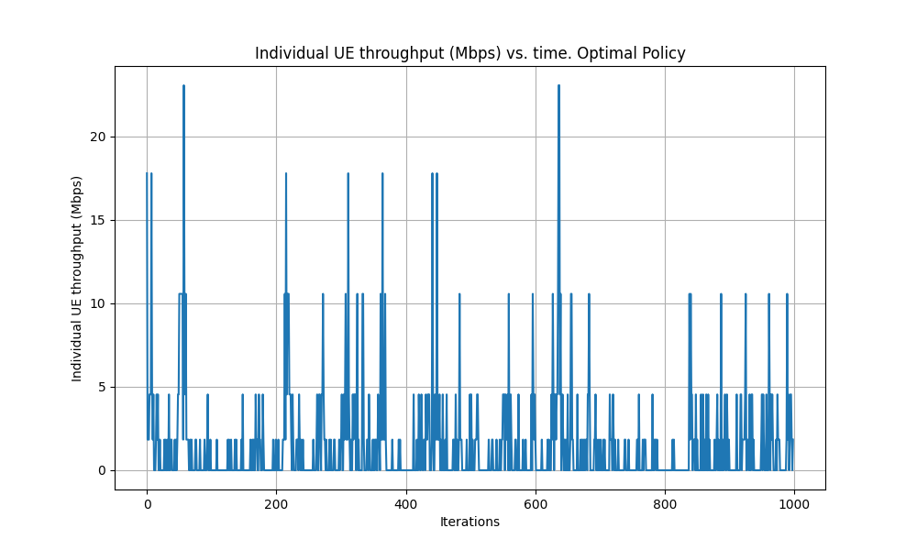
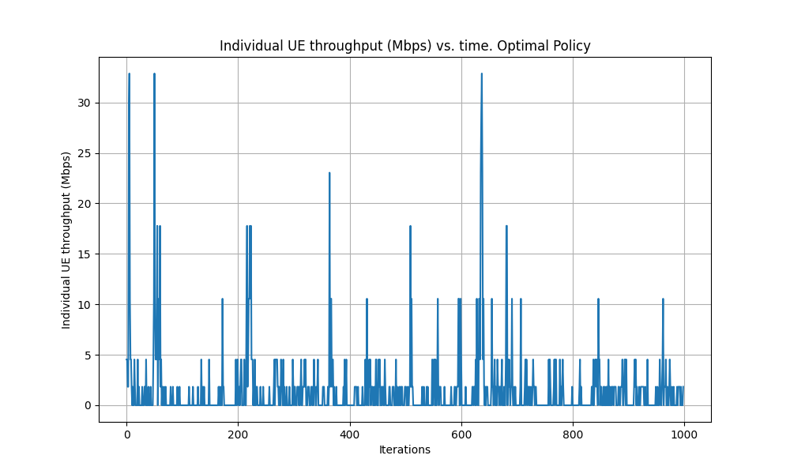
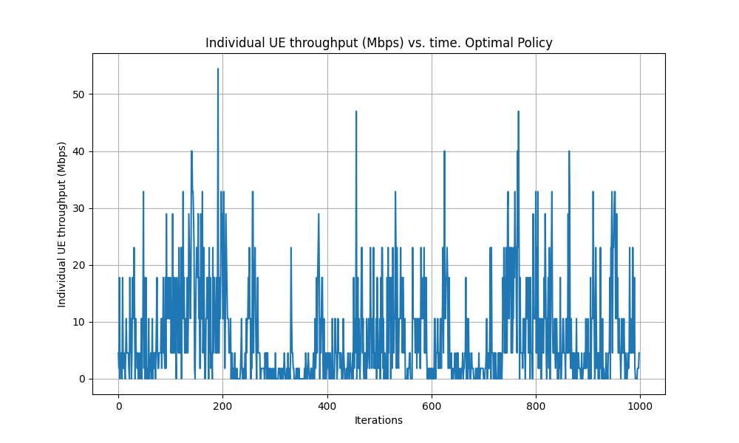
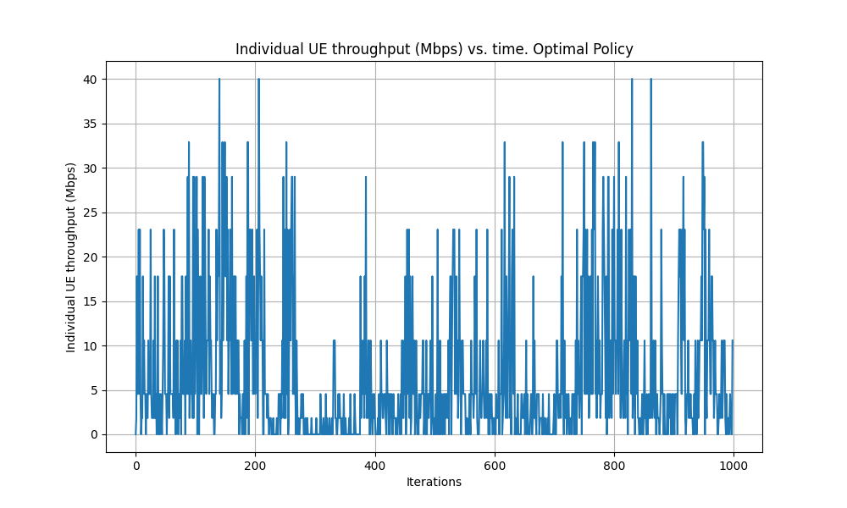
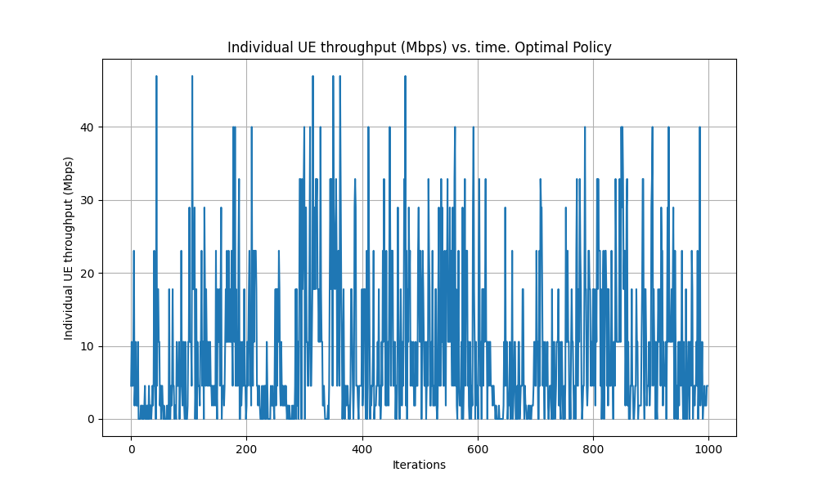
Performance Evaluation: UE Throughputs
UE1
UE2
UE3
UE4
UE5
UE6

Slide 15
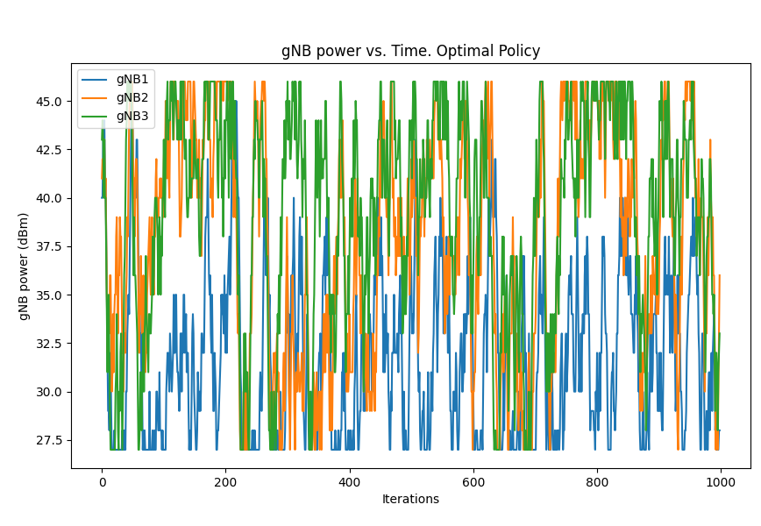
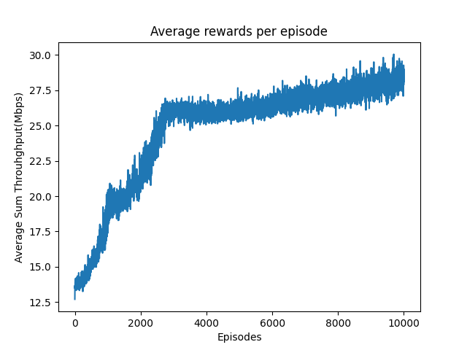
Results
GNB powers against iterations for optimal policy
Plot of average rewards for each episode

