Slide 1
query
Frontend Web Server
Super Root
News
Video
Aggregators
Web
Processes

Slide 2
Root
Aggregators
...
...
Processes
...
...

Slide 3
f₁
f₂
f₃
f₄

Slide 4
x₁
y
x₂

Slide 5
Output
Full Aggregate
Full Aggregate
Partial
Aggregate
Partial
Aggregate
Map
Map
Map
Map

Slide 6
Proportional-Split
Cedar
13.1%
12.7%
11.8%
13.4%
13.7%
13.3%
12.6%
13.0%
12.574203993524023, 12.965879265091862, 13.408393039918117, 13.670505758637967, 13.29082883766553, 13.125000000000009, 12.653446647780935, 11.838440111420
6

Slide 7
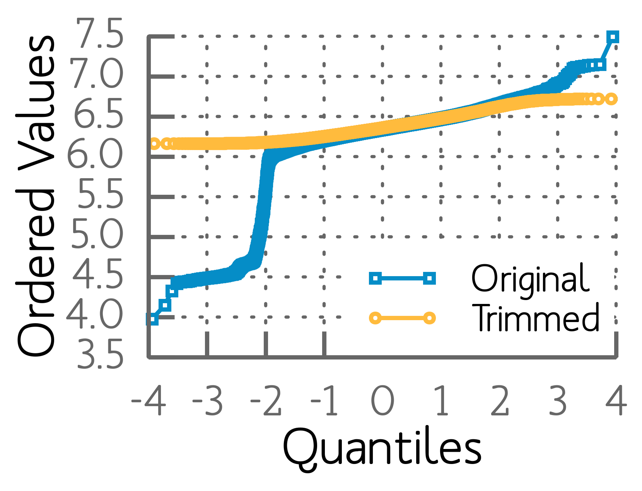
r² value = 0.99
r² value = 0.78
r² value = 0.78

