Slide 1

W³: Software Fault Detection in SDN
Colin Scott, Andreas Wundsam, Kyriakos Zarifis, Scott Shenker

Slide 2
SDN Layering
Control Application
Very simple policy specification
Global view of the network state
Virtual View
Physical View
Physical Network
Notes:
If you live in Scott Shenker’s world, SDN has a very nice layered architecture.
INTERFACES, narrow, well-defined

Slide 3
SDN/NOS Stack Assumptions
Layered controller / NOS stack
Non-trivial mappings between the layers
Virtualization
Multi-Tenancy
Distribution / replication
Fail-Over is complex!
(Mostly) proactive!
Driver for change: topology events
Notes:
If you live in Scott Shenker’s world, SDN has a very nice layered architecture.
INTERFACES, narrow, well-defined

Slide 4
SDN Debugging Challenge
Control Application
Policy: Packets Cannot go from A➞B
?
Virtual View
Where in the stack?
How did we get here?
Physical View
Physical Network
Reality: Packets do go from A➞B
Notes:
If you live in Scott Shenker’s world, SDN has a very nice layered architecture.
INTERFACES, narrow, well-defined

Slide 5
State of the Art: Logs
Painstaking correlation and manual analysis of Logfiles
Unsynchronized
Only manually parseable
Wrong granularity
➞ More powerful tools required

Slide 6
SDN Troubleshooting Opportunities
Concise, context free, global view
Direct expression of operator intent
Can serve as a policy specification
Clear, well-defined layering
Can interpose on interfaces

Slide 7
SDN Troubleshooting Ecosystem
Facilitate correct controller applications: Frenetic
Systematically explore the state-space of a controller app: NICE
Localize errors in SDN stack
Find causal event sequence
Formally model and analyze forwarding behavior: HSA
Experimentally check + troubleshoot Data-plane behavior: Dynamic checking, OFRewind
W³

Slide 8
W³: What, Where, When?
What went wrong?
SDN high level programs as invariant specification
Where in the control software did the problem develop?
Cross-Layer Correspondence Checking
When did the triggering events happen?
Simulation based causal inference
Where?
What?
When?

Slide 9
What?
Violation
Viola-tion
What went wrong?
SDN high level programs as invariant specification
Where in the control software did the problem develop?
Cross-Layer Correspondence Checking
When did the triggering events happen?
Simulation based causal inference
Where?
Viola-tion
What?
What policy violations occur?
When?

Slide 10
Where?
What went wrong?
SDN high level programs as invariant specification
Where in the control software did the problem develop?
Cross-Layer Correspondence Checking
When did the triggering events happen?
Simulation based causal inference
Where?
Where in the stack?
What?
When?

Slide 11
When?
What went wrong?
SDN high level programs as invariant specification
Where in the control software did the problem develop?
Cross-Layer Correspondence Checking
When did the triggering events happen?
Simulation based causal inference
Where?
When: Causal Sequence
of Events?
Violation
Trigger
Trigger
What?
Events
When?

Slide 12
When? (2)
When: temporary or persistent?
What went wrong?
SDN high level programs as invariant specification
Where in the control software did the problem develop?
Cross-Layer Correspondence Checking
When did the triggering events happen?
Simulation based causal inference
Where?
(temporary)
Viola-tion
Violation
What?
When?

Slide 13
W³ Mechanisms
Simulation based causal inference
Where?
Cross-Layer Corres-
pondence Checking
What?
When?

Slide 14
Talk Overview
Approach
What and Where: Correspondence checking
When: Simulation based causal inference
Architecture
Use cases
Conclusion

Slide 15
Correspondence Checking
What went wrong?
Where in the stack did the problem originate?

Slide 16
Correspondence Checking
HSA tells us:
What path will be taken by any possible input
Notes:
Well, James just showed us a really powerful tool! (HSA).

Slide 17
Correspondence Checking
Insight:
run HSA on each layer and compare
Control Application
Virtual View
Physical View
Physical Network
Notes:
But where do we get our invariants from? James mentioned a few of these invariants, “A can talk to B”.
Well, the application specifies its policies by configuring the virtual network. The virtual network is just a graph!

Slide 18
Formal Invariant
“All paths in the virtual network should have a corresponding path in the physical network”
Notes:
NOT isomorphism! The correspondence usually not going to be one to one. This is why we only care about the final location of the packet.

Slide 19
Correspondence Checking
Control Application
Virtual View
Physical View
Physical Network
Notes:
But where do we get our invariants from? James mentioned a few of these invariants, “A can talk to B”.
Well, the application specifies its policies by configuring the virtual network. The virtual network is just a graph!

Slide 20
Correspondence Checking
Control Application
Virtual View
Physical View
Physical Network
Notes:
But where do we get our invariants from? James mentioned a few of these invariants, “A can talk to B”.
Well, the application specifies its policies by configuring the virtual network. The virtual network is just a graph!

Slide 21
Causal Inference
When did the triggering events occur?

Slide 22
Causal Inference
Master
Crash
Ping
Pong
Ping
Backup
Master
Notify
Notify
ACK
Blackhole persists!
Switch
Link Failure

Slide 23
Causal Inference
Can we programmatically infer causes of a policy-violation?

Slide 24
Causal Inference
Deterministically repeat system execution (in simulator)
Replay “unexpected events” (e.g. link failures)
Iteratively prune irrelevant events

Slide 25
Minimal Causal Set
Prune event, Replay execution
Crash
Master
Ping
Pong
New Routing Table!
Backup
Link Down!
Blackhole resolved!
Switch
Link Failure

Slide 26
Minimal Causal Set
Prune event, Replay execution
Crash
Master
Ping
Pong
Ping
…
Backup
Master
Blackhole avoided!
Switch
Link Failure

Slide 27
Minimal Causal Set
Both are necessary conditions!
Crash
Master
Ping
Pong
Ping
…
Backup
Master
Link Down!
Not Master...
Link Down!
Blackhole persists!
Switch
Link Failure

Slide 28
Minimal Causal Set
?
Controller A
Switch 1
Switch 2
Switch3
Controller B
Switch 4
Switch 5
Switch 6
Controller C
Switch 7
Switch 8
Switch 9
Notes:
Now this algorithm becomes really useful when you’re running a friggin’ huge datacenter…. 8 Failures/s in a large datacenter

Slide 29
Architecture

Slide 30
Initial Case studies
Ran and found / reproduced errors in
Frenetic (Version 1)
Inconsistency caused by faulty rule housekeeping
POX
Faulty state-keeping in virtualization layer
Floodlight
Faulty failover mechanism between distributed controllers
Is your controller perfect? ☺

Slide 31
Summary / Future Work
Two approaches for troubleshooting SDNs:
Implemented in a System called W³
Future:
Run on more third-party controllers
Frenetic 2 (Netcore)
Commercial SDN controllers (Onix, Big Floodlight)
Gather library of corner-cases
Prototype on Github, try it out on your controller! https://github.com/noxrepo/sdn-debugger
Correspondence Checking
Simulation-based Causal Inference

Slide 32
Backup

Slide 33
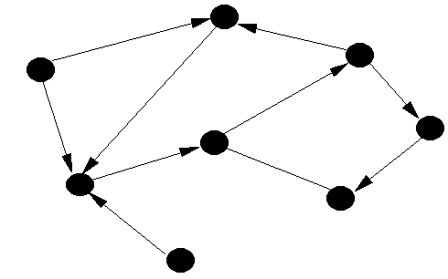
Formally
Networks:
Packets:
Switches:
0110110101101
1001101110110
10011110001…
* Peyman et al., Header Space Analysis, NSDI ‘12
Notes:
But let’s be a little more formal than that. You can think of…

Slide 34
Formally
Network Forwarding:
Network Traversal:
* Peyman et al., Header Space Analysis, NSDI ‘12

Slide 35
Formally
Network Behavior:
Notes:
What we really care about is the behavior of the network. This is just a mapping, from packets and edges, to their final destinations. Basically the set of all possible paths.

Slide 36
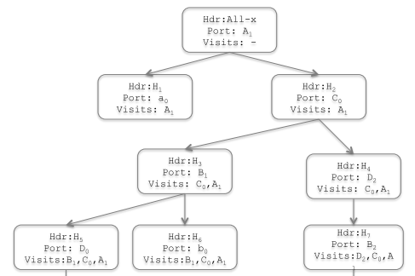
Checking Correspondence
Take snapshot of
Compute
Compute
For each access link
Insert symbolic packet
Iteratively apply
Check
}

Slide 37
SDN Layering
Control Application
Virtual View
Physical View
Physical Network
Notes:
Back to SDN: like I mentioned before, layered architecture. At each layer is a representation of the network state. These are just graphs!

Slide 38
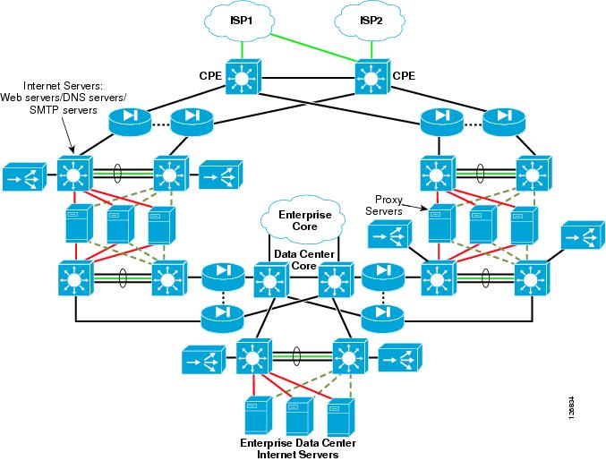
Reality
Huge Scale
Completely Distributed
Highly Dynamic
Heterogeneous
Virtualized
Multi-tenant
….

Slide 39
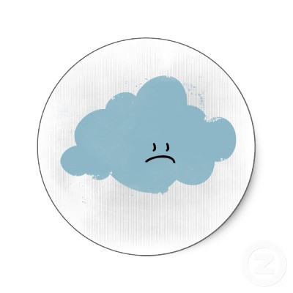
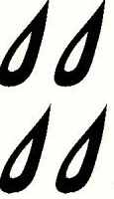


Reality
Inconsistencies
are everywhere!
Notes:
Unlike a tightly meshed cluster, where failures are relatively rare… Networks will ALWAYS be inconsistent.
In our world, it’s a fact of life that it will be inconsistent!!! When do we reach a point when this breaks our system?
What pushes your system over the edge?
So, how bad is it? Does it matter? What can we do about it?
Not necessarily a bad thing, but it can be!
NOT binary!

Slide 40

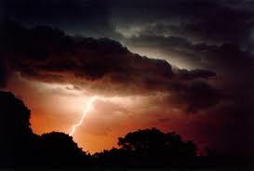
Research Question
How do pernicious inconsistencies come about?
How do they differ from benign inconsistencies?

Slide 41
What we’ll need from the network
Policy specification
Global view of network state
Notes:
These tools require two things from the network. To calibrate the barometer, we need some notion of how the network is supposed to behave. And for the lightning rod to be tractable, we’re going to need to a global view of the network state.

Slide 42
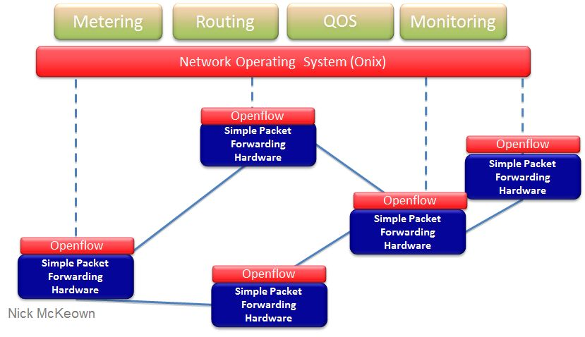
Software-defined Networking

Slide 43
Barometer Wrap Up
Mechanism to detect inconsistencies at a particular point in time.
Now what?

Slide 44
Lightning Rod
Notes:
This is a really high-level depiction of our system. Essentially what we’re going to do is simulate the entire execution of the physical network. In a single process, we model switches in the network. We then run control servers on top of this, but we interpose on all of the communication channels.
Mechanisn to explore those research questions! Not a software artefact….
Mark properties: delay, re-ordering, failure modes, ….

Slide 45
Using the Lightning Rod
Insert input traffic. Either:
Fuzzed
Production traces
Manipulate events:
Cause delays, drops
Induce failures
Filter out irrelevant events
Track inconsistencies
t₀
t₁
t₂
Notes:
So the way a network operator might use this…

Slide 46
Putting it all together
Goal:
Understand inconsistencies in the network
Barometer: “Invariant checker”
Infer inconsistencies at any point in time
Lightning Rod: “Simulator”
Explore system executions
Enabled by observation: SDN provides layering

