Slide 1


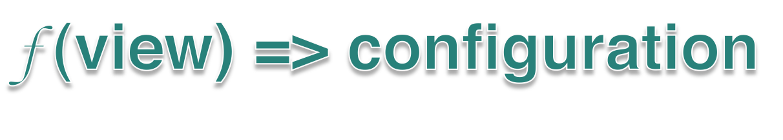
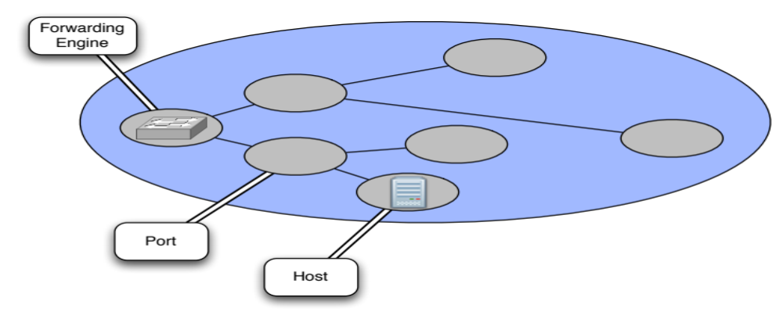

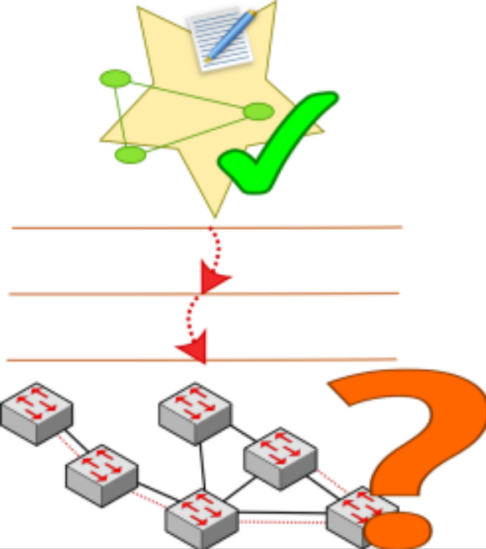

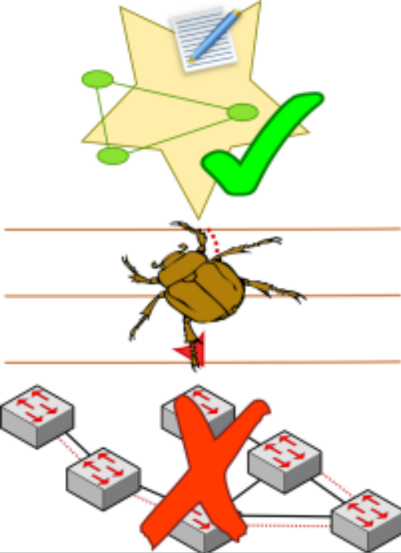

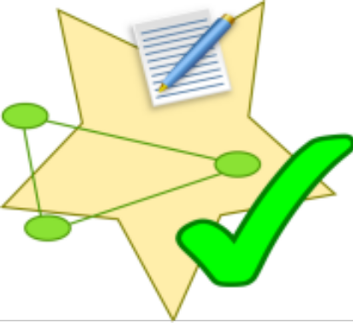

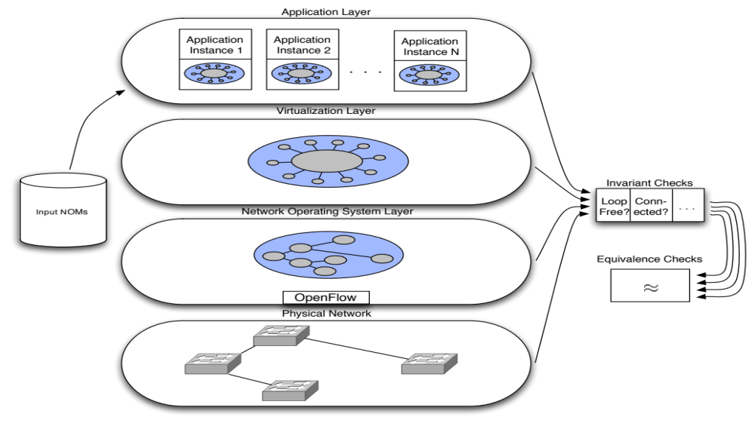

Detecting Network Invariant Violations with CLINT
Colin Scott, Justine Sherry
Software-Defined Networking (SDN) control applications are functions over an abstract network view
SDN platform manages network configuration for applications
Application sees a simple data structure representing the network
Applications configure the network by manipulating view entities
View may represent physical or virtual entities
Abstractions facilitate concise specifications of behavior
Easy to reason about state
Additional ‘distance to the metal’ makes it difficult to understand low-level behavior
Platform is complex
Bugs in platform affect behavior of control applications
Goal: mechanism to detect invariant violations in all layers of SDN stack
Approach and Insights:
Treat applications as black boxes: feed in views, and record output.
State space of relevant inputs is tractable (virtualized views are intentionally simple)
Well-defined interfaces
between layers allows us to check each layer separately.
Check invariants by traversing well-defined data structure (view)
Check correspondence of each layer to ensure network behaves as application intends
Pre-defined
User-defined
Platform consistency
Applicable to all networks, e.g.,
Loop-freeness
Graph connectivity
Application specific, e.g.,
ACL placement requirements
Link utilization limits
“Network should do what the application tells it to”. Verify by checking correspondence of layers
Current Work
Bug reports from Nicira (SDN startup)
Pipeline built for single control server topology
Evaluating on third-party applications
Future Work
Resolve consistency bugs between control servers (really hard!)
Improve visibility of virtualization details

