Slide 1
Ctrlr 1
Ctrlr 2
Test Orchestrator
Sw1
Fuzzer
Sw2
Sw3
Bug Checker
Coordinator
Log Manager
Host 1
Host 2

Slide 2
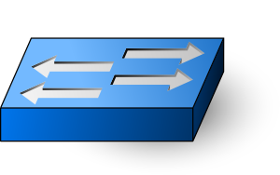
Controller 1
Controller N
Mock Network
= Interposition

