Slide 1

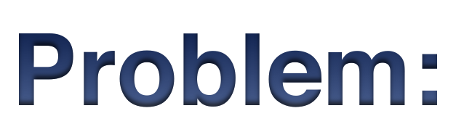
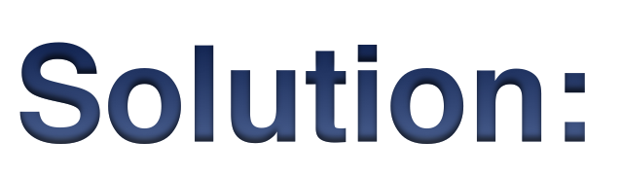

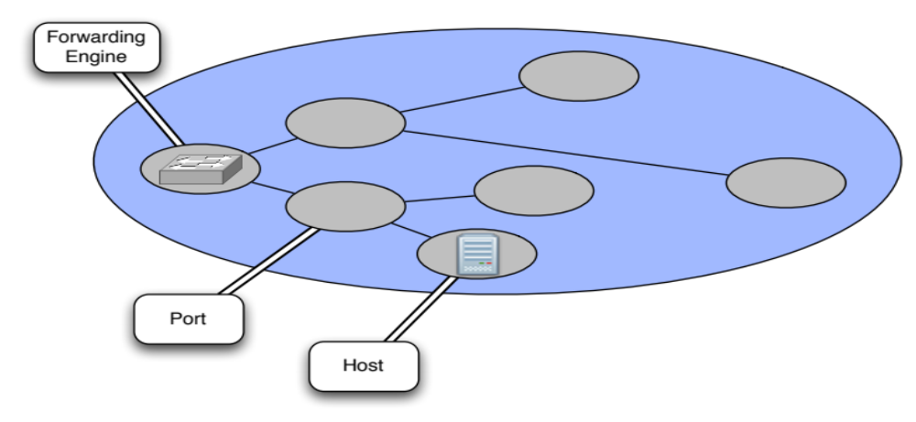
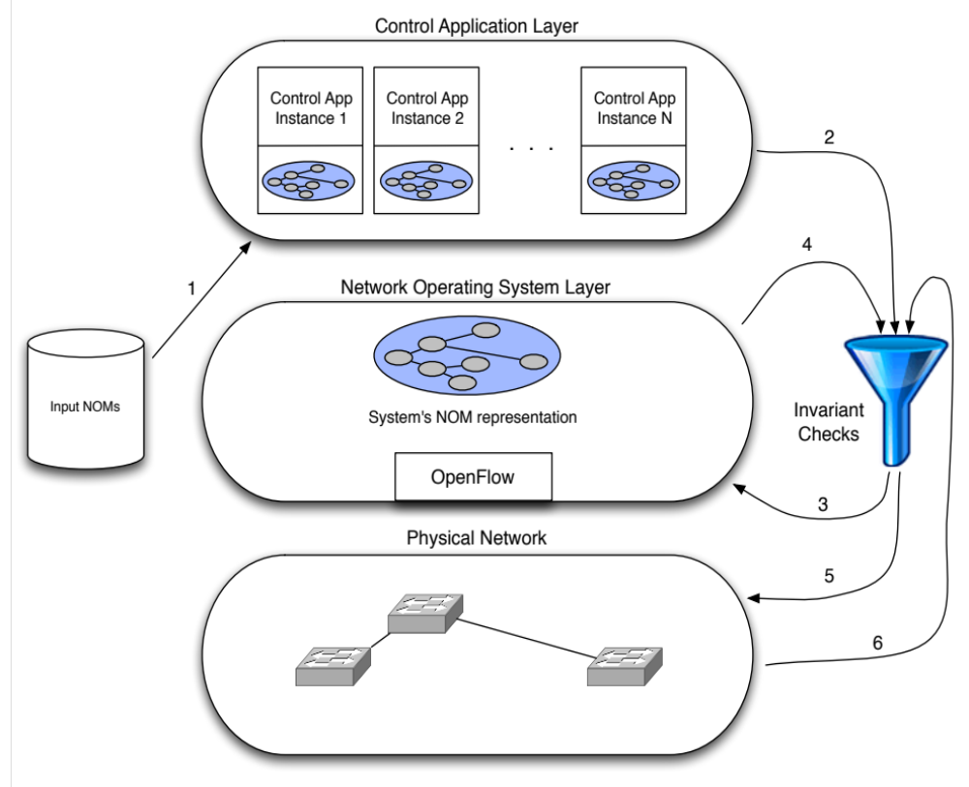
Enforcing Network Invariants with Gerasimus
Colin Scott, Andi Wundsam, Justine Sherry, and Scott Shenker
Aggregate network behavior is difficult to reason about
Network code is highly complex
} ->
Bugs and misconfigurations are common
Testing and debugging is much harder than it should be
Software-Defined Networking (SDN) abstractions allow us to enforce invariants
Ideal SDN control applications are simply functions:
View encapsulated in the Network Object Model (NOM):
  - Predefined entities (e.g. Forwarding Engine, Port, Host)
  - Handlers for abstract event types (e.g. PortDown, PacketIn)
Applications configure the network by examining and
manipulating entities in the NOM
This allows us to treat the control application as a black-box:
“Fuzz test” the application with successive
input NOMs
Check output configuration against
invariants
Feed configuration to platform
Check internal platform state against
invariants
Feed configuration actions to network
Check device state against
invariants
Verify that platform state matches output
configuration
Verify that device state matches output
configuration

