Slide 1


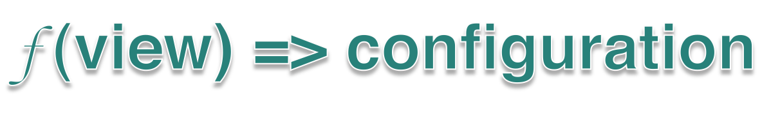
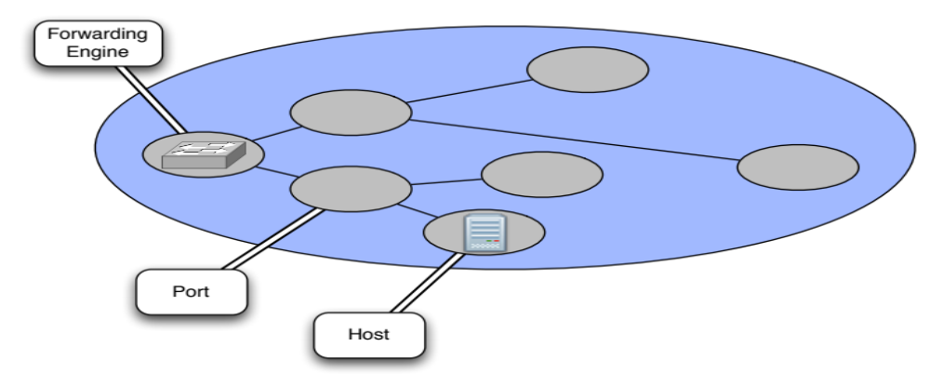

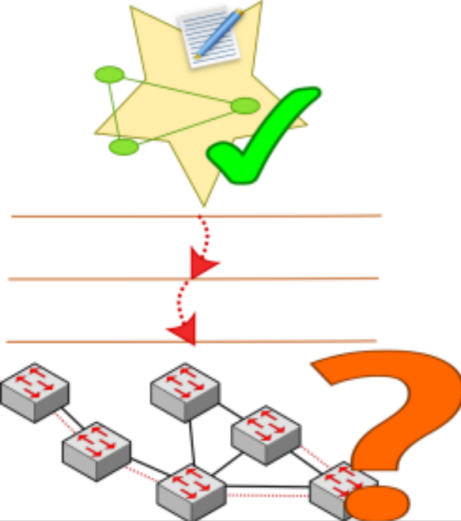

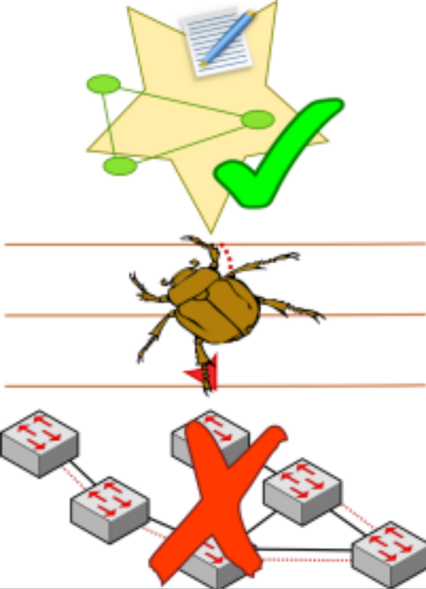

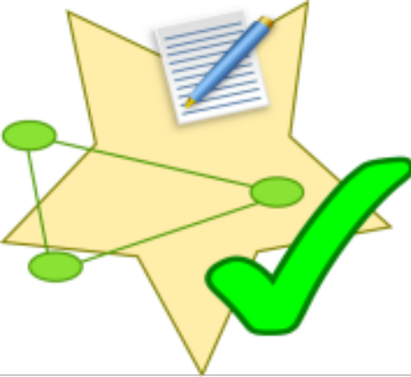

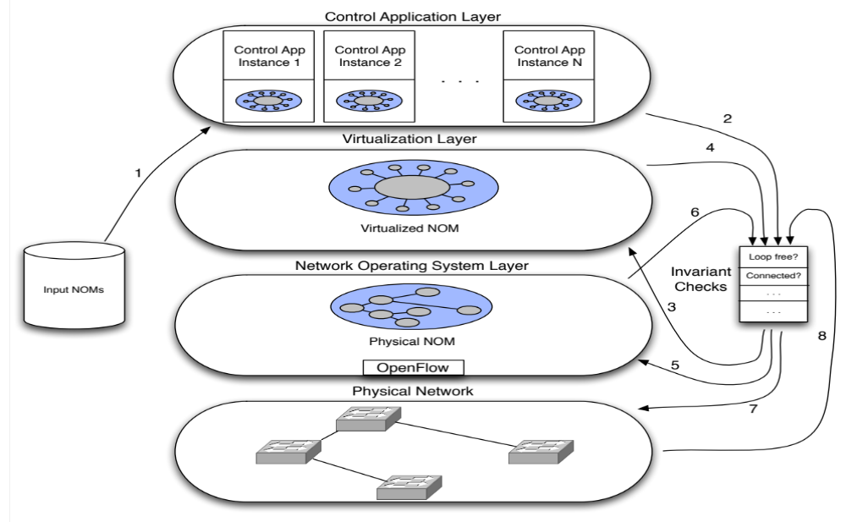

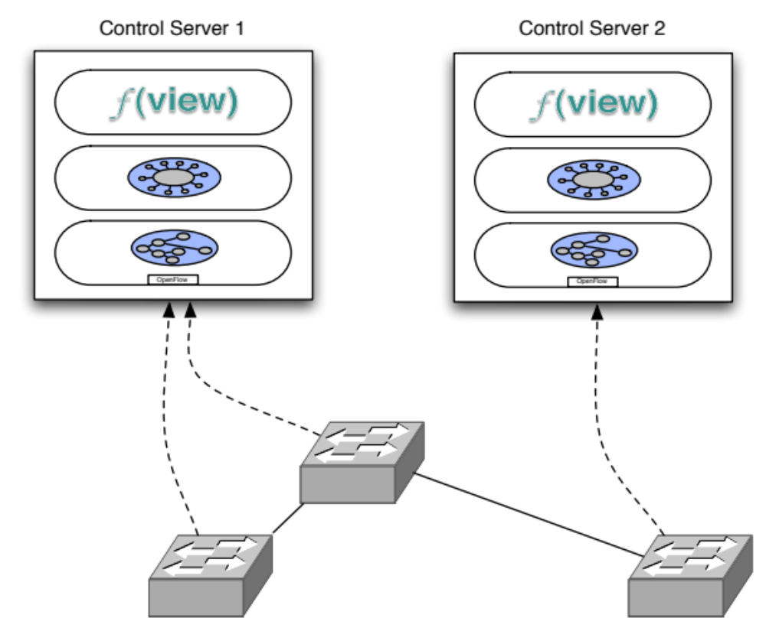
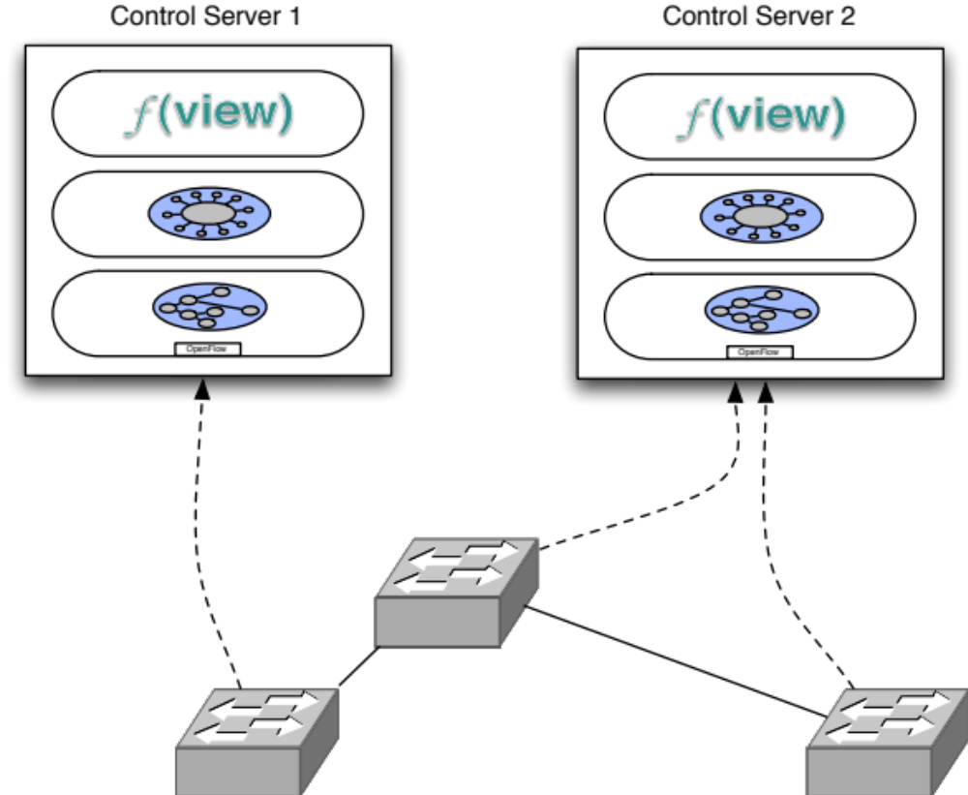
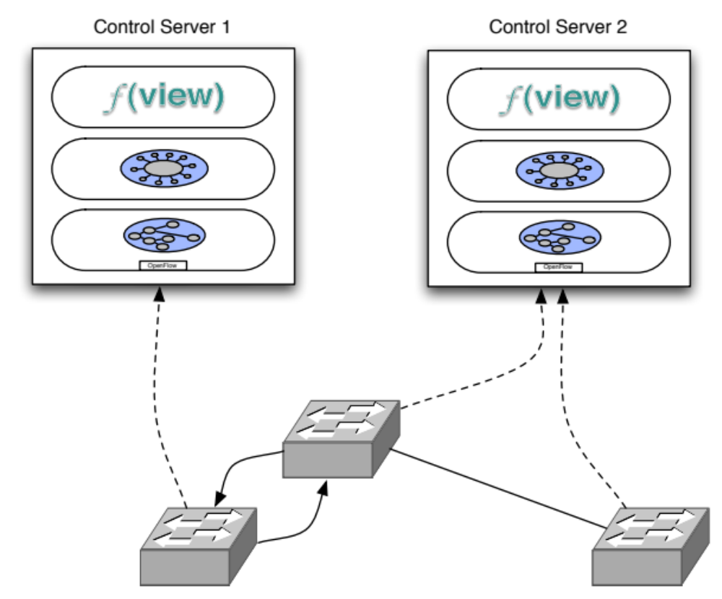

Detecting Network Invariant Violations with CLINT
Colin Scott, Andreas Wundsam, Justine Sherry, and Scott Shenker
Ideal Software-Defined Networking (SDN) control applications are simply functions:
View encapsulated in the Network Object Model (NOM):
  - Predefined entities (e.g. Forwarding Engine, Port, Host)
  - Handlers for abstract event types (e.g. PortDown, PacketIn)
NOM can represent either physical or virtual entities
Applications configure the network by examining and
manipulating entities in the NOM
Abstractions facilitate concise specifications of behavior
Easy to reason about state
Additional distance to the metal makes it difficult to understand low-level behavior
Platform itself is complex
Bugs in platform affect behavior of control applications
Treat the control application as a black-box:
“Fuzz test” the application with successive input NOMs
Feed output of each layer as input to the subsequent layer
Check invariants at every level
Verify each layer’s state matches the expected configuration given by the control application
1. Mock sharded network
2. Simulated failure causes switch
to connect to different control server
CLINT detects forwarding loop. Cause identified as an inconsistency between controllers, triggered by bug in the platform

