Slide 1


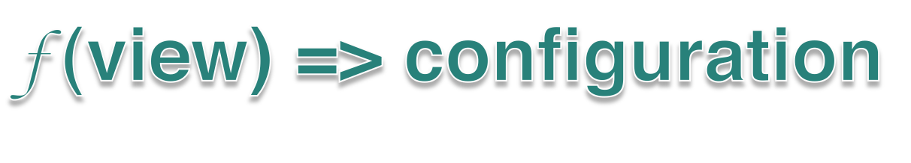
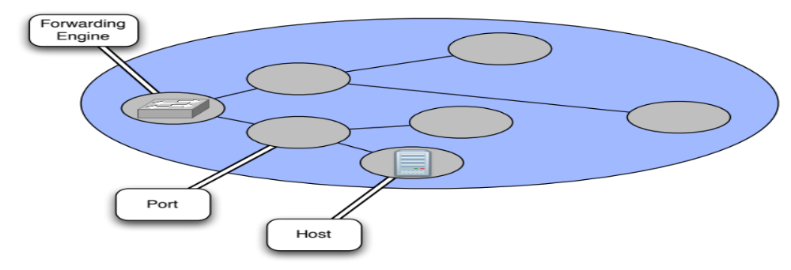

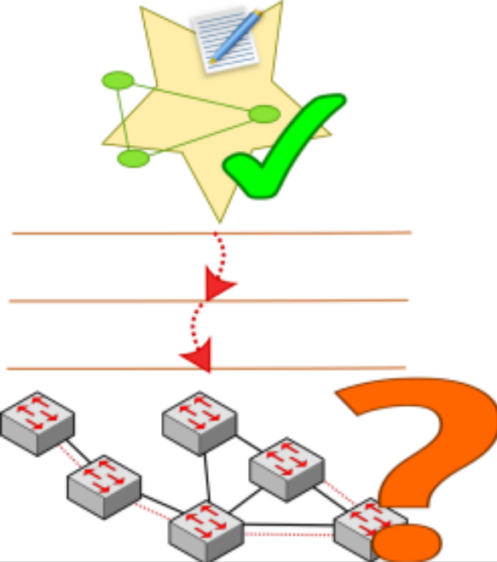

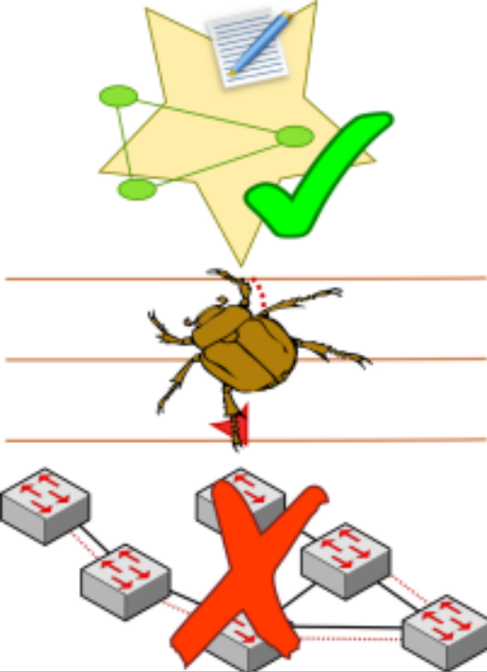



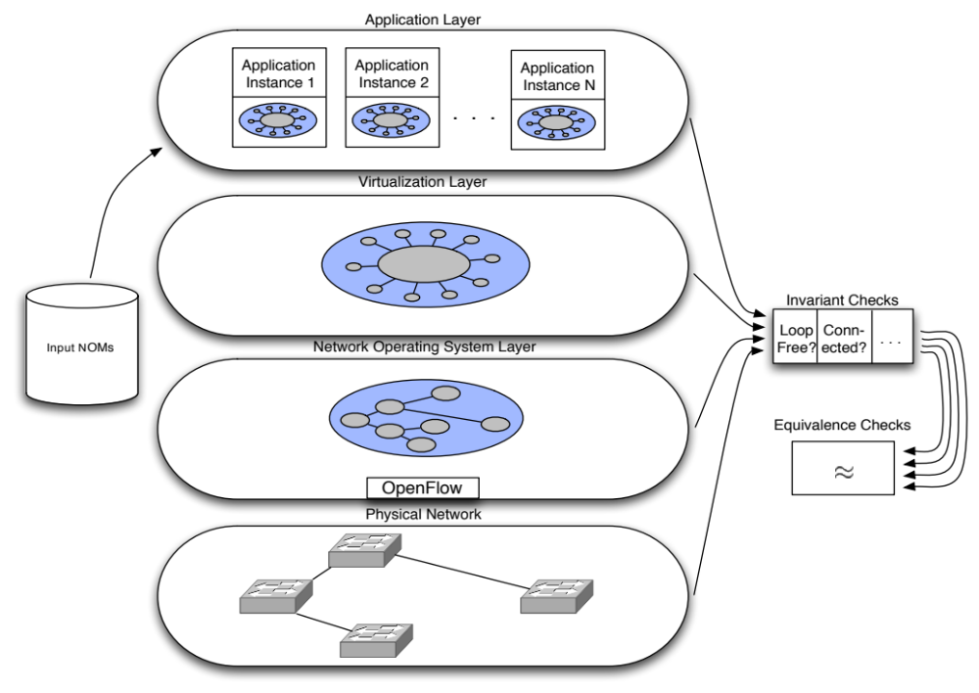

Detecting Network Invariant Violations with CLINT
Colin Scott, Andreas Wundsam, Justine Sherry, and Scott Shenker
Software-Defined Networking (SDN) control applications are simply functions:
View encapsulated in the Network Object Model (NOM):
  - Predefined entities (e.g. Forwarding Engine)
  - Handlers for abstract event types (e.g. PortDown)
NOM may represent physical or virtual entities
Applications configure the network by examining and
manipulating entities in the NOM
Abstractions facilitate concise specifications of behavior
Easy to reason about state
Additional distance to the metal makes it difficult to understand low-level behavior
Platform itself is complex
Bugs in platform affect behavior of control applications
Takeaway: need mechanism to verify all layers of SDN stack for any given control application
Key insights:
Since applications are functions, we can treat them as black boxes: feed in NOMs, and record output
Virtualized NOMs are intentionally simple, so the state space of relevant inputs should be tractable
Well-defined interfaces between layers allows us to test each separately
Well-defined datastructure (NOM) allows easy testing of invariants
Application output represents expected behavior of network -> verify equivalence of each layer to intended configuration
Pre-defined
User-defined
Application-derived
Some invariants apply to all control applications. For example:
Loop-freeness
Graph connectivity
Per-packet routing consistency
Application developers may define their own invariants, such as:
ACL placement requirements
Link utilization caps
Minimum redundancy levels
Expected behavior of the network is codified in the application’s output.
Equivalency checks translate between each layers’ representation of configuration state, and verify correspondence.

