Slide 1


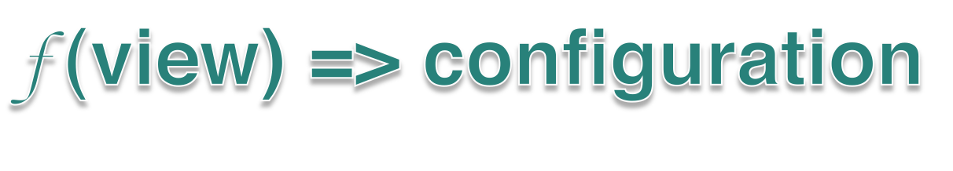
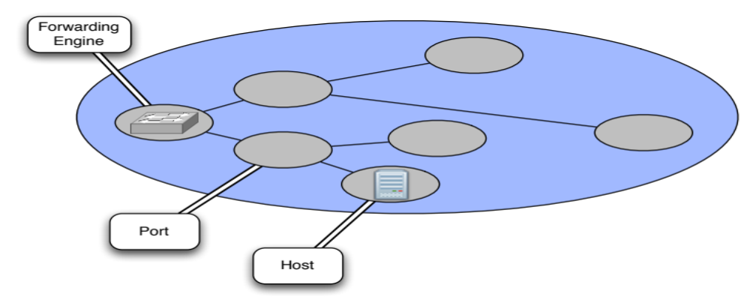

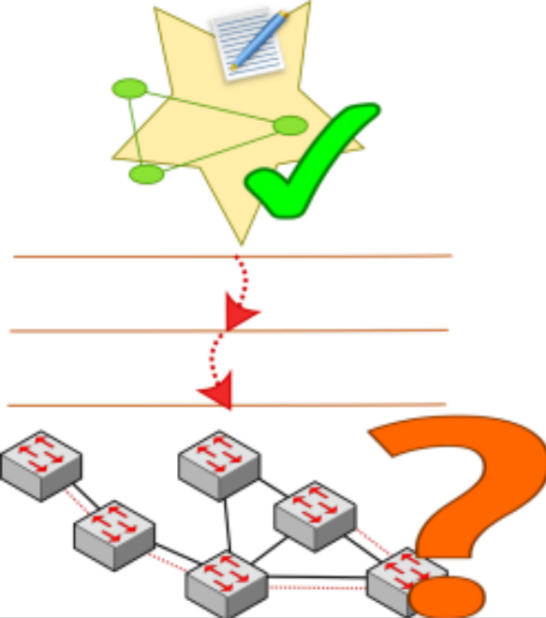

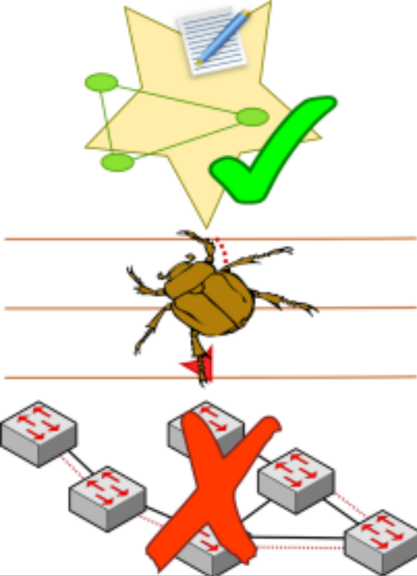



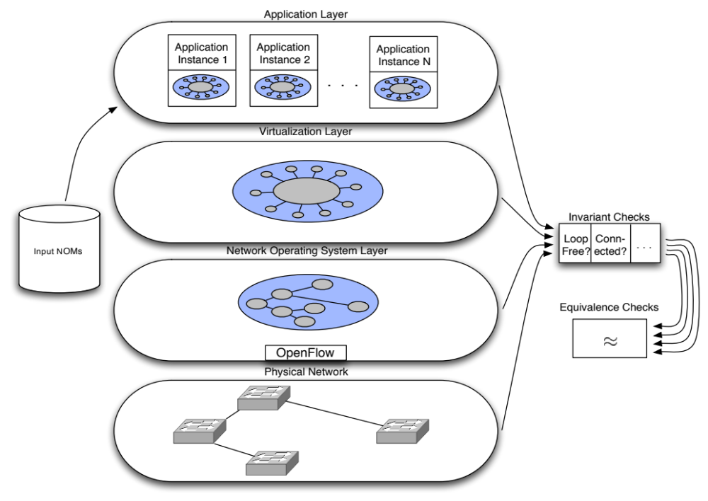

Detecting Network Invariant Violations with CLINT
Colin Scott, Andreas Wundsam, Justine Sherry, and Scott Shenker
Software-Defined Networking (SDN) control applications are functions over an abstract network view:
View encapsulated in the Network Object Model (NOM):
  - Predefined entities (e.g. Switch, Port)
  - Handlers for abstract event types (e.g. PortDown)
NOM may represent physical or virtual entities
Applications configure the network by examining and
manipulating entities in the NOM
Abstractions facilitate concise specifications of behavior
Easy to reason about state
Additional distance to ‘the metal’ makes it difficult to understand low-level behavior
Platform itself is complex
Bugs in platform affect behavior of control applications
Goal: mechanism to verify all layers of SDN stack for any given control application
Key insights:
Since applications are functions, we can treat them as black boxes: feed in NOMs, and record output. Later, check that output conforms to expected invariants.
Virtualized NOMs are intentionally simple, so the state space of relevant inputs is tractable
Well-defined interfaces between layers allows us to check each layer separately.
Well-defined data structure (NOM) makes invariants easy to test
Application output represents expected behavior of network; verify correspondence of each layer to intended configuration
Pre-defined
User-defined
Application-derived
Some invariants apply to all network control applications. For example:
Loop-freeness
Graph connectivity
Per-packet routing consistency
Application developers may define their own invariants, such as:
ACL placement requirements
Link utilization limits
Minimum redundancy levels
Expected behavior of the network is codified in the application’s output.
Translate between each layer’s representation of configuration state, and verify correspondence.

