Slide 1

Media
You

Slide 2
►
►
You

Slide 3
♪
You

Slide 4
☻
You

Slide 5
You

Slide 6
►
You

Slide 7
♪
You

Slide 8
☻
You

Slide 9
You

Slide 10
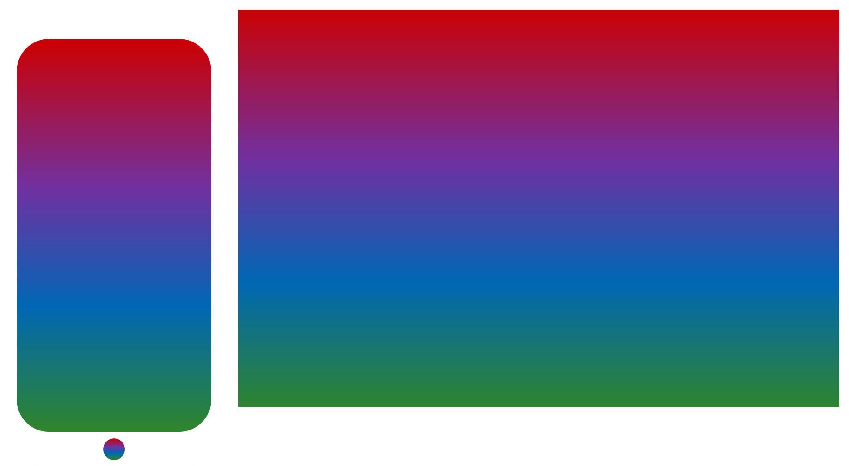

Slide 11

✓

Slide 12



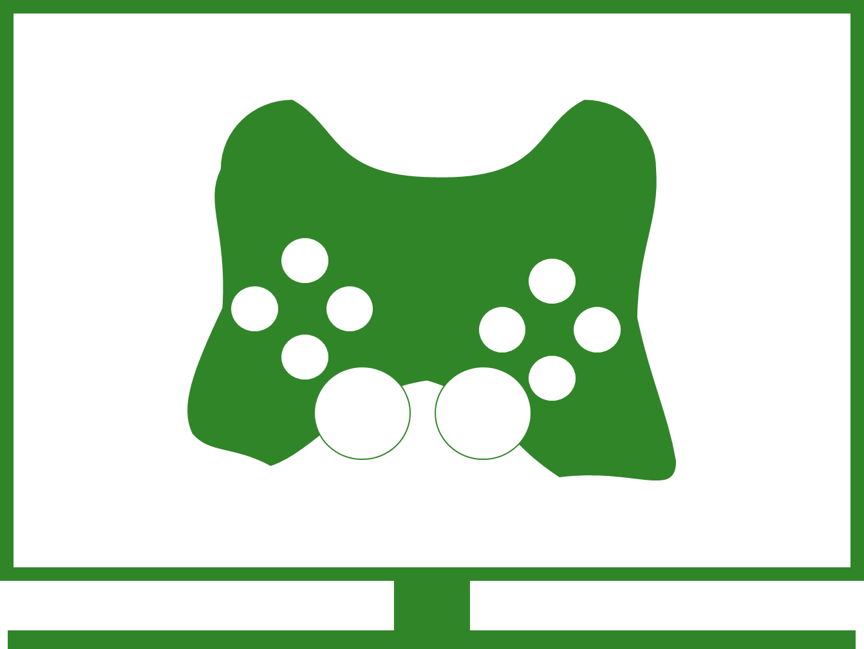
Videos
music
pictures
games

Slide 13

Videos
music
pictures

Slide 15
Media
You
Mediactor
You

