Slide 1
Parsons Problem
Project Guide
Mr. N. Venkatesh
V. Jayasri - 20VV1A0559
S. Netaji Sai Akash - 20VV1A0550
T. Jaswanth - 20VV1A0555

Slide 2
Agenda:
Introduction
Methodology
Algorithm
System Flow
Outcomes

Slide 3
Problem Statement:
Parsons problems are a type of coding exercise where the code is provided but is disordered, and the task is to rearrange the code segments to form a correct solution.
In light of the transformative influence of Large Language Models (LLMs) on various methods of assessing student competencies, it is noteworthy that Parson Problems offer a distinctive means for gauging skillsets, presenting a valuable alternative to the evaluation methodologies associated with LLM models.

Slide 4
What is Parsons Problems?
A Parson’s Problem is a task in which learners are given all of the blocks or lines of code needed to solve a problem, however, the lines have been jumbled so that they are no longer in the correct order. Learners are asked to reorganise the code into the correct order to perform a specific task.

Slide 5
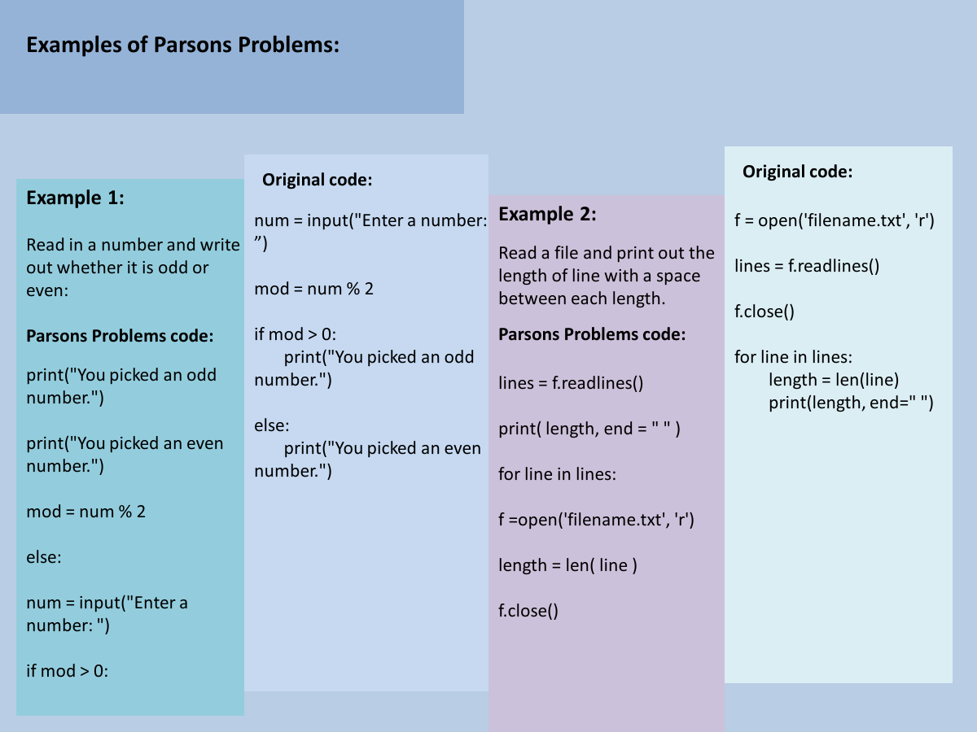

Slide 6
Why are they needed ?
With the evolution of language models, there arises a perspective that negates the necessity of instructing students the syntax. The contention is that if a student possesses a sound understanding of logic, they can leverage language models to generate code. Consequently, there is a proposition to reform the teaching methodology, shifting the focus from teaching syntax to emphasizing logical principles.

Slide 7
Methodology
1.Fixing the definition of Target Statements(for effective parson problem generation)
2.Dividing the code into blocks based on the target statement
3.Adding Distractors to the Divided Target statements to introduce levels of difficulty
4.Designing Web Interface
5.Integrating the code to web interface
6.Evaluating based on the test cases rather than order of target blocks
7.Feedback mechanism

Slide 8
Need of definition for target statement:
Need of Target Statement Definition:
Normal parson problem consider single line as block and jumbles the code.There is no guarantee that the question of equal hardness is produced. So, there is a need to identity the definition of target blocks in the code to ensure that the parson problem generated is same level of hardness and which enhances the logic building

Slide 9
Target Statement Definition
Target Statements Fixed:
Fixing the target Statements:
1.All independent statements are one target block
2.Conditional statements are one Target block
3.Functions are one Target block
4.Classes are one Target block
5.Exception handling constructs are one Target block

Slide 10
1.All independent statements are one target block
Example:
int i=0; ------>Target1
print(“Hello”)------->Target2
2.Conditional statements are one Target block
Example:
if day == 0: |--Target-1
print(" ", end="") |
else: |--Target-2
print(f"{day:3}", end="") |

Slide 11
3.Functions are one Target block
Example
def generate_subarrays(arr): |--Target-1
n = len(arr) |
ans = [] |
for i in range(n): |--Target-2
subset = [] |
for j in range(i, n): |--Target-3
subset.append(arr[j]) |
ans.append(subset.copy()) |
return ans --Target-4

Slide 12
4.Classes are one Target block
class FileManager: |--Target-1
def __init__(self, directory): |--Target-2
self.directory = directory
def read_lines(self, filename): |--Target-3
5.Exception handling constructs are one Target block
def divide(x, y): |--Target-1
Try: |--Target-2
result = x // y |
print("Yeah ! Your answer is :", result) |
except ZeroDivisionError: |--Target-3
print("Sorry ! You are dividing by zero ") |

Slide 13
Distractors for introducing difficulty
Missing Indentation
Adding extra target blocks with minute differences so that they need to choose which one os correct

Slide 14
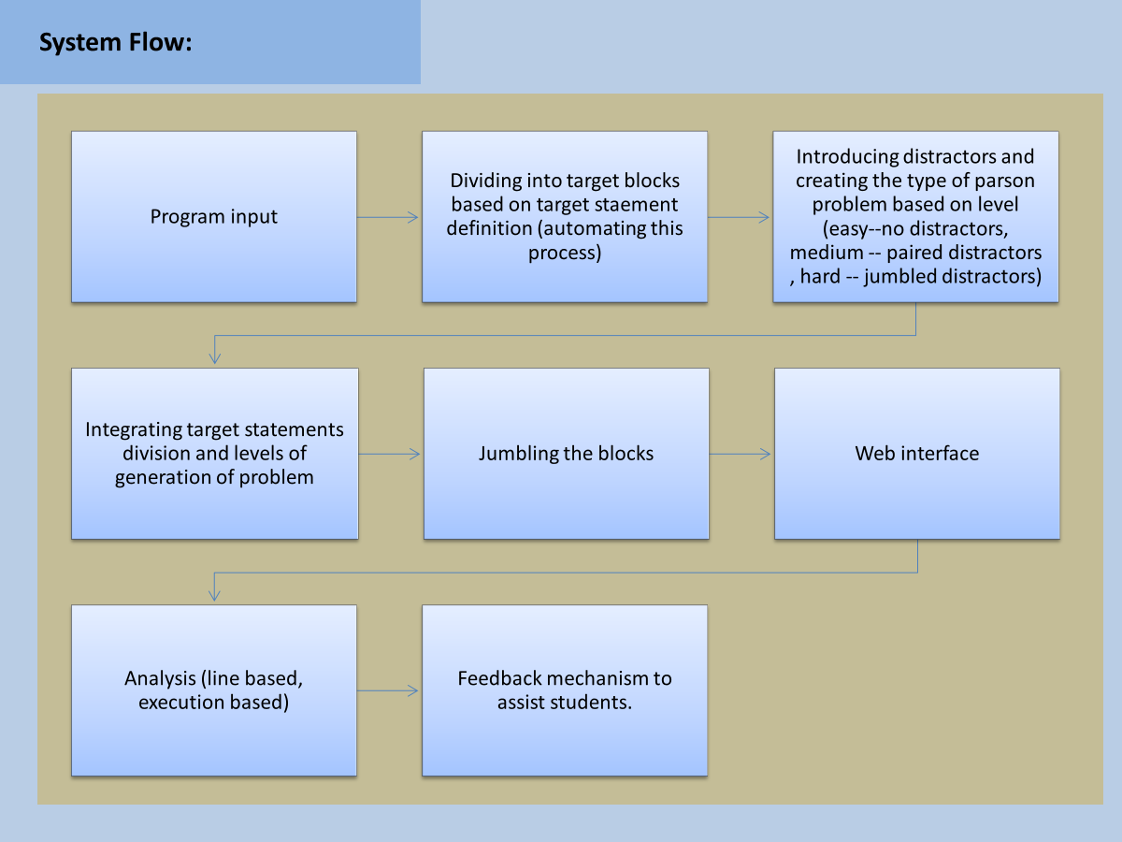

Slide 15
Our Progress:
Analysed various codes and fixed target statement definition
Started automating the process of dividing the code into target Statements
Started Web interface Design

Slide 16
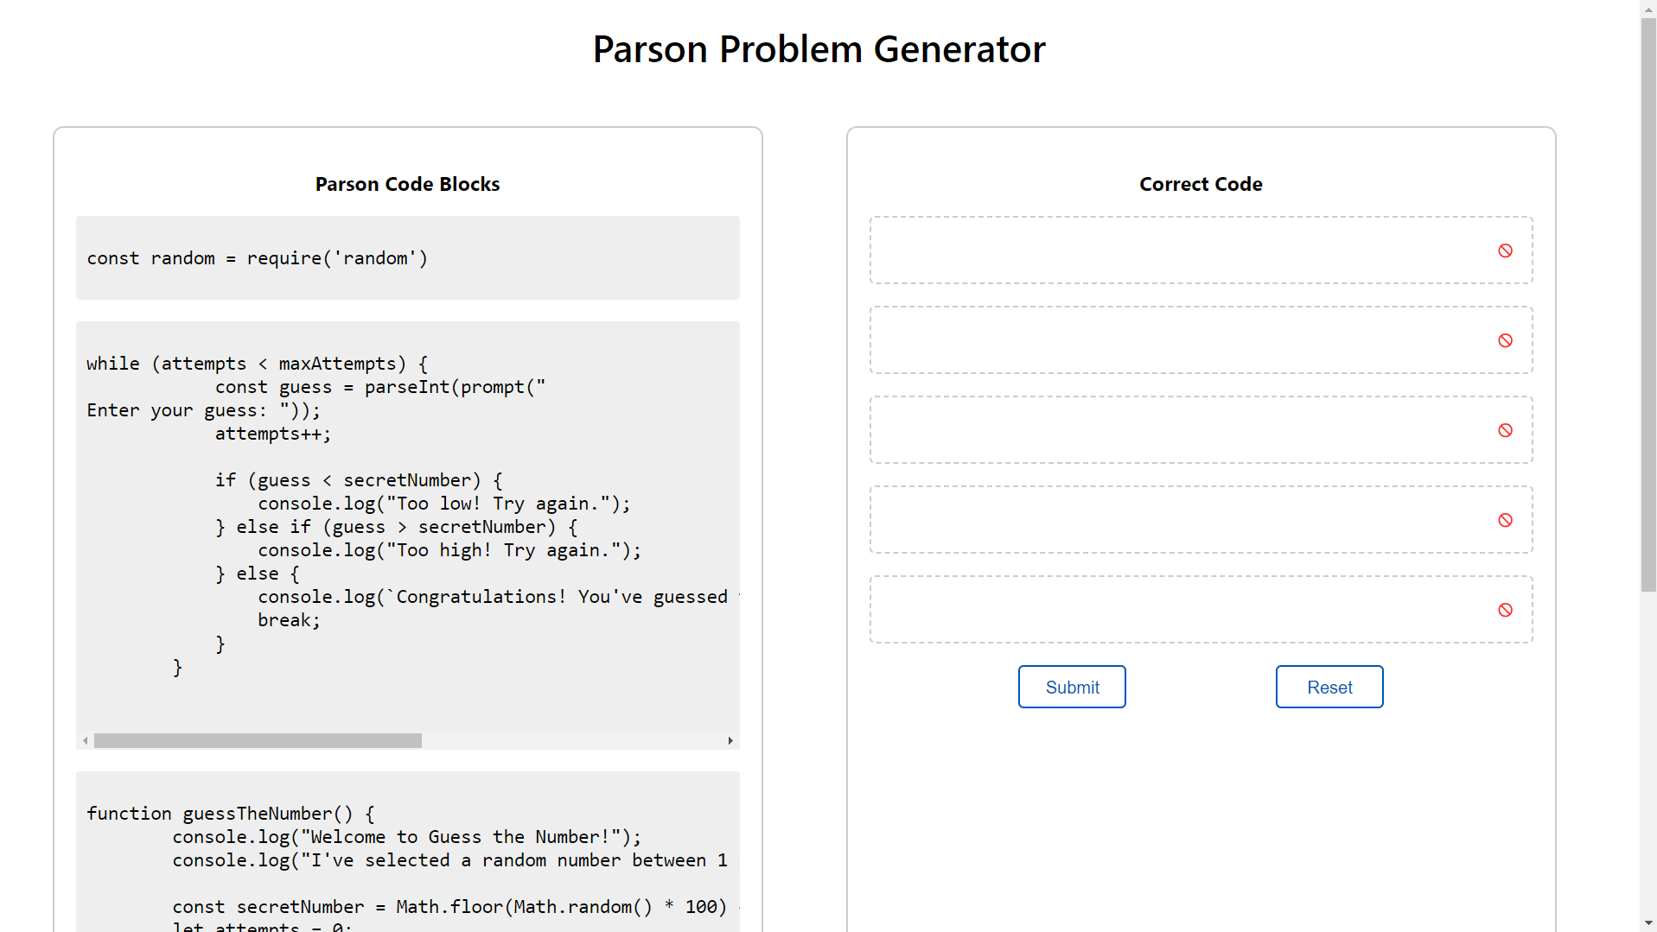
Web Interface:

Slide 17
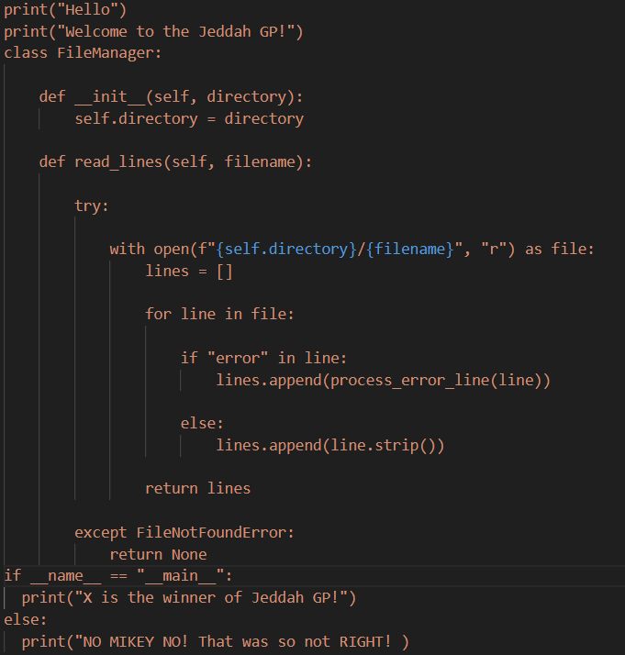
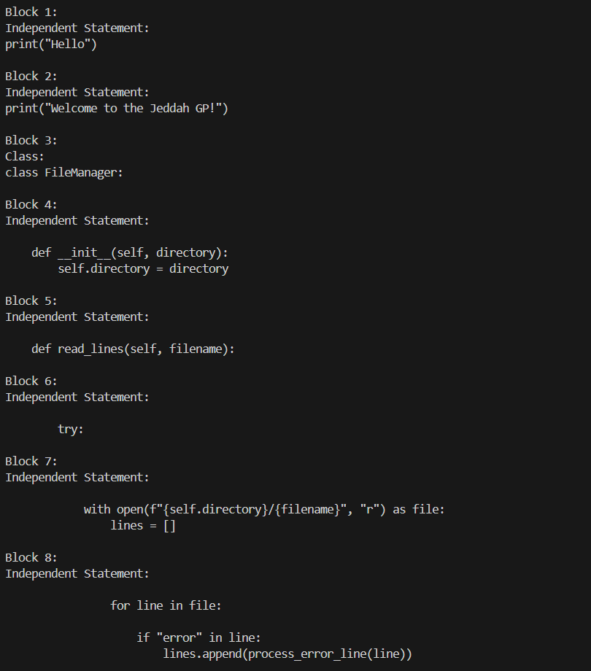
Example Code Block division

Slide 18
Thank You

