Slide 1

⌂
01
BH AI DECISION SUPPORT
From Opinion
to Evidence
A decision-support workflow that combines internal precedent, current site evidence, external research and scenario modelling — while keeping the consultant in control.
- Netal Chandak
HUMAN JUDGMENT
BH KNOWLEDGE
SCENARIOS
The agent strengthens the evidence. The consultant decides.
Prepared for BH • AI decision support concept

Slide 2
⌂
02
01 — EXECUTIVE SUMMARY
The idea in one slide
Turn fragmented assumptions into a traceable evidence package.
T
TODAY
A
AGENT
O
OUTPUT
V
VALUE
Assumptions are often built from fragmented knowledge, similar past projects and partial precedent.
Combine past similar projects + present site conditions + external evidence + future technologies + scenarios.
A traceable evidence package: facts, assumptions, comparables, scenarios, sensitivities and open questions.
Faster research and broader evidence — with a clearer basis for the consultant’s judgment.
Core thesis
The agent strengthens the evidence; the consultant owns the decision.
Design principle: every material number should be labelled as verified fact, internal input, assumption or modelled estimate.
BH AI DECISION SUPPORT
2
2

Slide 3


⌂
03
02 — BUSINESS PROBLEM
Where evidence gets lost
The issue is not lack of expertise. It is fragmented evidence and inconsistent synthesis.
1
Question
UNCERTAINITIES
What do we think will happen?
Consultant starts with
2
Search
- Which cases are truly comparable?
- Which assumptions matter most?
- What changes under a different future?
Current project information
Personal experience
3
Judgment
Experience + assumptions.
A few known precedents
The opportunity is to make the evidence path repeatable — not to automate judgment.
Manual external research
4
Recommendation
Evidence trail is fragmented.
BH AI DECISION SUPPORT
3
3

Slide 4
⌂
04
03 — DECISION FRAMEWORK
Evaluate the present site first. Then stress-test the future.
Scenario analysis is not a generic forecast; it starts from observable site conditions and explicit drivers.
A
PRESENT SITE EVALUATION
Land use & density
Access + network capacity
Trip origins / destinations
Baseline the site and network before forecasting
Current mode split
Walk / PT catchments
Known constraints & phasing
B
FUTURE SCENARIOS
Population / jobs
Land-use phasing
Transport supply
Change the drivers — not just the output number
Policy / parking
Technology adoption
Travel behaviour
SCENARIO OUTPUT
Conservative
Slower adoption • higher friction
Base
Most likely planning assumptions
Upside
Higher adoption • enabling conditions
BH AI DECISION SUPPORT
Method: site baseline → drivers → scenarios → sensitivity → decision context
4
4

Slide 5


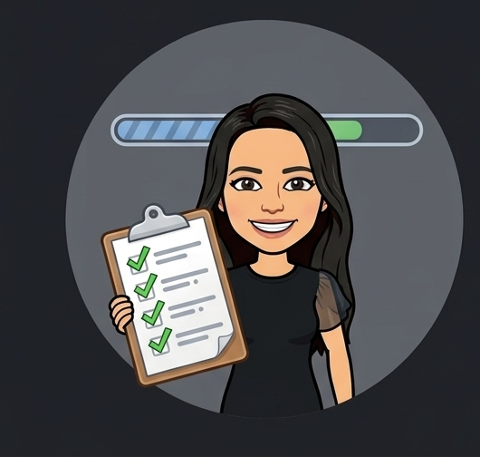

⌂
05
04 — PROPOSED APPROACH
From question to evidence package
A purpose-built workflow makes the research repeatable and auditable.
01
02
03
04
05
TASK AGENT
→
RETRIEVE
→
ANALYZE
→
VALIDATE
→
EVIDENCE PACK
Frame the question
Decompose work
Set constraints
BH history
External research
Comparable cases
Check comparability
Model scenarios
Run sensitivity
Citations
Assumptions
Conflicts / gaps
Facts + sources
Scenarios + ranges
Decision context
GUARDRAIL
No material conclusion without source trail + assumption register + explicit uncertainty.
BH AI DECISION SUPPORT
5
5

Slide 6
05 — AGENT VS. GENERAL CHATGPT VS. Copilot Premium VS. Copilot Agent
06
The differentiator is the workflow — not the base model
The comparison is about configured capabilities and workflow — not model intelligence.
Capability
Purpose-built
Agent
General
ChatGPT
Copilot
Premium*
Copilot
agent
BH-specific knowledge
Approved BH sources + access controls
Depends on context provided or connected
Can ground in Microsoft 365 work data + connectors
Can be configured with selected knowledge / connectors
Historical project context
Reusable BH retrieval layer + project taxonomy
Depends on supplied / connected context
Can use organizational data when available and permitted
Can be configured for specific project context
External research
Integrated as a workflow step
Available when web / tools are enabled
Web-grounded research available; configuration varies
Can be configured with web / external sources
Evidence traceability
Required: source + timestamp + assumption
Can cite sources; schema depends on usage
Can provide grounded references; implementation varies
Can be designed with explicit source / evidence outputs
Scenario analysis
Standard driver set + sensitivity ranges
Possible, but user/workflow driven
Possible with prompts, agents and workflows
Can be built into the agent workflow
Repeatable business process
Fixed BH workflow + validation gates
Requires deliberate setup
Can be automated with Microsoft 365 / Power Platform capabilities
Designed for a specific repeatable process
* “Copilot Premium” is shown using the requested label; Microsoft’s current enterprise product name is Microsoft 365 Copilot.
Key point: BH differentiation is the configured evidence workflow — internal precedent + external evidence + scenario analysis + validation gates.
BH AI DECISION SUPPORT
05

Slide 7
⌂
07
06 — LIVE DECISION LAB
Same question. Two evidence paths.
Use this as the interactive moment: compare the consultant’s starting evidence with the agent-generated evidence package.
PATH 1
PATH 2
Human only
Agent assisted
Starting evidence
Retrieve
BH history + external sources
Current project information
Personal experience
Compare
Find genuinely comparable cases
Known precedents
Model
Conservative / base / upside
Manual web research
Validate
Citations + assumptions + gaps
OPEN QUESTIONS
Comparability • future drivers • sensitivity
REVEAL → more transparent decision basis, not an automated decision.
BH AI DECISION SUPPORT
7
7

Slide 8
⌂
08
07 — EVIDENCE PACKAGE
What the consultant actually receives
The agent does not return one magic number. It returns a structured decision input.
1
BH History
EVIDENCE PACKAGE
1
Sensitivity
Prior projects / lessons
What changes the result
Verified facts
Source + date
Internal inputs
Project / client data
2
External Research
Comparable cases
Why comparable
2
Decision matrix
Market + technology signals
Trade-offs / constraints
Assumptions
Explicit + editable
Scenarios
Drivers + ranges
3
Site Baseline
3
Source trail
Present conditions
Open gaps
What still needs evidence
Every material claim mapped
BH AI DECISION SUPPORT
8
8

Slide 9
⌂
09
08 — REAL-PROJECT VALIDATION
Project #1 — NoRA mobility targets
Use the example to show how the agent turns a target question into a bounded modelling problem.
USER PROMPT
"For 2030, what is a plausible range for public transport mode share and internal trips by sustainable modes — considering history, current conditions, future estimates and growth factors?"
BASELINE
PROJECT TARGETS
MODEL
Riyadh historical modal split
NoRA planning inputs
Working 2030 estimate
2% public transport / 85% private car (2016)
Internal / project-specific — verify against approved source
Range driven by explicit assumptions; not an approved target
What the agent adds
A sensitivity range + the assumptions that move it (network supply, land use, accessibility, technology adoption, policy and behaviour).
BH AI DECISION SUPPORT
Baseline: UITP/UCLG-MEWA Urban Mobility Report 2020; project targets/inputs require internal source validation.
9
9

Slide 10
⌂
10
08 — REAL-PROJECT VALIDATION
NoRA — from point estimate to sensitivity range
Separate long-term aspiration, working estimate and uncertainty.
Metric | Current Baseline | NoRA Long-Term Target | 2030 Working Estimate | 2030 Sensitivity Range
Public transport mode share | Riyadh ~9% of trips | 40%+ | 25–30% | ~19–35%
Internal trips by sustainable modes (PT + walking + micromobility) | not available | 50%+ KPI; rec 70–80% | ~45% | ~35–55%
Internal trips within NoRA | not available | 70%+ KPI | ~55–60% | ~50–65%
Population | Greenfield | ~3.0M ±7.5% | Phasing-dependent | 2.5–3.5M
BH AI DECISION SUPPORT
Keep this slide only when the underlying NoRA source pack is available; otherwise label all figures as illustrative.
10
10

Slide 11
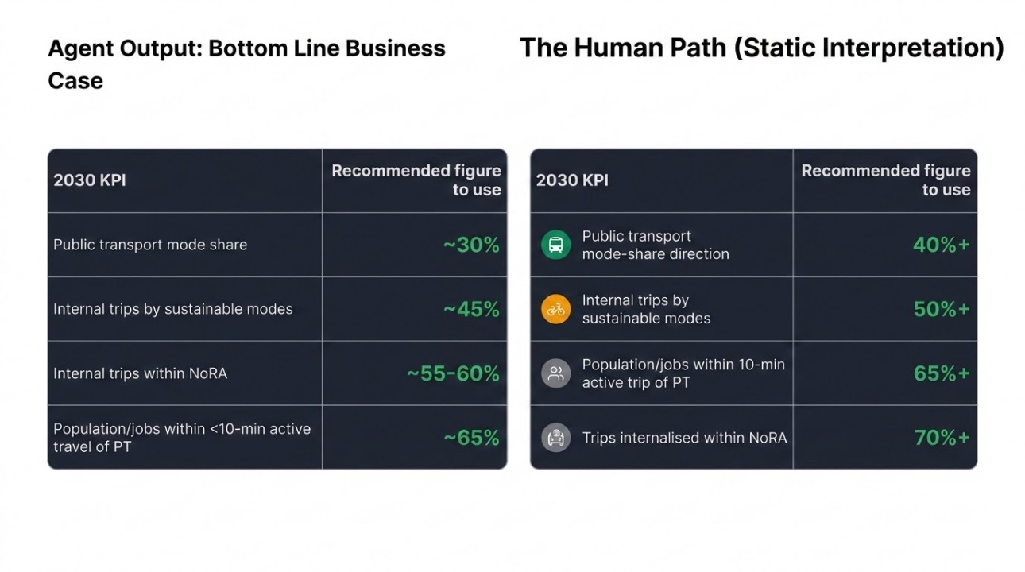
⌂
11
08 — REAL-PROJECT VALIDATION
BH AI DECISION SUPPORT
Keep this slide only when the underlying NoRA source pack is available; otherwise label all figures as illustrative.
10
10

Slide 12
⌂
12
09 — REAL-PROJECT VALIDATION
Project #2 — RUA / King Salman Gate
Use public sources for context; keep mobility shares explicitly in the modelling layer.
PUBLICLY VERIFIABLE CONTEXT
MODELLED LAYER — DO NOT PRESENT AS FACT
Estimate 2030 mobility modal shares
Location
Adjacent to AlMasjid AlHaram, Makkah
The model should combine:
Scale
Up to ~96.4 ha / 964K m² site area in AS+P masterplan description
Site program + phasing
Visitor / resident / worker trip mix
Use
Mixed-use destination with hospitality, residential, retail and public realm
Access & public transport supply
Walking / first–last-mile conditions
Mobility intent
Integrated access strategy + supporting public transport + crowd management
Peak pilgrimage demand
Technology & policy scenarios
OUTPUT = RANGE + ASSUMPTIONS
Not a single “predicted” number.
BH AI DECISION SUPPORT
Sources: AS+P King Salman Gate Master Plan (2024–2026); RUA AlHaram; PIF. Mobility-share figures require project source data / model validation.
11
11

Slide 13
⌂
13
09 — REAL-PROJECT VALIDATION
RUA — agent logic for the estimate
The model becomes defensible when each estimate is traceable to a driver.
Driver
Baseline / evidence
Scenario change
Mobility implication
Site access
Existing / planned access network
Add capacity / constrain access
Trip distribution + mode choice
Land use
Residential / hotel / retail mix
Phasing + intensity
Trip generation + time of day
Visitor demand
Pilgrimage + tourism peaks
Peak / off-peak scenarios
PT capacity + crowd management
Walking
Public realm + connections
Heat / distance / shade
Walkability + first/last mile
Public transport
Planned / supporting services
Frequency / coverage / integration
Mode share sensitivity
Technology
Ride-hail, micromobility, smart access
Adoption rates
First/last mile + vehicle trips
Policy
Parking / access management
Strict / moderate / open
Mode shift + demand management
Validation gate: every output range must be reproducible from the driver table + source trail.
BH AI DECISION SUPPORT
Framework is a modelling method; it is not a claim that the listed future conditions are confirmed for RUA.
12
12

Slide 14
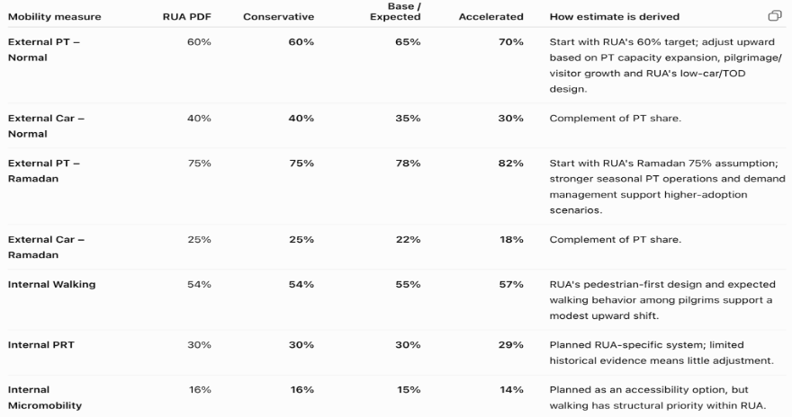
⌂
14
09 — REAL-PROJECT VALIDATION
RUA — agent logic for the estimate
BH AI DECISION SUPPORT
Framework is a modelling method; it is not a claim that the listed future conditions are confirmed for RUA.
12
12

Slide 15
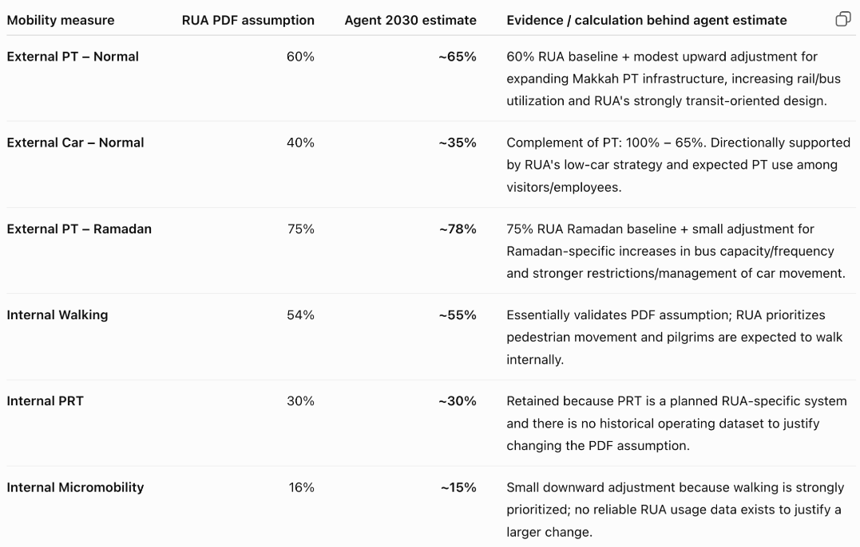
⌂
15
09 — REAL-PROJECT VALIDATION
RUA — agent logic for the estimate
BH AI DECISION SUPPORT
Framework is a modelling method; it is not a claim that the listed future conditions are confirmed for RUA.
12
12

Slide 16
⌂
16
10 — CONSULTANT EXPERIENCE
What changes in the day-to-day workflow
The agent removes research friction while preserving ownership of assumptions and judgment.
BEFORE
AFTER
Search → remember → interpret → assemble
Frame → retrieve → model → validate → decide
Multiple sources
One reusable workflow
Repeated research
Comparable-case logic
Inconsistent precedent
Explicit assumptions
Hard to see sensitivity
Scenario ranges
Manual evidence trail
Traceable sources
CONSULTANT OWNS → question • constraints • assumptions • trade-offs • final recommendation
BH AI DECISION SUPPORT
13
13

Slide 17
⌂
17
11 — POTENTIAL BUSINESS IMPACT
Measure the workflow, not just the chatbot
The business case should be tied to observable changes in research effort, evidence coverage and decision quality.
R
RESEARCH
S
SYNTHESIS
D
DECISION
Less manual search
Faster comparison
Broader evidence
Time to first evidence pack
Time from question → scenario set
% of key claims with traceable sources
R
RISK
A
ADOPTION
Q
QUALITY
Better sensitivity
Repeatability
Human validation
# of material assumptions surfaced
Reuse across projects / teams
Consultant acceptance / correction rate
Better evidence + systematic scenarios → better-informed decisions
BH AI DECISION SUPPORT
14
14

Slide 18
⌂
18
12 — COST & SCALE
What would 100 employees cost per month?
Illustrative Copilot Studio agent consumption — cost depends on questions, agent actions, grounding, and the licensing model.
100
3
22
6,600
employees
questions / day
working days
questions / month
Usage cost scenarios — PAYG
A
Simple generative answer
B
Answer + 1 agent action
C
Tenant Graph grounding + answer
2 credits / question
2 answer + 5 action = 7 credits / question
10 grounding + 2 answer = 12 credits / question
6,600 × 2 × $0.01
6,600 × 7 × $0.01
6,600 × 12 × $0.01
$132 / month
$462 / month
$792 / month
$1.32 / employee / month
$4.62 / employee / month
$7.92 / employee / month
If usage rises to 5 questions/day (11,000/month):
$220 / $770 / $1,320 per month
Scenarios A / B / C
Key takeaway
The agent itself does not imply a $30/user charge. Under standalone PAYG, the usage bill is driven by Copilot Credits consumed.
BH AI DECISION SUPPORT
Microsoft Copilot pricing / licensing pages checked Sept 2026. Actual enterprise pricing may vary by contract and existing entitlements.
15
15

Slide 19
⌂
19
12 — COST & SCALE
Do we need both licenses for every employee?
No. Separate the question of who needs Microsoft 365 Copilot from who needs access to your published agent.
For a standalone Copilot Studio PAYG agent:
employees using the published agent do NOT need a separate Copilot Studio license.
A Standalone Copilot Studio — PAYG
B Microsoft 365 Copilot — $30/user/month
Best fit when the goal is a shared agent for employees
A separate employee productivity license
• Azure subscription / billing connection is required.
• Organization pays for Copilot Credits actually consumed.
• End users of the published agent need access to the deployment channel, not a Copilot Studio user license.
• Only people who create/manage agents need Copilot Studio author access; under PAYG, the author role is $0.
• Can publish to channels such as Teams, depending on the agent/channel configuration.
• If all 100 employees need full Microsoft 365 Copilot: 100 × $30 = $3,000/month.
• A qualifying Microsoft 365 plan is also required.
• Provides broader Copilot functionality across Microsoft 365 apps.
• Agents built for Teams, SharePoint and Microsoft 365 Copilot can be included with the licensed user, subject to Microsoft's terms/fair-use limits.
• This is NOT automatically required just because employees use your standalone agent.
For the above use case:
Agent in Teams / chatbot only → PAYG + usage credits. | Full Copilot in Word/Excel/Outlook/Teams for employees → add $30/user licenses for those employees.
BH AI DECISION SUPPORT
Illustrative estimate • Verify current Microsoft pricing, licensing scope and fair-use terms before procurement.
13

Slide 20
⌂
20
13 — EVALUATION & PILOT
How to prove the concept
A strong pilot measures evidence quality and consultant time — not whether the model can produce fluent text.
1
Evidence coverage
2
Research efficiency
3
Scenario quality
% of material claims with source + date + provenance
Time from question → first usable evidence pack
% of material assumptions explicitly stress-tested
4
Human acceptance
5
Reusability
6
Risk control
Consultant correction / override rate
Projects using the same workflow without custom rebuild
Unsupported / conflicting claims detected before output
Pilot gate: compare 20–30 real questions with and without the workflow, then review outputs with experienced consultants.
BH AI DECISION SUPPORT
16
16

Slide 21
⌂
21
14 — GUARDRAILS
What the agent must never hide
The credibility of the solution comes from making uncertainty visible.
S
SOURCE STATUS
F
FRESHNESS
C
COMPARABILITY
Verified / internal / modelled / unverified
Timestamp external research and flag stale inputs
Explain why a precedent is relevant before using it
A
ASSUMPTIONS
C
CONFLICTS
H
HUMAN GATE
Expose every material assumption and allow edits
Surface conflicting sources instead of silently choosing one
No automated recommendation or approval without consultant review
The goal is not certainty. The goal is a more transparent basis for judgment.
BH AI DECISION SUPPORT
17
17

Slide 22
⌂
22
15 — SOURCES & VERIFICATION
What was verified vs. what remains project-specific
This slide is intentionally explicit so the deck does not overstate evidence.
1
Riyadh mobility baseline
UITP / UCLG-MEWA Urban Mobility Report (2020): 2016 modal split reported 2% public transport and 85% private car.
Verified external baseline
2
Riyadh 2030 ambition
RCRC’s 2024 Voluntary Local Review confirms the Riyadh Public Transport Program as a major urban-mobility initiative; it does not verify the NoRA-specific percentages.
Verified external planning context
3
RUA / King Salman Gate
AS+P documents the 2024–2026 concept/master-planning work, integrated access strategy, public transport support and crowd management; PIF confirms the project context.
Verified external project context
4
Microsoft cost model
Microsoft currently lists M365 Copilot from $30/user/month and Copilot Studio at $200 / 25,000 Copilot Credits/month for the prepaid plan; actual enterprise cost varies.
Verified current list pricing; validate contract
5
NoRA / RUA mobility estimates
The specific 2030 ranges in the original deck are not independently verifiable from the supplied materials; keep them labelled illustrative unless the underlying project source pack is attached.
Requires internal/project source validation
Verification rule used in this edit: do not present an internal target, modelled range or illustrative estimate as an externally verified fact.
BH AI DECISION SUPPORT
18
18

Slide 23
⌂
23
THE TAKEAWAY
AI doesn't replace the decision.
It improves the evidence behind it.
Human Judgment
→
BH Knowledge
→
Scenarios
→
Better-informed decisions
The strongest version of this idea is a transparent evidence workflow — not an automated recommendation engine.
19

