Slide 1

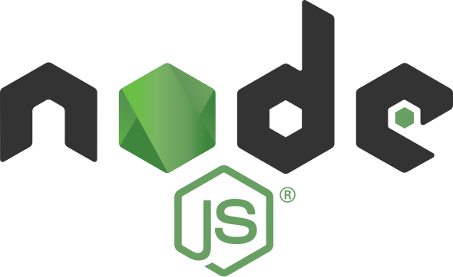
Introduction to Backend Development with Node.js & Express
A Guide to Building APIs and Server-Side Applications

Slide 2
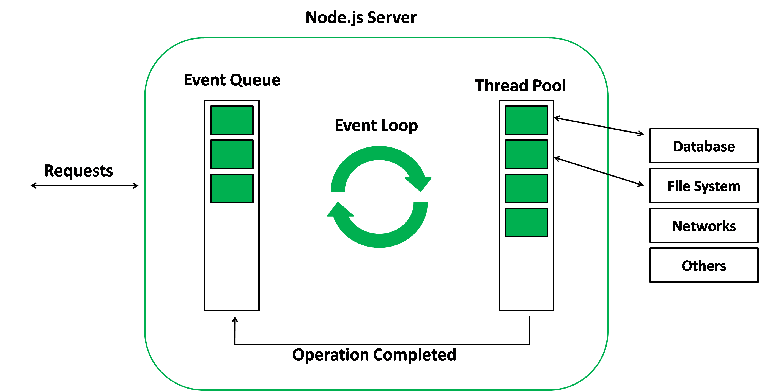



The Role of Node.js in Web Development
What is Node.js?
A JavaScript runtime built on Chrome’s V8 engine, allowing JavaScript to run on the server.
Key Features:
Non-blocking I/O: Lets multiple I/O operations happen simultaneously.
Single-threaded: Node uses one thread to manage multiple requests with minimal resources.
Asynchronous: Tasks run without blocking each other, making it highly efficient.
Why Node.js?
It’s fast, efficient, and well-suited for real-time applications.
Use Cases:
Powering parts of applications at companies like Netflix, LinkedIn, and Uber.

Slide 3
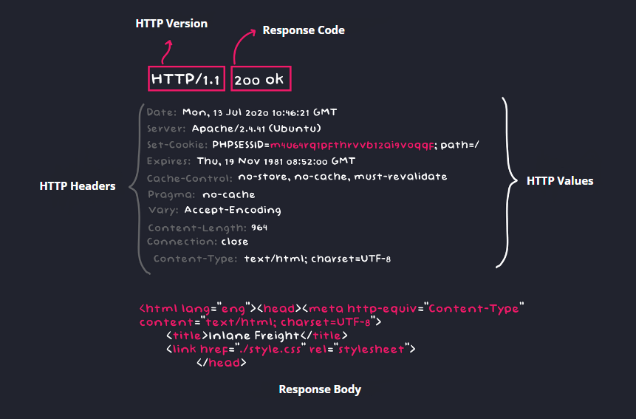
Understanding the Request-Response Cycle in HTTP
What is HTTP?
A protocol for transferring data on the web, based on a request-response model.
Request Structure:
Contains method (e.g., GET, POST), headers (metadata), URL, and sometimes a body.
Response Structure:
Includes status code (e.g., 200 OK, 404 Not Found), headers, and a body with data sent back to the client.
HTTP Methods:
GET: Retrieves data.
POST: Adds new data.
PUT: Updates existing data.
DELETE: Removes data.

Slide 4
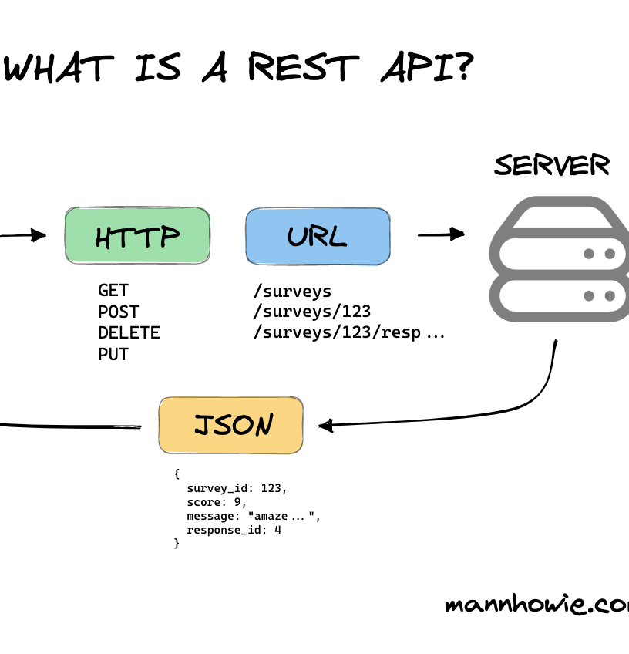
What is an API?
API Definition:
An API (Application Programming Interface) enables communication between two applications, allowing the client and server to interact.
REST API Basics:
Stateless: Each request contains all information needed to process it, with no session-based data stored on the server.
Resource-Based: APIs are organized around resources (like users, products).
HTTP Methods: REST APIs use HTTP methods to operate on resources.
CRUD Operations:
Create (POST), Read (GET), Update (PUT), and Delete (DELETE).

Slide 5
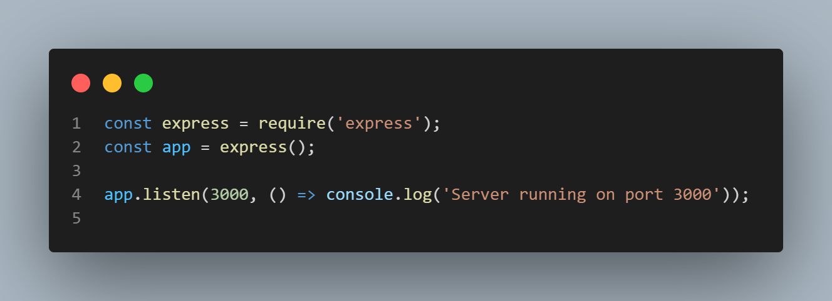
Setting Up an Express App
What is Express.js?
A minimal and flexible Node.js web application framework.
Designed to simplify the process of building web applications and APIs.
Key Features of Express.js:
Middleware Support: Easily handle requests and responses through middleware functions.
Routing: Powerful routing capabilities for managing different HTTP methods and URL paths.
Error Handling: Simplified error handling mechanisms

Slide 6
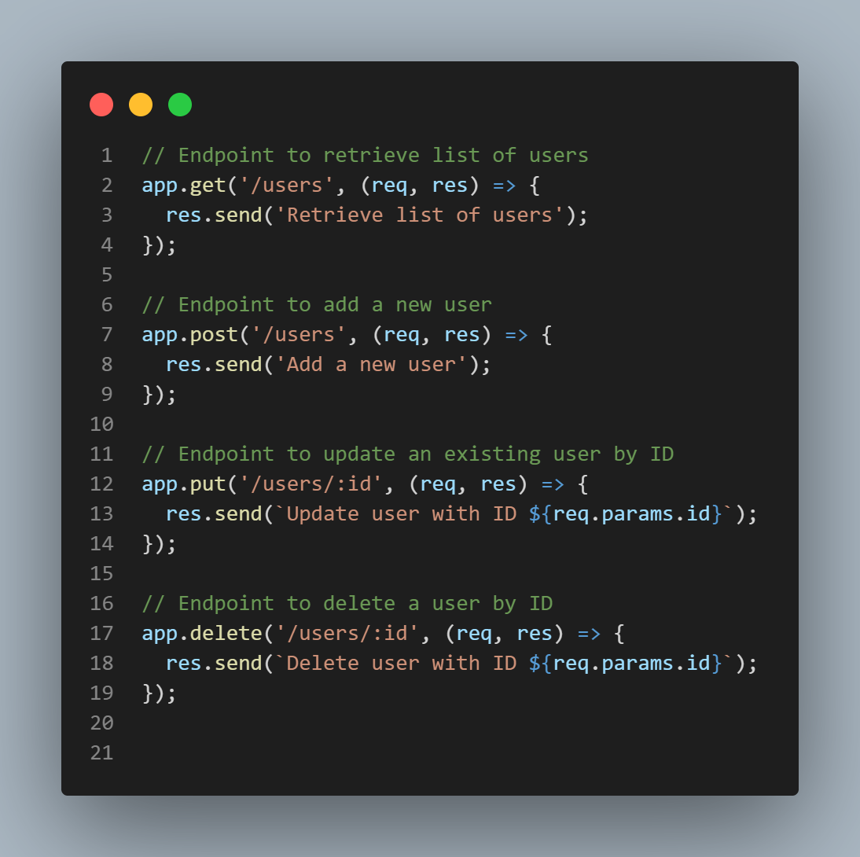
Defining Routes in Express
Creating Basic Routes
What are Routes?
Routes specify how an app responds to different HTTP requests at specific endpoints (URLs).

Slide 7
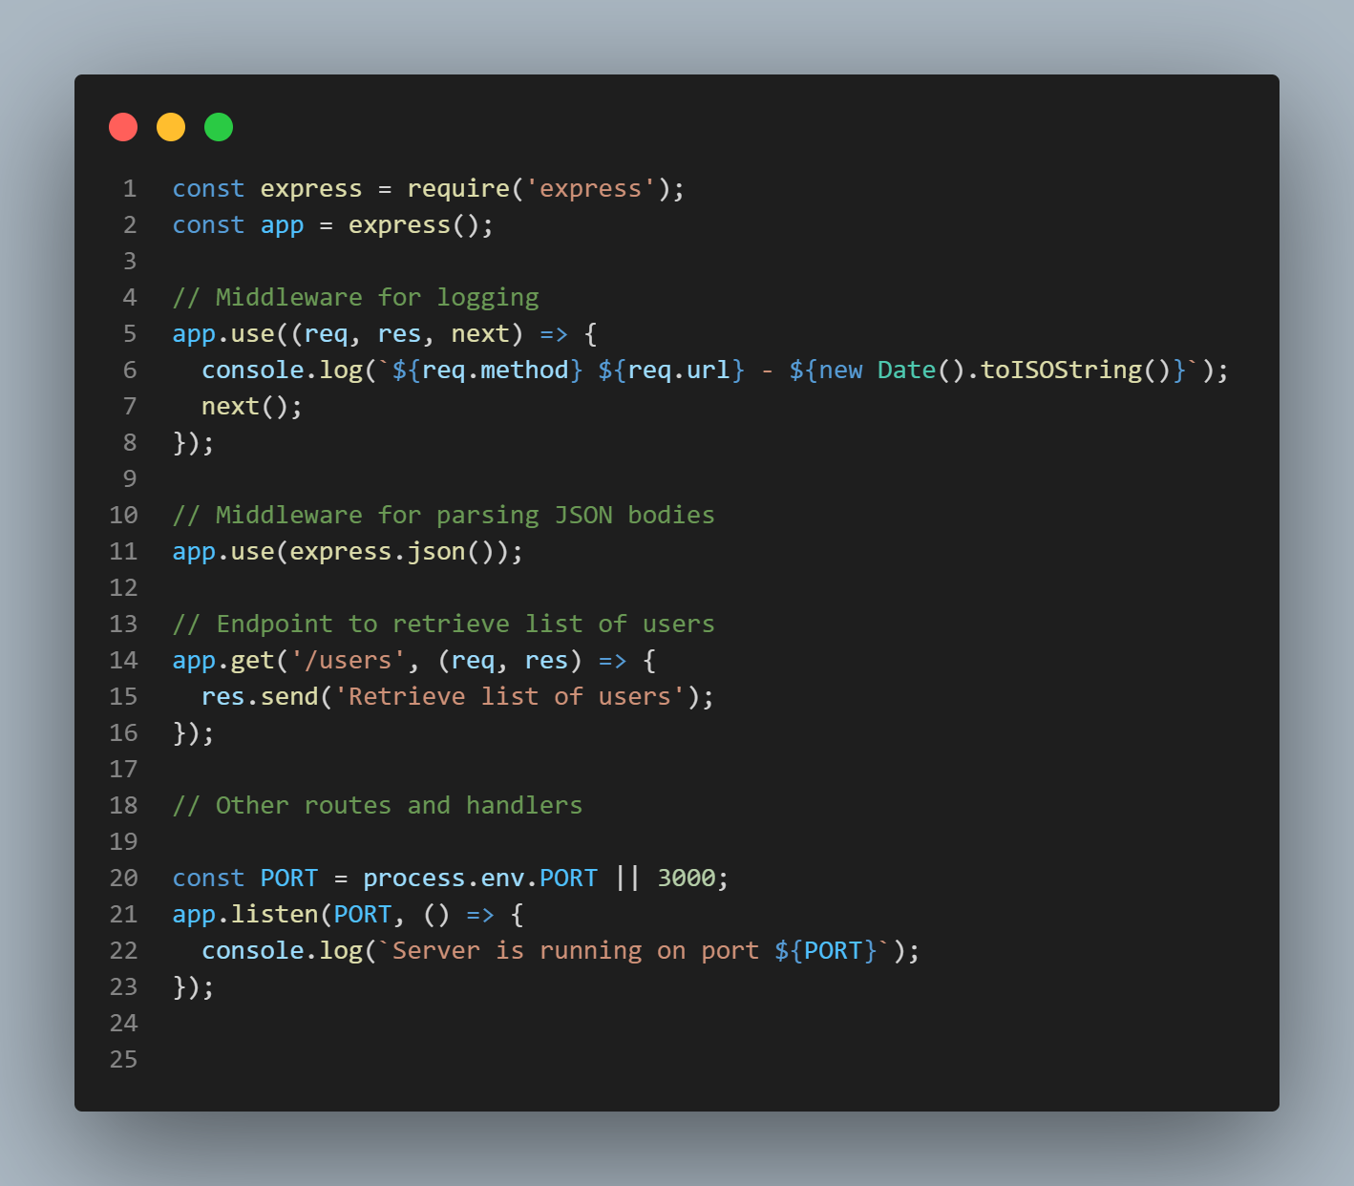
Introduction to Middleware in Express
What is Middleware?
Middleware functions can process requests before they reach the route handler. They have access to req, res, and a next function.
Common Uses:
Logging requests, parsing JSON, and validating data.
Built-In Middleware:
to parse JSON bodies.
express.json()
GET /users
Logging function
Express.json()
Res.send(users)

Slide 8
you’re ready to build your first api 😎
Congratulations🎊🎇
✨

