Slide 1
LoSST-AD: A Longitudinal Corpus for Tracking Alzheimer’s Disease Related Changes in Spontaneous Speech
By: Ulla Petti, Anna Korhonen.
May, 2024
Names: Netanel Shalev, Avi Mish, Bar Redel, Yarden Nahum

Slide 2
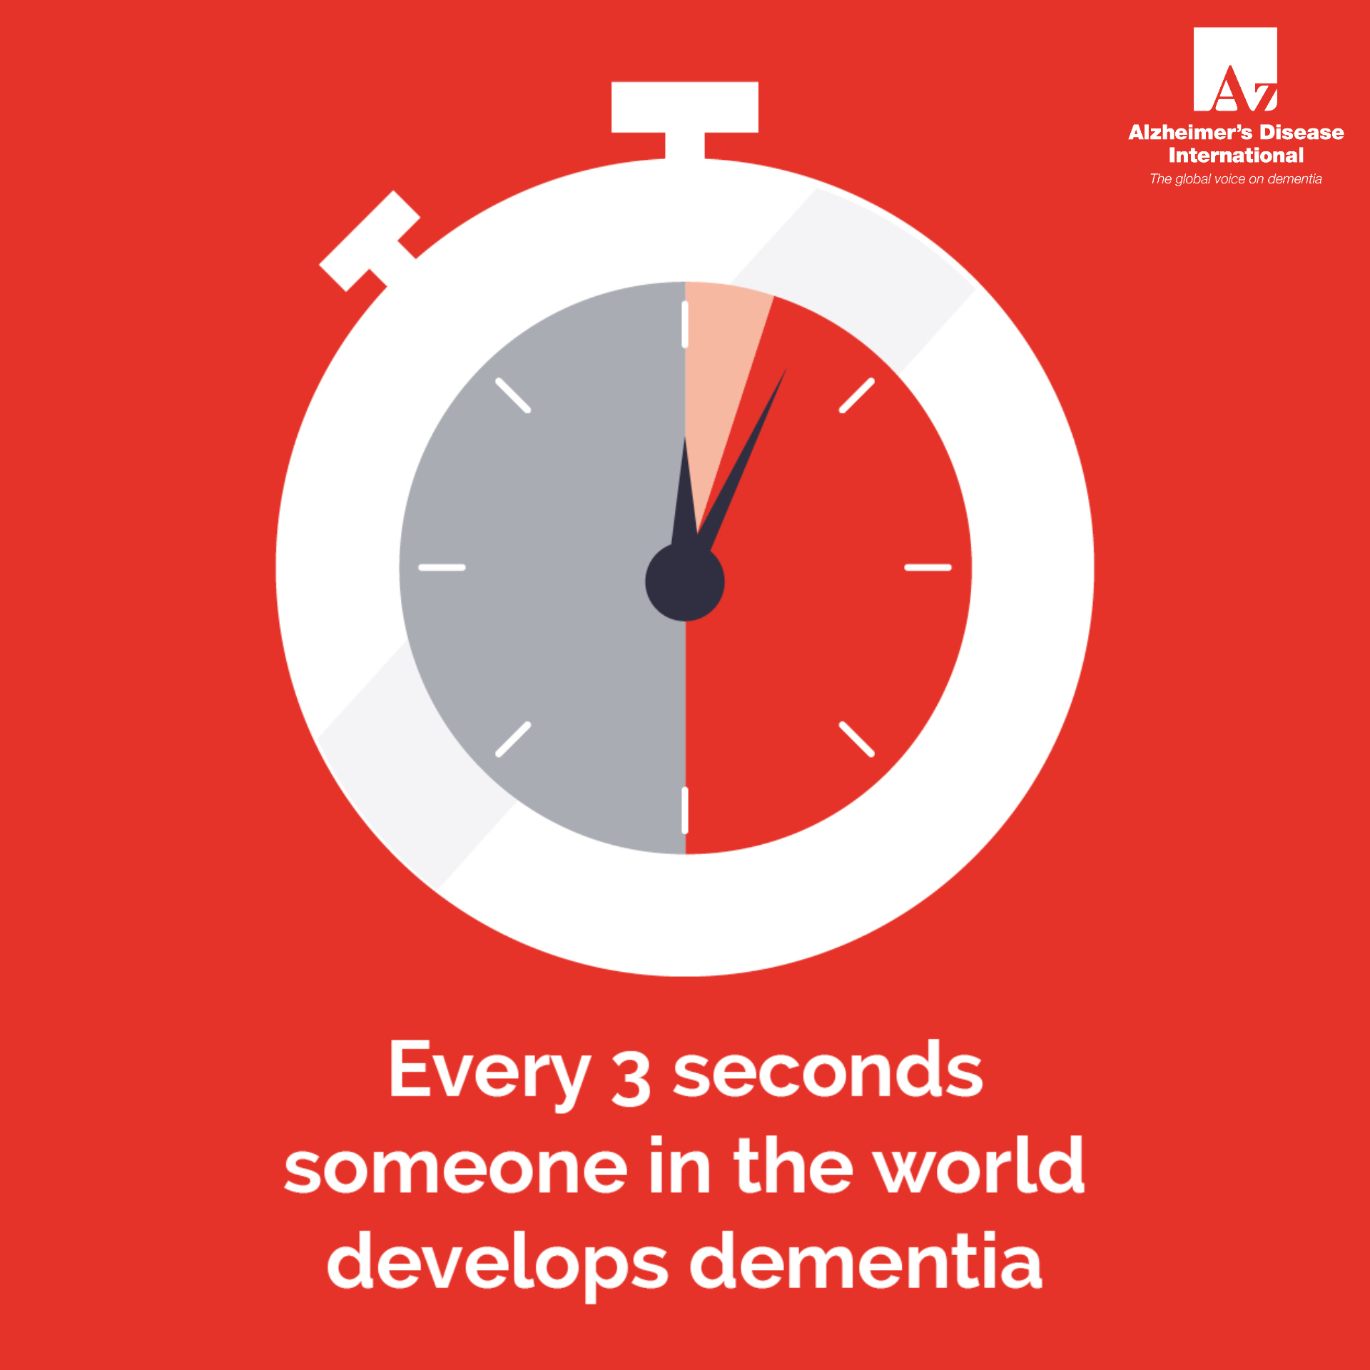
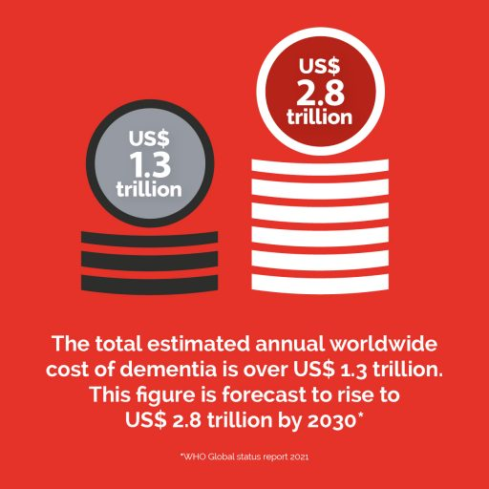
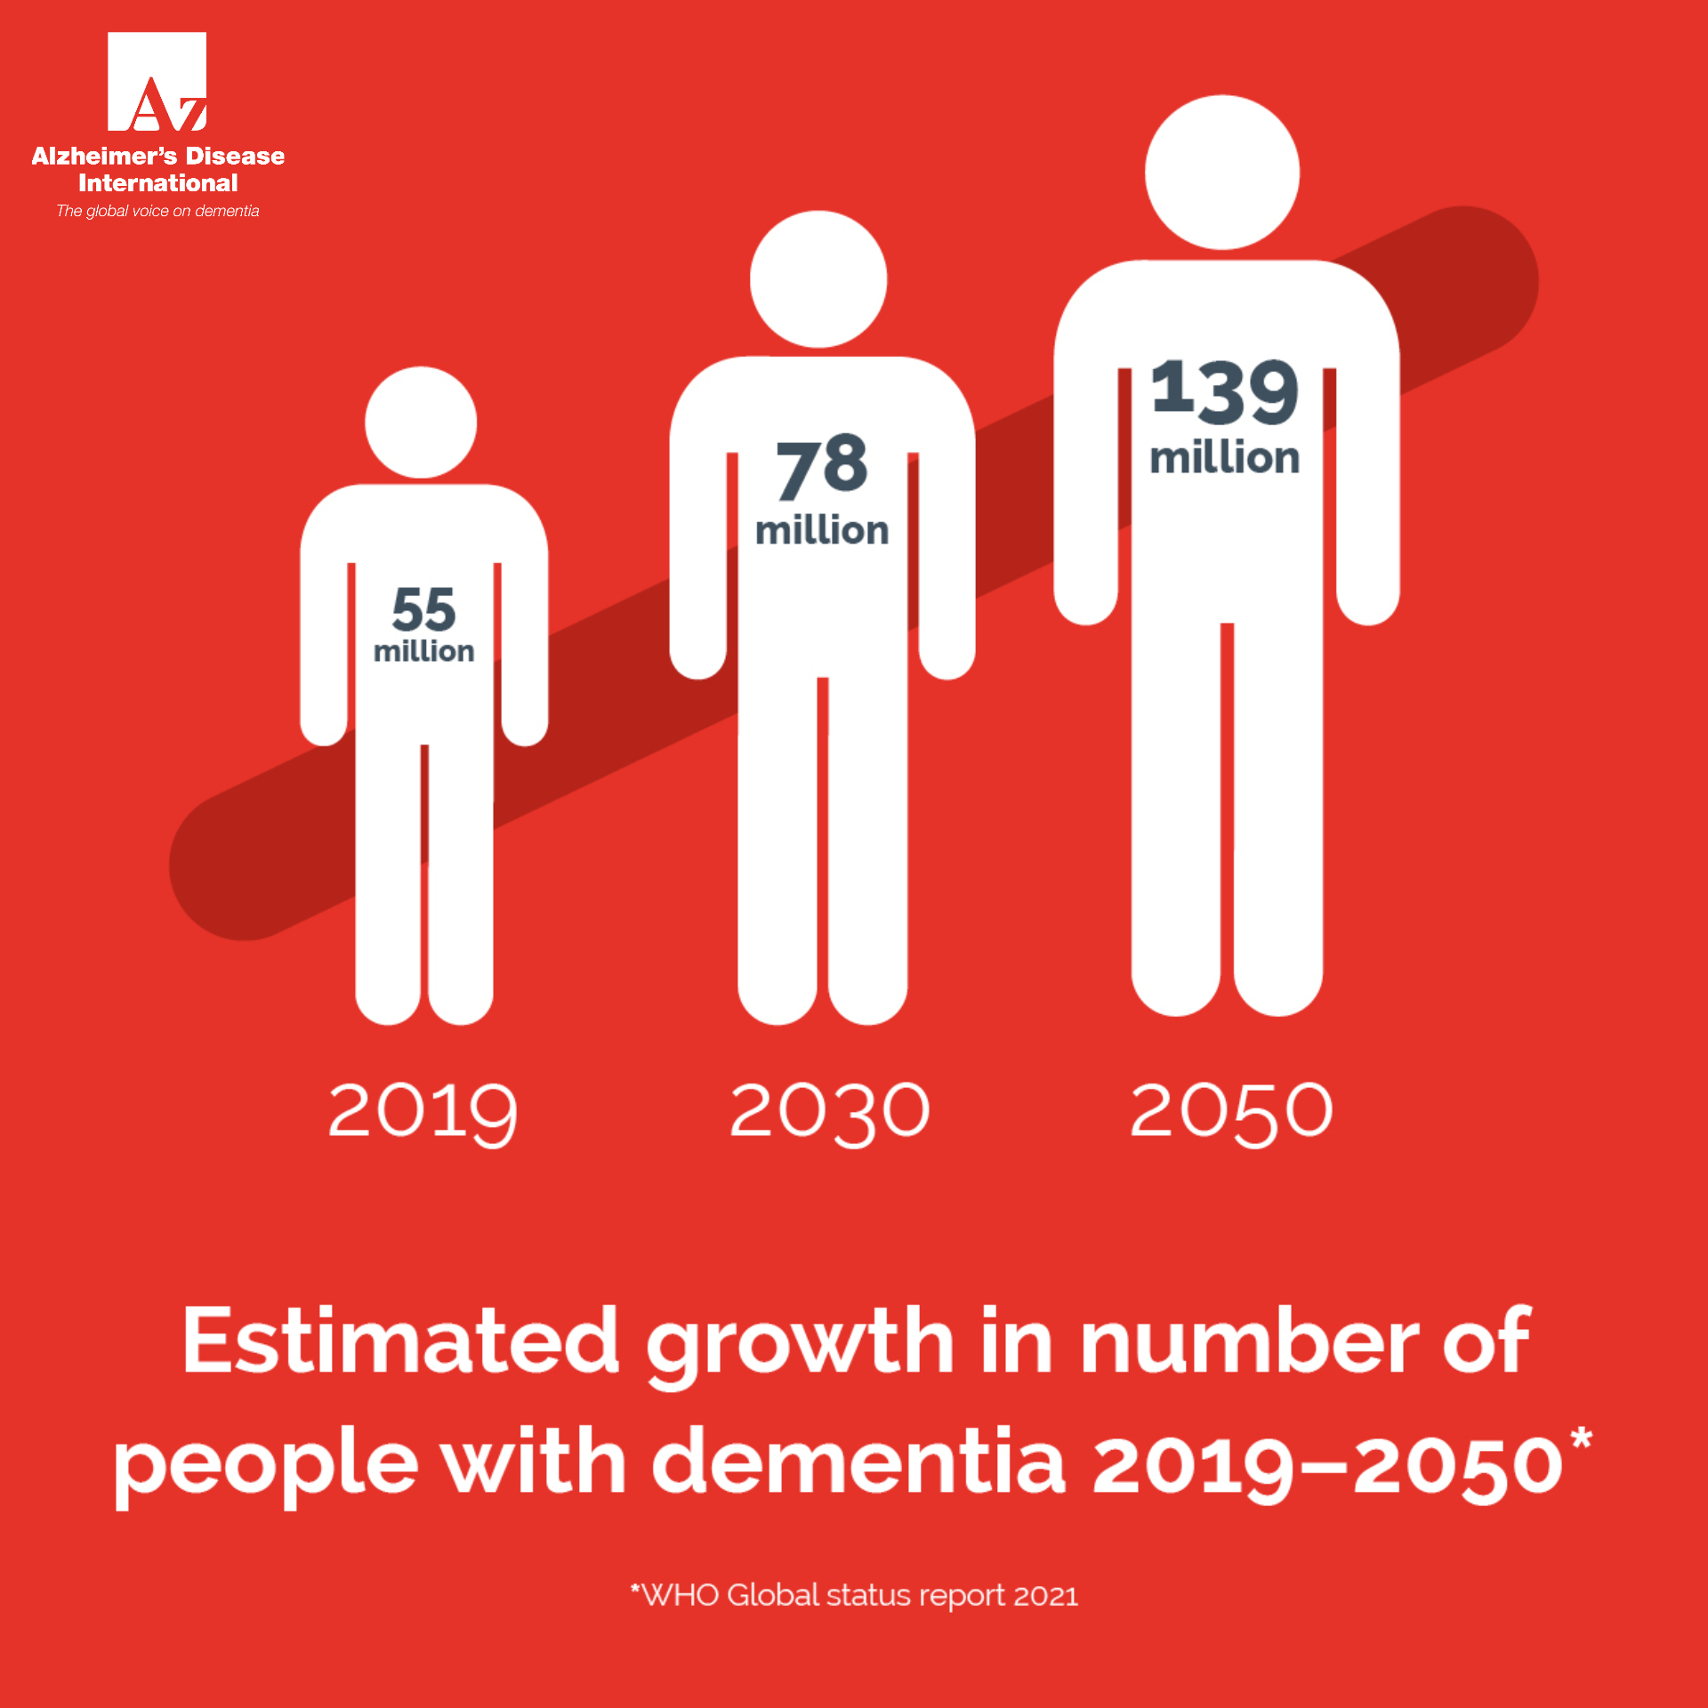
Intro
Over 55 million people worldwide live with dementia as of 2020. This number is projected to nearly double every 20 years, reaching 78 million in 2030 and 139 million in 2050.
Source: Alzheimer’s Disease International – Dementia Statistics
Approximately 10 million new cases of dementia are diagnosed each year globally.
Source: World Health Organization – Dementia
Alzheimer’s disease accounts for 60% to 80% of all dementia cases, making it the most common cause of dementia.
Source: Centers for Disease Control and Prevention – About Dementia
In the United States, an estimated 7.2 million Americans aged 65 and older are living with Alzheimer’s in 2025.
Source: Alzheimer’s Association – 2024 Alzheimer’s Disease Facts and Figures

Slide 3
Intro
There is no cure for the AD , but early diagnosis can slow the deterioration and improve treatment. Diagnosis today is based on expensive, complex and invasive tests. Language is a sensitive cognitive process – linguistic signs can appear years before diagnosis. If it is possible to diagnose through speech alone, it may be possible to develop a simple, inexpensive and accessible tool for early diagnosis.

Slide 4
motivation
Most existing datasets provide only a single recording per patient.
We cannot observe the progression of language decline over time.
This paper introduces a new language resource a longitudinal corpus – Enabling us to track deterioration over the years by analyzing the corpus and validating known patterns of vocabulary richness changes related to AD from the literature.
Easy : The speech was spontaneous and publicly available → no clinical burden.
It enables research into early detection signals in natural speech.

Slide 5
What the Paper Actually Does
What the paper does:
Collects and curates a longitudinal speech corpus of 20 public figures.
Aligns transcripts by time and disease stage.
Extracts linguistic features and analyzes patterns of deterioration.
Focus on the changes in vocabulary richness and demonstrate that lexical diversity features can provide comprehensive results in tracking AD-related language change. What it doesn’t do:
Does not introduce a new classification model.
Does not train predictive systems.

Slide 6

THE Data
The article introduces a new corpus called LoSST-AD, which includes transcripts of public interviews with 20 famous personalities, half of whom were diagnosed with Alzheimer’s. 135 public interviews of the individuals were transcribed for the purpose of building the dataset. Each transcript includes: date, age, medical status. A shortened database (99 transcriptions) of uniform length was created for fair comparison. The data is available online https://www.losst-ad.com (password required)

Slide 7
Method
Manual transcription of 135 interviews. Filtering the interviewer's text and direct quotes such as song lyrics in order to prevent bias and allow for more accurate analysis of fluent speech. Shorten the length of the transcripts in order to minimize the impact of the length on the extraction of features. Divided into experimental groups and control groups, with each AD patient assigned a person from the control group with similar demographic characteristics.
Extract features with NLP tools.

Slide 8
Features researched
Example | Meaning | Features
Book, Car, Run – 2/3 | Number of nouns from the entire corpus | Noun frequency (Ratio)
Blue, blue, red - 1 | Words used once | hapax legomena
A, A, A, B -1 | Search for richness of vocabulary | words used once or twice
A, b ,b ,b - 2 | Number of unique words | Brunet index
The cat chased the cat. TTR: 3/5 | Ratio of unique words to total words | Type : token ratio
or, from, in, to ,as etc… | words that show relationships between nouns or pronouns | Adposition frequency
Zipf : 6–7 = very frequent (e.g. "the", "dog") 3–4 = moderate (e.g. "banana") 1–2 = rare (e.g. "epistemology") | Zipf scale: a 1–7 logarithmic scale for easier comparison Subtlex frequency: word appears per million words | word frequency – Subtl / Zipf
I saw the dog. The dog was big. The dog ran fast. Dog -3 , the dog - 3 | Unigram repetition: Repeating the same word Bigram repetition: Repeating the same two-word sequence | uni- and bigram repetitions
The data analysis and feature extraction were performed with the help of SpaCy and NLTK.

Slide 9
Experiments
Experiment 1 – First vs. Last Transcription
Compared early and late transcripts of each speaker.
Method: double-sided T-pair test for features with a normal distribution, and a double- sided Wilcoxon test for features that do not distribute normally.
Found significant drop in:
noun frequency
word length
lexical diversity
Only for the AD group – not in healthy controls.
Experiment 2 – Longitudinal Trends Toward Diagnosis – vocabulary richness
Aligned transcripts by time-to-diagnosis.
Method: simple linear regression
Clear gradual decline in:
TTR
unique words
noun/adposition frequency
Increase in:
repetitions
simpler words

Slide 10
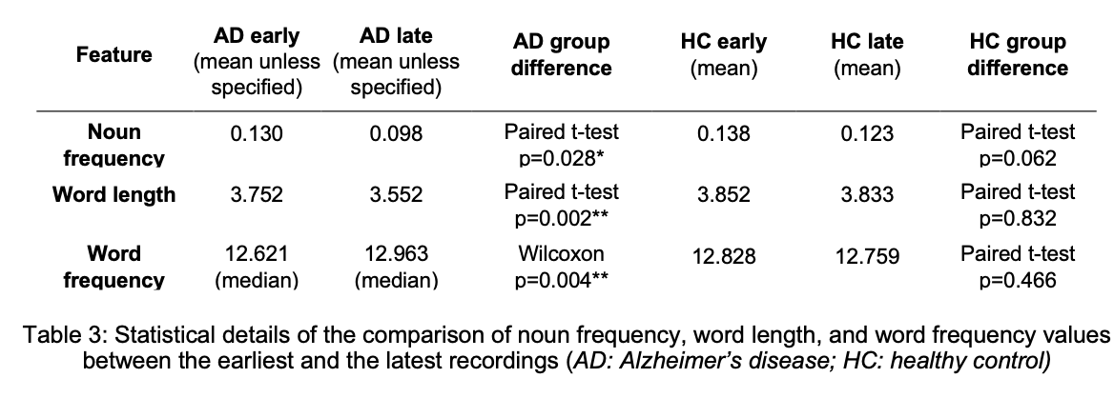
Results - Experiment 1

Slide 11
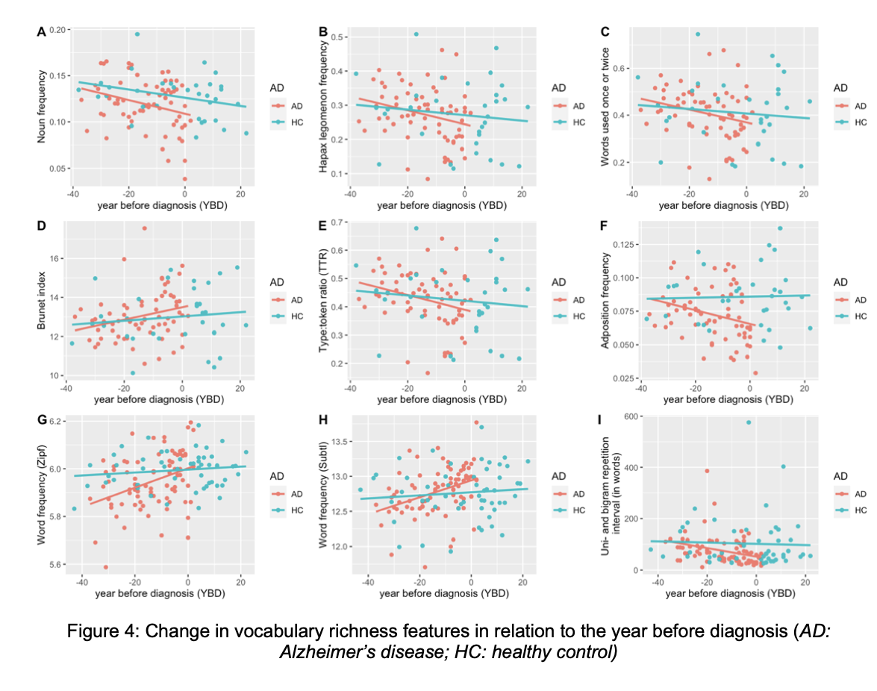
Results - Experiment 2

Slide 12
Limitations of the experiment - from the article
The main limitation of the study is the size of the data set. We are talking about only 2x10 subjects. In addition, the lack of concrete medical information about the subjects can skew the results greatly. They did succeed to some extent in filtering out biases such as Parkinson's patients, and despite this, data such as the year of diagnosis, the stage or severity of the disease are not clear to us, and these are only hypotheses. The data is discontinuous and has a lot of variability. The time points of the recordings are irregular and vary from one interviewee to another.

Slide 13
Limitations
Small dataset (20 participants).
Diagnosis year collected from public sources, not confirmed by medical records.
No access to clinical data (e.g., MMSE scores, stage of AD).
Transcripts were from uncontrolled settings (media interviews).
Can’t guarantee the absence of AD in control group.

Slide 14
Proposed Project Direction:
We aim to generate synthetic longitudinal speech data using ChatGPT or a similar large language model.
Design:
Simulate a dataset of 20 synthetic participants.
Each participant will have 5-10 conversations representing different time points.
In a subset of participants, a gradual linguistic decline will be embedded across conversations.
The identity of participants with decline will not be revealed to the analysis team.

Slide 15
Research Objectives:
Determine whether linguistic features highlighted in LoSST-AD—such as noun frequency, type-token ratio (TTR), word length, and lexical richness—remain effective in identifying decline within synthetic data.
Assess whether synthetic longitudinal data can serve as a viable resource for benchmarking, training, or validating models for early detection of cognitive decline.
Compare trends in feature changes (e.g., slopes of decline) between “healthy” and “declining” synthetic speakers.

Slide 16
Key Considerations:
How can we control the nature and rate of decline in a way that resembles real-world AD progression?
How do we ensure that the decline is subtle and realistic, rather than artificially obvious?

Slide 17
Current Work
Prompt Design & Methodological Considerations
We began designing a structured prompt aimed at obtaining multiple re-tellings of the same story by a single persona (Mike Donovan) across different life stages.
The core idea: simulate cognitive and emotional shifts in storytelling over time, while keeping the central memory constant.
Prompt output includes 9 stories told at ages 40–80, in 5-year increments.
Story length capped at ~250 words, in line with constraints in the original study.
We did not use TinyTroupes, but our approach parallels theirs: generate biographical depth from minimal input using language models.

Slide 18
Two-Step Prompt Design: Persona Construction and Temporal Storytelling
Expand the character into a realistic human with clear psychological, behavioral, and social traits.
Provide the following fields in JSON format:
name: Full name of the person.
age: Age in years.
persona_summary: 2–3 sentences that describe the person in general.
goals: A list of 2–3 key personal goals or aspirations.
background: A short biography (family, career, relevant history).
mental_state: A brief description of current emotional or cognitive condition.
example_dialogue: A short snippet of realistic dialogue from this person.
beliefs: A list of core beliefs or opinions they hold.
personality_traits: A list of adjectives that capture their personality.
Short description:
Mike is a journalist.

Slide 19
Two-Step Prompt Design: Persona Construction and Temporal Storytelling
Given the following persona, generate 5 short personal stories told by the character at the following ages:
50 or the minimum between the figure’s current age, 60, 70, 80, and 90.
___________________________________________________________________________________________________________________________
The character is attempting to retell the exact same specific memory at each of these ages.
That means:
The core event and setting should remain consistent across all five retellings.
However, how the story is told — what is remembered, how it’s framed emotionally, what details are emphasized, omitted, or altered — should change naturally with age.
___________________________________________________________________________________________________________________________
Each story should:
Be written in first person, as if the character is telling the memory aloud.
Be approximately 150 words in length.
Show the evolution of storytelling over time: through shifts in language, tone, clarity, emotional insight, or memory reliability.
Do not summarize or repeat text — each retelling should feel like a unique, authentic moment of personal reflection.
Do not mention or explain Alzheimer’s or any diagnosis explicitly.
________________________________________________________________________________________________________________
The character begins to experience Alzheimer’s disease at the age of X
Let this be reflected — subtly and naturally — in the storytelling itself: You are free to decide how and when these changes appear based on your understanding of the condition. Give your answer in JSON.

Slide 20
Two-Step Prompt Design: Persona Construction and Temporal Storytelling new
Given the following persona, generate 5 short personal stories told by the character at the following ages:
60, 63, 66, 69, 75 ___________________________________________________________________________________________________________________________
The character is attempting to retell the exact same specific memory at each of these ages.
That means:
The core event and setting should remain consistent across all five retellings.
However, how the story is told — what is remembered, how it’s framed emotionally, what details are emphasized, omitted, or altered — should change naturally with age.
___________________________________________________________________________________________________________________________
Each story should:
Be written in first person, as if the character is telling the memory aloud.
Be approximately 150 words in length.
Do not mention or explain Alzheimer’s or any diagnosis explicitly.
________________________________________________________________________________________________________________
The character begins to experience Alzheimer’s disease at the age of X
Let this be reflected — subtly and naturally — in the storytelling itself: You are free to decide how these changes appear based on your understanding of the condition. Please approach this task with intellectual depth and seriousness. Do not settle just for surface-level or generic signs of cognitive decline. Instead, research the subject thoroughly and let the deterioration emerge in subtle, realistic, and progressively complex ways, informed by real understanding.
Give your answer in JSON.

Slide 21
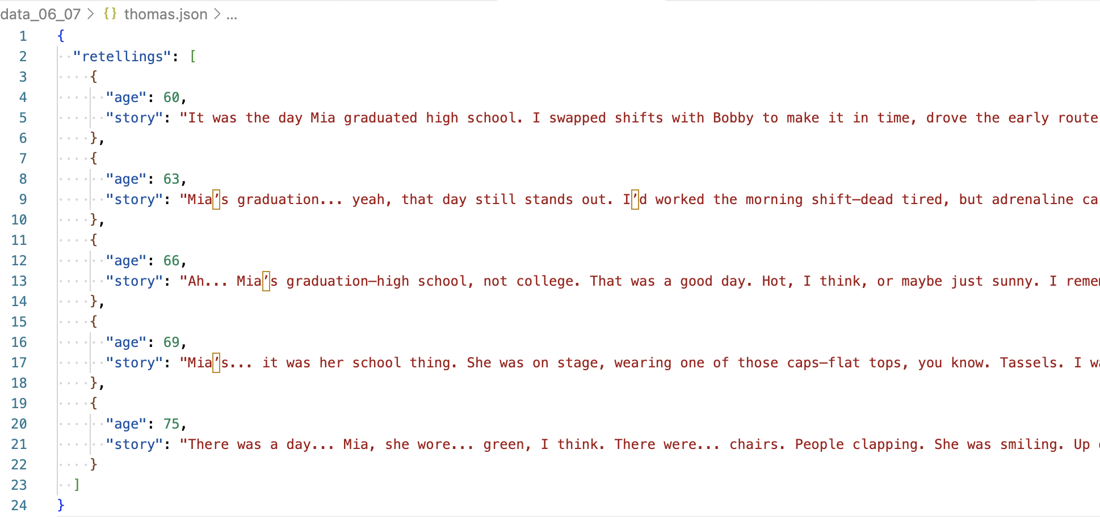
Generated dATA

Slide 22
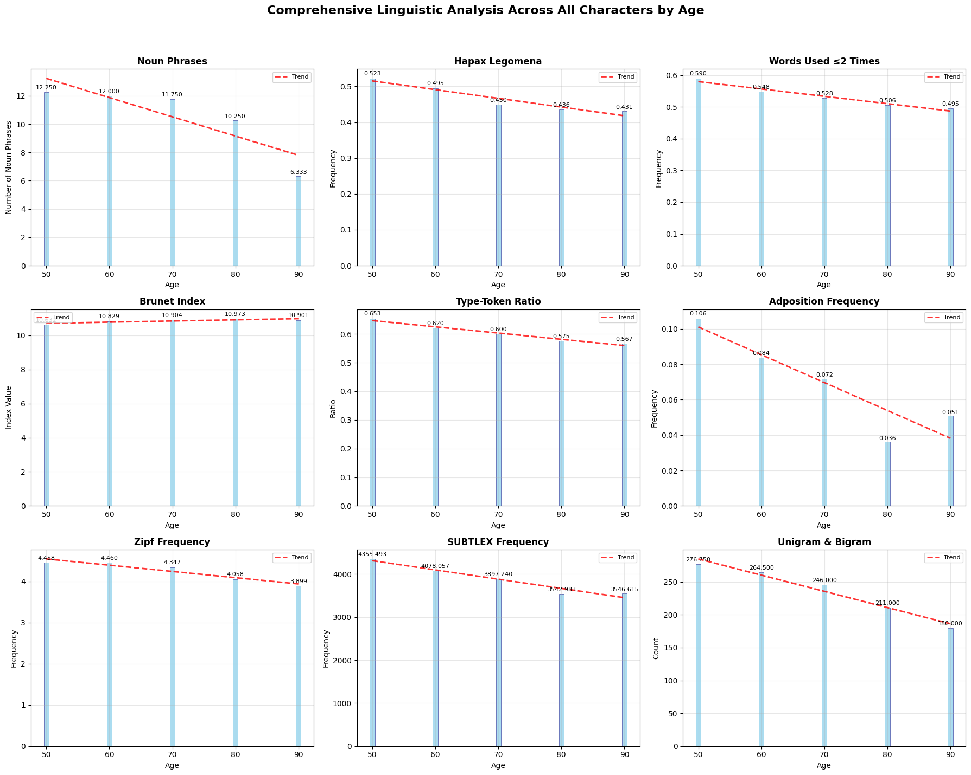
Results in progress

Slide 23
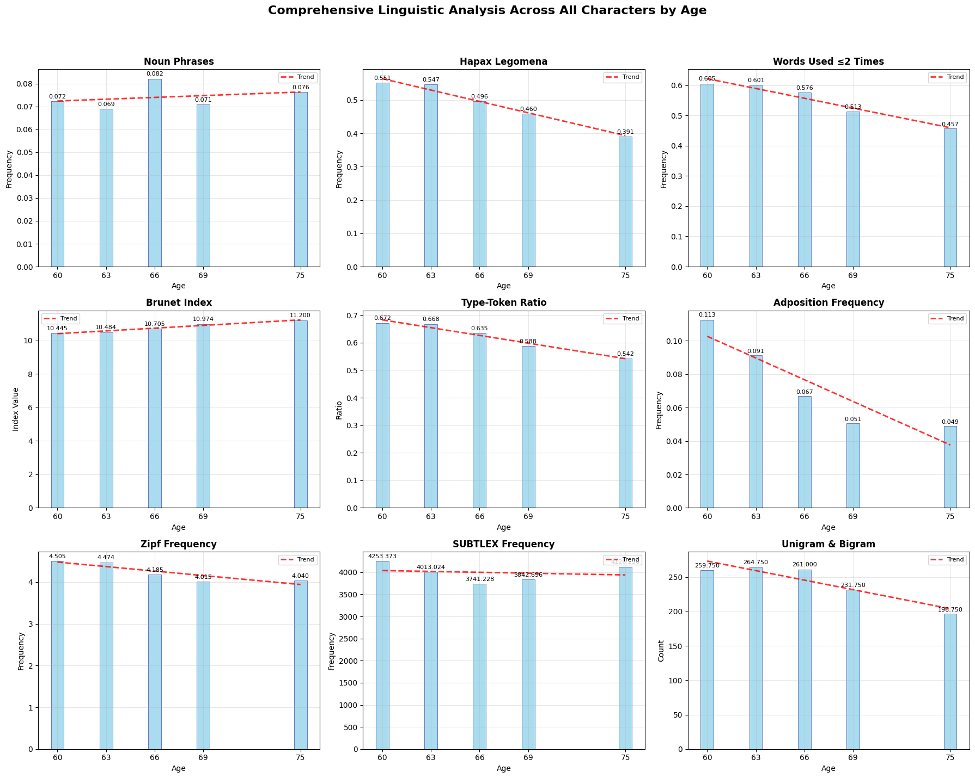
Results in progress new

Slide 24
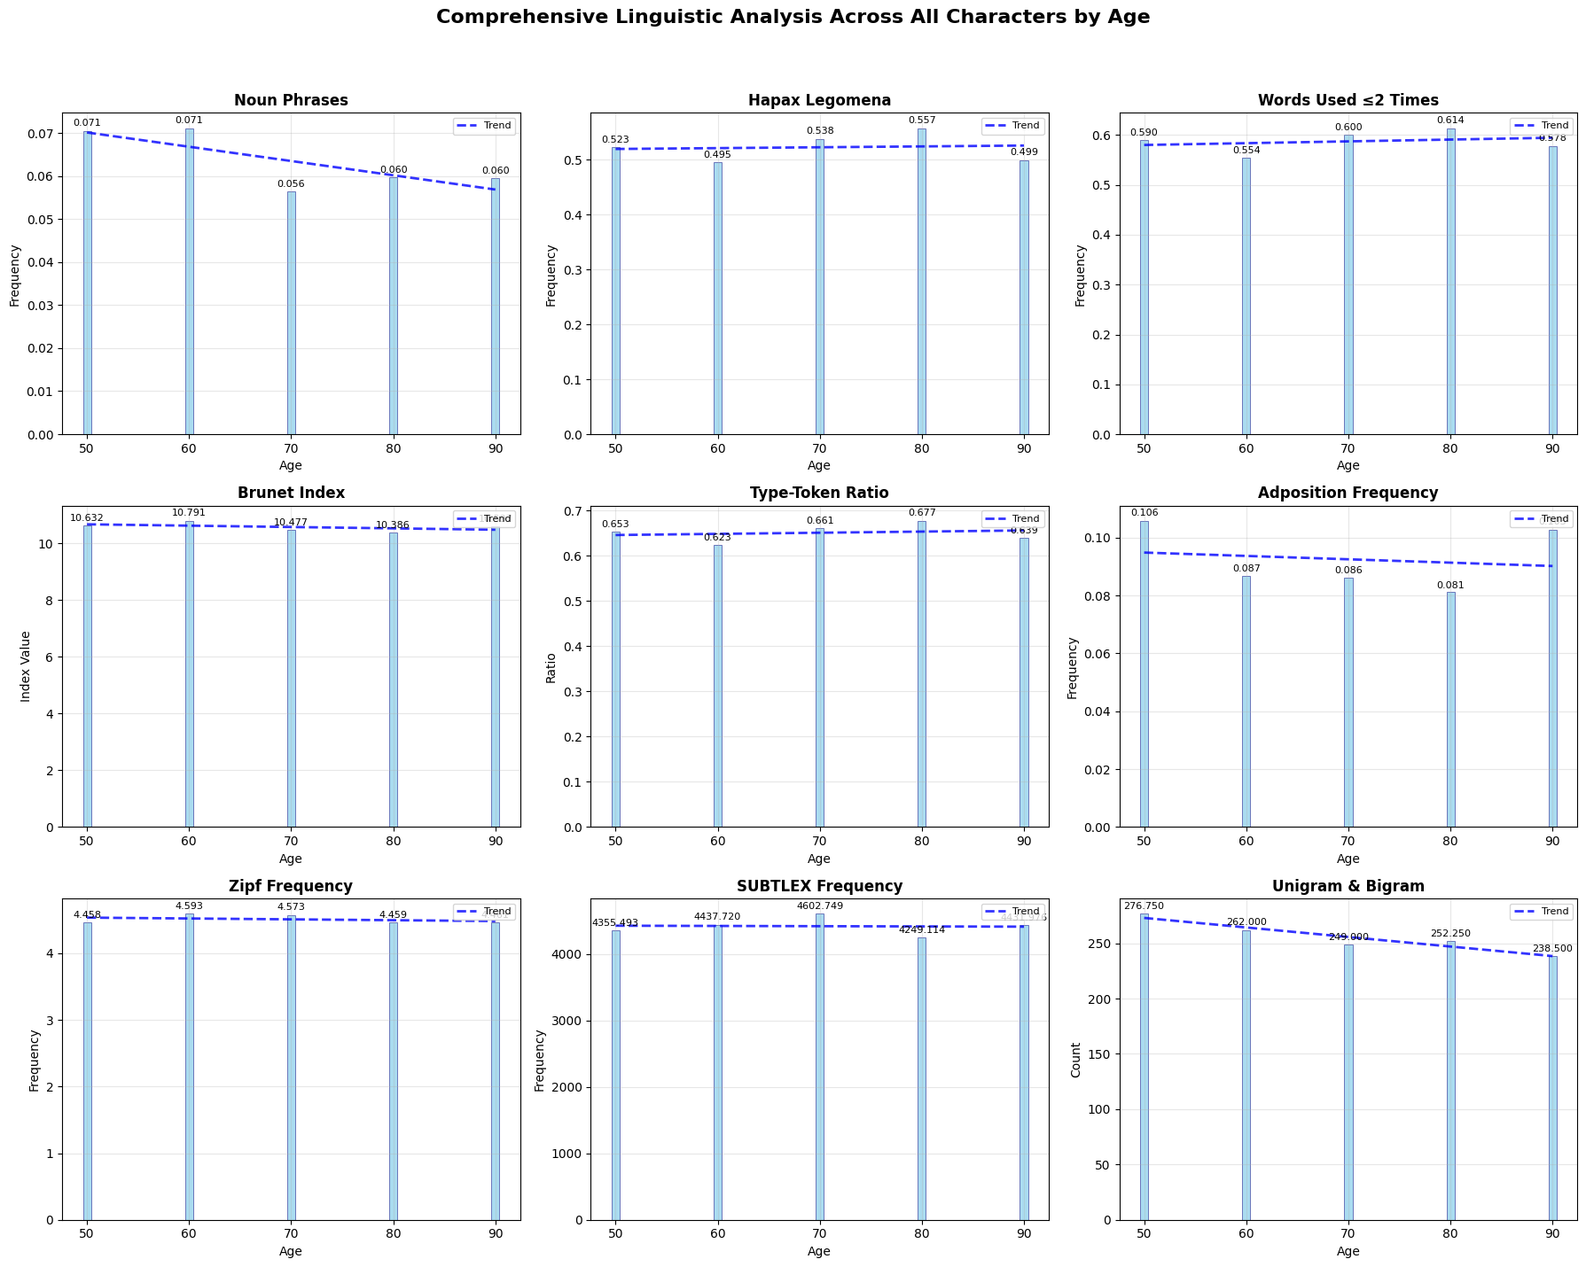
Results in progress Control
please write the same stories of X as an healthy person without Alzheimer. use the same stories and send your answer in JSON

Slide 25
Current progress
Problems:
It seems that the chat expresses the deterioration mainly by adding words that superficially convey uncertainty, like "I think...", "It seems to me...", "Maybe...", or something like that. We would like the chat to express the deterioration in a more realistic way.

Slide 26
Current progress
solutions:
Age Selection Adjusted – 60-75.
Intellectual Depth and Seriousness - The model is encouraged to approach the task with rigor and sensitivity, treating the character’s decline as a complex human process - not just a set of symptoms.

Slide 27
What now?
Key Questions and Next Steps
Next step – Refine code/Prompt and repeat metric evaluation to achieve better results.
Unclear / future work :
Real distribution of diagnosis – Mean around 75. So, we would like to change the stories to be from 60-81 every 3 years.
Diagnosis year. Death is after 4-8 years from diagnosis. So, tell max 2 stories after diagnosis.
Decline pace distribution – Avi grandfather.

Slide 28
What now?
Should we add more deterioration features simply due to old age?
Should we force the features as Reichart suggested? That is, state them explicitly in the prompt
How should we do evaluation? And how do we deal with the fact that there is one or two metrics that contradict the paper’s results (is it critical? Can we live with it?)
What is the final deliverable for submission? Only a poster, only a paper (maybe a report is enough?)
How many different personas should be generated in the final deliverable? (5-7 stories each)

