Slide 1
Employee Data Analysis using Excel
STUDENT NAME:S.NETHAJI
REGISTER NO:312212255
DEPARTMENT:commerce
COLLEGE:shree chandra prabhu jain college minjur

Slide 2
PROJECT TITLE
Employee Performance Analysis using Excel

Slide 3


AGENDA
Problem Statement
Project Overview
End Users
Our Solution and Proposition
Dataset Description
Modelling Approach
Results and Discussion
Conclusion
3/21/2024 Annual Review

Slide 4

PROBLEM STATEMENT
1. Inconisistent employee performance data
2. Identifying pattrens
3. Employee metrics
4. decision making
5. actionable insights

Slide 5

PROJECT OVERVIEW
CONTENT
•AIM; To streamline employee data analysis using excel tools
•OBJECTIVES; Identify key metrics, analyae trends & provide data -driven insights.

Slide 6

WHO ARE THE END USERS?
▪HR mangers ▪team leads & departments heds ▪company exectives company manager

Slide 7

OUR SOLUTION AND ITS VALUE PROPOSITION
CONTENT:
1.Implement excel-based data analysis techniques.
2.Generate automated reports and dashboards.
3.Enable easy data
manipulation and visualization

Slide 8
Dataset Description
CONTENT:
Data collected from employee records,including performance,attendance,& demographics
Number of records,time span,& key variables

Slide 9

THE "WOW" IN OUR SOLUTION
CONTENT:
automated reporting : our excel based
system automates complex reporting tasks, saving
HR managers hours of manual work. Tise enables
quick access to insightful data withoout the need for extensive excel expertise
3/21/2024 Annual Review
9

Slide 10
MODELLING
CONTENT: Data cleaning and preprocessing
Using excel functions for statistical analysis
Visualization using excel charts and pivot tables
10

Slide 11
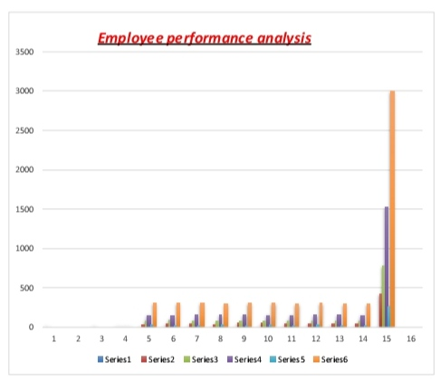
RESULTS
11

Slide 12
conclusion
CONTENT: Summary of insights gained impact on decision- making and empolyee management Future steps for futher analysis or implementation

