Slide 1
Development of AI Response Validation System with Hallucination Detection Assistance – Group 2
Final Project Demonstration
By Nethara G
RAG-based reference retrieval + multi-agent response validation
Infosys Springboard Internship • Group 2

Slide 2
1. Problem Statement
• Large Language Models can generate incorrect, incomplete, irrelevant, or unsupported information.
• Manual evaluation of AI responses is time-consuming and difficult to scale.
• A reliable evaluation platform should compare an AI response against trusted reference information.
• The system should provide explainable scores for accuracy, relevance, hallucination, and completeness.
LLM Response Quality Evaluator • Final Demonstration

Slide 3
2. Project Objectives
Reference Retrieval
Multi-Agent Validation
Retrieve relevant reference information using RAG.
Evaluate Accuracy, Relevance, Hallucination and
Completeness.
Scoring Dashboard
Report Generation
Visualize scores, verdicts and batch evaluation results.
Generate structured evaluation reports for
documentation.
LLM Response Quality Evaluator • Final Demonstration

Slide 4
3. System Architecture
User Input
RAG Pipeline
Validation Agents
Dashboard
Question + AI Response + Optional PDF/CSV
Chunking → Embedding → ChromaDB → Retrieval
Accuracy • Relevance Hallucination • Completeness
Scores → Verdict Charts → Report
Key Technologies: Python • Streamlit • FastAPI • Sentence Transformers (all-MiniLM-L6-v2) • ChromaDB
LLM Response Quality Evaluator • Final Demonstration

Slide 5
4. RAG-Based Reference Retrieval
Reference Text
all-MiniLM-L6-v2
Numerical Embedding
ChromaDB
Question → Query Embedding → Similarity Search → ChromaDB → Top-K Similar Results → Relevant Reference
The retrieved reference is supplied to the validation agents as evaluation context.
LLM Response Quality Evaluator • Final Demonstration

Slide 6
5. Multi-Agent Evaluation
Accuracy Agent
Relevance Agent
Checks factual consistency.
Checks whether the answer addresses the question.
Hallucination Agent
Completeness Agent
Identifies unsupported or fabricated claims.
Checks important information that is missing.
Retrieved Reference + AI Response → Validation Agents → Overall Score → Final Verdict
LLM Response Quality Evaluator • Final Demonstration

Slide 7
6. Final Demonstration Flow
• Explain the project objective and evaluation workflow.
• Evaluate a single AI response live through the dashboard.
• Run batch evaluation using a CSV file.
• Show dashboard metrics, verdict distribution and agent scores.
• Export and open the evaluation report.
• Compare ChatGPT and Gemini on the same five questions.
• Summarize findings, strengths, limitations and future improvements.
LLM Response Quality Evaluator • Final Demonstration

Slide 8
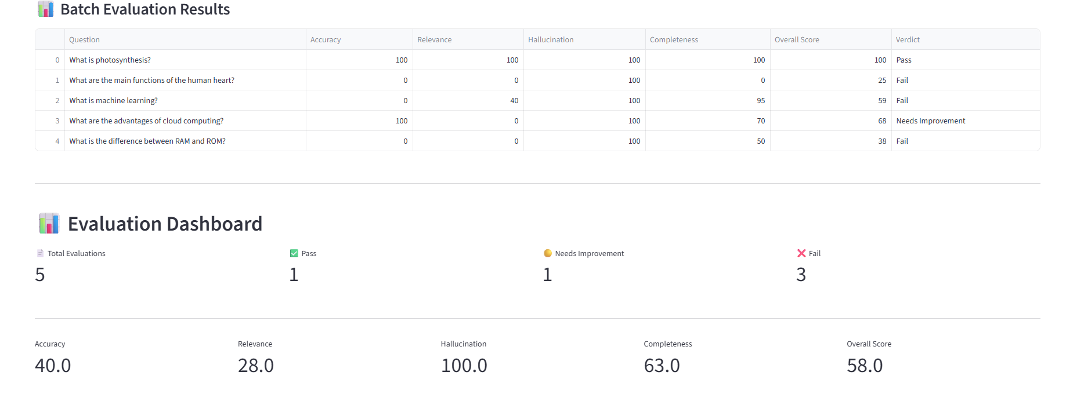
7. ChatGPT - Batch Evaluation
.
LLM Response Quality Evaluator • Final Demonstration

Slide 9
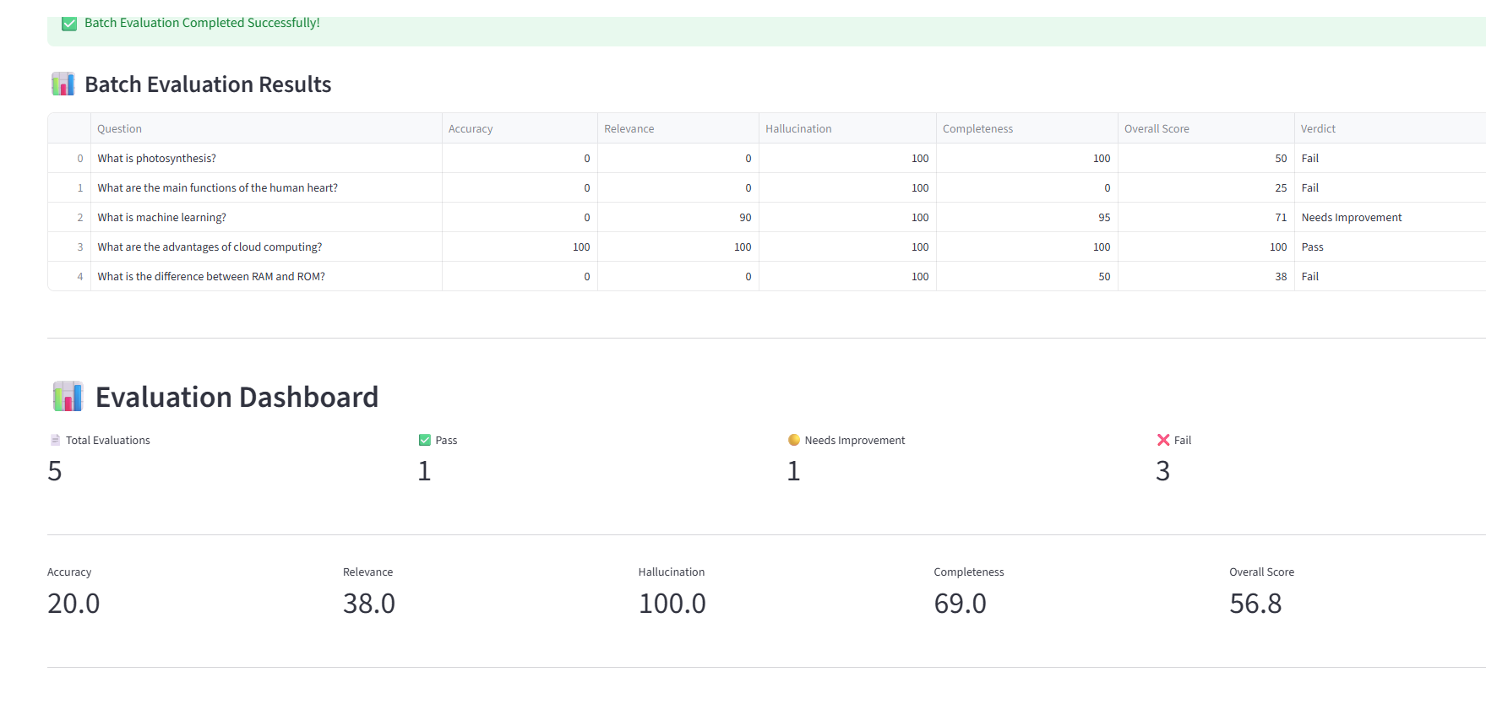
8. Gemini - Batch Evaluation
.
LLM Response Quality Evaluator • Final Demonstration

Slide 10
9. ChatGPT vs Gemini — Batch Evaluation
Metric
ChatGPT
Gemini
Accuracy
40.0
20.0
Relevance
28.0
38.0
Hallucination
100.0
100.0
Completeness
63.0
69.0
Overall Score
58.0
56.8
Pass / Needs Improvement / Fail
1 / 1 / 3
1 / 1 / 3
ChatGPT scored higher overall; Gemini scored higher in Relevance and Completeness.
LLM Response Quality Evaluator • Final Demonstration

Slide 11
10. Testing & Validation
• RAG retrieval and reference matching
• Single evaluation workflow
• Batch CSV evaluation
• Frontend–backend integration
• Accuracy, relevance, hallucination and completeness scoring
• Overall verdict generation
• Dashboard updates and result visualization
• PDF/report generation
• Repeated-run consistency validation
LLM Response Quality Evaluator • Final Demonstration

Slide 12
11. Findings, Strengths & Limitations
Strengths
Limitations
Automated multi-dimensional evaluation RAG-based reference grounding Batch evaluation and dashboard Two-model comparison Structured reporting
Scores depend on retrieved reference quality Small comparison dataset in this demonstration Agent scoring can vary with evaluation prompts Hallucination score should be interpreted with context
LLM Response Quality Evaluator • Final Demonstration

Slide 13
12. Future Improvements
• Support more LLM providers and model-specific comparisons.
• Expand benchmark datasets and domain-specific reference collections.
• Improve scoring consistency through calibration and standardized evaluation prompts.
• Add richer filters and quality trends across large evaluation histories.
• Improve report analytics and recommendation generation.
• Deploy the platform for team-based or production evaluation workflows.
LLM Response Quality Evaluator • Final Demonstration

Slide 14
Conclusion
The platform provides an end-to-end workflow for evaluating AI-generated responses using
trusted references and multiple validation dimensions.
The final demonstration validates the system using both ChatGPT and Gemini.
Thank You

