Slide 1




Software Architecture
Team Lead 2: Nate Osterberg

Slide 2
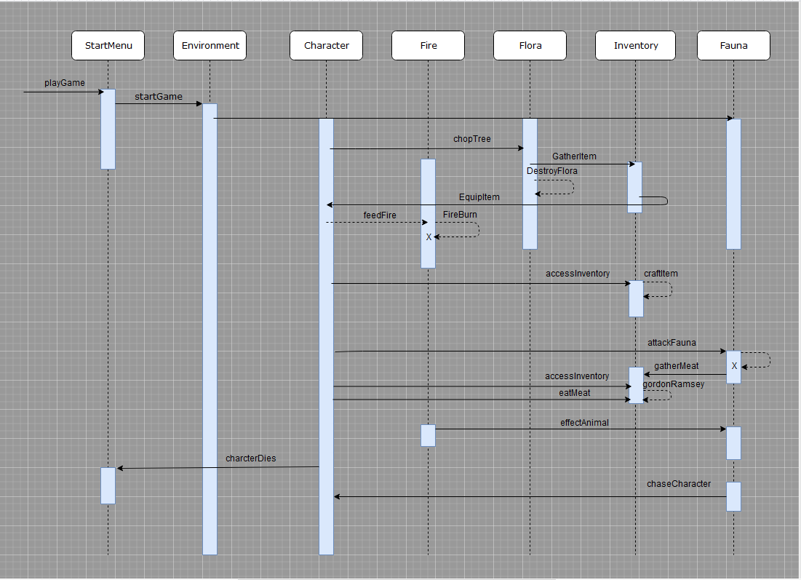
Sequence Diagram

Slide 3
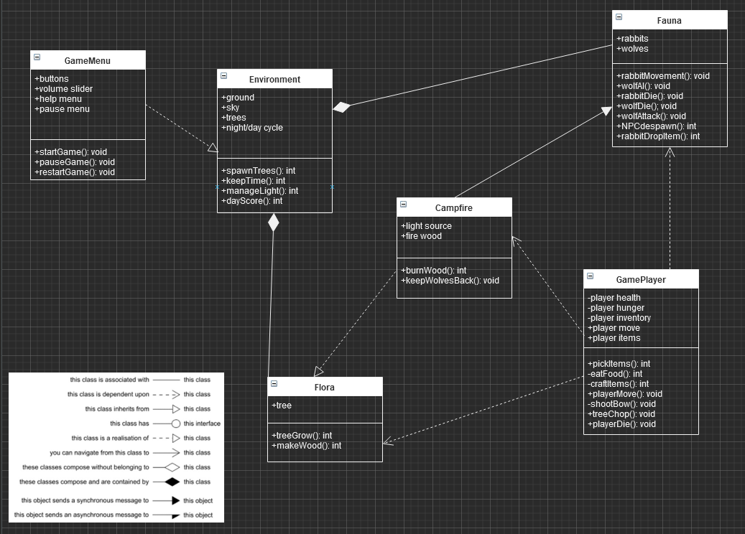
Class Diagram

Slide 4
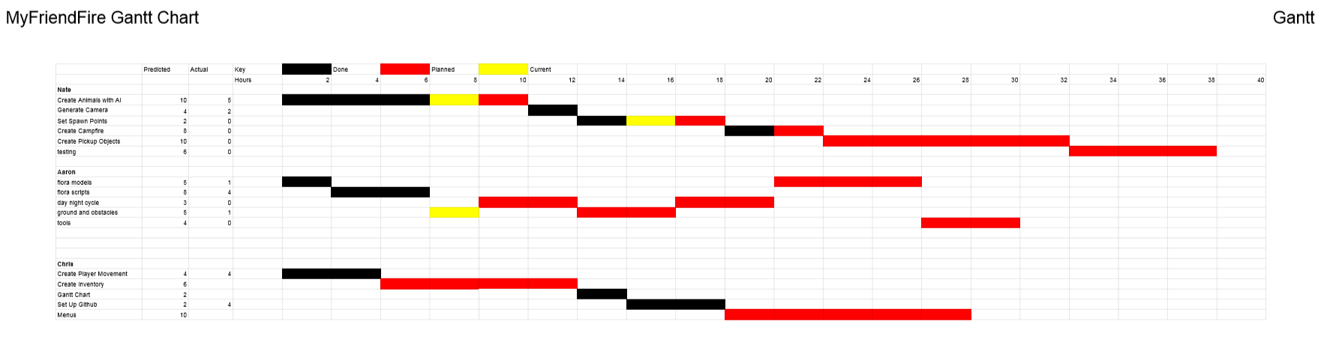
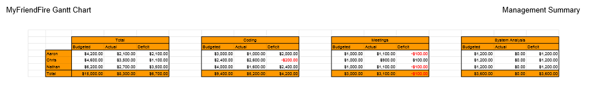
S.A. Gantt Charts

Slide 5
Game Demo

