Slide 1

Good Morning, I’m J A Mujeeb
BSc (hons) Software Engineering – Plymouth
ISAD253SL – Database Assignment

Slide 2
6 Main Entities
Library
Book
Publisher
Employee
Member
Copy

Slide 3
Relationship Entities
Has Relationship
Borrow Relationship
Published_by Relationship

Slide 4
For Example, Library Entity is generalized to
Academic Entity
Public Entity
Special Entity

Slide 5
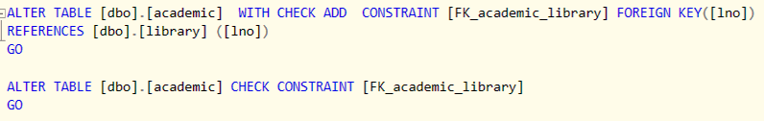
Constraint

Slide 6
Assumption
I have assumed that library location and copy location of library and copy entity as multi valued attribute.
So, I created 2 new tables for the 2 multivalued attributes.

Slide 7
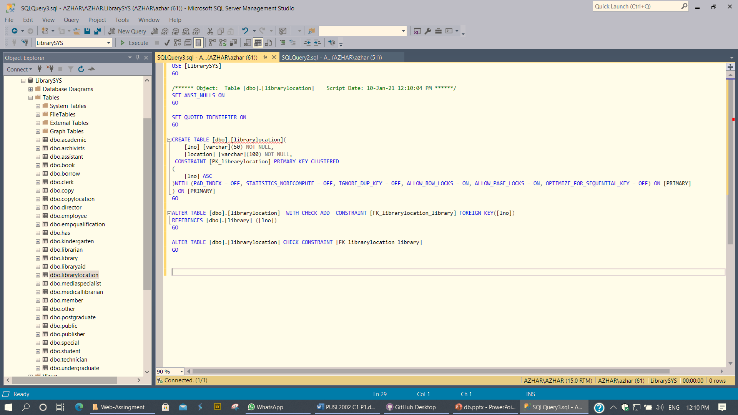

Here’s the code for the 2 multivalued attributes

Slide 8
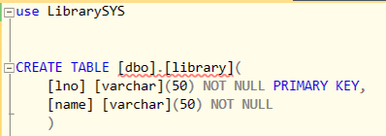
For Library

Slide 9
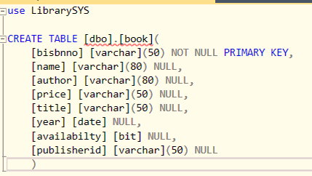
For Book Entity

Slide 10
Data Dictionary in brief
Name | Data type
For ID (Primary Key values) | varchar(50)
For Names (Author, title, etc.) | varchar(80)
Address (location) | varchar(120)
Price/Salary | Numeric(6,3)
Age | int
Gender | bit
Date (exp_date, issue_date) | date

Slide 11
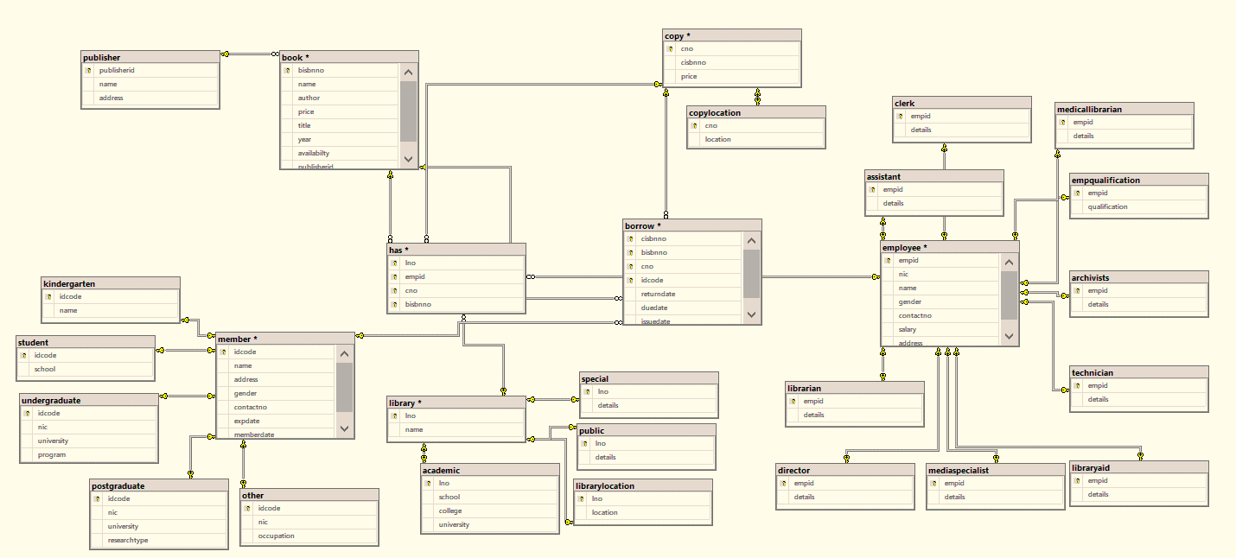
Database Diagram

Slide 12

Thank you

