Slide 1
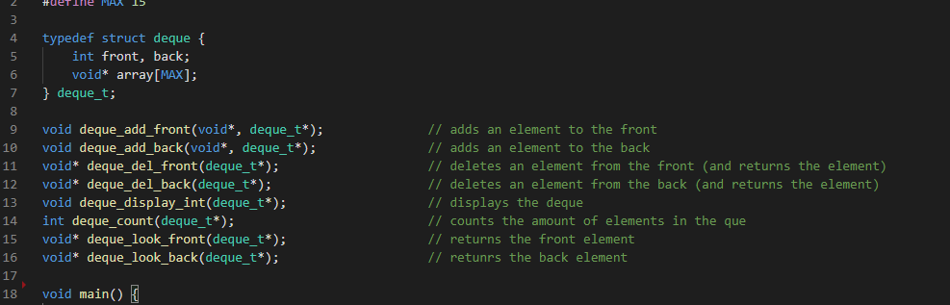

Datastructures in C Double-ended-queue
Eine Präsentation von Naumann Marco
Bildquelle: https://www.thoughtco.com/thmb/su46sbq08VX4unr8_ehrqKGreug=/2449x1224/filters:fill(auto,1)/Getty_cue_and_queue-158318139-5847493c3df78c0230e83369.jpg
Notes:
Img src: https://www.thoughtco.com/thmb/su46sbq08VX4unr8_ehrqKGreug=/2449x1224/filters:fill(auto,1)/Getty_cue_and_queue-158318139-5847493c3df78c0230e83369.jpg

Slide 2
Einleitung
Inhalt:
Was ist eine Double-Ended-Queue? – Allgemein
Array
Linked List
Blocks / Chunks
Was bringt eine deque eigentlich?
Anwendung
work stealing algorithm

Slide 3
Was ist eine Double-Ended-Queue?
Allgemein:
Ein sequenzieller Container, welcher schnelles einfügen und löschen sowohl am Anfang als auch am ende der Datenstruktur bereitstellt.
typische Implementierungen in:
Array
(Double-) Linked-List
Block / Chunks
Notes:
Die Datenstruktur deque ist am ehesten mit der Daten Struktur des Vector zu vergleichen
Mit welchem mitteln kann man dies tun (bsp, array, linked list, blocks / chunks,…)
Vor/nachteile
Was ist eine Double-Ended-Que
Was für Funktionen bringt Deque mit?
Was bringt eine deque eigentlich?

Slide 4
Was ist eine Double-Ended-Queue
Allgemein: 1. Array:
Deque, gebaut aus einem Array…
Fügen wir doch einfach mal was ein:
deque_add_back – 1
deque_add_back – 2
deque_add_front – 3
deque_add_front – 4
0
1
2
4
3
0
1
2
3
4
5
6
7
8
9
?
Front Pointer
Back Pointer
Element
Notes:
NACH ALLOCATION DES ARRAYS!!!

Slide 5
Was ist eine Double-Ended-Queue
Allgemein: 2. Linked-List
Deque, gebaut aus einer Double-Linked-List...
Fügen wir doch einfach mal was ein:
deque_add_back – 1
deque_add_back – 2
deque_add_front – 3
deque_add_front – 4
deque_del_back
4
3
0
1
2
?
Front Pointer
- Head
Back Pointer
-Tail
Element
Notes:
Ineffektiv… MALLOC

Slide 6
Was ist eine Double-Ended-Queue
Allgemein: 3. Block/Chunks
Deque, gebaut aus Blöcken/Chunks...
head
blocks
headBl
tailBl
tail
head
blocks
tail
head
tail
ch0
e1
Notes:
Somit sind Blöcke direkt allokiert und man spart sich somit viele malloc befehle… zudem, die einzelnen Blöcke können sonst wo im Speicher liegen.
Man nehme, eine stuktur… eine karte… und chunks…
Okay… was brauchen wir dafür alles?
Wir wissen… head / tail
Dazu werfen wir ne Karte noch dazu um uns zu orientieren
Und… einen pointer IN der Karte auf das aktuelle ding…

Slide 7
Was ist eine Double-Ended-Queue?
Fügen wir doch einfach mal was ein:
deque_add_back
… mehr… noch mehr… viel mehr
Deque_add_front
… mehr… noch mehr… viel mehr
Allgemein: 3. Block/Chunks
Deque, gebaut aus Blöcken/Chunks...
head
blocks
headBl
tailBl
tail
e6
e7
e8
ch2
ch0
ch1
ch0
ch1
ch0
e3
e1
e2
e4
e5
Notes:
Eingefügt, e2 und e3
Jetzt voll… darn it…
→ Was passiert, wenn ich jetzt hinten was neues anhänge?

Slide 8
Was ist eine Deque eigentlich
Was für Funktionen bringt Deque mit?
Common name | My implementation | operation
push, cons | deque_add_front | Inserts element at the front
Inject, snoc, push | deque_add_back | Inserts element at the back
pop | deque_del_front | Removes first element and ret.
eject | deque_del_back | Removes last element and ret.
peek_front | deque_look_front | Returns the first element
peek_back | deque_look_back | Returns the last element

Slide 9
Was bringt eine deque eigentlich?
Was bringt eine deque:
Task | Linked List / Array / … | Deque
Access first element | O(1) | O(1)
Access last element | O(n) | O(1)
Arr(1)
Arr(2)
Arr(n)
Arr(99)
DATA
Notes:
Zugriffszeit…

Slide 10
Was bringt eine deque eigentlich?
Was bringt eine deque:
Task | Linked List / Array / … | Deque
Access first element | O(1) | O(1)
Access last element | O(n) | O(1)
Arr(1)
Arr(2)
Arr(n)
Arr(99)
DATA
DATA
Notes:
Zugriffszeit…

Slide 11


Anwendung:
Anwendung:
Webbrowserverlauf
speichern von undo-Aktionen von Anwendungen
realistische „Warteschlangen“
„work stealing algorithm“
ZURÜCK!!!
Ah… ne… doch ned...
Komm hier ned raus ☹
Notes:
Web-Browser verlauf
Aufgerufene Websites deque_add_front
Wenn die Liste „zu lang“ wird, werden Elemente einfach von hinten gelöscht

Slide 12
Anwendung:
Work Stealing Algorithm:
Job 3
Job 2
Job 2
Job 1
Job 1
Job 1
Thread 1
Thread 2
Thread n
Notes:
The randomized version of the work stealing algorithm presented by Blumofe and Leiserson maintains several threads of execution and schedules these onto P {\displaystyle P} processors. Each of the processors has a double-ended queue (deque) of threads. Call the ends of the deque "top" and "bottom".
Each processor that has a current thread to execute, executes the instructions in the thread one by one, until it encounters an instruction that causes one of four "special" behaviors:^{[2]:10}
A spawn instruction causes a new thread to be created. The current thread is placed at the bottom of the deque, and the processor starts executing the new thread.
A stalling instruction is one that temporarily halts execution of its thread. The processor pops a thread off the bottom of its deque and starts executing that thread. If its deque is empty, it starts work stealing, explained below.
An instruction may cause a thread to die. The behavior in this case is the same as for an instruction that stalls.
An instruction may enable another thread. The other thread is pushed onto the bottom of the deque, but the processor continues execution of its current thread.
Initially, a computation consists of a single thread and is assigned to some processor, while the other processors start off idle. Any processor that becomes idle starts the actual process of work stealing, which means the following:
it picks another processor uniformly at random;
if the other processor's deque is non-empty, it pops the top-most thread off the deque and starts executing that;
else, repeat.

Slide 13








tu-freiberg.de
TU Bergakademie Freiberg bergakademie_freiberg TUBergakademie TUBergakademie
TU BERGAKADEMIE FREIBERG Universitätskommunikation Prüferstr. 2 09599 Freiberg Tel. +49(0)3731 39-2711, -3461 kommunikation@tu-freiberg.de

Slide 14
Bye :D:
Quellen
Bildquelle: https://www.thoughtco.com/thmb/su46sbq08VX4unr8_ehrqKGreug=/2449x1224/filters:fill(auto,1)/Getty_cue_and_queue-158318139-5847493c3df78c0230e83369.jpg
Infoquellen:
https://bradfieldcs.com/algos/deques/introduction/
https://www.studytonight.com/data-structures/double-ended-queue
https://www.programiz.com/dsa/deque
https://www.cplusplus.com/reference/deque/deque/
https://en.wikipedia.org/wiki/Double-ended_queue
https://stackoverflow.com/questions/6292332/what-really-is-a-deque-in-stl/6292437
https://en.wikipedia.org/wiki/Work_stealing
https://actor-framework.readthedocs.io/en/latest/Scheduler.html
Notes:
The randomized version of the work stealing algorithm presented by Blumofe and Leiserson maintains several threads of execution and schedules these onto P {\displaystyle P} processors. Each of the processors has a double-ended queue (deque) of threads. Call the ends of the deque "top" and "bottom".
Each processor that has a current thread to execute, executes the instructions in the thread one by one, until it encounters an instruction that causes one of four "special" behaviors:^{[2]:10}
A spawn instruction causes a new thread to be created. The current thread is placed at the bottom of the deque, and the processor starts executing the new thread.
A stalling instruction is one that temporarily halts execution of its thread. The processor pops a thread off the bottom of its deque and starts executing that thread. If its deque is empty, it starts work stealing, explained below.
An instruction may cause a thread to die. The behavior in this case is the same as for an instruction that stalls.
An instruction may enable another thread. The other thread is pushed onto the bottom of the deque, but the processor continues execution of its current thread.
Initially, a computation consists of a single thread and is assigned to some processor, while the other processors start off idle. Any processor that becomes idle starts the actual process of work stealing, which means the following:
it picks another processor uniformly at random;
if the other processor's deque is non-empty, it pops the top-most thread off the deque and starts executing that;
else, repeat.

Slide 15
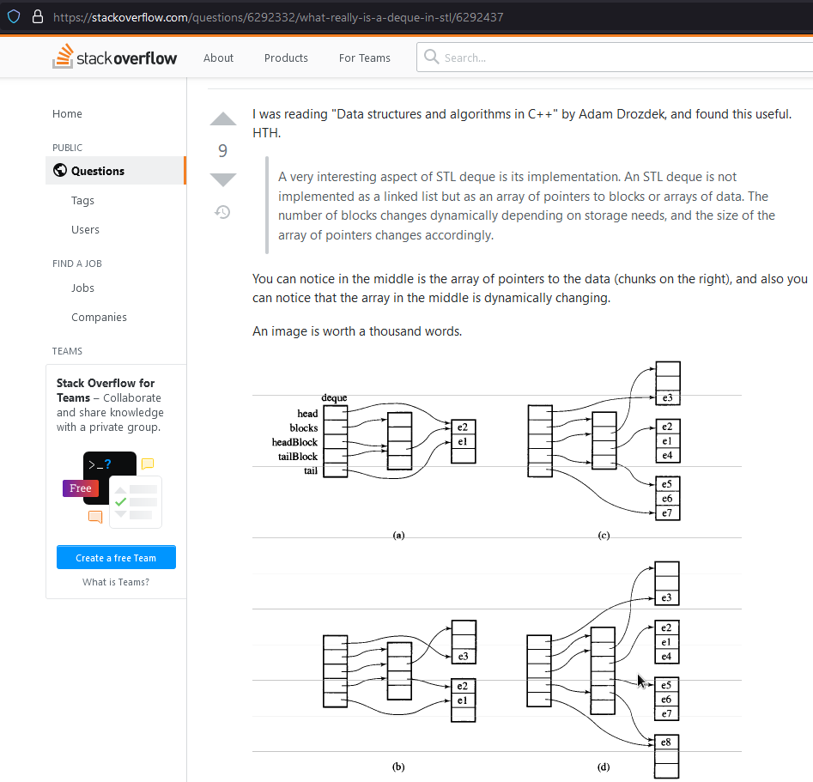
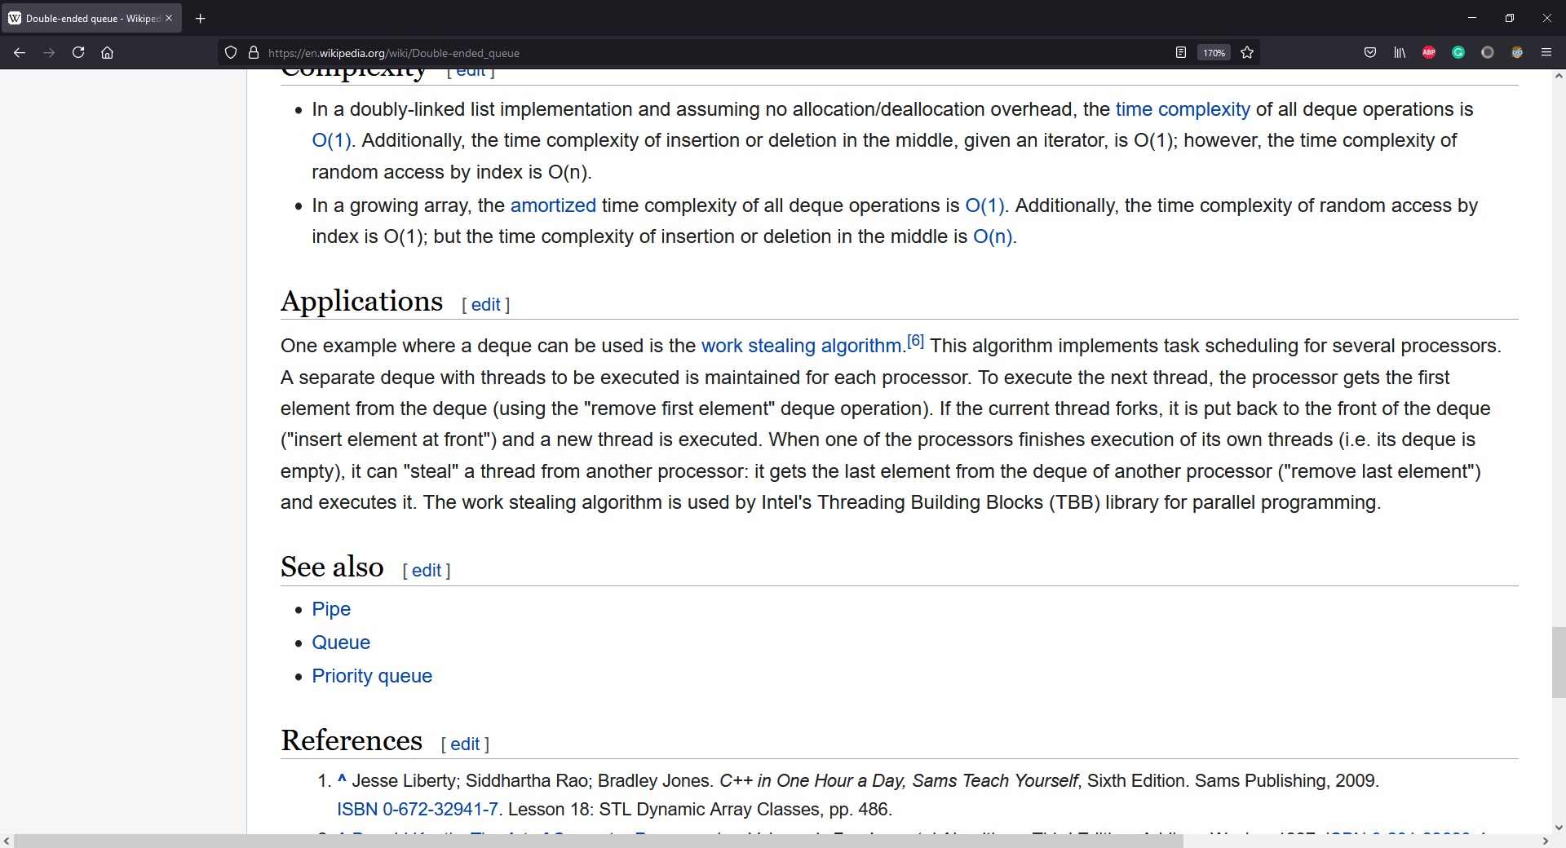
REEEEEEEE
REEEEEE
REEEEEEEEE
Blocks? –man kann das auch anders implementieren… ERWÄHNEN!
Benchmarking! VS Linked List
Meine implementierung VS die von python, oder c++
Wenn benchmark, mit –o3 benchmarken, ohne debug info
Deque in cpp… idee?!

