Slide 1
HUECTECH
Internship Portal
Client & Employee Project Walkthrough
LOGIN
ATTENDANCE
TASKS
HISTORY
HUECTECH Info Technologies Pvt Ltd | Internship Portal | 1

Slide 2
1. Project Context & Problem Statement
Why HUECTECH needed a dedicated internship management experience
Before
Business impact
Need
Attendance may be tracked manually or across disconnected tools. Student identity, attendance and learning tasks are not naturally connected.
More administrative effort, slower visibility, difficulty maintaining consistent records and a weaker student experience.
A single portal where an intern can authenticate, see their profile, mark daily attendance and follow learning tasks.
• Primary users: interns / students
• Business owner: HUECTECH training & internship team
• Goal: digitize the daily internship workflow
• Design principle: simple, secure, mobile-friendly experience
HUECTECH Info Technologies Pvt Ltd | Internship Portal | 2

Slide 3
2. How the Project Was Initiated
A practical delivery approach from requirement discovery to implementation
1
Identify pain points
2
Capture requirements
3
Design workflow
4
Select stack
5
Build modules
6
Test & refine
7
Prepare deployment
Initiation narrative
“We started by understanding the intern journey end-to-end. The first priority was reliable identity and attendance tracking; then the portal was structured so future modules such as task management, reporting and administration can be added without redesigning the core experience.”
HUECTECH Info Technologies Pvt Ltd | Internship Portal | 3

Slide 4
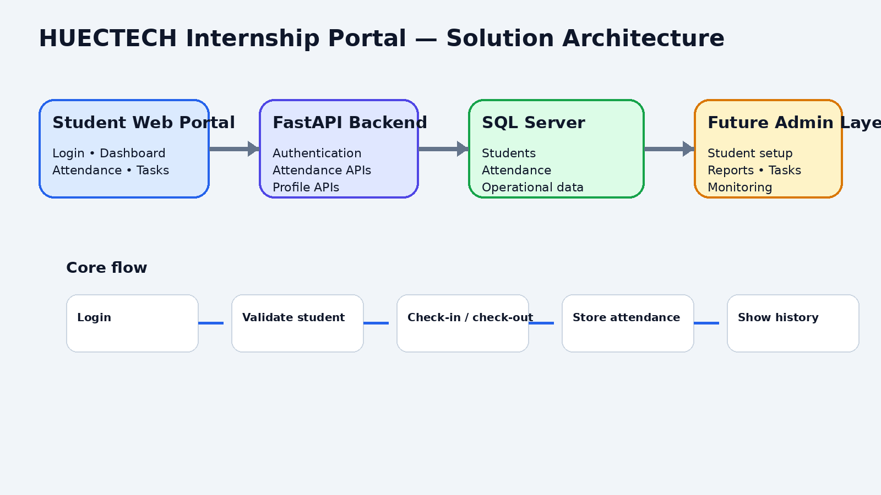
3. Solution Overview
The portal connects the student UI, API layer and SQL Server
HUECTECH Info Technologies Pvt Ltd | Internship Portal | 4

Slide 5
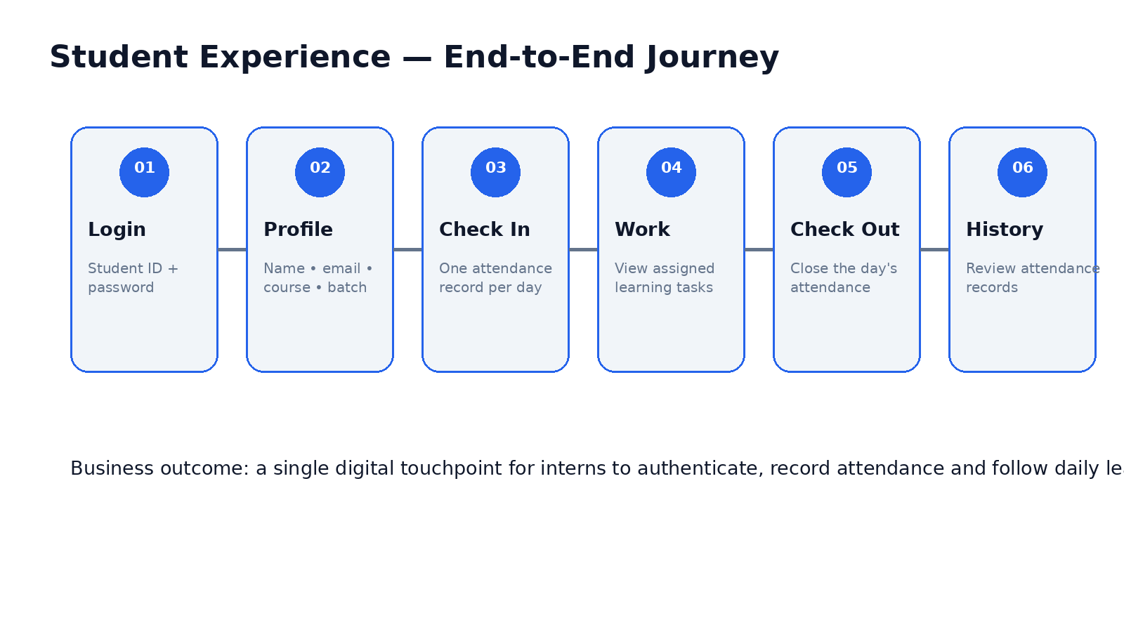
4. Student Journey
What a student experiences from login to attendance history
HUECTECH Info Technologies Pvt Ltd | Internship Portal | 5

Slide 6
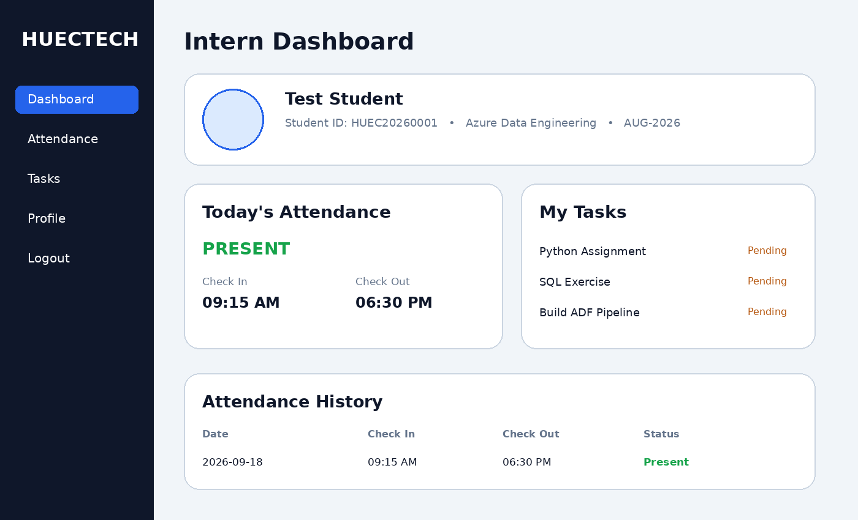
5. Portal UI — Dashboard Concept
The interface is organized around the intern’s daily workflow
HUECTECH Info Technologies Pvt Ltd | Internship Portal | 6

Slide 7
6. Core Functional Modules
What is represented in the current project package
Authentication
Student Profile
Today's Attendance
Student ID + password login; password verification with bcrypt.
Displays name, student code, email, course and batch.
Check-in, check-out and current-day status.
Attendance History
Learning Tasks
Responsive UI
API returns attendance records ordered by date.
Dashboard UI contains Python, SQL and ADF task examples.
HTML/CSS/JavaScript front end with reusable styling.
HUECTECH Info Technologies Pvt Ltd | Internship Portal | 7

Slide 8
7. Technical Architecture
Technology choices and responsibilities
Frontend
Backend
Data & Security
HTML5
CSS3
Vanilla JavaScript
localStorage for logged-in student context
Python
FastAPI
Pydantic request models
REST-style endpoints
SQL Server
pyodbc
python-dotenv
bcrypt password hashing
API flow
Browser → FastAPI endpoint → validation / business rule → SQL Server → JSON response → dashboard update
• Current API areas: /login, /attendance/* and /profile/* in the source package
• CORS is configured for development; production deployment should restrict allowed origins
• Frontend currently points to localhost API, so deployment requires environment-based API configuration
HUECTECH Info Technologies Pvt Ltd | Internship Portal | 8

Slide 9
8. Attendance Logic
Rules that protect the integrity of daily attendance
• 1. Validate the student exists and is active.
• 2. On check-in, look for an existing record for the current date.
• 3. If a record exists, reject duplicate check-in.
• 4. Otherwise insert AttendanceDate + CheckInTime + Present status.
• 5. Check-out is allowed only after check-in and only once.
• 6. History returns records ordered from newest to oldest.
Business rule
One attendance record per student per day, with controlled check-in / check-out transitions.
HUECTECH Info Technologies Pvt Ltd | Internship Portal | 9

Slide 10
9. Client Value
What this solution enables for HUECTECH
Centralized
Scalability
Future-ready extension areas
Student identity and attendance are brought into one portal.
API-based structure allows admin, task, reporting and notification modules to be added.
• Admin dashboard
• Student CRUD / ID assignment
• Task management with due dates and completion status
• Attendance calendar and monthly reports
• Email / WhatsApp notifications
• Role-based access control
• Cloud deployment and production monitoring
• Audit logging and analytics
Visibility
Professional Experience
Interns can see their daily status and historical records.
A branded portal gives interns a consistent digital touchpoint.
Consistency
Backend rules reduce duplicate or invalid attendance actions.
HUECTECH Info Technologies Pvt Ltd | Internship Portal | 10

Slide 11
10. Demo Script for a Client Meeting
A simple 5-minute walkthrough
• Open portal → show branded login
• Enter Student ID + password → demonstrate authentication
• Show profile → explain course and batch context
• Click CHECK IN → show Present status and timestamp
• Open Attendance History → show record retrieval
• Explain task area → connect it to internship learning
• Close with architecture + future roadmap
Client message
“The portal is designed around the intern’s daily journey, while the API and database provide a foundation for operational scale.”
Demo tip
Use one controlled test student. Show the same record moving from login → attendance action → history.
HUECTECH Info Technologies Pvt Ltd | Internship Portal | 11

Slide 12
11. Production Readiness & Next Steps
Important items to complete before a live client rollout
• Register the correct authentication router in main.py and verify the login route end-to-end.
• Register the profile router so /profile/{student_id} is exposed.
• Move API URL and environment settings out of hard-coded frontend JavaScript.
• Restrict CORS to approved production domains.
• Use a production authentication/session approach rather than relying only on localStorage context.
• Add admin controls, task persistence and reporting as business requirements mature.
• Deploy backend + database securely and add monitoring, backups and audit logging.
Current package assessment
Strong functional prototype foundation; a short hardening phase is recommended before production.
HUECTECH Info Technologies Pvt Ltd | Internship Portal | 12

Slide 13
HUECTECH Internship Portal
A digital foundation for managing the intern experience.
Login → Attendance → Learning → History → Scale
HUECTECH Info Technologies Pvt Ltd | Internship Portal | 13

