Slide 1
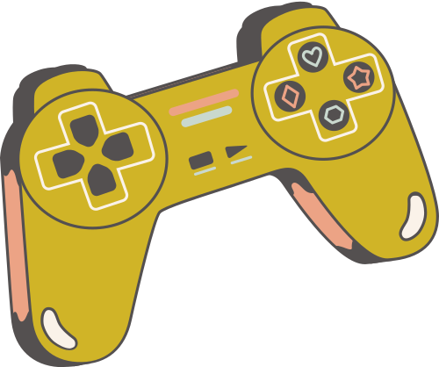
COMPUTER GRAPHICS
AND VISUALIZATION
CMIS 3234
FINAL PROJECT PRESENTATION
Supervisor: T. Aruchchelvam
182009: W. B. A. N. Bandara

Slide 2
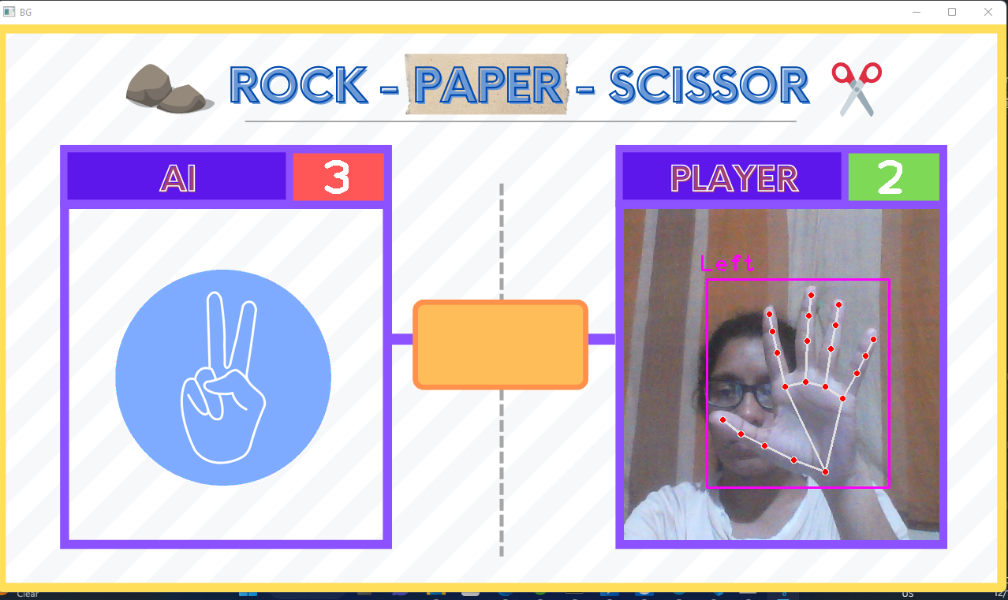

ROCK PAPER SCISSOR
This game takes the input (hand gesture) of the user through web cam and the AI generates a random output comparing the two gestures game points are distributed to the player or to the AI

Slide 3
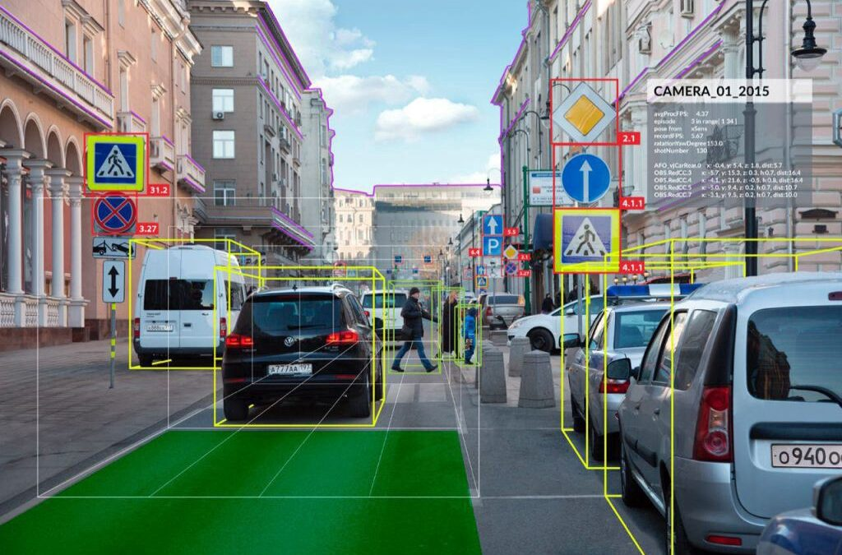
COMPUTER VISION
Computer vision is a process by which we can understand the images and videos, how we can manipulate and retrieve data from them.
Mostly used for Artificial Intelligence.
Plays a major role in self-driving cars, robotics as well as in photo correction apps.

Slide 4

OPENCV
OpenCV is the huge open-source library for computer vision, machine learning, and image processing
It plays a major role in real-time operation
Using this we can process images and videos to identify objects, faces, or even handwriting of a human.

Slide 5

Transformation Techniques
Window Transformation
GRAPHIC CONCEPTS

Slide 6
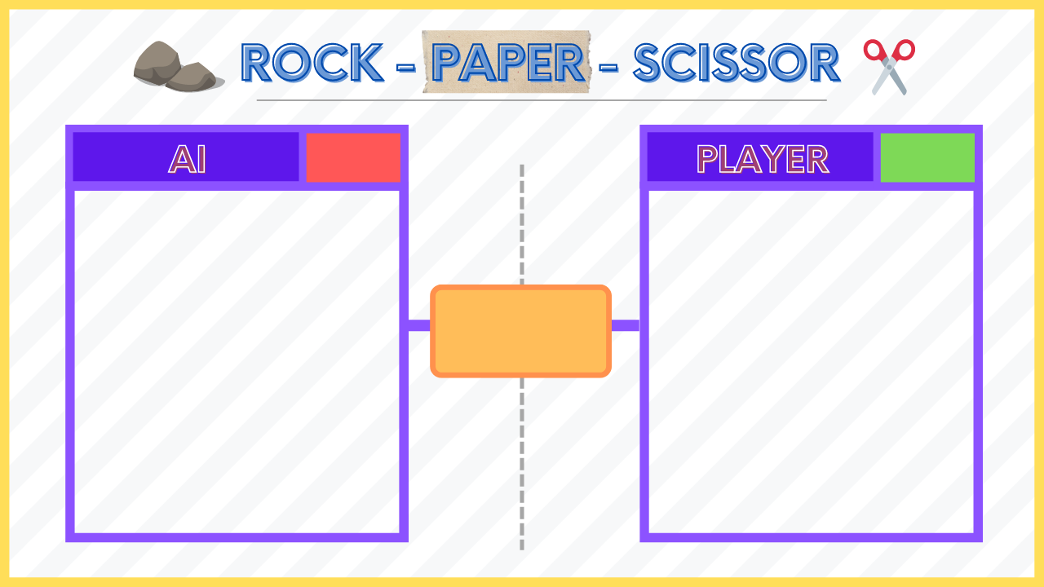
BACKGROUND USED

Slide 7



DEMONSTRATION

Slide 8
THANK YOU

