Slide 1
FOUNDATIONS OF ARTIFICIAL INTELLIGENCE | PROJECT REVIEW
AI-Based Resume Screener
Resumes in
▼
CSP constraint filter
Transparent candidate screening using CSP with backtracking, BFS and heuristic scoring
▼
Ranked shortlist
TEAM MEMBERS
NETHRA CHANDRAGANDHI T 240701357
NETHRA G 240701358
Score = 50S + 20P + 15E + 10C + 5X
Failed candidates are filtered out with reasons
Guided by: Mrs. B.Deepa
Notes:
Introduce the project: a symbolic-AI resume screener that treats mandatory job requirements as constraints (CSP) and ranks eligible candidates with a weighted heuristic score. No machine learning is used.

Slide 2
Problem Statement & Abstract
02
ABSTRACT
THE PROBLEM
The AI-Based Resume Screener compares candidate details (skills, education, CGPA, experience) against explicit job requirements. Mandatory requirements are modelled as constraints in a Constraint Satisfaction Problem (CSP). Constraint propagation stops the checks as soon as a hard requirement fails, and backtracking search tries the constraints one by one, undoing a step when it fails and recording which constraint failed. Breadth-First Search (BFS) then explores the candidates level by level through a queue, and those who pass are ranked by a manually designed weighted heuristic score. The system is rule-based (symbolic AI): no machine learning is used, so every decision can be explained.
Recruiters receive many resumes for one vacancy; manual review is slow and inconsistent.
Basic keyword filters miss qualifications and give no explanation for rejection.
Black-box ranking tools are hard to audit for fairness.
Goal: check mandatory criteria, explain every failure, and rank eligible candidates transparently.
5
100
8
0
constraint types
point heuristic score
pipeline stages
ML models used
AI-Based Resume Screener | Foundations of AI
Notes:
Problem: manual screening is slow, keyword filters are opaque. Our solution: CSP for mandatory criteria, constraint propagation for early rejection, heuristic score for ranking. Symbolic AI only.

Slide 3
Literature Survey (1/2)
03
Paper (title · authors · venue) | Methodology | Implementation | Advantages (+) | Limitations (−) | How our project overcomes it
[1] Gender, Race, and Intersectional Bias in Resume Screening via Language Model Retrieval — K. Wilson, A. Caliskan, AIES 2024 | Audit of LLM-based resume retrieval using resumes with varied names and identities. | Tested retrieval systems on a large set of resumes and job descriptions to measure demographic disparity. | Shows bias in AI screening with real evidence; motivates audits. | Black-box embeddings; cause of bias is hard to trace; no explanations. | Uses explicit, auditable constraints and fixed weights; no name or demographic feature is used.
[2] Perceived algorithmic fairness: transparency and anthropomorphism in algorithmic recruiting — J. Ochmann et al., Information Systems Journal, 2024 | Empirical (survey/experiment) study of how transparency affects perceived fairness. | Participants evaluated algorithmic recruiting scenarios with varied transparency. | Shows transparency improves perceived fairness. | Studies perception only; no screening system is built. | Builds the transparency in: shows passed/failed constraints and score breakdown.
[3] Fairness, AI & recruitment — Computer Law & Security Review, 53, 2024 | Legal and ethical analysis of fairness and discrimination in AI recruitment. | Conceptual review of regulation and accountability. | Clear view of discrimination and accountability risks. | No technical implementation or evaluation. | Rule-based decisions are reproducible; human review makes the final decision.
AI-Based Resume Screener | Foundations of AI

Slide 4
Literature Survey (2/2)
04
Paper (title · authors · venue) | Methodology | Implementation | Advantages (+) | Limitations (−) | How our project overcomes it
[4] Measuring gender and racial biases in LLMs: intersectional evidence from automated resume evaluation — J. An et al., PNAS Nexus, 2025 | Scores resumes with LLMs under randomised identities and compares results across groups. | Audit across multiple identities and occupations. | Reveals intersectional biases at scale. | Only audits; offers no fairer alternative; LLM outputs vary. | Deterministic scoring: same input always gives same result.
[5] Cracking the AI recruitment code: transparency in person–job fit — A. Chen, F. Han, X. Zhang, Y. Lu, Information & Management, 2025 | Studies how transparency in AI job-fit assessment affects trust and comparison with humans. | Empirical study of AI vs human person–job fit assessments. | Transparency narrows the gap between AI and human assessments. | Focuses on perception; model internals not simplified for small systems. | Every verdict has a reason (which constraint failed or how the score was formed).
[6] Fair and Transparent AI-Driven Resume Screening: Bias-Aware ML — K. Shah, M. Rana, T. Pimple, SEEJPH, 2025 | Bias-aware machine-learning model for automated screening. | ML pipeline with fairness-aware evaluation of resume ranking. | Automates screening and considers fairness. | Needs training data; ML decisions harder to explain. | No training data needed; symbolic CSP + heuristic is simple and explainable.
AI-Based Resume Screener | Foundations of AI

Slide 5
System Architecture & Working
05
1
2
3
4
5
6
7
8
Input
resume + job criteria
Parse
normalize fields
CSP model
criteria as constraints
Backtracking check
propagation + backtrack
Eligibility
pass / fail + reasons
BFS search
queue, level by level
Score & rank
weighted, out of 100
Results
ranked list + reasons
Hard constraints decide eligibility first; the score ranks only candidates who pass. Human review makes the final hiring decision.
CSP formulation
Example (illustrative)
Technology stack
Variables: candidate attributes
Domain: skills, degree, CGPA, years
Constraints: required skills, min. education, min. CGPA, min. experience
Search: backtracking (CSP) + BFS (candidates)
Propagation: first failure rejects the candidate
Rank: h = 50S + 20P + 15E + 10C + 5X
Job: Python + SQL, CGPA ≥ 7.0
Candidate A: CGPA 6.4 → fails, backtrack and reject
Candidate B: all constraints pass
Score B: Skills 50 + Preferred 10 + Edu 15 + CGPA 8 + Exp 3
Total: 86 / 100
Output: B ranked, A rejected with reason
Language: Python
Logic: CSP + rule-based scoring
Input: resume form / text
Interface: [Web UI / CLI – edit]
Data: sample resumes (CSV/JSON)
AI-Based Resume Screener | Foundations of AI
Notes:
Walk the pipeline left to right. Stage 4 is the CSP check using constraint propagation and backtracking; stage 6 is BFS over the candidate queue; stage 7 is the weighted heuristic ranking. Edit the technology stack to match your code.

Slide 6
Implementation — Modules 1 to 3
06
1
Input & Parsing
2
CSP Constraint Engine
3
BFS & Ranking
Collect resume details and job criteria
Eligibility using constraint propagation
BFS exploration, then score-based ranking
Fields: skills, education, CGPA, experience
Normalise text: lower-case, trim, skill aliases (py → python)
Build candidate and job objects
Mandatory criteria = hard constraints
Backtracking search: check constraints one by one, backtrack on failure
Records which constraint failed and why
BFS: candidates processed level by level using a FIFO queue
Weights: Skills 50, Preferred 20, Education 15, CGPA 10, Experience 5
Sort by score; show score breakdown
Output: clean structured candidate data
Output: Eligible / Rejected + reasons
Output: ranked shortlist + explanation
AI-Based Resume Screener | Foundations of AI
Notes:
Module 1 prepares data, Module 2 decides eligibility using constraints with backtracking, Module 3 uses BFS to explore candidates and ranks the eligible ones with the weighted heuristic.

Slide 7
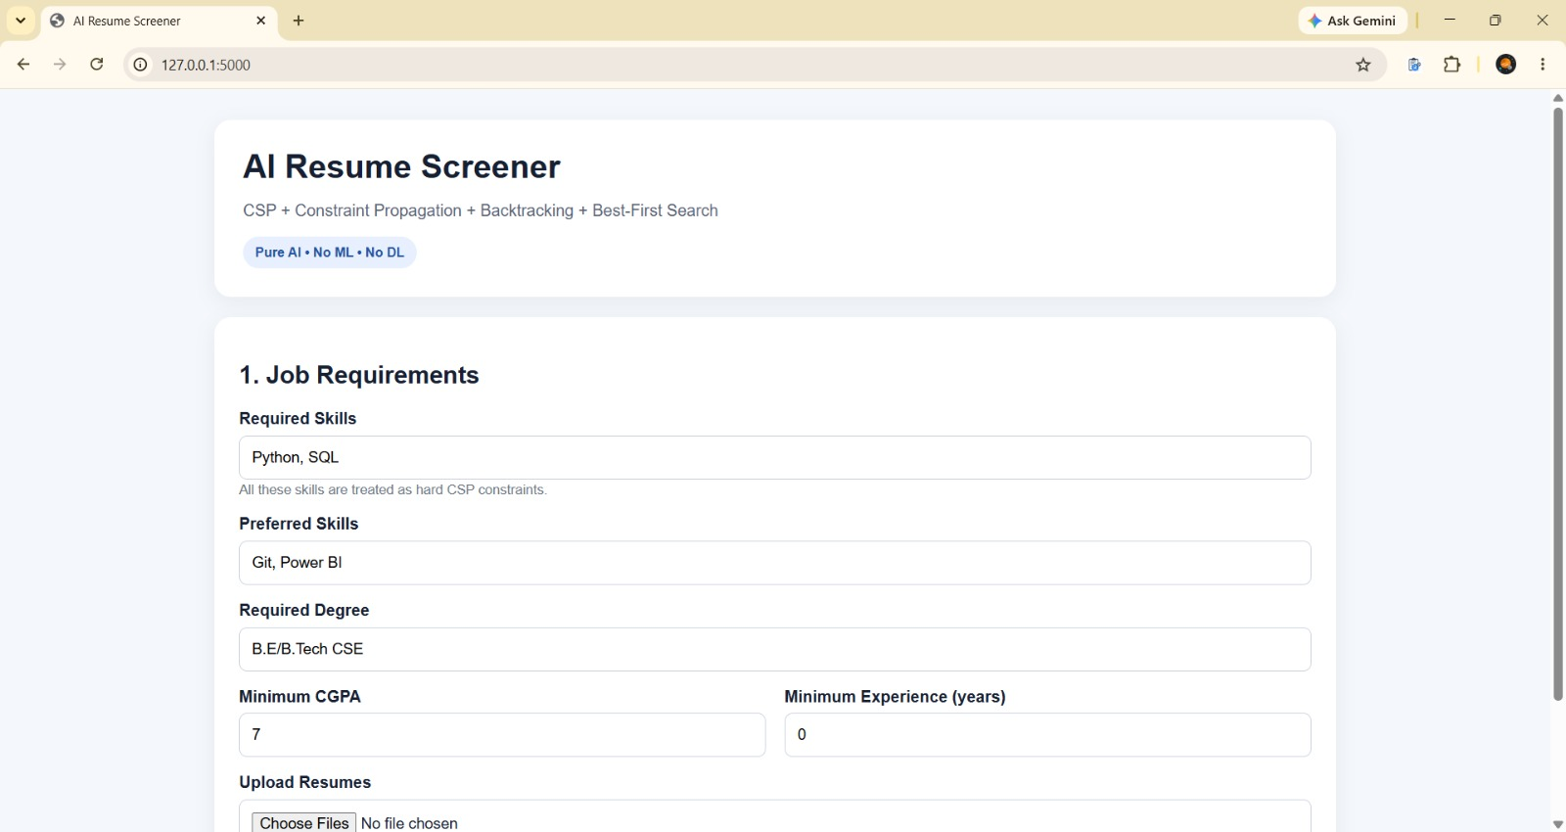
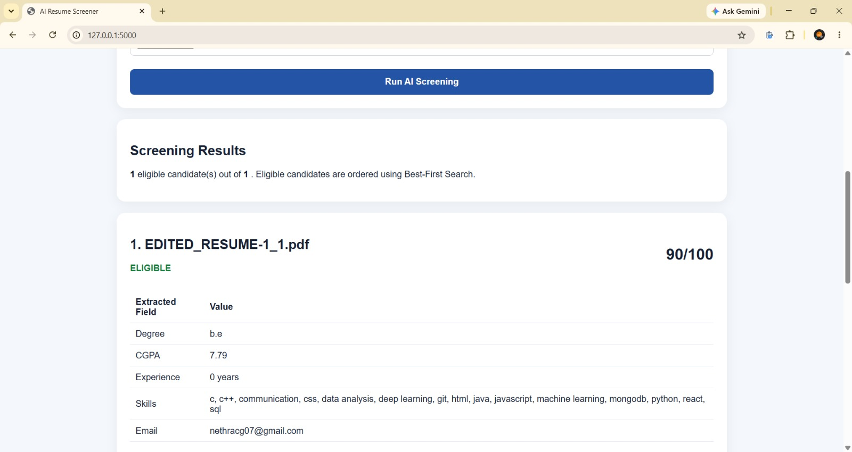
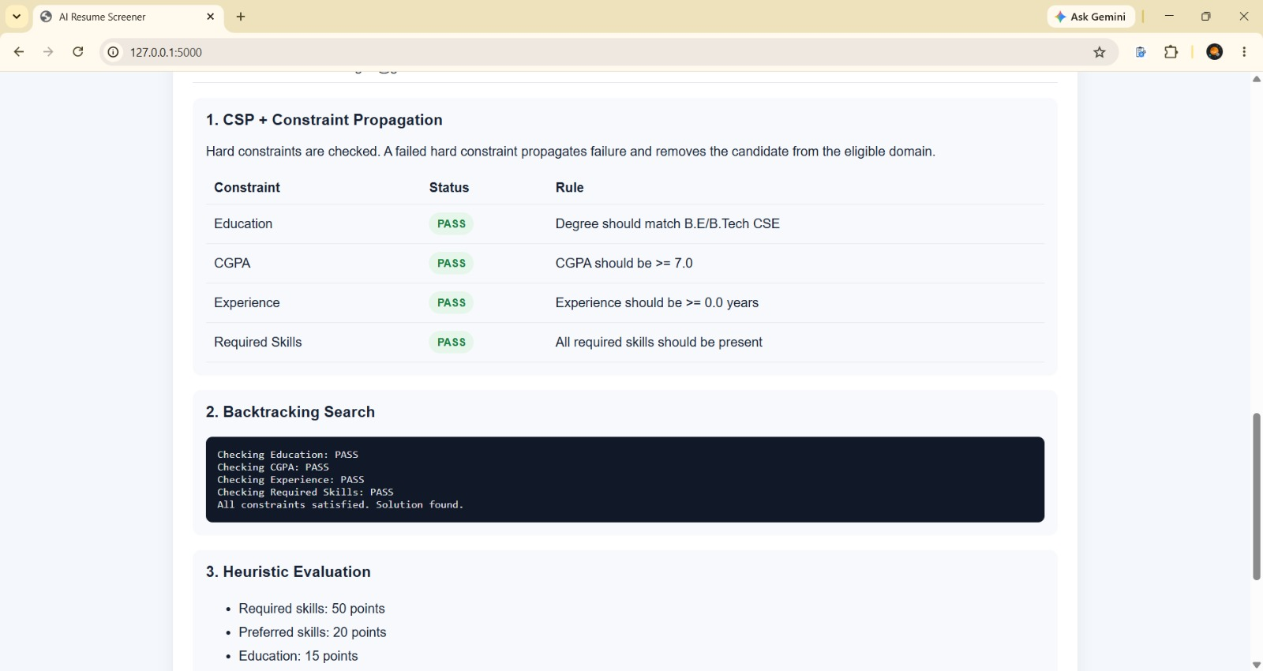
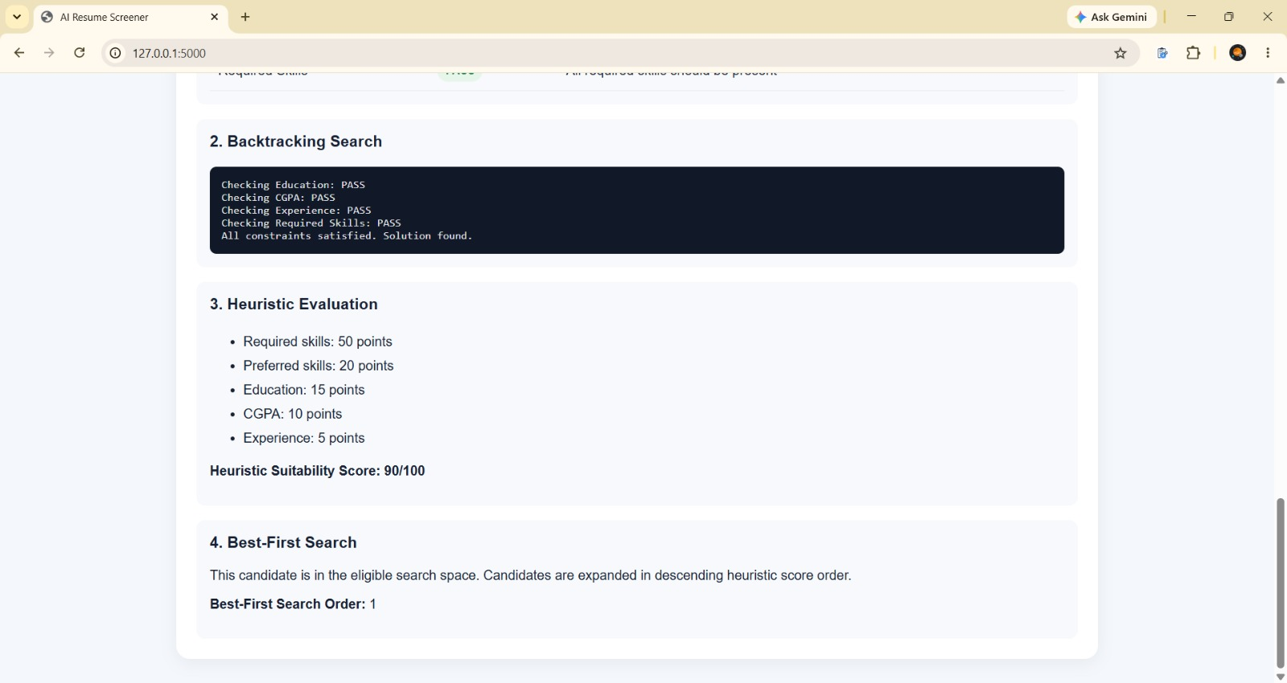
Output Screenshots
07
[ Paste screenshot 2 here ]
Home screen — resume details and job criteria input
Eligibility result — passed / failed constraints with reasons
[ Paste screenshot 3 here ]
[ Paste screenshot 4 here ]
Ranked candidate list with score breakdown
Rejected candidate — failed constraint explained
AI-Based Resume Screener | Foundations of AI
Notes:
Demo flow: enter job criteria, add a candidate who passes and one who fails, show the ranked list and the rejection reason.

Slide 8
Conclusion & Future Enhancements
08
CONCLUSION
FUTURE ENHANCEMENTS
5
100
0
01
Better resume parsing
PDF/DOCX text extraction
constraint types
point score
ML models
02
Configurable rules
recruiter-set constraints and weights
Job requirements are represented as explicit constraints (CSP).
Constraint propagation and backtracking find hard-constraint failures early.
BFS explores candidates systematically; a weighted heuristic ranks those who pass.
Every decision comes with an understandable reason.
Symbolic AI only: no training data or ML/DL model needed.
03
Bias audit
anonymised screening and audit reports
04
Evaluation
consented, diverse sample resumes
05
Feedback & logs
recruiter feedback, audit trail, data protection
AI-Based Resume Screener | Foundations of AI
Notes:
Summarise: explainable baseline. Limitations: depends on correct input, rule weights are manually chosen, human review is essential.

Slide 9
References
09
[1] K. Wilson and A. Caliskan, “Gender, Race, and Intersectional Bias in Resume Screening via Language Model Retrieval,” Proc. AAAI/ACM Conf. on AI, Ethics, and Society, vol. 7, no. 1, pp. 1578–1590, 2024, doi: 10.1609/aies.v7i1.31748.
[2] J. Ochmann et al., “Perceived algorithmic fairness: An empirical study of transparency and anthropomorphism in algorithmic recruiting,” Information Systems Journal, vol. 34, no. 2, pp. 384–414, 2024, doi: 10.1111/isj.12482.
[3] “Fairness, AI & recruitment,” Computer Law & Security Review, vol. 53, 105966, 2024, doi: 10.1016/j.clsr.2024.105966.
[4] J. An et al., “Measuring gender and racial biases in large language models: Intersectional evidence from automated resume evaluation,” PNAS Nexus, vol. 4, no. 3, pgaf089, 2025, doi: 10.1093/pnasnexus/pgaf089.
[5] A. Chen, F. Han, X. Zhang and Y. Lu, “Cracking the AI recruitment code: Striving for transparency in finding the right person–job fit,” Information & Management, vol. 62, no. 5, 104156, 2025, doi: 10.1016/j.im.2025.104156.
[6] K. Shah, M. Rana and T. Pimple, “Fair and Transparent AI-Driven Resume Screening: Enhancing Recruitment with Bias-Aware Machine Learning,” South Eastern European Journal of Public Health, 2025, doi: 10.70135/seejph.vi.4674.
[7] S. Russell and P. Norvig, Artificial Intelligence: A Modern Approach, 4th ed. Pearson, 2020.
AI-Based Resume Screener | Foundations of AI

Slide 10
Thank You
Questions & discussion

