Slide 1
CLOUD-ENABLED
SmartHostel Management System
A multi-tenant, cloud-integrated DBMS application for modern campus living
Cloud database integration · Scalability · Secure remote access

Slide 2
PROJECT OVERVIEW
The Challenge of Hostel Operations
Hostel logs, room bookings, inventory tracking, leave passes, and fee billing are traditionally handled offline or on siloed local systems — slow, error-prone, and hard to access.
24/7 Access
Reachable from any laptop, device, or campus location, any time.
Multi-user Concurrency
SmartHostel replaces this with one unified, cloud-hosted dashboard.
Students, wardens, and admins query and update data simultaneously.
Centralized State
One managed source of truth — no local data loss.
SmartHostel
02

Slide 3
SYSTEM INFRASTRUCTURE
Cloud-Native Architecture Model
01
Client Layer
Key Cloud Benefits
Responsive, lightweight Single Page Application (Vite / JS) running in the browser.
Automated backups
Elastic scalability
High availability
Compute and storage kept separate
↓
02
Application Hosting (PaaS)
FastAPI backend deployed to a serverless platform — proposed: Azure App Service, containerized Python 3.12.
↓
03
Cloud Database (DBaaS)
Fully managed database on Azure Database for PostgreSQL Flexible Server.
SmartHostel
03

Slide 4
SECURITY & NETWORKING
Cloud Security and Access Control
Secure Transport
IP Firewall Whitelisting
Data in transit is encrypted via SSL/TLS (sslmode=require enforced on every PostgreSQL connection string).
The cloud database enforces a strict incoming firewall — only approved developer, client, and server IPs are allowed.
Bypassing Campus Restrictions
Authentication
Encrypted virtual tunnels (e.g. Cloudflare WARP / VPN) route around restrictive institutional network firewalls.
JWTs are generated on the server and verified on every API request.
SmartHostel
04

Slide 5
TECHNICAL STACK
Modern & Scalable Technology Stack
Frontend
Backend API
Database Engine
ORM & Driver
HTML5, vanilla CSS3 (custom glassmorphism design), JavaScript — built with Vite.
Python 3.12, FastAPI (high-performance ASGI framework), Pydantic for request validation.
PostgreSQL — Azure Flexible Server tier, compatible with PostgreSQL 16+.
SQLAlchemy for object-relational mapping, psycopg2-binary as the native driver.
SmartHostel
05

Slide 6
ROLE-BASED ACCESS CONTROL
System Roles & Administrative Authority
Admin
Accountant
Global monitoring dashboard
Infrastructure registration — add hostels, add rooms, assign wardens
Manage assets — log and monitor furniture and utility inventories
Access financial report metrics — total dues, collected fees, pending balances
Billing — generate fee invoices linked to specific room categories
Manual overrides — register offline / cash payments and update ledgers
SmartHostel
06

Slide 7
ROLE-BASED ACCESS CONTROL
Warden Operations — Hostel Management
Room allocations
Assign students to rooms and process vacates
Complaint resolution
Assign and update maintenance request statuses — electrical, plumbing, wifi, and more
Leaves and passes
Approve or deny student home and out-pass requests
Daily logging
Record student attendance and manage visitor check-in / check-out logs
4
core responsibility areas
Wardens are the operational backbone — the single role connecting day-to-day student life to the system.
SmartHostel
07

Slide 8
ROLE-BASED ACCESS CONTROL
Student Operations — Self-Service
Room & Roommates
Complaints
Leave & Passes
View allocated room details and roommate information.
File maintenance complaints directly from mobile or laptop.
Submit out-pass and leave requests for approval.
Fees & Payments
Mess Feedback
Pay invoices through integrated mock payments and view fee history.
Submit weekly feedback on food quality, taste, and cleanliness.
SmartHostel
08

Slide 9
DATA MODEL
Relational Schema — 19 Tables
Auth & Accounts
users · student · warden
Hostel Infrastructure
hostel · room · room_allocation
Finance Ledgers
fee_structure · student_fee · payment
Operations Loggers
complaint · visitor · leave_request · room_change_request · attendance · notice
Resources & Utility
inventory · inventory_transaction · mess_menu · mess_feedback
SmartHostel
09

Slide 10
DATA MODEL
Relationship Integrity
Foreign-key relationships across the 19 tables are enforced with deliberate delete rules, keeping the dataset consistent as hostels, rooms, and students change over time.
Example Chain
hostel
↓
room
ON DELETE CASCADE
Dependent records (e.g. allocations, payments) are cleaned up automatically when their parent record is removed.
↓
room_allocation
↓
student_fee
ON DELETE RESTRICT
Prevents deletion of a record while dependent records still reference it — stops accidental data fragmentation.
↓
payment
SmartHostel
10

Slide 11
DATABASE OPTIMIZATION
Server-Side Logic for Data Integrity
trg_update_room_occupancy
Trigger
Fires on room_allocation updates — automatically increments or decrements bed counts and shifts room status between AVAILABLE and FULL.
trg_update_payment_status
Trigger
Fires on payment insertions — aggregates payments and updates invoice status dynamically to PAID, PARTIAL, or PENDING.
allocate_room( )
Stored Procedure
Validates student status and room vacancy, then atomically updates tables, terminates old allocations, and commits the transaction.
SmartHostel
11

Slide 12
PROPOSED DEPLOYMENT
Cloud Deployment Pipeline
1
2
3
Vite Frontend
FastAPI Backend
PostgreSQL Database
Static Web App
API App Service
Managed Database
Azure Static Web Apps
Azure App Service (Linux PaaS)
Azure Database for PostgreSQL — Flexible Server
→
→
Global CDN distribution, low-cost static hosting.
Continuous integration from GitHub, automated certificate management.
Secure private connection, automatic daily snapshots.
SmartHostel
12

Slide 13
ROADMAP
Future Scope
Mobile App
Analytics Dashboard
A companion mobile client for students, built on the same FastAPI backend.
Occupancy, revenue, and complaint-trend reporting for administrators.
Notifications
Payment Gateway
Automated email or SMS alerts for dues, approvals, and notices.
Replace mock payments with a live gateway integration for real fee collection.
SmartHostel
13

Slide 14
SUMMARY
Why Cloud Matters for SmartHostel
High Availability
Scalability
No downtime — accessible 24/7 from anywhere on or off campus.
New hostels, blocks, and thousands of student records added without friction.
Security
Maintenance-Free
Centralized IP whitelists and SSL keep student profiles and transactions protected.
Cloud-managed scaling, backups, and networking remove physical server overhead.
SmartHostel
14

Slide 15
THANK YOU
Cloud-Enabled SmartHostel Management System
Questions & Discussion

Slide 16
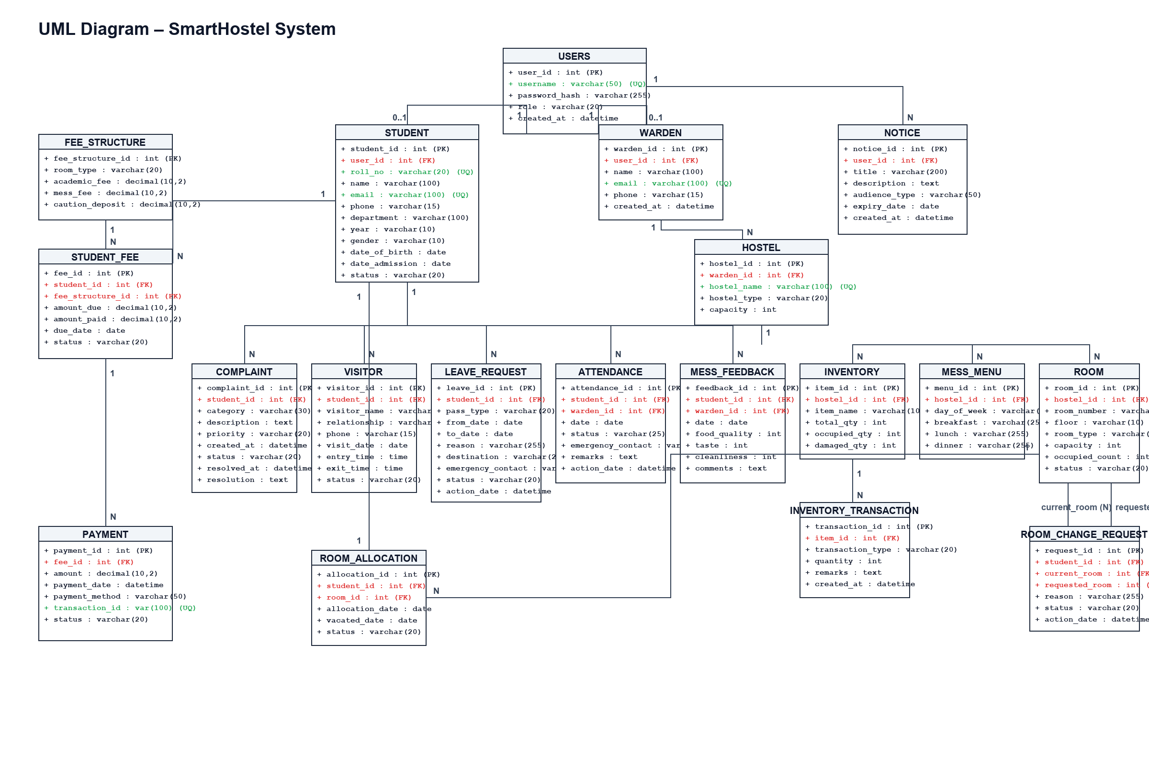
DATABASE DESIGN
UML Class Diagram — System Architecture & Multiplicities

Slide 17
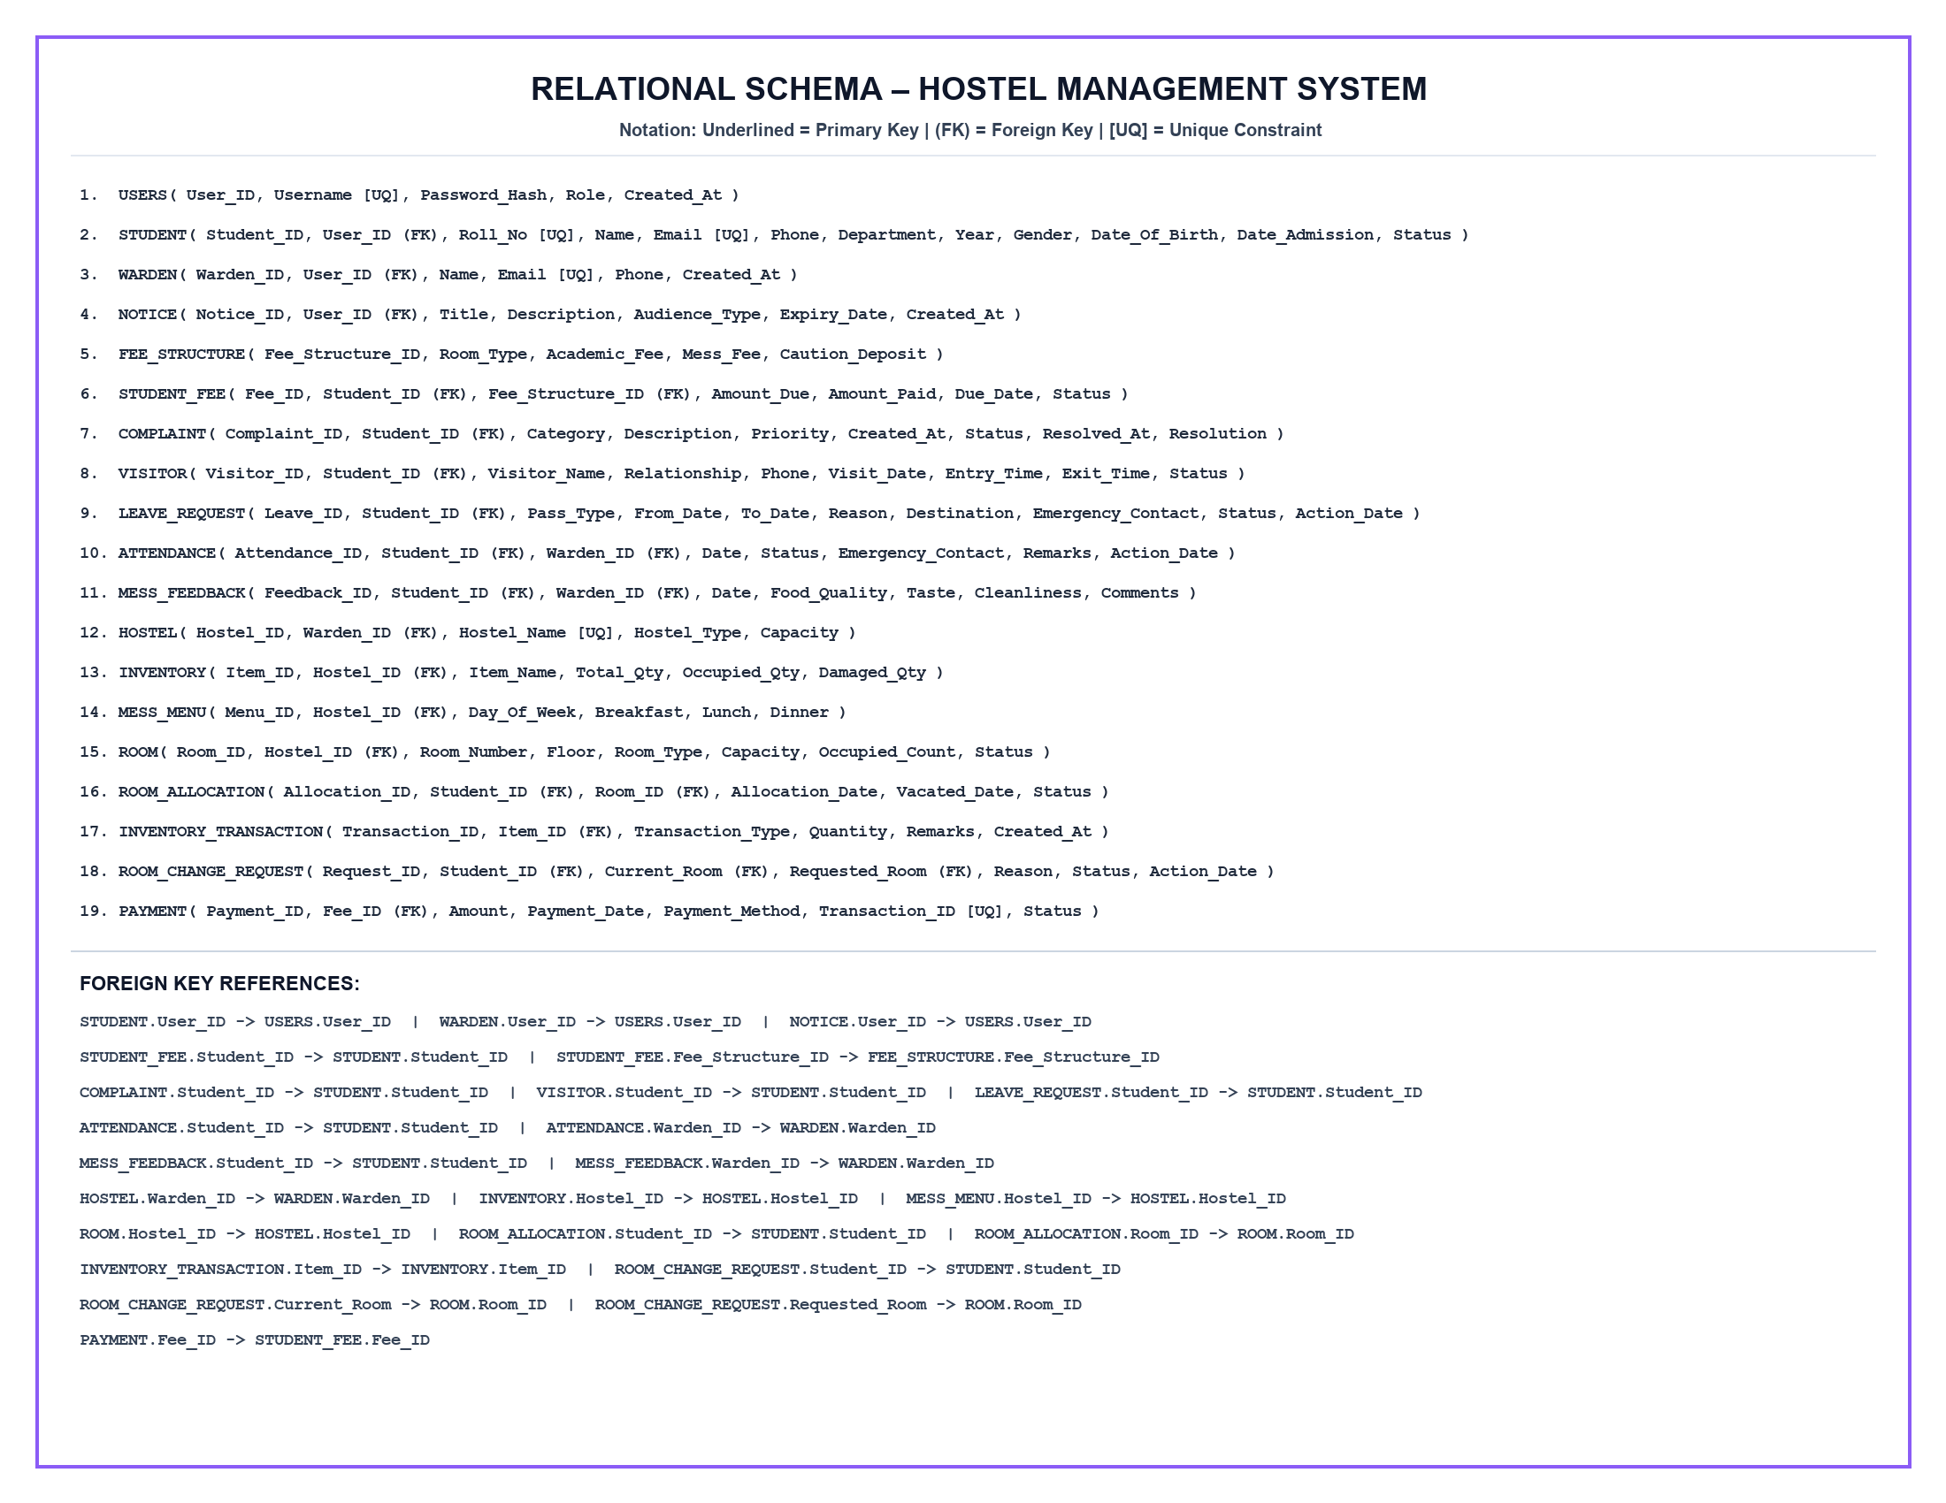
DATABASE DESIGN
Relational Schema — 19 Core Tables & Referential Integrity

Slide 18
DATABASE DESIGN & ENTITY RELATIONSHIP
Entity-Relationship (ER) Model — Entities, Attributes & Cardinalities
• Core Entities & Strong Types:
USERS, STUDENT, WARDEN, HOSTEL, ROOM, FEE_STRUCTURE, NOTICE, INVENTORY, MESS_MENU.
• Weak & Temporal Junction Entities:
ROOM_ALLOCATION (associates Student to Room over time), STUDENT_FEE (instance bills), PAYMENT (settlement audit), INVENTORY_TRANSACTION (stock delta), ROOM_CHANGE_REQUEST.
• Multiplicity & Participation:
• USERS to STUDENT / WARDEN: 1 : (0..1) optional total participation
• HOSTEL to ROOM: 1 : N (mandatory existence)
• STUDENT to ROOM_ALLOCATION: 1 : N (tracks residency history)
• FEE_STRUCTURE to STUDENT_FEE: 1 : N rate billing
• STUDENT_FEE to PAYMENT: 1 : N partial and full settlement logs
• Referential Integrity Rules:
• ON DELETE CASCADE: Purges child allocations, complaints, passes upon student exit.
• ON DELETE SET NULL: Preserves historical records when wardens depart.
• ON DELETE RESTRICT: Protects fee structures from deletion while active student dues exist.

Slide 19
DATABASE DESIGN & FORMAL VALIDATION
Normalization Justification — Decomposition Proofs up to 3NF & BCNF
• 1NF (First Normal Form):
Eliminated all repeating groups and composite fields. Every column (e.g. fees, roommates) holds atomic scalar values with explicit unique primary keys.
• 2NF (Second Normal Form):
Eliminated partial functional dependencies. In unnormalized allocations {StudentID, RoomID} -> HostelName, RoomCapacity; separated into independent relations STUDENT, ROOM, and ROOM_ALLOCATION so non-key attributes fully depend on the entire primary key.
• 3NF (Third Normal Form):
Eliminated transitive dependencies (X -> Y and Y -> Z). Extracted fee tariffs into FEE_STRUCTURE (RoomType -> Fees) so tuition pricing does not transitively depend on individual Student records, preventing deletion anomalies.
• BCNF (Boyce-Codd Normal Form):
Every non-trivial functional dependency X -> Y has a candidate superkey for X. Surrogate keys (SERIAL PRIMARY KEY) and unique business keys ([UQ] roll_no, email, transaction_id) strictly enforce BCNF across all 19 schemas.

