Slide 1
Detection of Diabetic Retinopathy using ResNet - 50
CSE-6363-002 : Machine Learning
Team 11 -
Nethra Renjarla - 1002166130
Dhyuthi Sri Ramya Cheruvu - 1002137729
Swarna Kannambadi Ramesh - 1002176011
Jesus Gonzalez

Slide 2
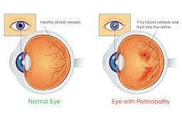
Description
Diabetic Retinopathy is a complication of diabetes that affects vision by damaging the retina's blood vessels due to high blood sugar levels.
In its early stages, it may be asymptomatic or cause intermittent vision disturbances.
As the condition progresses, it impacts both eyes and may result in partial or complete vision loss, particularly when blood sugar levels are poorly managed.
Individuals with diabetes mellitus are at a higher risk of developing this disease.
Early detection is essential to prevent irreversible blindness, emphasizing the need for an effective screening system.
This study employs a deep learning approach using ResNet-50, a deep Convolutional Neural Network (CNN), to facilitate early detection of diabetic retinopathy.

Slide 3
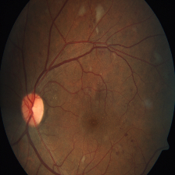
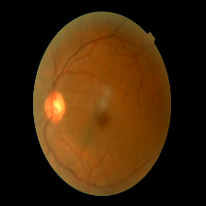
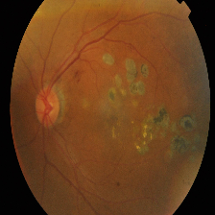
Dataset
The datasets that are taken into consideration are Diabetic Retinopathy detection 2019 obtained from Kaggle.
It classifies the fundus images based on their severity levels as No DR, Mild, Moderate, Severe and Proliferative DR.

Slide 4
Research papers references
Base Paper:
Y. Wankhede, P. Shinde, S. Naik, R. Raut and A. Devkar, "Diabetic Retinopathy Detection Using Convolutional Neural Network," 2023 7th International Conference On Computing, Communication, Control And Automation (ICCUBEA), Pune, India, 2023, pp. 1-6, doi:10.1109/ICCUBEA58933.2023.10391972

Slide 5
Additional References:
1. Das, D., Biswas, S. K., & Bandyopadhyay, S. (2022). Detection of Diabetic Retinopathy using Convolutional Neural Networks for Feature Extraction and Classification (DRFEC). Multimedia tools and applications, 1–59. Advance online publication. https://doi.org/10.1007/s11042-022-14165-4
2. Moin, K., Shrivastava, M., Mishra, A., Jena, L., Nayak, S. (2023). Diabetic Retinopathy Detection Using CNN Model. In: Swarnkar, T., Patnaik, S., Mitra, P., Misra, S., Mishra, M. (eds) Ambient Intelligence in Health Care. Smart Innovation, Systems and Technologies, vol 317. Springer, Singapore. https://doi.org/10.1007/978-981-19-6068-0_13
3. Suedumrong, C., Phongmoo, S., Akarajaka, T., & Leksakul, K. (2024). Diabetic Retinopathy Detection Using Convolutional Neural Networks with Background Removal, and Data Augmentation. Applied Sciences, 14(19), 8823. https://doi.org/10.3390/app14198823

Slide 6
Timeline
Feb 1st 2025 | Problem definition, data collection and research
Feb 22nd 2025 | Data cleaning and data preprocessing
March 29th 2025 | Training of the model
April 19th 2025 | Testing and evaluation

Slide 7
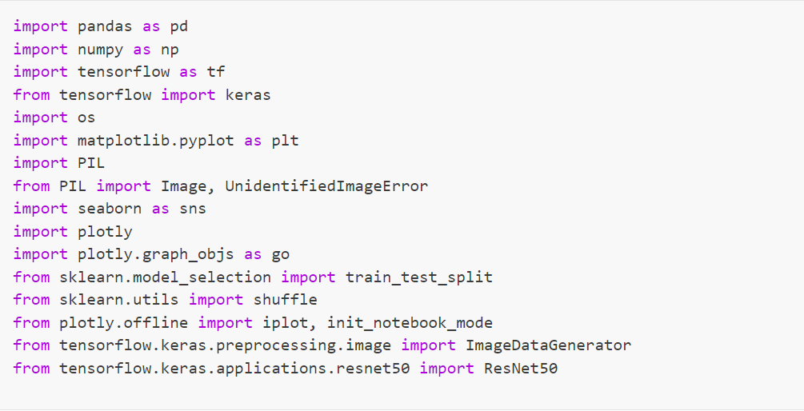
Libraries used
Pandas
NumPy
TensorFlow
Keras
Matplotlib
PIL(Pillow)
Seaborn
TensorFlow

Slide 8
Data Preparation Process
Data Collection
Data Visualization
Data Transformation
Data Cleaning
Data Augmentation

Slide 9
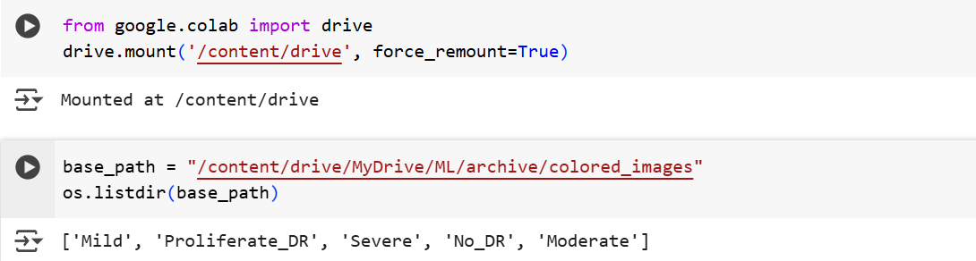
Data Collection
Gathered the Kaggle data and stored it on Google Drive for convenient access. The code lists every file and subdirectory in the given base_path using os.listdir(base_path).

Slide 10
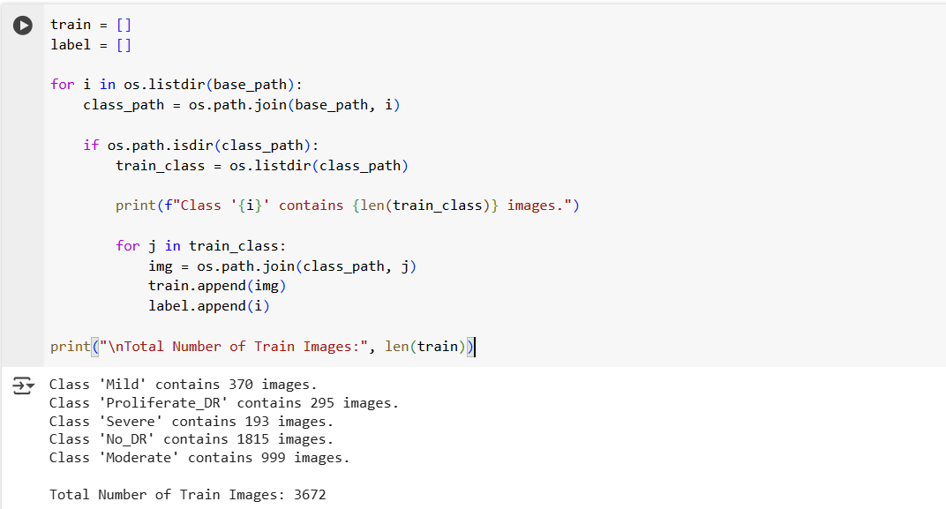
The total number of training photos discovered in every class:
3672 photos from five different classes –
“Mild”, “Proliferate_DR”, “Severe”, “No_DR” and “Moderate”

Slide 11
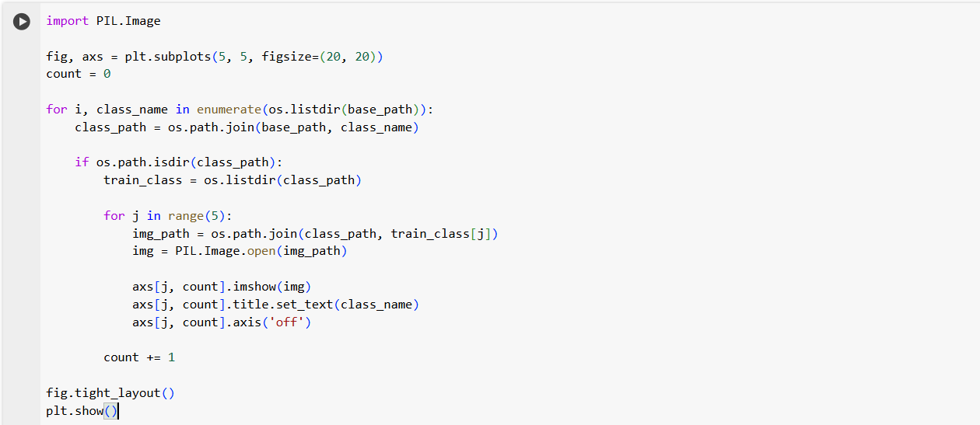
Data Visualization
Images from several class folders within a specified base path are visualized by this Python application. Images are opened using PIL, and they are shown in a grid form using matplotlib. Five photographs are chosen from each class directory when the script iterates through them, then arranged in a 5x5 subplot. Every picture has its class name labelled on it.

Slide 12
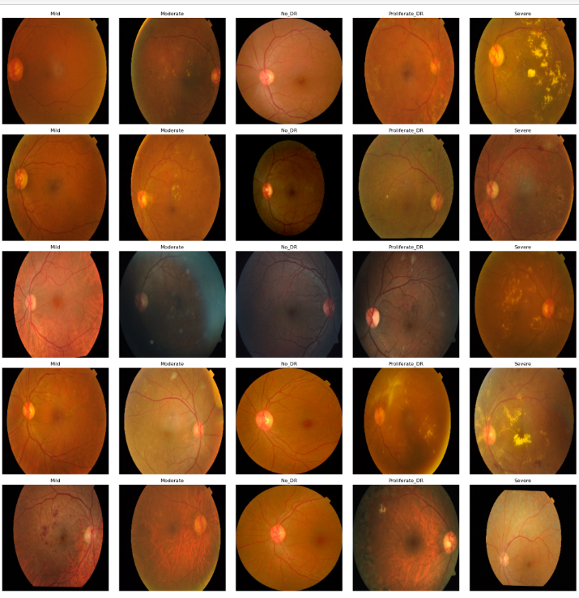
Below are the images displayed with its class name:

Slide 13
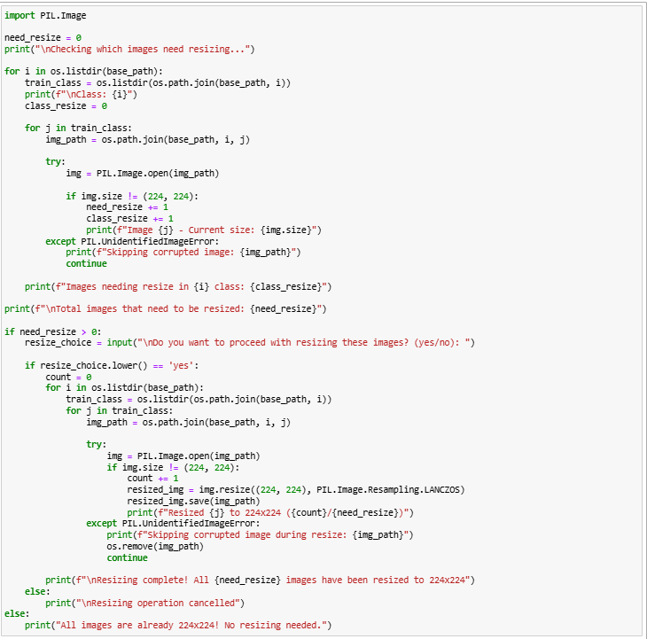
Data Transformation
Resizing
Using PIL, this script verifies and resizes images in class directories to a consistent 224x224 size. It skips over any faulty photos and initially examines every image to determine which ones require resizing. Before resizing, it asks the user for approval if resizing is required. The original photos are replaced by the resized ones. No action is made if every image is already 224x224.

Slide 14
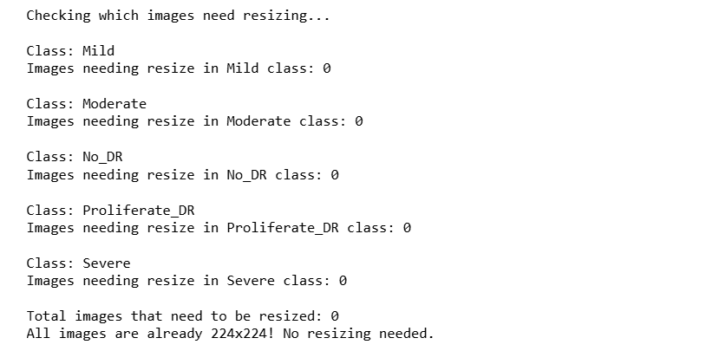
Data Transformation
Output:
There is no need for resizing because this output verifies that every image in the collection is already 224x224. Every class directory (Mild, Moderate, No_DR, Proliferate_DR, and Severe) was correctly scanned by the script, and no photos that required resizing were discovered. The resizing process was therefore omitted.

Slide 15
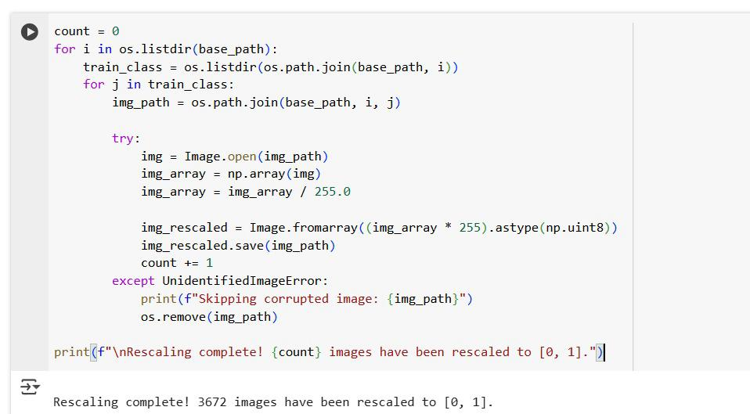
Data Transformation
Rescaling
This script normalizes image pixel values to [0,1] to improve model performance, stability, and training efficiency in machine learning. It processes images from directories, rescales them, and removes corrupted ones to ensure clean, standardized input for further processing.

Slide 16
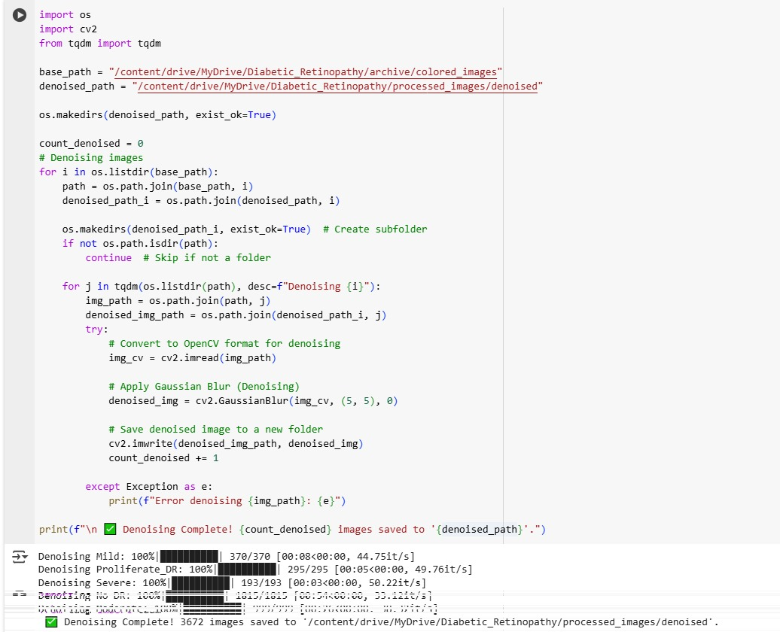
Data Cleaning
Images in a specified directory are subjected to Gaussian blur denoising by this script, which then saves the treated images to a new folder. It uses tqdm for progress tracking, OpenCV for image processing, and preserves the original folder structure. When denoising is finished, a summary of the procedure is shown, and any errors that were encountered are recorded.

Slide 17
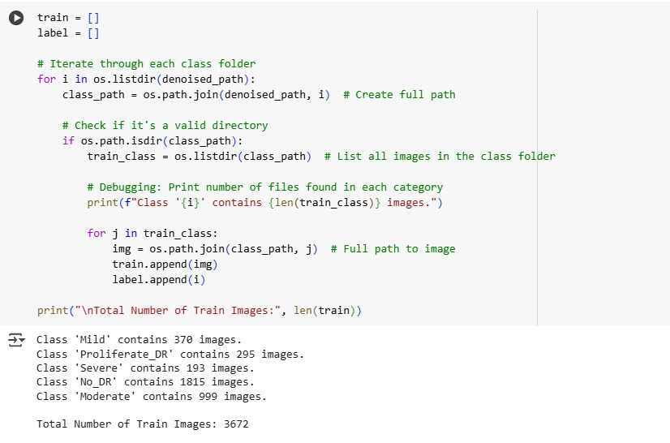
Data Cleaning
Using class labels as a guide, this script loads and arranges photos from a denoised dataset into a training set. It keeps the picture paths and associated names in distinct lists, iterates over class directories, and counts the number of images in each class. Lastly, a summary of the total number of photos in each category and the size of the dataset as a whole is printed.

Slide 18
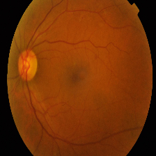

Output
Mild
Original image Denoised image

Slide 19
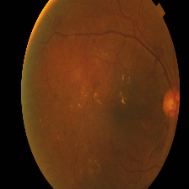

Output
Moderate
Original image Denoised image

Slide 20
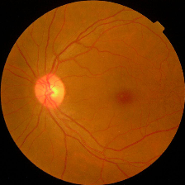
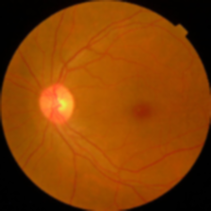
Output
No_DR
Original image Denoised image

Slide 21
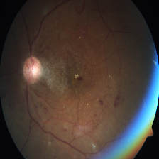

Output
Proliferate_DR
Original image Denoised image

Slide 22
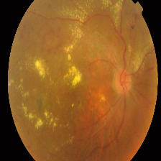
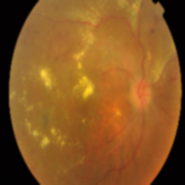
Output
Severe
Original image Denoised image

Slide 23
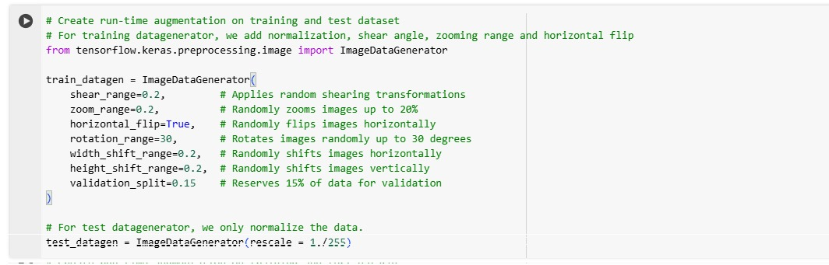
Data Augmentation
This ImageDataGenerator applies data augmentation to enhance training diversity. It includes:
Shear (shear_range=0.2) - Tilts images slightly.
Zoom (zoom_range=0.2) - Randomly zooms in/out by 20%.
Flip (horizontal_flip=True) - Flips images horizontally.
Rotate (rotation_range=30) - Rotates images up to ±30°.
Shift (width_shift_range=0.2, height_shift_range=0.2) - Moves images randomly.

Slide 24
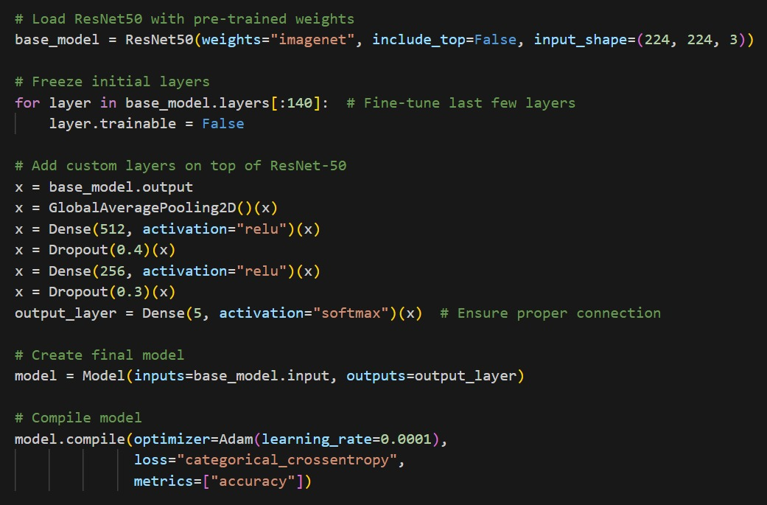
Resnet-50 Model Architecture

Slide 25
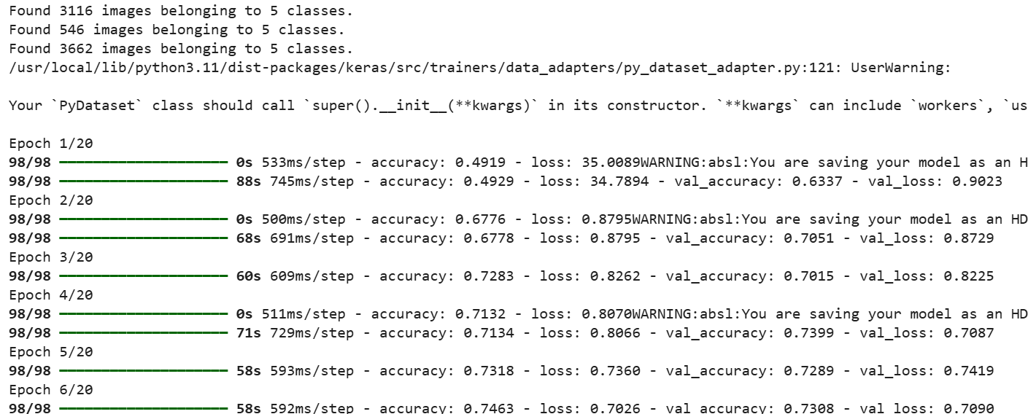
Results

Slide 26
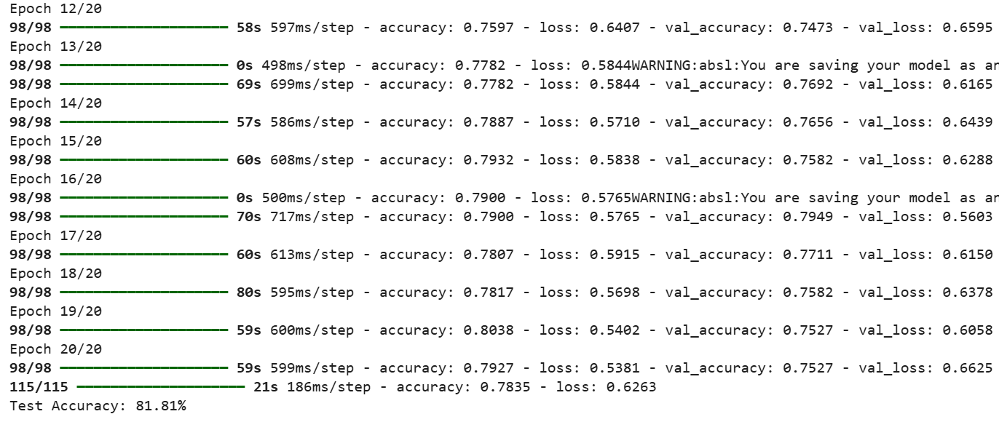
Results

Slide 27
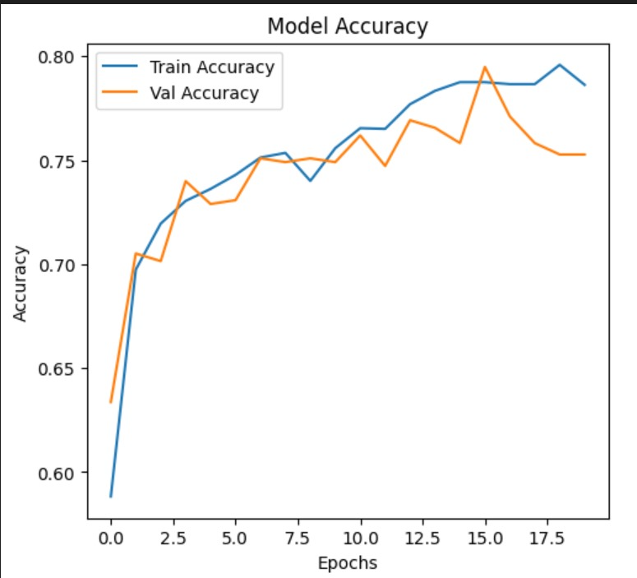
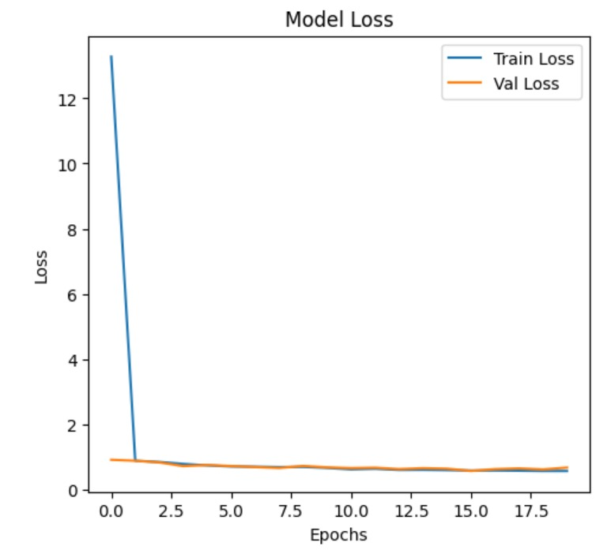
Results

Slide 28
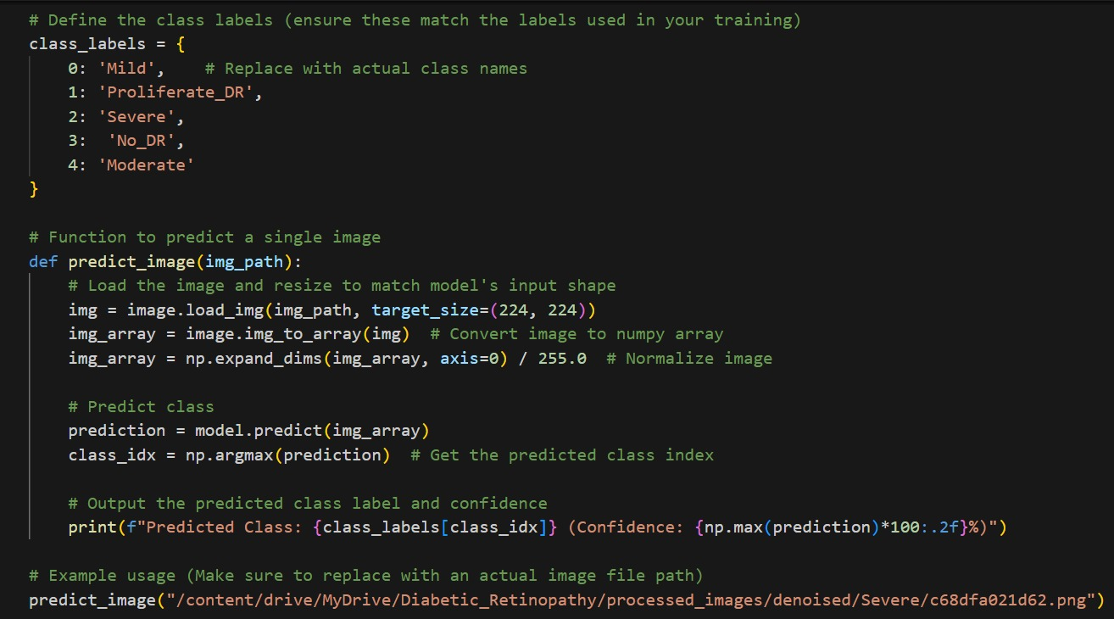
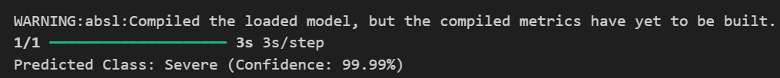
Predictions

Slide 29
Thank you

