Slide 1
Data Visualisation
End Sem Project
DATASET
Lok Sabha Election Results 2024
GROUP MEMBERS
Pranika S
Nethra Vijayabaskar
Priyadarshini R

Slide 2
Data Quality & Cleaning
543
8
7
542
Raw Rows
Columns
Issues Found
Clean Records
#01 Margin: String → Numeric
#02 Constituency Casing
#03 Missing Trailing Candidate
#04 Column Rename: Const. No.
BEFORE:
BEFORE:
BEFORE:
BEFORE:
Trailing Candidate & Trailing Party: 1 null row (Surat)
df["Margin"] → dtype: object (string)
125 ALL-CAPS rows (e.g. AJMER, ALWAR) vs 418 Title-case rows
"Const. No." — period & space make column access error-prone
FIX (Python):
FIX (Python):
FIX (Python):
FIX (Python):
df["Margin"] = pd.to_numeric(df["Margin"], errors="coerce")
df["Constituency"] = df["Constituency"].str.title()
df[["Trailing Candidate","Trailing Party"]] = df[...].fillna("Uncontested")
df.rename(columns={"Const. No.": "Const_No"}, inplace=True)
WHY:
WHY:
WHY:
WHY:
Margin was stored as string, blocking all arithmetic. 1 non-numeric value (Surat — uncontested) coerced to NaN and handled separately.
Inconsistent casing caused groupby/filter mismatches. Standardized to Title Case for uniform string operations.
Surat was uncontested — no opposition candidate filed. Filled with 'Uncontested' to preserve row and signal special status.
Column names with periods/spaces require bracket notation and break attribute access. Renamed to snake_case for clean scripting.
#05 Duplicate Constituency Names
#06 Special Chars in Candidate Names
BEFORE:
#07 Trailing Party Whitespace
✓ Dataset Logical Validity
Aurangabad ×2 (Maharashtra+Bihar), Maharajganj ×2 (UP+Bihar)
BEFORE:
BEFORE:
"HASMUKHBHAI PATEL (H.S.PATEL)", "GAJENDRAN, G.V."
1 trailing party entry had invisible leading whitespace
✓ 542 valid contested results
FIX (Python):
FIX (Python):
FIX (Python):
✓ 1 uncontested seat (Surat — BJP)
# Both are valid distinct seats in different states
# Retained as-is; documented in data dictionary
df["Leading Candidate"] = df["Leading Candidate"].str.strip()
# Parentheses retained — official ECI names
✓ All margins ≥ 48 votes (min valid)
df["Trailing Party"] = df["TrailingParty"].str.strip()​
df["Leading Party"] = df["LeadingParty"].str.strip()​
✓ No negative margins found
:
✓ 40+ parties — India's multi-party reality
WHY:
WHY:
Two same-named constituencies exist in different states. Both records are legitimate — retained with documentation note.
Parentheses/commas are part of official ECI candidate names. Whitespace stripped only — no valid characters removed.
✓ Status: 542 Declared, 1 Uncontested
WHY:
invisible whitespace breaks group by operations. Applied strip() across all party name columns for consistency.
✓ No fully duplicate rows detected

Slide 3
Analysis of Data
- Key Findings from 2024 Indian General Elections
Key Statistical Findings
Distribution Insights
BJP dominance: Won 240 seats (44.2%) — largest single-party haul
INC recovery: Won 99 seats (18.23%) — significant improvement over 2019
Vote share: BJP secured ~52.36% of aggregate votes across constituencies
Margin extremes: Ranges from <1,000 votes to over 1 million (INDORE outlier)
Trailing diversity: Aurangabad, HAMIRPUR & Maharajganj show 2 unique trailing parties
Regional patterns: SP strong in UP; DMK dominant in Tamil Nadu; AITMC sweeps Bengal
High-turnout seats: INDORE, Dhubri, VIDISHA record highest Votes per Constituency (>1M)
Margin vs seat no.: Lower-numbered constituencies (1-50) tend to show larger victory margins
Alliance impact: NDA alliance collectively controls ~55% of all constituencies
Party-wise Seat Distribution
Margin & Competitiveness
Vote % Analysis
Bharatiya Janata Party leads with 240 seats followed by INC (99), SP (37), and AITMC (29). Smaller parties like DMK, TDP, and Shiv Sena collectively hold ~15% of remaining seats, indicating a fragmented opposition landscape.
The margin distribution is heavily right-skewed. Most constituencies were won by moderate margins (50K–200K votes). A few outliers like INDORE (~1M margin) significantly inflate the mean, suggesting BJP's strongholds are exceptionally secure.
Aggregate vote % analysis shows BJP's commanding national presence. INC holds ~14.78% of votes. Regional parties like DMK (~5.77%) punch above their weight in vote share relative to seat count, reflecting concentrated regional dominance.

Slide 4
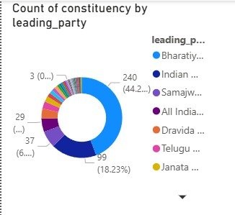
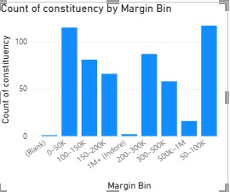
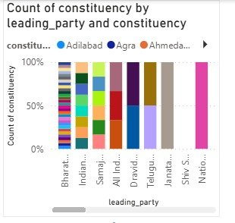
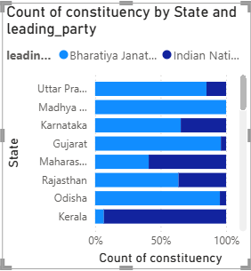
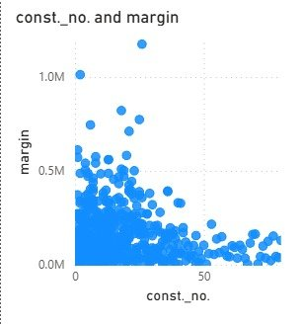
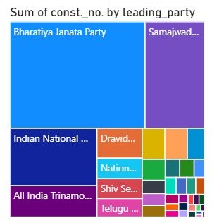
Visualizations — Dashboard 1
Donut Chart – Seat Share
Bar chart– Margin Distribution
Stacked Bar – Party × Constituency Mix
Chosen to show part-to-whole relationship at a glance. Viewer immediately sees BJP's commanding 44.2% vs fragmented rest.
Winning margins are small — most races were closely fought.
Indore (∼10 lakh margin) is a one-of-a-kind outlier
Stacked 100% bars expose constituency diversity per party — parties with single-color bars have homogeneous wins; multicolor shows contested wins.
Scatter Plot – Seat No. vs Margin
Scatter shows correlation (or lack thereof) between constituency number and margin. Outlier ~1M margin at const #1 (INDORE) is immediately visible.
Treemap – Seat Count by Party
Treemap encodes seat count as area — humans excel at area comparison. BJP block dwarfs others, making the dominance viscerally clear.
Stacked bar chart
It makes it easy to compare theproportion between two parties acrossdifferent states in one glance. BJPdominates most states; INC holds groundin select regions

Slide 5
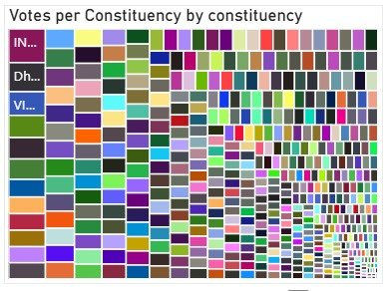
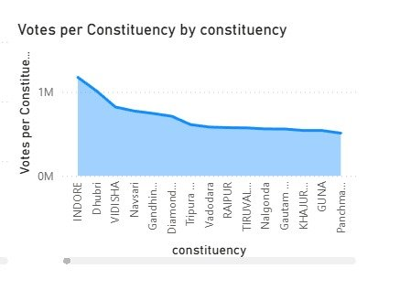
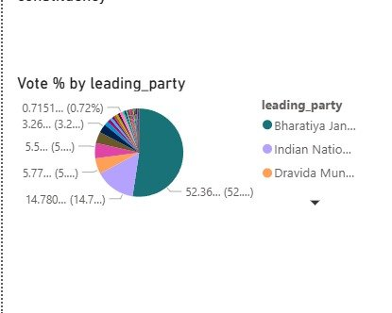
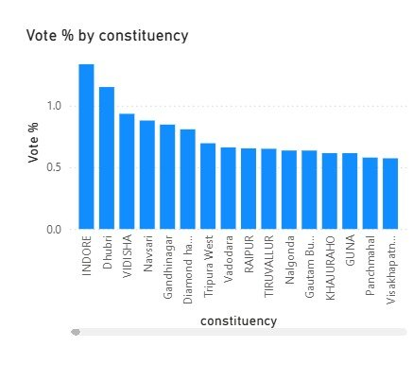
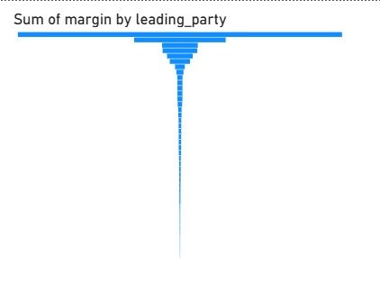
Visualizations — Dashboard 2
Votes · Vote % · Margin Analysis by Constituency
Matrix Heatmap – Votes per Constituency
Color matrix displays vote density across candidates and parties per constituency. Useful for spotting outliers and high-competition zones.
Area Chart – Votes per Constituency Trend
Area chart shows descending vote volume by constituency — smooth decay confirms a power-law distribution with a few hyper-active constituencies.
Pie Chart – Vote % by Leading Party
Bar Chart – Vote % by Constituency
Pie chart shows vote share distribution. BJP's 52.36% slice vs INC's 14.78% is immediately clear — reinforcing seat count data from Dashboard 1.
Funnel Chart – Margin Sum by Party
Ranked bar reveals top constituencies by vote %. INDORE tops at ~1.4%, confirming its status as the highest-participation single constituency.
Funnel encodes cumulative margin — widest bar = BJP's massive aggregate margin advantage over others, revealing structural dominance.

Slide 6
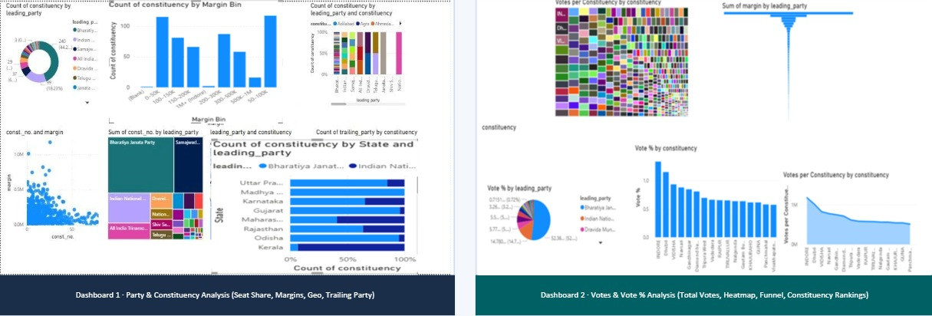
Dashboard Overview
Dashboard 1 · Party & Constituency Analysis (Seat Share, Margins, Geo, Trailing Party)
Both dashboards built in Power BI · Cross-filtering enabled across all visuals · Designed for exploratory analysis by political analysts & researchers

Slide 7
Documentation
Dataset & Schema
Tools Used
Data Preprocessing
Design Decisions
Source: 2024 Indian General Elections (ECI)
Format: CSV / Tabular
Records: 542 constituency rows
Columns: const_no, constituency, leading_party, trailing_party, margin, votes_per_constituency, vote_pct
Data type: Categorical + Numeric
Power BI Desktop: All visualizations and dashboards
Power Query: Data transformation & cleaning
DAX: Calculated measures (Vote %, Margin sum)
Python/Pandas: Initial EDA & data profiling
PowerPoint (pptxgenjs): Presentation generation
Standardized party name strings (removed whitespace, casing)
Derived vote_pct column from raw votes
Removed duplicate constituencies (none found)
Validated margin = winner_votes – runner_up_votes
Geocoding: Added lat/long for map visuals (partial)
Dashboard 1: Focus on party-level and seat distribution
Dashboard 2: Focus on voter behavior and constituency-level
Used consistent blue palette for BJP, green for INC
Cross-filter enabled: all visuals interact on click
Avoided 3D charts — prioritized clarity over decoration

Slide 8
Conclusion
How each visualization contributes to insights & the overall conclusion
Visualization
Insight Derived & Contribution to Conclusion
Donut Chart (Seat Share)
Instantly communicates BJP's 44.2% majority — sets the narrative for single-party dominance
Stacked Bar (Party×Const.)
Reveals which parties win diversely vs concentrated — DMK wins homogeneous southern seats
Treemap (Seats by Party)
Area encoding makes NDA vs INDIA bloc contrast tangible and emotionally resonant
Scatter (Const # vs Margin)
Identifies INDORE as a ≥1M margin outlier — signals a landslide safe seat for BJP
Funnel (Margin Sum)
Cumulative margin gap proves BJP doesn't just win more — it wins by much larger margins
Pie (Vote % by Party)
52.36% vote share for BJP vs 14.78% INC quantifies popular mandate beyond just seat count
Bar (Vote % by Constituency)
INDORE tops turnout — actionable for election commission planning and resource allocation
BAR(Votes per Constituency)
Power-law decay confirms a few mega-constituencies dominate total voter engagement
Map Visuals
Geographic anchoring surfaces North/East India dominance; exposes South India INC/DMK belt
Bar (Trailing Party Count)
Multi-trailing-party seats = hard-fought battles; helps identify swing or three-cornered contests
Overall Conclusion: The 2024 Indian elections reveal a clear BJP-led NDA supermajority with 240+ seats and 52% vote share, driven by stronghold constituencies with massive margins. The combination of donut, treemap, funnel, and area charts paints a consistent picture of structural dominance. Opposition fragmentation (INC 14.78%, regional parties 5-6% each) is the defining feature of India's current political landscape.

