Slide 1






Internship Management System
Students
LOW-CODE PROJECT
Evaluation
Companies
IMS
NETHRA CHANDRAGANDHI T
240701357
Guided by: Dr. J.Jinu Sophia
Attendance
Applications
Forms
Workflows
Deluge
Reports
Dashboard
Notes:
Good morning everyone. Today I will present my Internship Management System, a low-code application I built on Zoho Creator. It connects five areas: students, companies, applications, attendance and evaluation, and manages the full internship journey in one place.

Slide 2






What I built
PROJECT AT A GLANCE
5
3
3
7
1
Forms
Workflows
Deluge scripts
Report types
Dashboard
Objective
Built with
Manage the complete internship lifecycle in one low-code app: student registration, company onboarding, applications, approvals, attendance and evaluation, with automatic calculations and clear reports for the administrator.
Zoho Creator (low-code platform)
Deluge scripting language
Workflows, Blueprint, Schedules
Reports and dashboard
Blueprint
Schedules
Approvals
Role-based access
Student portal
Notes:
The objective was to manage the complete internship lifecycle in one place. The app has five forms, three workflows, three Deluge scripts, seven report types and one dashboard. I built it with Zoho Creator, so most of it is configuration, and Deluge handles the logic. On top of that I added governance features: Blueprint, Schedules, Approvals, role-based access and a student portal.

Slide 3





From application to approval
THE IDEA
Register
Apply
Review
Decide
Notify
Profile created
Application submitted
Admin checks details
Approve or reject
Student gets an email
The problem
The solution
Applications are tracked by hand and easy to lose
Working hours and attendance are calculated manually
No clear approval trail for the administrator
Application ID is generated automatically
Duration, hours and attendance % calculated by Deluge
Approval workflow with email notification
Notes:
A student registers and submits an internship application. The admin reviews it through the Blueprint and the approval process, then approves or rejects it. When it is approved, the student gets an email. Before this, applications, attendance and evaluation were handled manually. Now the Application ID is generated automatically, durations and hours are calculated by Deluge, and every approval is tracked.

Slide 4
Five forms capture the data
DATA LAYER
1
2
3
4
5
Student Registration
Company Details
Internship Application
Internship Attendance
Internship Evaluation
Student ID, name, email, phone
Department, year, semester
CGPA and skills
Resume and photo upload
Company ID, name, logo
Industry and contact person
Domain and mode (on-site, hybrid, remote)
Duration, stipend, positions
Application ID (auto)
Student and company lookup
Dates and duration (auto)
Cover letter, resume, status
Student and company
Date and attendance status
Check-in and check-out
Working hours (auto)
Student and company
Performance scores
Performance result (auto)
Average rating on dashboard
Notes:
The application is built on five forms. Student Registration stores the profile, skills and resume. Company Details stores the company and the internship on offer, and it has a map report. Internship Application links one student to one company, with an automatic Application ID and duration. Internship Attendance records check-in and check-out, and working hours are calculated automatically. Internship Evaluation stores performance scores and the final result.

Slide 5
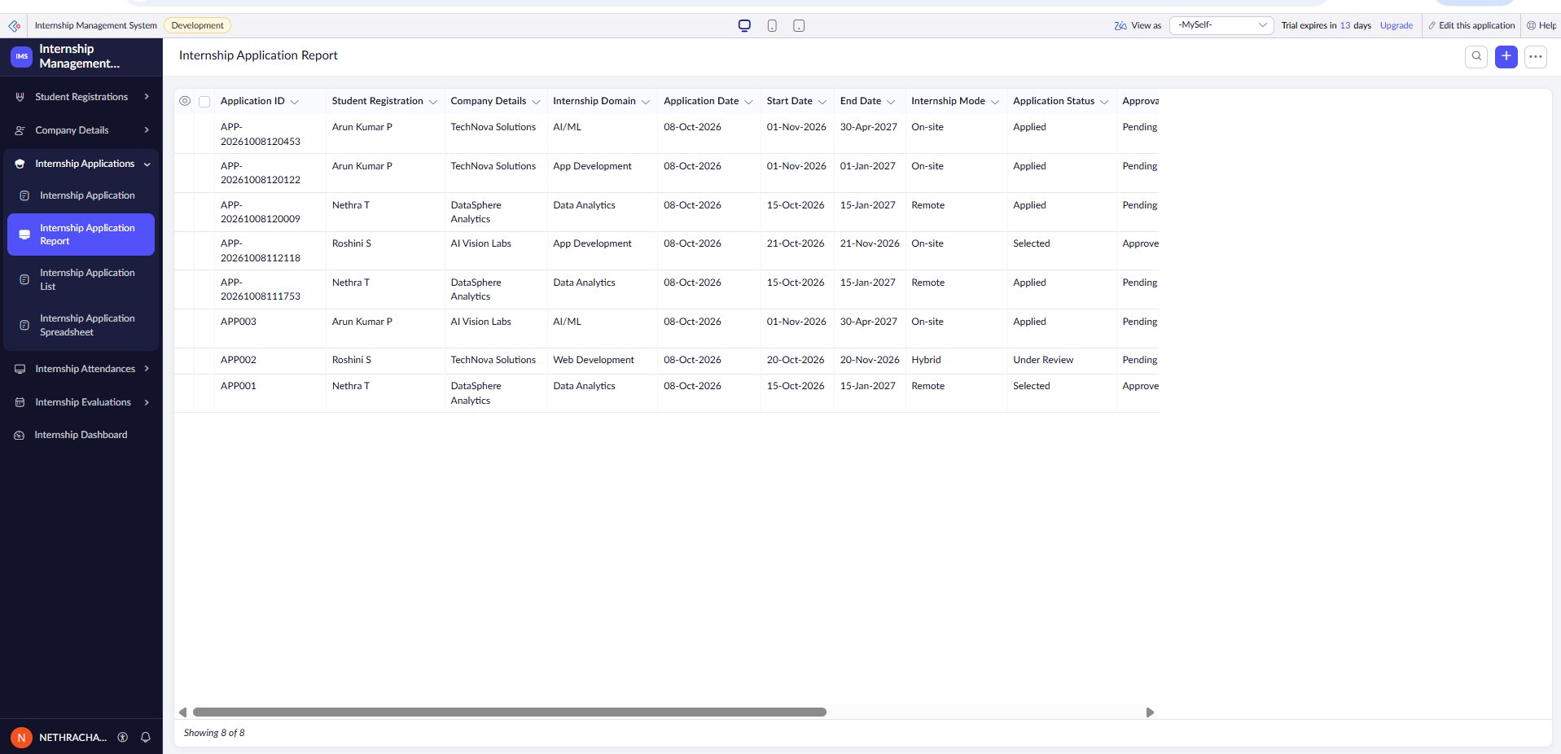







Seven report types, one data set
REPORTS
List
Tabular view to search and manage applications
Spreadsheet
Grid view for fast review and editing
Timeline
Internship periods along a calendar
Kanban
Attendance cards grouped by status
Application list report
Pivot chart
Working hours plotted by date
Why many views?
Calendar
Month view of daily attendance
One form feeds every report, so there is no duplicate entry. Each role sees the data in the format that suits the task.
Map
Company locations plotted on a map
Notes:
The same data is shown in many ways. The list report displays all internship application records in a tabular format, making it easier for the administrator to view, search, and manage applications. The spreadsheet lets the admin review and edit quickly. The timeline shows internship periods. The Kanban groups attendance by status, the pivot chart plots working hours, the calendar shows daily attendance, and the map shows company locations.

Slide 6
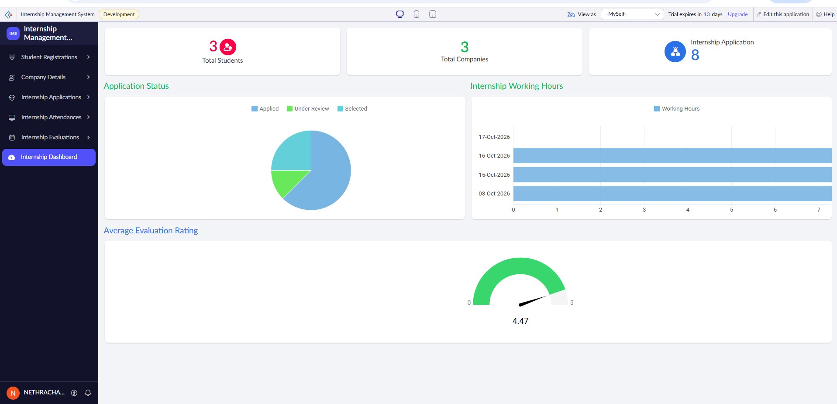

Internship Dashboard
INSIGHTS
Application status
Pie chart of applied, selected and other statuses.
Working hours
Bar chart of hours logged by students.
Average rating
Live dashboard
Gauge of the average evaluation score.
Notes:
The dashboard combines everything on one screen: key numbers at the top, a pie chart of application status, a bar chart of working hours, and a gauge for the average evaluation rating. The admin can understand the state of the program in seconds.

Slide 7
Two workflows automate the application
WORKFLOWS
Workflow 1: Application Submission
DELUGE SCRIPT
input.Application_ID = "APP-" +
zoho.currenttime.toString(
"yyyyMMddHHmmss");
Runs when a new application is submitted. Creates a unique Application ID, so there are no duplicates and no manual entry.
Submit
Generate ID
Saved
Workflow 2: Application Approval
DELUGE SCRIPT
if(input.Application_Approval == true)
{
input.Approval_Status = "Approved";
input.Application_Status = "Selected";
}
Runs when the administrator approves. Updates both statuses and sends the approval email to the student.
Admin approves
Selected
Email sent
Notes:
I created the submission workflow to automate the application submission process. Whenever a new internship application is submitted, it automatically generates a unique Application ID using Deluge. This reduces manual work, avoids duplicate IDs, and helps us identify and manage applications easily. The approval workflow automates approval: when the administrator approves an application, the system automatically changes the approval status to Approved and the application status to Selected, and then sends an email to the student.

Slide 8

Automatic calculations with Deluge
DELUGE SCRIPTING
Internship Duration
Attendance Working Hours
Start Date
End Date
Duration
Check-in
Check-out
Working Hours
Duration comes from the dates, so it is never typed by hand.
No manual entry: hours are worked out from check-in and check-out.
Performance Result
Attendance Percentage
Evaluation scores
Performance Result
Attendance records
Attendance %
Scores roll up into the average rating shown on the dashboard.
Keeps every student's attendance percentage up to date.
Notes:
Deluge is the scripting language of Zoho Creator. I used it for four calculations. Internship duration is derived from the start and end dates. Working hours come from check-in and check-out, so nobody enters them manually. The performance result is calculated from the evaluation scores, and the attendance percentage is calculated from attendance records.

Slide 9
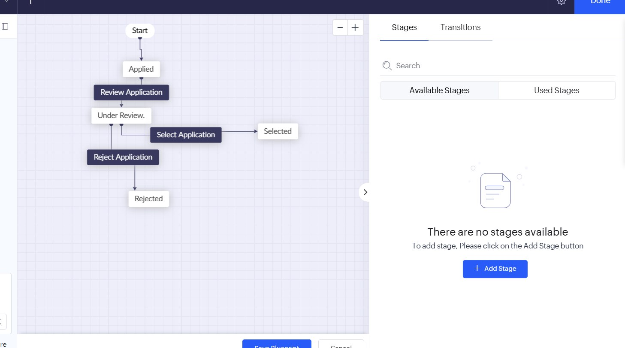
Process control and access
CONTROL AND SECURITY
Blueprint
Controls how an application moves from one stage to the next, so status cannot be changed out of order.
Applied
Under Review
Selected
Rejected
Schedules
Approvals
Role-based access
Student portal
Daily Pending Application Check runs at 9:00 AM and emails the admin a reminder.
Each application lands in the admin's pending tasks to approve or reject.
Admin role set in Settings, User Permissions, Roles to manage applications.
Portal permissions limit students to permitted internship information.
Notes:
Without a Blueprint, users might update the application status without following a defined process. With a Blueprint, we control how an application moves from one stage to another. A daily schedule at 9:00 AM emails the administrator to review pending applications. The approval process puts each application in the admin's pending tasks. Role-Based Access defines a user's role and responsibilities, and Portal User Permissions control what an external student can access through the portal.

Slide 10

Thank you. Questions?
KEY BENEFITS
Less manual work
Accurate results
Controlled process
Clear visibility
Application IDs, durations and working hours are generated automatically.
Deluge calculates duration, hours, performance and attendance.
Blueprint, approvals and roles keep every step in order.
Seven report types and a dashboard show the full picture.
Internship Management System | Built on Zoho Creator
Notes:
To summarise: less manual work because IDs and hours are generated automatically; accurate results because Deluge does the calculations; a controlled process through Blueprint, approvals and roles; and clear visibility through reports and the dashboard. Thank you for listening. I am happy to take questions.

