Slide 1

Payroll Management System
A C programming solution for automated employee payroll processing
Submitted by: Nethra V D, Ridhinya shree S, Poornima A, Sadhana S

Slide 2

The Problem
Traditional Challenges
Manual calculations prone to errors
Paper-based records and outdated software
Miscalculated salaries and tax deductions
Lack of centralized employee data
Compliance issues and delays
Business Impact
These limitations significantly affect organizational productivity and employee satisfaction, creating the need for a streamlined, automated solution.

Slide 3




Our Solution
Employee Data Management
Automated Calculations
Centralized storage and retrieval of employee records
Accurate salary, tax, and deduction processing
Salary Slip Generation
Secure File Handling
Professional payslip creation and distribution
Data consistency and long-term accessibility
A console-based C programming system offering fundamental payroll functionalities with modular, scalable architecture.

Slide 4
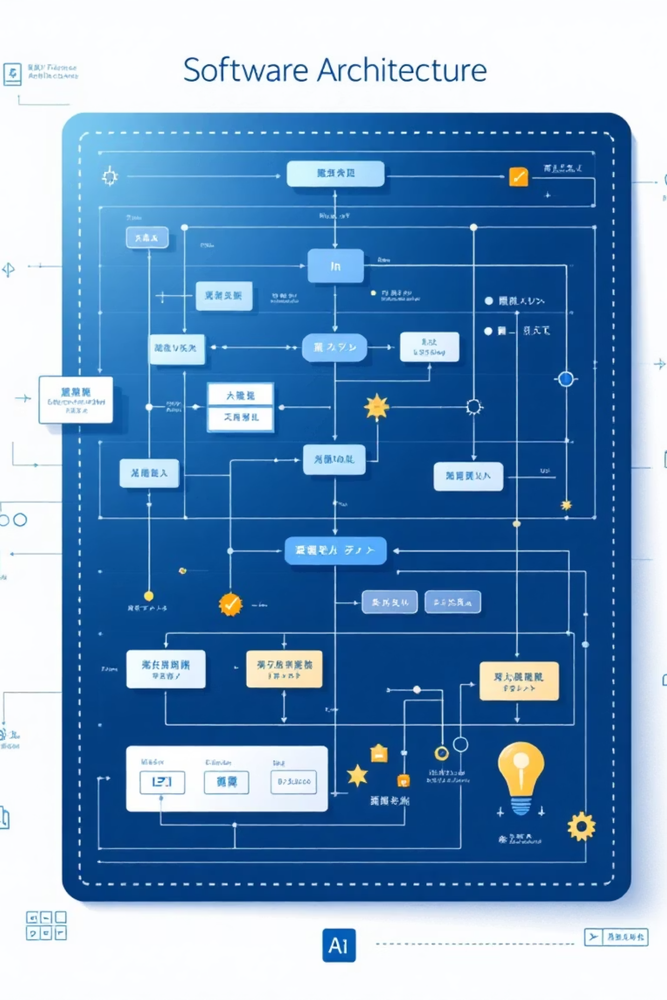
System Architecture
01
Initialize Data Structures
Set up employee records and system variables
02
Present Main Menu
Display user options for payroll operations
03
Process User Selection
Execute chosen operation with validation
04
Calculate & Store Results
Compute payroll and save data securely

Slide 5
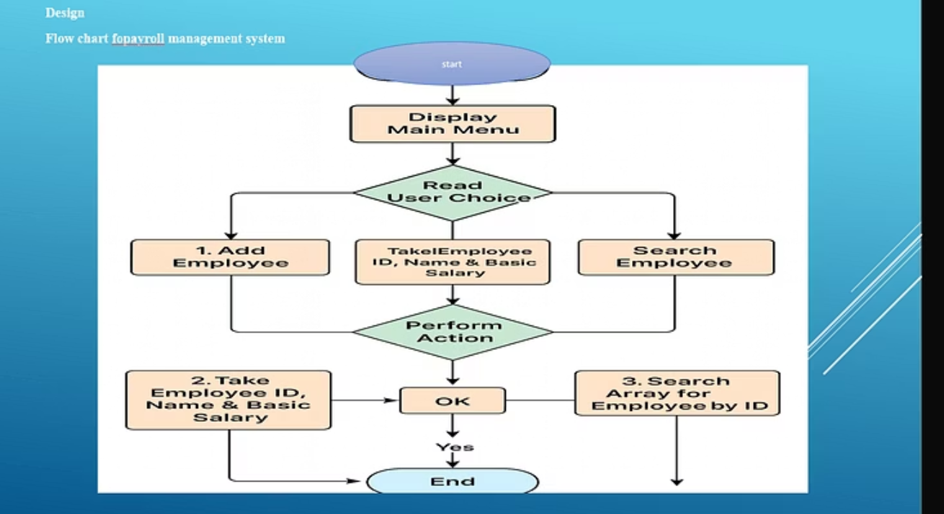

Slide 6
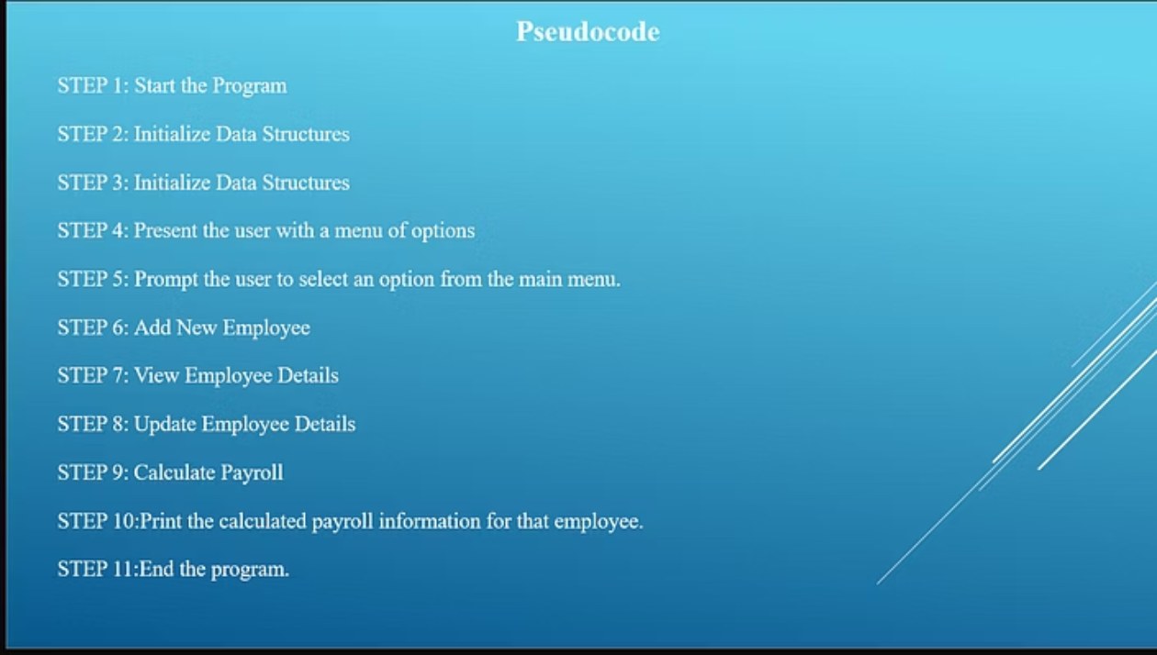

Slide 7





Key System Functions
Add Employee
Register new employees with ID, name, and salary structure
Search Records
Quickly locate employee information by ID
Update Salary
Modify employee compensation with automatic recalculation
Delete Employee
Remove records upon resignation or termination

Slide 8
system Implementation
Data Structure Design
Core Functions
User Interface
Employee struct with ID, name, basic salary, HRA, DA, PF, and gross salary fields stored in array supporting up to 100 employees
calculateSalary(), addEmployee(), displayEmployees(), searchEmployee(), updateSalary(), and deleteEmployee() with input validation
Console-based menu system with 6 options providing intuitive navigation and clear feedback messages

Slide 9
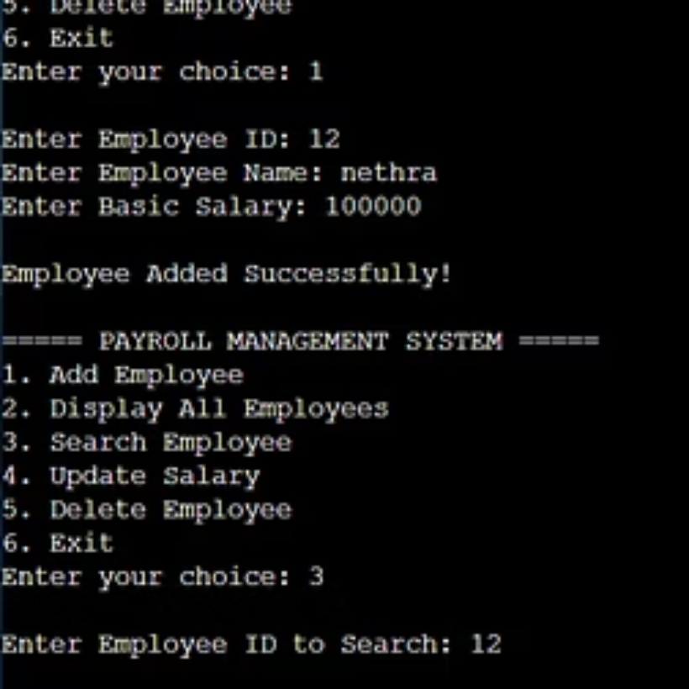
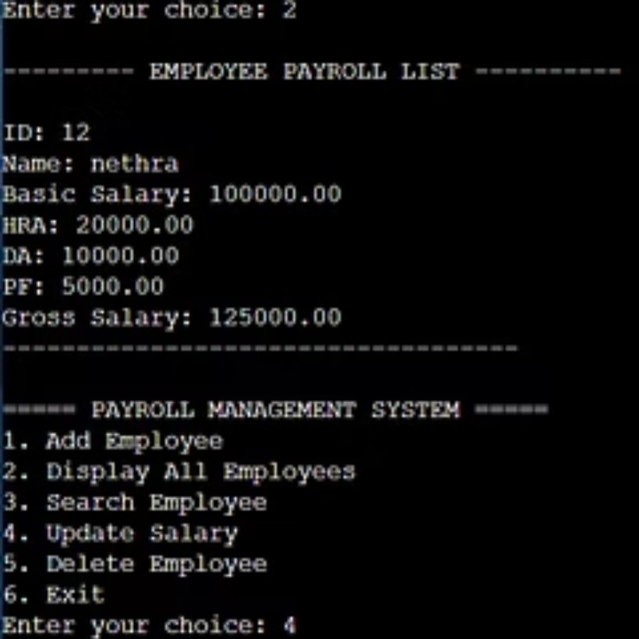
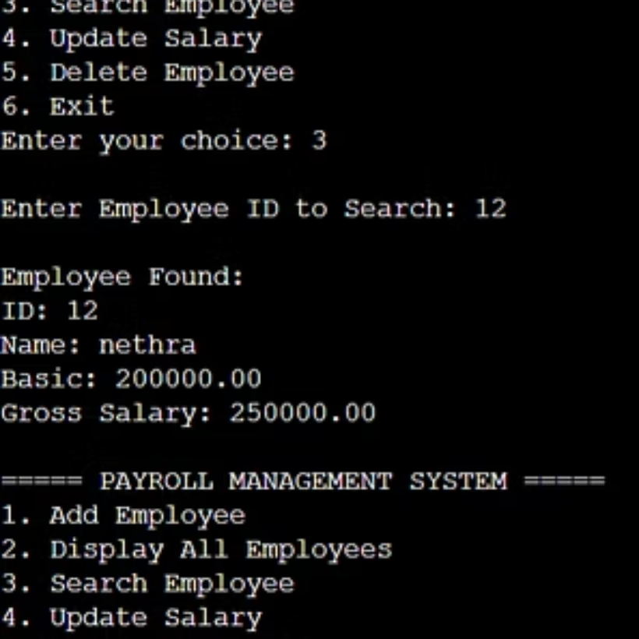
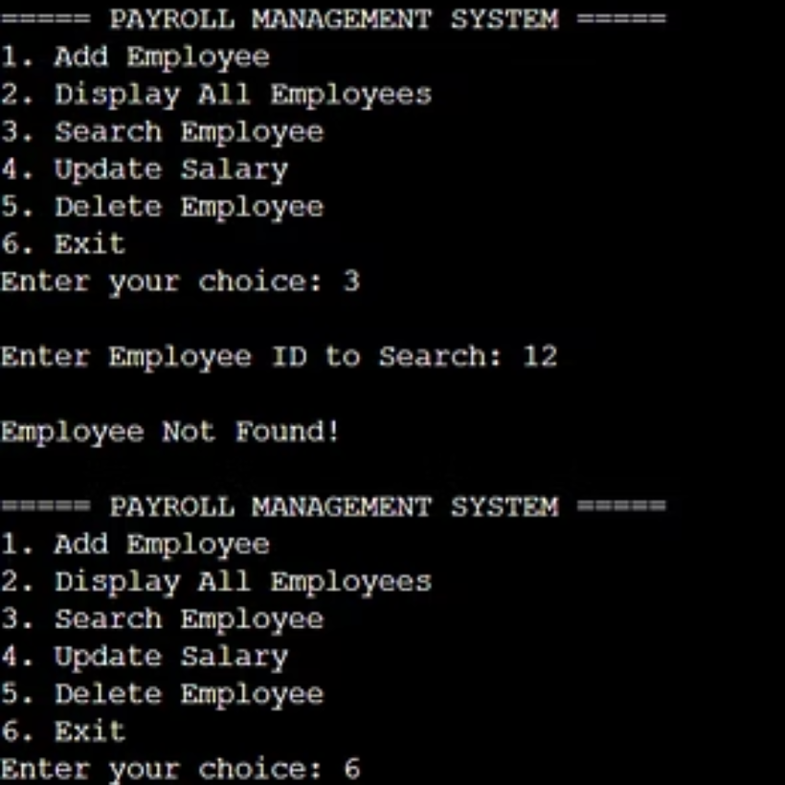
System Output Examples
The system provides clear, formatted output for all operations including employee addition, payroll display, search results, and salary updates.

Slide 10

Conclusion & Future Scope
Key Achievements
Future Enhancements
Automated core payroll operations
Tax automation and compliance
Modular, maintainable code structure
User authentication system
Detailed HR analytics and reporting
Persistent file-based data storage
Role-based access control
User-friendly console interface
Database integration
Accurate salary calculations
This project demonstrates how C programming can effectively automate real-world organizational processes, serving as both an excellent learning tool and a functional prototype for small organizations.

