Slide 1

WORDS GAME DATA STRUCTURE PROJECT
15MCA26 MINI PROJECT ON DATA STRUCTURES USING C
A Dissertation submitted in partial fulfilment of
the requirements for the award of degree of
MASTER OF COMPUTER APPLICATIONS
of
An Autonomous Institution Affiliated to VTU
DEPARTMENT OF MASTER OF COMPUTER APPLICATIONS
NEW HORIZON COLLEGE OF ENGINEERING
MAY 2016
By
NETHRA.R
( 1NH15MCA53)
I Year MCA, 2nd Semester
Under the Guidance of
M.Govindaraj
Assistant Professor
DEPARTMENT OF MASTER OF COMPUTER APPLICATIONS
NEW HORIZON COLLEGE OF ENGINEERING
Accredited by NAAC with ‘A’ Grade

Slide 2
Index
INTRODUCTION
HARDWARE & SOFTWARE REQUIREMENTS
IMPLEMENTATION – SCREEN SHOT
CONCLUSION
BIBLIOGRAPHY

Slide 3
INTRODUCTION
Word games (also called word game puzzles) are spoken or board games often designed to test ability with language or to explore its properties.
A common strategy for finding all the words in each stage is to go through the puzzle horizontally, vertically, or diagonally and look for the word.
After finding the word, one should look at the surrounding letters to find the next word.
One can then continue this method until the entire words is found. A way to find words is to go row by row.
First, all the horizontal rows should be read both backwards and forwards, then the vertical, and so on.

Slide 4
INTRODUCTION
A word game is a word game puzzle that consists of two levels.
LEVEL 1:
The first level consist three stages, namely
1.Animals
2.Birds
3.Places
LEVEL 2:
The second level consist of two stages, namely
1.Can You Guess
2.FullFill

Slide 5
HARDWARE & SOFTWARE REQUIREMENTS
SOFTWARE CONFIGURATION
Operating System: Windows
Tool /Languages used for development:
Front End: C Language ( Version C11 )
IDI:Turbo C
HARDWARE CONFIGURATION
RAM - 128MB or above
HDD - 20 GB or above
Processor - Pentium 4 or above
I/O Devices - Keyboard, Mouse, Color monitor

Slide 6
IMPLEMENTATION
* SCREEN SHOT *

Slide 7
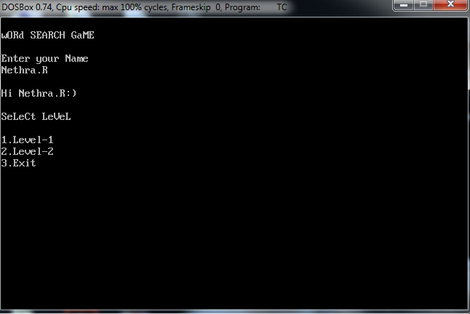
LOGIN WINDOW

Slide 8
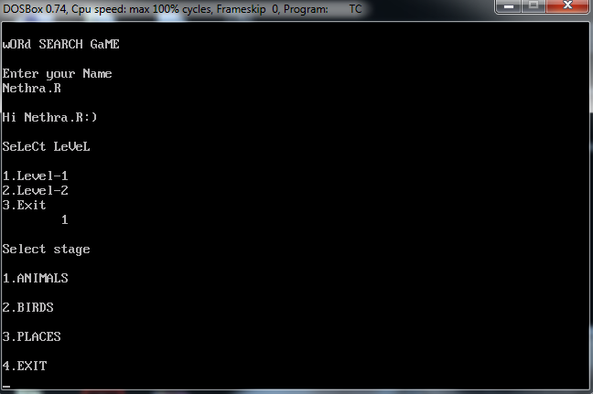
MAIN MENU

Slide 9
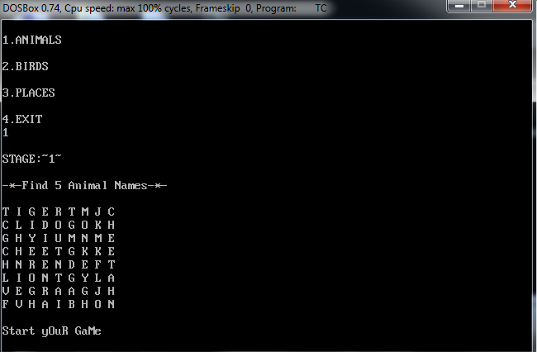
STAGE:1

Slide 10
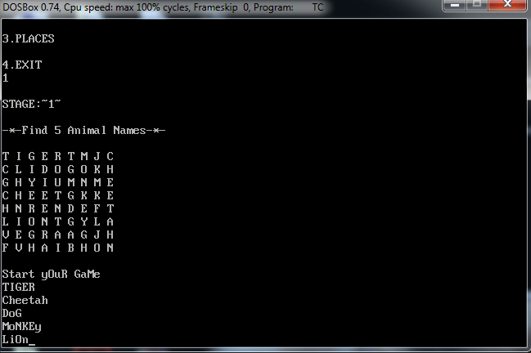
STAGE:1

Slide 11
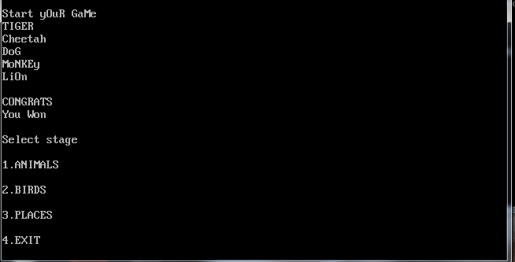
STAGE:1

Slide 12
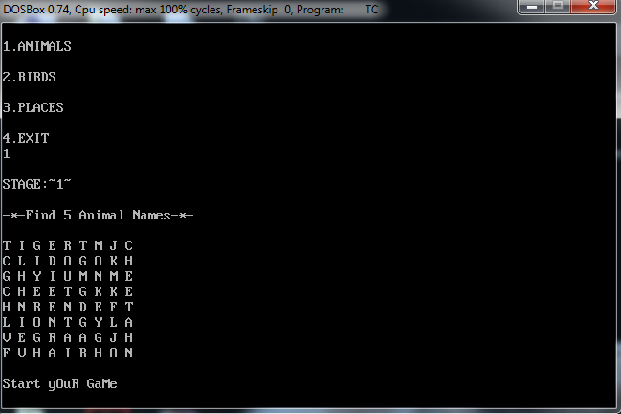
STAGE:1

Slide 13
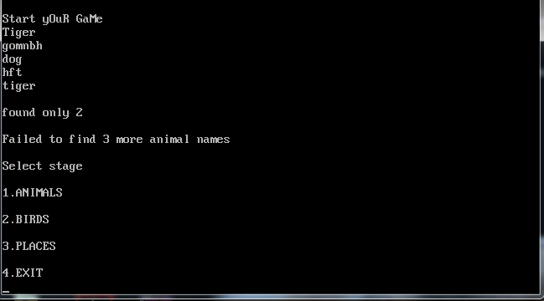
STAGE:1

Slide 14
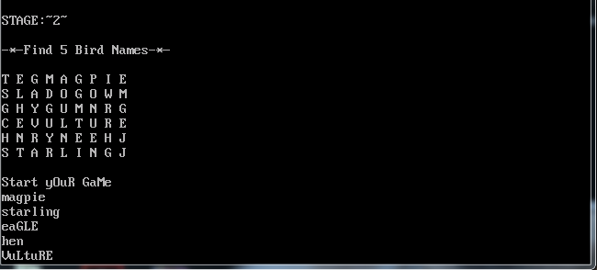
STAGE:2

Slide 15
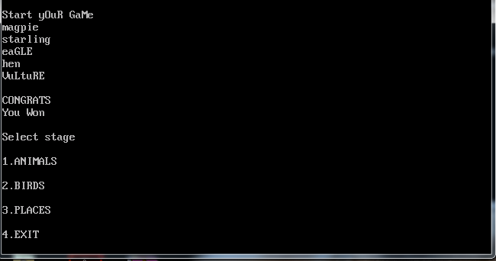
STAGE:2

Slide 16
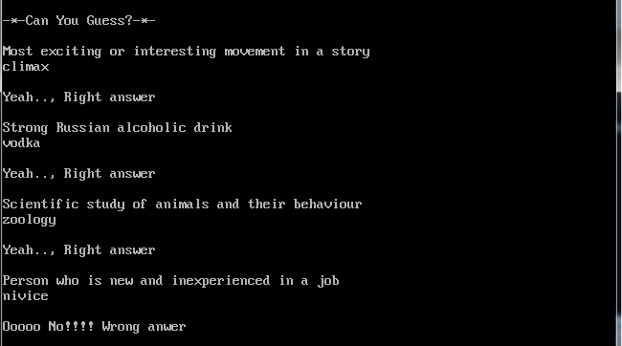
STAGE 4

Slide 17
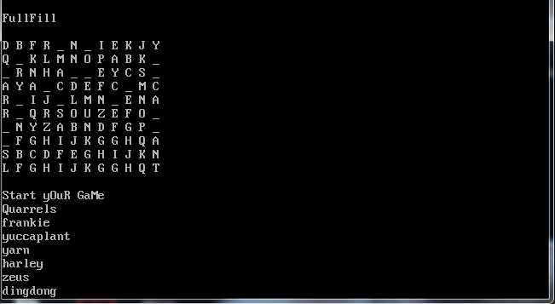
STAGE:5

Slide 18
CONCLUSION
This is to conclude that the project that undertook was worked upon with a sincere effort. Most of the requirements have been fulfilled up to the mark and the requirements which have been remaining, can be completed with a short extension

Slide 19
BIBLIOGRAPHY
http://www.tutorialspoint.com
http://stackoverflow.com
http://www.answers.com

Slide 20
LIBRARY MANAGEMENT SYSTEM
THANK YOU !.....

