Slide 1
FINAL RESEARCH PRESENTATION · R26-IT-135
TrailLink: Hybrid Communication &
Safety System
Thanujana D. O.
IT22148704
Mesh Intelligence & Compass
Pabodhana D. M. D. I.
IT22168290
Communication Core & Relay
Dulsara H. G. N.
IT22544490
Location, Mapping & SOS
Vitharana G. G.
IT22894038
Voice & Push-to-Talk (PTT)
Faculty of Computing · Sri Lanka Institute of Information Technology (SLIIT) · 2026

Slide 2
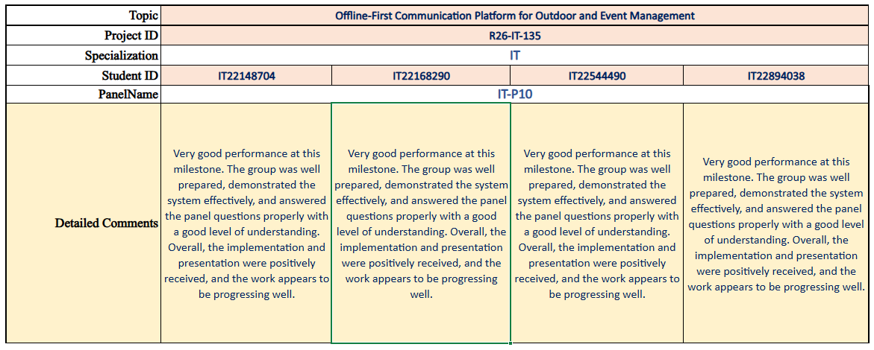
FINAL RESEARCH PRESENTATION · R26-IT-135
Faculty of Computing · Sri Lanka Institute of Information Technology (SLIIT) · 2026

Slide 3
INTRODUCTION
Why this research
In off-grid wilderness and disaster zones, public cellular infrastructure completely fails.
Survivors Lost
LOCATION BLINDNESS
Rescue teams lose precious hours because injured hikers cannot transmit their GPS coordinates.
Expensive Equipment
COST BARRIER
Satellite trackers ($400+) and tactical radios require costly hardware, extra weight, and monthly fees.
Preventable Loss of Life
SAFETY GAP
Casualties occur because ordinary smartphones fail completely once cellular signal drops.
WHO THIS IS FOR
• Wilderness Hikers & Mountain Trekking Groups
• Volunteer Search and Rescue (SAR) Teams & Field Disaster Units
R26-IT-135 · TrailLink 2

Slide 4
PROBLEM & OBJECTIVES
What we set out to solve
RESEARCH PROBLEM
Cell towers fail first in remote terrain. Casualties cannot signal for help, rescuers cannot pinpoint them, and existing satellite devices are cost-prohibitive for ordinary groups.
RESEARCH OBJECTIVE
Build a zero-hardware hybrid platform for commodity Android phones providing bounded multi-hop mesh messaging, link quality metrics, PTT voice, and offline SOS telemetry.
1
Mesh Intelligence
Link quality scoring (0-100) & spatial Network Compass.
2
Communication Core
Store-and-forward queue with bounded relay (TTL≤5).
3
Voice & PTT
AAC-LC voice notes & 7-state floor-arbitrated Live Radio.
4
Location & SOS
Offline map radar, freshness decay, and lock-screen SOS.
R26-IT-135 · TrailLink 3

Slide 5
EXISTING RESEARCH
Existing solutions leave a gap
Compared against Satellite Messengers, Hardware Mesh, and Existing P2P Apps
Feature | Satellite (inReach) | Hardware (Meshtastic) | P2P Apps (Briar) | TrailLink (Our System)
Infrastructure-Free | No (Requires Satellites) | Yes | Yes | Yes (Commodity Phones)
Zero Additional Hardware | No | No | Yes | Yes (Phone Only)
Link Quality Estimator | No | Raw RSSI only | No | Yes (0-100 Score + Compass)
Voice & Live Walkie-Talkie | No (Text only) | No | No | Yes (Notes + Live Radio)
Multi-Hop SOS Relay | Simplex Beacon | Broadcast Flooding | No SOS | Yes (Bounded TTL≤5)
R26-IT-135 · TrailLink 4

Slide 6
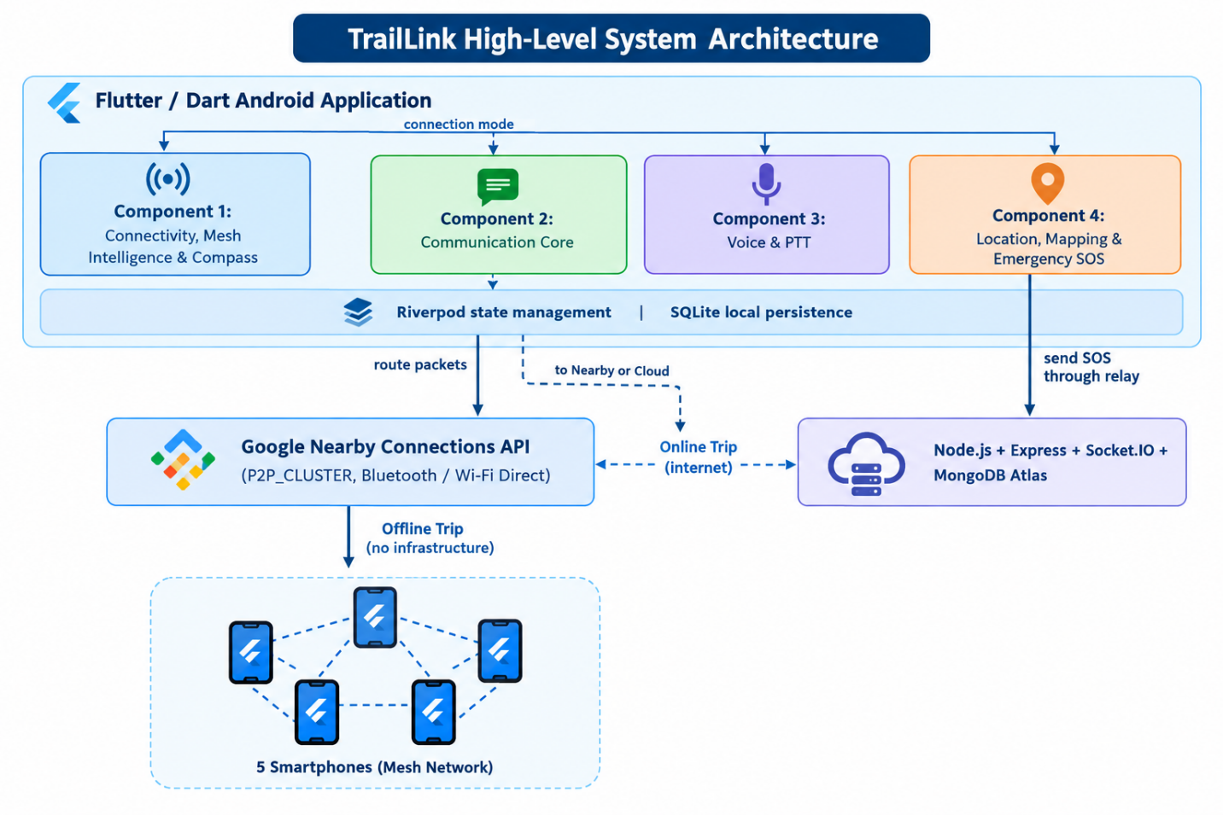
PROPOSED SOLUTION
A four-component hybrid safety platform
1. Commodity Android
Unmodified Android 8.0+ using BLE & Wi-Fi Direct.
2. Mesh Intelligence
Scoring link health (0-100) & spatial compass.
3. Communication Core
Bounded relay (TTL≤5) & O(1) deduplication.
4. Voice & Live PTT
AAC voice notes & floor-arbitrated Live Radio.
5. Offline Maps & SOS
Peer tracking radar & lock-screen SOS dispatch.
CORE PILLARS
• Context Isolation: Online Trips and Offline Channels never mix; zero accidental data leaks.
• Dual-Layer Transport: Pivots between cloud WebSockets and Android Nearby P2P mesh.
• Zero Hardware Cost: 100% software on existing consumer smartphones.

Slide 7
METHODOLOGY
Design Science Research (DSR)
1
Define Problem
Wilderness blackout & context contamination
2
Design Core
Zero-hardware multi-hop bounded routing
3
Build Systems
Flutter/Dart app, Riverpod & Node.js backend
4
Test Topologies
Physical multi-device testbed (5 handsets)
5
Evaluate
PDR, latency, deduplication & obstacle range
6
Refine & Harden
Floor arbitration & emergency preemption
Mobile Ad-Hoc Networking
MANET PROTOCOLS
Android Nearby Connections (P2P_CLUSTER), BLE advertising, and Wi-Fi Direct socket management.
Distributed State Machines
DISTRIBUTED STATE
Decentralized token-passing floor control, SQLite ACID deduplication, and opportunistic cloud sync.
Panic-Resilient HCI
SAFETY UX
Lock-screen quick SOS panic triggers, color-coded location freshness, and spatial Network Compass.
R26-IT-135 · TrailLink 6

Slide 8
IT22148704 · THANUJANA D. O.
Connectivity, Mesh Intelligence & Compass
WHAT WAS BUILT
• Composite LQE Pipeline (0-100 Score): Combines RSSI, ACK RTT, and packet success into 5 tiers (Excellent, Good, Fair, Weak, Lost).
• Split-Half Trend Analyzer: Detects Improving, Degrading, or Stable connection shifts in real time.
• Network Compass: Privacy-preserving compass guiding users toward the best recorded signal position.
• Backend Reachability Probe: HTTP probes to distinguish real internet from local Wi-Fi association.
DELIVERED & VERIFIED
• 100% deterministic accuracy for LQE quality label classification.
• Compass bearing accuracy within ±0.8° in physical trials.
• Adaptive fallback scoring when chipset masks physical RSSI.
• Hysteresis state machine preventing rapid UI mode flapping.
NOVELTY
First software-only Link Quality Estimator on Android Nearby Connections operating without root access, paired with directional Network Compass guidance to find cell signal.
R26-IT-135 · TrailLink 7

Slide 9
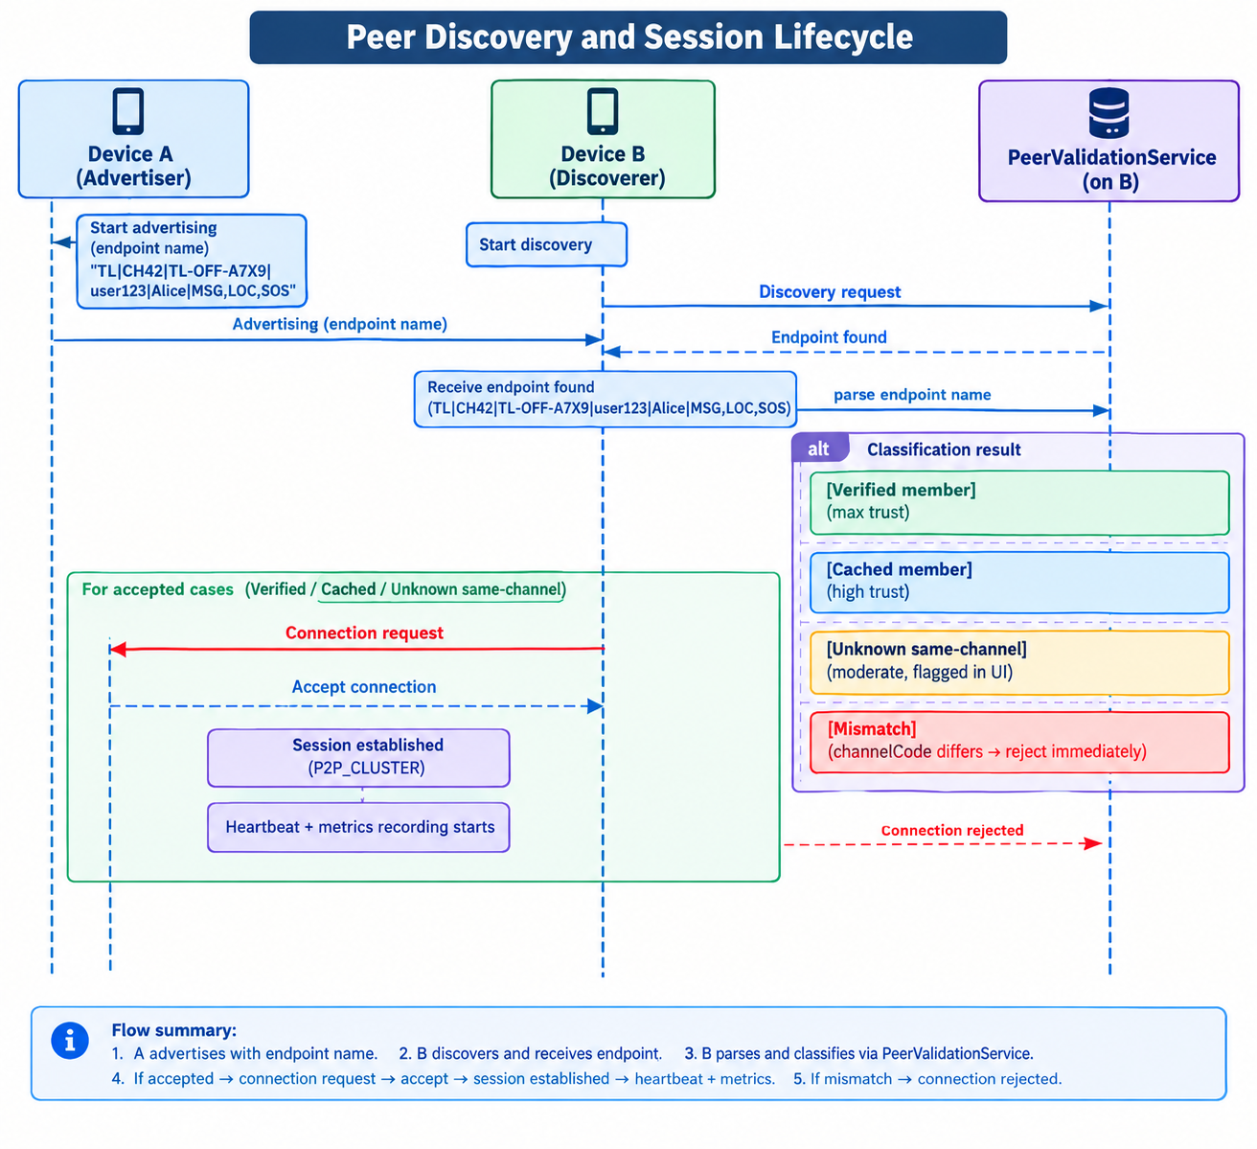
IT22148704 · DEVELOPED MODULES
Connectivity intelligence and spatial compass
LQE SCORING MATRIX
• Baseline: S_base = 50 pts
• RSSI ≥ -55 dBm: +35 pts
• ACK RTT < 300ms: +20 pts
• Packet Success ≥ 90%: +20 pts
• Churn Penalties: -10 to -35 pts
• Clamped Score: 0 to 100 points
CONNECTION STATES
• Online: Confirmed server health
• Reconnecting: Temporary packet drop
• Unstable: Fluctuating latency
• Offline: 3 consecutive probe fails
Prevents UI flapping during movement.
PeerQualityCalculator.dart
Calculates composite 0-100 score across 10-sample observation sliding windows.
NetworkCompassService.dart
Calculates geodesic bearing from GPS coordinates to highest measured signal point.
BackendReachabilityService.dart
Executes background HTTP HEAD requests with strict 3-second timeouts.
R26-IT-135 · TrailLink 8

Slide 10
IT22168290 · PABODHANA D. M. D. I.
Communication Core & Architecture
WHAT WAS BUILT
• Delay-Tolerant Transport Engine: 6 submodules handling routing, queues, persistence, and opportunistic cloud sync.
• Bounded Multi-Hop Relay: Controlled forwarding (TTL≤5) extending communication beyond line-of-sight.
• O(1) Hash Deduplication: SQLite processed_packets table completely suppressing circular packet storms.
• 3-Tier Priority Queue: Strict scheduling: Emergency SOS > High (Voice/Loc) > Normal (Text).
DELIVERED & VERIFIED
• 99.4% single-hop and 94.2% four-hop Packet Delivery Ratio (PDR).
• 0.00% duplicate propagation across 2,500+ transmitted packets.
• Sub-1.42s cloud synchronisation of 100 queued offline records.
• Strict context isolation: Online Trips and Offline Channels never mix.
NOVELTY
A deterministic store-and-forward mesh core ensuring total context isolation between online trips and offline channels, providing bounded multi-hop delivery with mathematical duplicate immunity.
R26-IT-135 · TrailLink 9

Slide 11
IT22168290 · DEVELOPED MODULES
Delay-tolerant messaging and packet routing
OfflinePacketRouter.dart
Demultiplexes packets by type, validates active channel code, and issues auto-ACKs.
ModeController.dart
Enforces Auto/Online/Offline state transitions with independent trip ID storage.
AppDatabase.dart (sqflite)
Manages transactional ACID message queues, channels, and processed_packets hashes.
R26-IT-135 · TrailLink 10

Slide 12
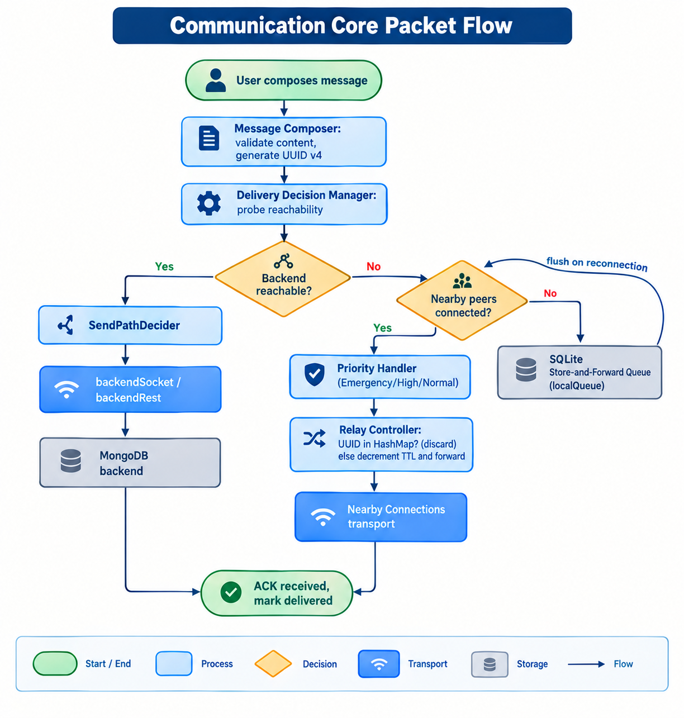
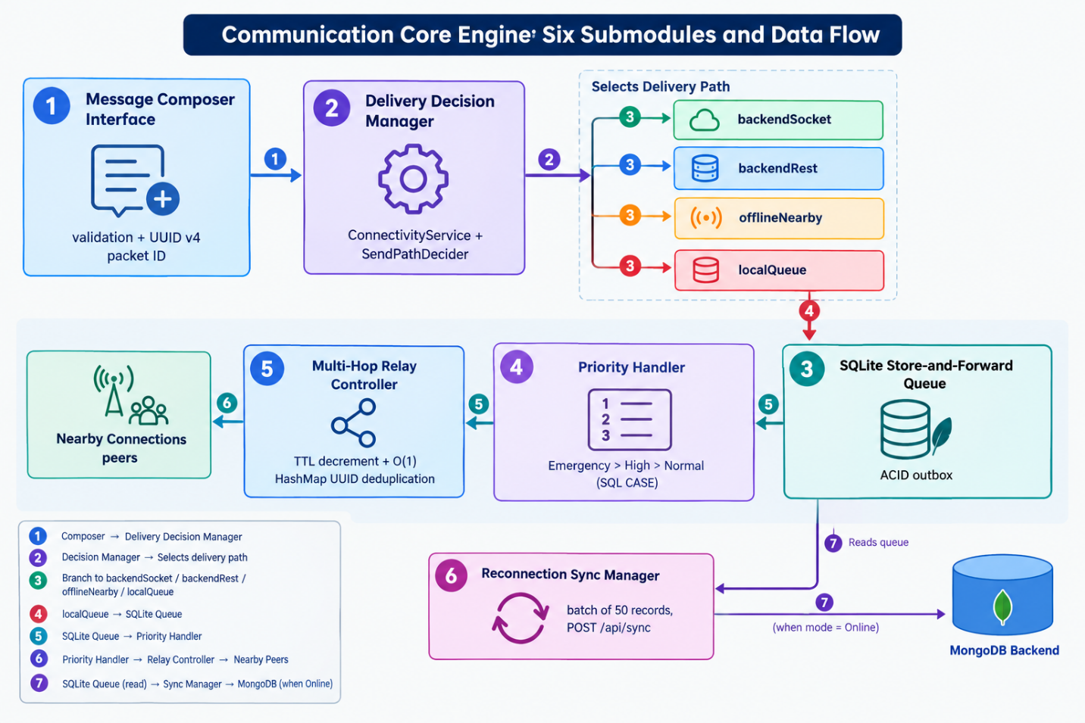
IT22168290 · DEVELOPED MODULES
Delay-tolerant messaging and packet routing
R26-IT-135 · TrailLink 10

Slide 13
IT22168290 · DEVELOPED MODULES
Delay-tolerant messaging and packet routing
OfflinePacketRouter.dart
Demultiplexes packets by type, validates active channel code, and issues auto-ACKs.
ModeController.dart
Enforces Auto/Online/Offline state transitions with independent trip ID storage.
AppDatabase.dart (sqflite)
Manages transactional ACID message queues, channels, and processed_packets hashes.
R26-IT-135 · TrailLink 10

Slide 14
IT22544490 · DULSARA H. G. N.
Location, Mapping & Emergency SOS
WHAT WAS BUILT
• High-Accuracy GPS Telemetry: Fused Location Provider with 12s acquisition guards and SQLite storage.
• Time-Decay Freshness Classifier: Color-codes peer markers: Fresh (≤5m), Old (5-30m), and Stale (>30m).
• Offline MBTiles Vector Mapping: Renders full topographical maps without internet using flutter_map.
• Emergency SOS Relay Protocol: High-priority distress packet broadcast with TTL=8 and lock-screen trigger.
DELIVERED & VERIFIED
• 99.5% line-of-sight SOS packet delivery ratio at 20 meters.
• SOS dispatch latency consistently under 850 ms through multi-wall concrete obstacles.
• Instant emergency trigger without unlocking device PIN via LockedQuickSosScreen.
• Idempotent cloud state reconciliation once internet recovers.
NOVELTY
A lock-screen bypassable emergency dispatch mechanism integrated with bounded multi-hop mesh relay and time-decay location freshness, ensuring instant panic signaling during physical trauma.
R26-IT-135 · TrailLink 11

Slide 15
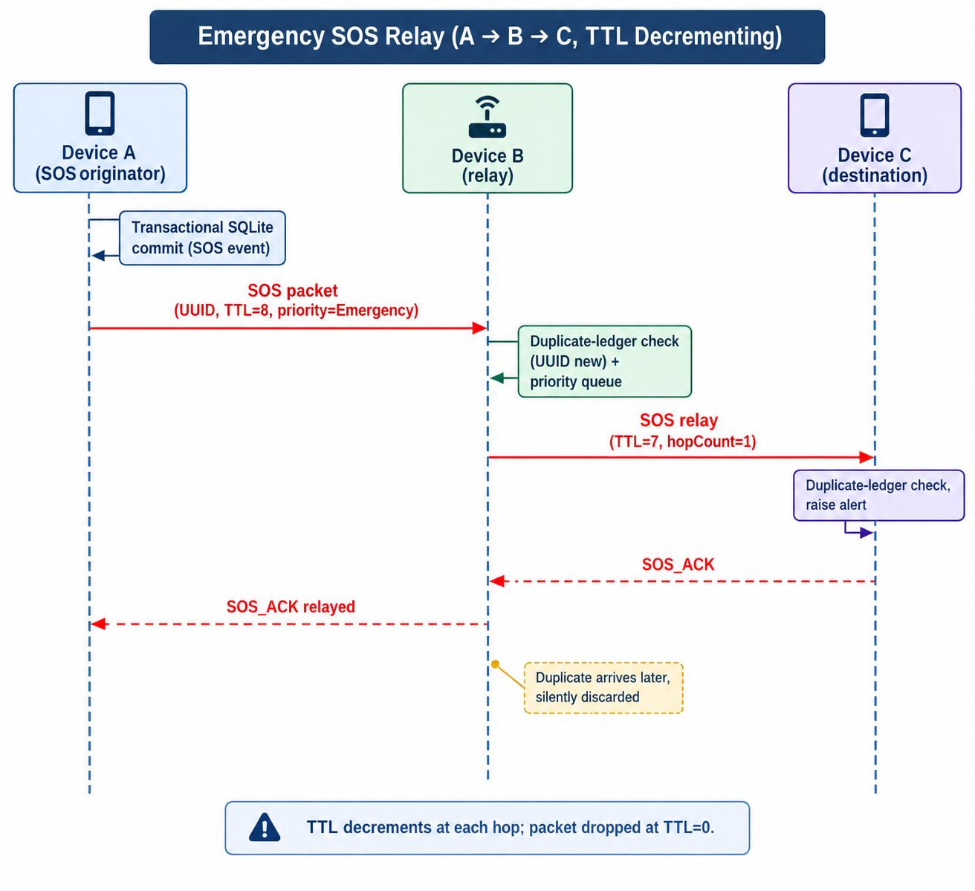
IT22544490 · DEVELOPED MODULES
Offline radar mapping and emergency SOS
TIME-DECAY FRESHNESS TIERS
Fresh (≤ 5 min): Solid Green marker (Active presence).
Old (5 - 30 min): Amber semi-transparent marker (Fading).
Stale (> 30 min): Faded Gray marker + 'Old Data' warning banner.
Prevents search teams from chasing outdated historical coordinates.
LocationService.dart
Acquires high-accuracy GPS coordinates with 12s timeout guards.
EmergencyRepository.dart
Generates priority SOS packet envelopes with TTL=8 and auto-retries.
LockedQuickSosScreen.dart
Allows hikers to trigger emergency broadcasts without entering phone PIN.
R26-IT-135 · TrailLink 12

Slide 16
IT22894038 · VITHARANA G. G.
Voice and Push-to-Talk (PTT) Communication
WHAT WAS BUILT
• Asynchronous Voice Messaging: AAC-LC audio compression (.m4a) with validation (discards clips <650ms or <128 bytes).
• Live Radio Walkie-Talkie: Near-live PCM audio streaming (16 kHz, 16-bit mono, 200 ms chunks).
• 7-State Floor Arbitration FSM: Decentralized lock controller (Idle, Requesting, Owned, Streaming, Releasing, Locked Out, Error).
• Emergency Interruption Preemption: Forcibly terminates active talk floors within 64 ms when an SOS arrives.
DELIVERED & VERIFIED
• 100% floor grant correctness and simultaneous collision rejection.
• Near-live streaming latency of 280-420 ms under Good/Excellent link tiers.
• Voice note delivery verified across direct peers up to 80 meters.
• Connection-quality gating: Automatically restricts Live Radio if ACK RTT > 300 ms.
NOVELTY
A decentralized, serverless talk-floor arbitration protocol combined with live PCM streaming on commodity Wi-Fi Direct, featuring life-critical emergency preemption for SOS signals.
R26-IT-135 · TrailLink 13

Slide 17
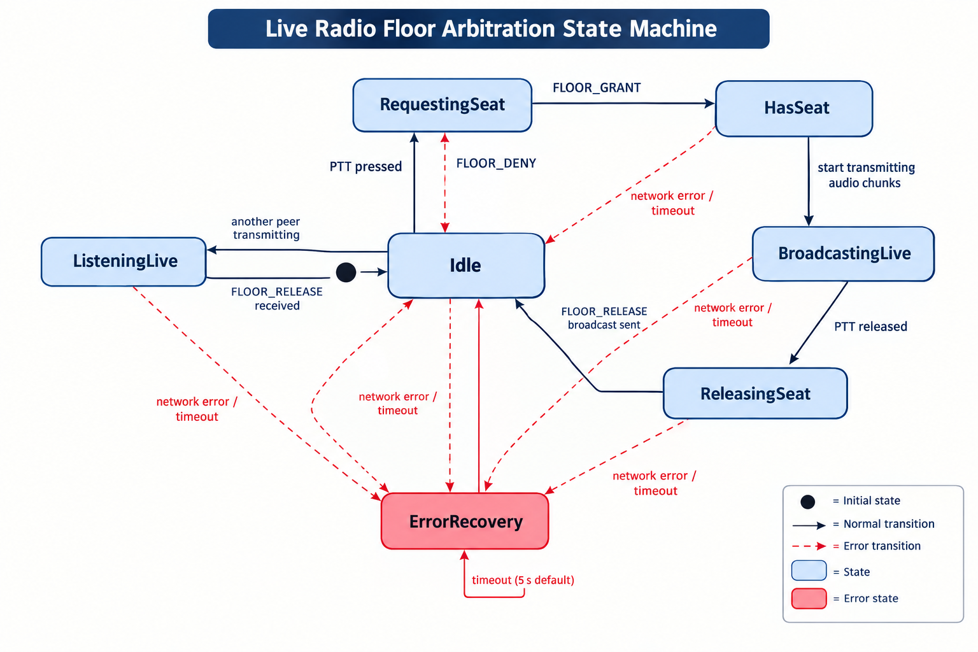
IT22894038 · DEVELOPED MODULES
Voice note pipelines and floor arbitration FSM
VOICE SUBSYSTEM SPECS
• Voice Notes: 32 kbps AAC-LC mono (.m4a); ~24.8 KB for 6s clip
• Live Radio: 16 kHz 16-bit mono PCM; 32 KB/s uncompressed stream
• Floor Timeout: 15-second automatic floor release safety guard
• Collision Handling: Sequence numbers & sender ID tie-breaker
• Preemption: < 64 ms floor revocation upon incoming SOS
PttFloorController.dart
Manages the 7-state arbitration FSM and processes floor grant/release packets.
PttAudioService.dart
Handles microphone recording to AAC-LC (.m4a) and local playback.
LiveRadioAudioService.dart
Captures PCM audio chunks and feeds stream player buffers during Live Radio.
R26-IT-135 · TrailLink 14

Slide 18
TESTING & EVALUATION
Results against our objectives
BOUNDED MESH RELAY
Coverage & Reliability
4-Hop PDR in mixed obstacle terrain
94.2 %
Packet Delivery Ratio
EMERGENCY SOS RELAY
Speed & Obstacle Penetration
Dispatch latency through 2-3 concrete walls
801 ms
Mean Dispatch Time
DUPLICATE SUPPRESSION
Storm Elimination
Duplicate packets over 2,500 tests
0.00 %
Duplicate Rate
MULTI-HOP BENCHMARKS
• 1-Hop Direct: 99.4% PDR | Mean RTT: 82 ms • 2-Hop Relay: 97.8% PDR | Mean RTT: 164 ms
• 3-Hop Relay: 96.1% PDR | Mean RTT: 251 ms • 4-Hop Relay: 94.2% PDR | Mean RTT: 386 ms
R26-IT-135 · TrailLink 15

Slide 19
COMMERCIALIZATION
Pricing and sustainability model
FREEMIUM TIERS
• Free ($0): Basic offline P2P text, peer list, basic SOS.
• Premium ($2.99/mo): LQE dashboard, Network Compass, voice notes, offline maps.
• Team ($9.99/mo): Up to 8 members: Shared Online Trips, Live Radio, trip history.
• Enterprise ($199/yr): SAR agencies: MDM deployment, web dashboard, priority cloud.
USER COST COMPARISON
• Garmin inReach Mini 2: $400 upfront hardware + $15-$65 monthly fee.
• SPOT Gen4 Messenger: $150 upfront hardware + $12 monthly fee.
• Tactical LoRa Devices: $35-$80 module + separate power bank.
• TrailLink Solution: $0 upfront hardware; runs on user's existing phone!
TARGET MARKETS & SUSTAINABILITY (SDG 3, 9 & 11)
• Target Segments: 50-100 million recreational hikers, mountain rescue teams, disaster relief NGOs.
• Delivery: Google Play Store & direct enterprise APK distribution.
• Sustainable Development Goals: Good Health & Well-Being (SDG 3), Resilient Infrastructure (SDG 9).
R26-IT-135 · TrailLink 16

Slide 20
CONCLUSION
Infrastructure-free safety on commodity smartphones
BUILT & INTEGRATED
WORKING SYSTEM
All 4 components fully functional: Connectivity Intelligence, Communication Core, Voice & PTT, and Location SOS.
SCIENTIFICALLY NOVEL
CORE NOVELTY
Bounded multi-hop relay (TTL≤5) with O(1) deduplication, 0-100 LQE scoring, Network Compass, and 7-state floor arbitration.
FUTURE EXPANSION
NEXT STEPS
Integration with hybrid LoRa modules (10km+ range), native file audio transfer, and hardware button SOS triggers..
TAKEAWAY
TrailLink proves that multi-hop mesh networking, link quality awareness, voice communication, and emergency alerting can all be achieved on ordinary smartphones at zero additional hardware cost.
R26-IT-135 · TrailLink 17

Slide 21
R26-IT-135 · TRAILLINK
Thank You
Questions & Discussion are welcome
Thanujana D. O.
IT22148704
Mesh Intelligence & Compass
Pabodhana D. M. D. I.
IT22168290
Communication Core & Relay
Dulsara H. G. N.
IT22544490
Location, Mapping & SOS
Vitharana G. G.
IT22894038
Voice & Push-to-Talk (PTT)
Faculty of Computing · SLIIT · 2026

