Slide 1
🌾
AgriPrice Intelligence
Smart Market Analytics for Farmers
Helping farmers sell smarter using real government market data
Project Presentation Showcase 2026

Slide 2
THE PROBLEM
Farmers sell at a loss — not from bad crops, but bad information
Prices for the same crop can differ sharply between mandis just a few kilometers apart. Most farmers have no easy way to see:
The Fix
AgriPrice Intelligence turns real government mandi price data into a direct, plain-language answer:
Which nearby market is paying more, today
Whether prices are trending up or down
How risky / volatile a crop's price typically is
When unusual price crashes or spikes have happened before
“Where should I sell, and what will I get for it?”
...plus a full analyst dashboard for anyone who wants to dig deeper.
AgriPrice Intelligence
2

Slide 3
OBJECTIVES
What the system needed to do
01
02
03
Predict Prices
Explain Predictions
Score Risk
Forecast future crop prices from historical patterns
Show what actually drives each forecast (SHAP)
Classify crops by price volatility
04
05
06
Detect Anomalies
Recommend Markets
Fetch Live Prices
Flag unusual historical price crashes/spikes
Rank nearby markets by predicted price
Pull current government-reported prices via API
AgriPrice Intelligence
3

Slide 4
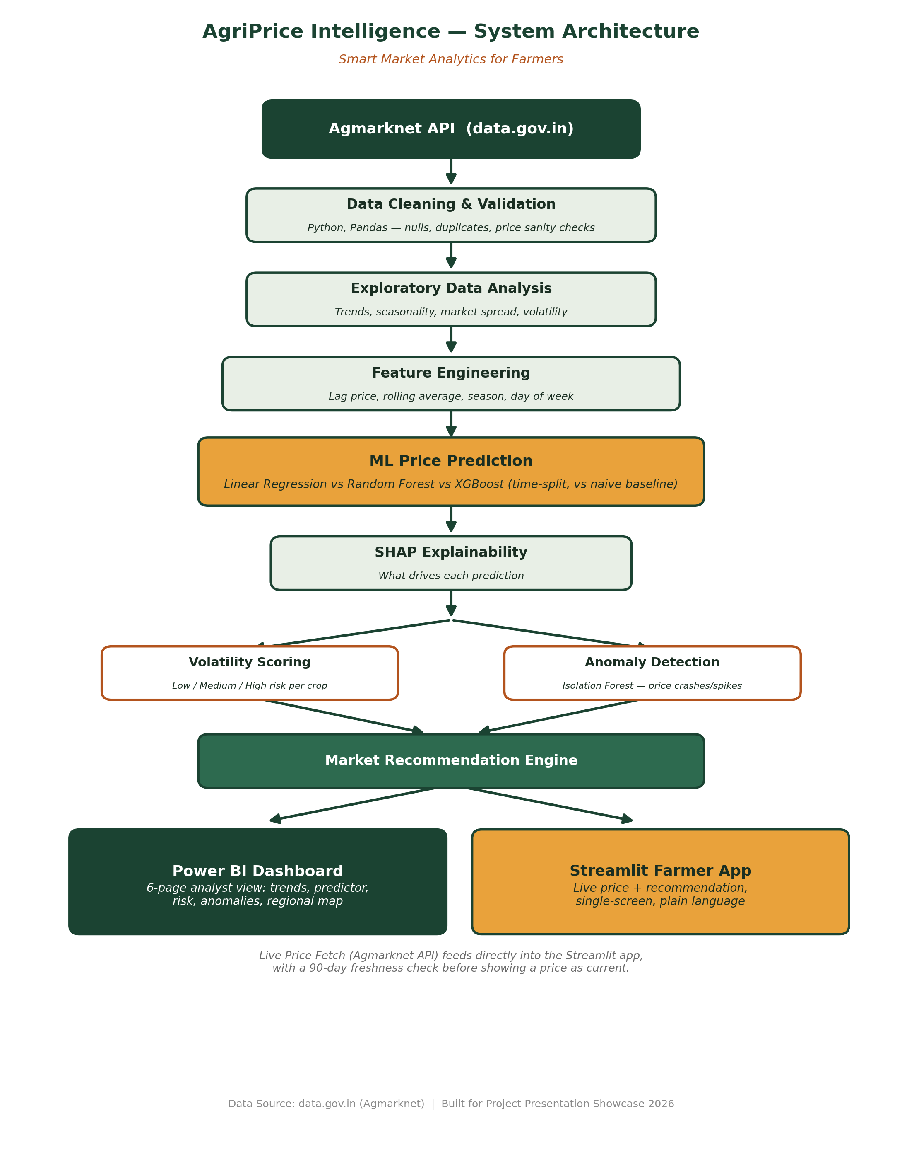
SYSTEM DESIGN
Architecture
One pipeline, two audiences
A single trained model feeds both an analyst-facing Power BI dashboard and a farmer-facing Streamlit app.
Live data, checked
A freshness check (90 days) prevents stale government data from being shown as current.
AgriPrice Intelligence
4

Slide 5
DATA
Real government market data, not a synthetic dataset
19,373
2
9
10
cleaned records
states — Telangana & Karnataka
districts
target crops
Source: data.gov.in — Variety-wise Daily Market Prices Data (Agmarknet API), Ministry of Agriculture & Farmers Welfare
Crops covered:
Onion · Tomato · Potato · Rice · Maize · Cabbage · Carrot · Brinjal · Banana · Mango
Note: Andhra Pradesh was excluded — its available records didn't fall within the last 2 years, so it was dropped to keep data recency consistent across all included states.
AgriPrice Intelligence
5

Slide 6
MACHINE LEARNING
Price Prediction — Model Comparison
Model | MAE | RMSE | R²
Naive Baseline | 617.30 | 1364.07 | —
Linear Regression (chosen) | 464.86 | 867.04 | 0.704
XGBoost (tuned) | 477.74 | 904.30 | 0.678
Random Forest (tuned) | 492.11 | 914.74 | 0.670
Why Linear Regression won
Tree models overfit at default settings on this dataset size. Tuned/shallow versions closed most of the gap — confirming the diagnosis. Linear Regression still generalized best on the time-based test set. Beats naive baseline by ~25%.
AgriPrice Intelligence
6

Slide 7
EXPLAINABILITY
What actually drives the model's predictions (SHAP)
Reading the chart
Recent price momentum (7-day rolling average) dominates — ~7x more influential than everything else combined. This means the model is strong at trend continuation, but cannot anticipate sudden shocks — weather events, policy changes, unexpected oversupply. This limitation is stated openly, not hidden.
AgriPrice Intelligence
7

Slide 8
RISK INTELLIGENCE
Volatility Scoring & Anomaly Detection
Volatility / Risk Scoring
Anomaly Detection
Coefficient of variation per crop, classified into bands:
Isolation Forest, run per crop (not globally) since 'normal' price ranges differ hugely by commodity.
🟢 Low
Brinjal
Real example found:
🟠 Medium
Potato, Maize, Mango, Cabbage, Banana, Carrot
Tomato, Miryalguda (Rythu Bazar) ₹800/quintal in Mar–Apr 2022 → ₹5,800–6,300/quintal by June 2022 A real oversupply-then-shortage event, surfaced directly by the model.
🔴 High
Rice, Onion, Tomato
AgriPrice Intelligence
8

Slide 9
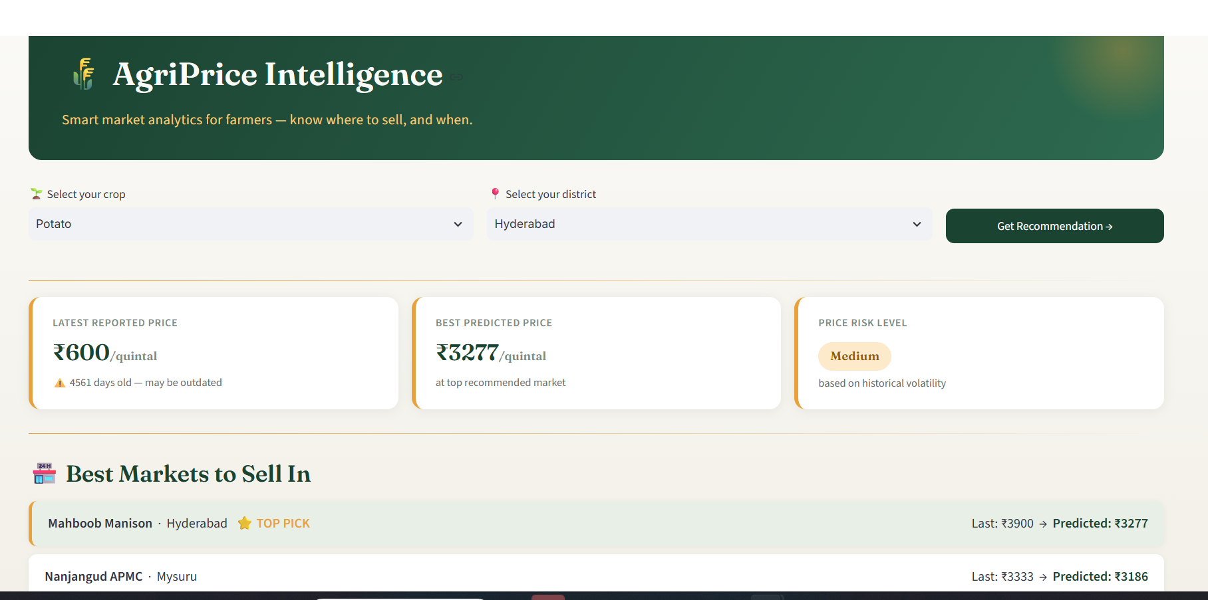
THE FARMER APP
Streamlit Farmer-Facing App
Two dropdowns, one button, a plain-language answer — built for a farmer standing in a field with a phone.
AgriPrice Intelligence
9

Slide 10
THE ANALYST VIEW
Power BI Dashboard — 6 Pages
01
02
03
Overview
Price Trends
Price Predictor
Totals, avg price, anomaly count, risk table, slicers
Monthly trend + seasonality by crop
Predicted vs actual, drill-through, accuracy %
04
05
06
Volatility & Risk
Anomaly Timeline
Regional Map
Risk bar chart + crop/risk matrix
Flagged price crash/spike events
Geographic price comparison by district
AgriPrice Intelligence
10

Slide 11
TECH STACK
Tools Used
Data & ML
Python, Pandas, NumPy, Scikit-learn, XGBoost, SHAP
Visualization
Plotly, Power BI (DAX, Maps)
Apps
Streamlit
Data Source
data.gov.in — Agmarknet API
Validation
Excel
Version Control
Git, GitHub
AgriPrice Intelligence
11

Slide 12
HONESTY BY DESIGN
Limitations
Uneven live-data freshness
Government reporting isn't uniform — the app flags stale data (90-day check) instead of hiding it.
Trend-following, not shock-predicting
Strong at continuation; cannot anticipate weather events or policy shocks — by design of the feature set.
Andhra Pradesh excluded
Its data didn't fall within the last 2 years — dropped to keep recency consistent.
Uneven crop/district coverage
Some combinations have thin data — a realistic reflection of where each crop is actually traded.
AgriPrice Intelligence
12

Slide 13
Built for a farmer, backed by real analysis
One trained model. Two interfaces. A dashboard for the analyst, an answer for the farmer.
github.com/Neti-Geethika/AgriPrice-Intelligence
Thank you

