Slide 1
FPGA NTP v1
4 NTP servers
2 PPS/10MHz inputs
IPV4/V6
ARP/ND
No signing
<100ns stamping accuracy (resolution 8ns)

Slide 2
Simple NTP server
Collect RX time
Extract clients tx timestamp
Swap src and dst addresses
Collect TX time
Transmit responses

Slide 3
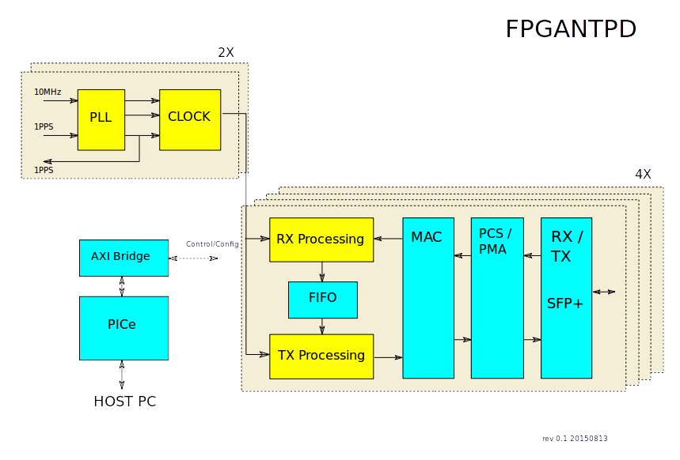
Block Diagram

Slide 4
Clocks
2 Independent clocks
PLL generates 128MHz for timestamps
Clock phase aligned to PPS input

Slide 5
Network paths
4 Independent paths
10Gbs
64 bit data path @ 156MHz
Simple self contained packet processing
RX and TX in pipeline (wire speed processing)

Slide 6
RX Processing
Packet decoding
Checksum validation (IPH, UDP, Eth in MAC)
Extraction of client MAC/IP TX timestamp etc.
RX Timestamp
Statistics

Slide 7
TX processing
Assemble packets
Generate checksums
TX timestamp

Slide 8
Host Interface
PCI Express
1MB BAR0 window
Allows shared memory access
or simple device driver
Currently no Interrupt

Slide 9
Clock API
Current time 64b (second+fracs)
New time 32b (seconds) for next pps
Leap second 32b
Leap add/sub
PLL status (locked to 10MHz, synced to PPS)

Slide 10
Network Path API
Optional NTP/4, NTP/6, ARP, ND
Optional check of our MAC / IPno
MAC adress
IP numbers
NTP config
Leap Indicator
Precision
Root delay
Root disp
Reference ID
Reference Timestamp
RX/TX offset (32bits)

Slide 11
Network Statistics
ipv4_arp_pass_cnt
ipv4_ntp_pass_cnt
ipv6_nd_pass_cnt
ipv6_ntp_pass_cnt
ipv4_arp_drop_cnt
ipv4_ntp_drop_cnt
ipv4_gen_drop_cnt
ipv6_nd_drop_cnt
ipv6_ntp_drop_cnt
ipv6_gen_drop_cnt
bad_mac_drop_cnt
eth_gen_drop_cnt
bad_ipv4_nbr_cnt
bad_ipv6_nbr_cnt
bad_eth_frame_cnt
tx_blocked_cnt

