Slide 1
Foundation of Databases The British College Level 4 / Semester 1-Section F Jan 26,2021

Slide 2
Overview
The differences between data and information
What is a database
What the various types of databases are
Database Management System (DBMS)
Database Vs DBMS
What the database system’s main components are
How a database system differs from a file system

Slide 3
Data Vs. Information
Data:
Raw fact
Some raw materials or facts that can be recorded
Recorded in the form of text,numbers,videos, speech, images etc.
building blocks or foundation of information

Slide 4
Data Vs. Information
Information:
Processed or meaningful data
Information produced by processing data
result of processing raw data into more useful form to reveal meaning
- Accurate, relevant, and timely information is key to good decision making.

Slide 5
Database
Database:
Collection of data
Collection of related data that represent some real world entities (object).
A database is an organized collection of related files and records designed to meet the needs of an organization.
Attendance Register (at office reception)
Bank Accounts (in a bank)
Contact List (in your mobile phone)

Slide 6
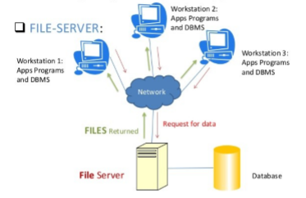
Types of Database
Can be classified according to:
– Number of users
– Database location(s)
Single User
- Supports only one user at a time
Single-user database running on a personal computer
Multi User
Supports multiple users at the same time
Workgroup database supports a small number – Enterprise database supports a large number

Slide 7
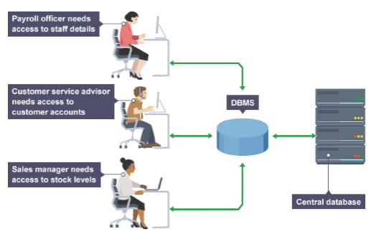
Types of Database
Centralized
Supports data located at a single site

Slide 8
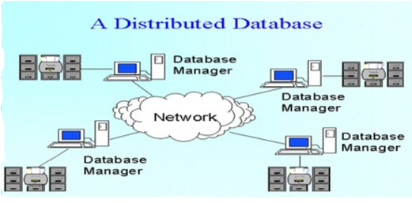
Types of Database
Distributed:
Supports data distributed across several sites

Slide 9
Database Management System (DBMS)
DBMS:
Short name for database management system is DBMS
Software tool to manage data
A database management system is a software used to create, query, manipulate and control databases.
Creation: specification of a name for the database and other parameters
Querying: retrieving required data from the database.
Manipulation:- adding new data to the database  modifying existing data in the database or  deleting existing data from the database
Control: limiting access to data only to authorized users
DBMS is the intermediary between the user and the database

Slide 10
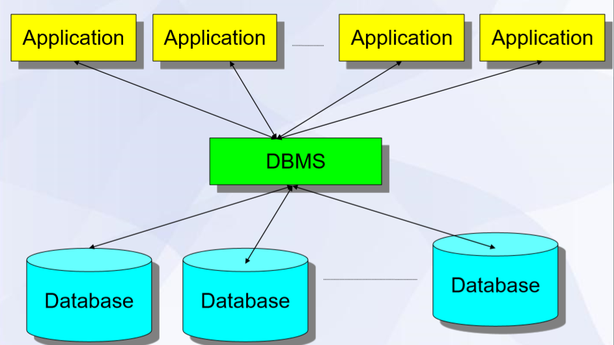
DBMS

Slide 11
DBMS
Advantages:
Improved data sharing.
Improved data security.
Better data integration.
Minimized data inconsistency.
Improved data access.
Improved decision making.
Increased end-user productivity.

Slide 12
DBMS
Disadvantage:
- Increased costs
- Management complexity
- More Disk Space
- Security Risk
- Frequent upgrade/replacement cycles

Slide 13
Application
Application: Almost every field dbms has been used
Airlines,
Railways,
Accounting
Financing
Telecommunications
Medical

Slide 14
Database Vs DBMS
Database != DBMS
A database is a collection of data.
database usually consists of data in one or more files on one or more disks of a computer or it may be distributed across multiple computers.
Database is not a software
DBMS on the other hand is a software.
DBMS is used to manage databases.
DBMS usually consists of one or more programs (executables and libraries) written in programming languages such as C, C++ and Java.

Slide 15
Database System
Database + DBMS = Database System
Components
- Data
- Hardware
- Software
- User

Slide 16
How a database system differs from a file system
Unstructured and Structured
know the file location vs any where remote location
Accessibility
Redundancy
Inconsistency
Integrity
Security
backup, recovery techniques in DBMS

Slide 17
Thank You

