Slide 1

Binary Classification using Banknote Authentication Dataset
CPSC 6820: Special Topics: Hands-on Machine Learning
November 25, 2019
Clemson University
Submitted by: Tamanna Baig | Netra Inamdar

Slide 2
Problem Description
Banknote Authentication Dataset. This dataset was obtained from the UCI Machine Learning Repository and can be downloaded here.
A wavelet tool has been used to extract features from the images. Hence, the dataset has 5 distinct features that are explained in the Data Description.
The aim of the project is to design a classification algorithm that will use the first 4 features as independent variables and predict a class outcome to distinguish between forged(0) and authentic(1) bank notes.

Slide 3
Data Description
The dataset is a text file with 1372 rows and 5 features.
Data was extracted from images that were taken from genuine and forged banknote-like specimen.
Each image was converted into grayscale with a resolution of about 660 DPI.
5 Features were extracted from these images using a Wavelet Transform tool.
Attribute Information:
1. variance of Wavelet Transformed image (continuous)
2. skewness of Wavelet Transformed image (continuous)
3. curtosis of Wavelet Transformed image (continuous)
4. entropy of image (continuous)
5. class (integer)
Data Set Characteristics: | Multivariate | Number of Instances: | 1372 | Area: | Computer
Attribute Characteristics: | Real | Number of Attributes: | 5 | Date Donated | 2013-04-16
Associated Tasks: | Classification | Missing Values? | N/A | Number of Web Hits: | 204945
Notes:
It represents the information regarding the authenticity of banknotes. Abstract: Data were extracted from images that were taken for the evaluation of an authentication procedure for banknotes.

Slide 4
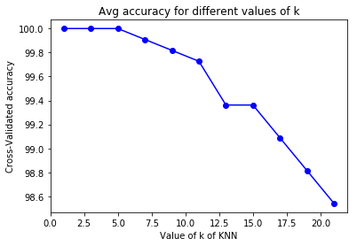
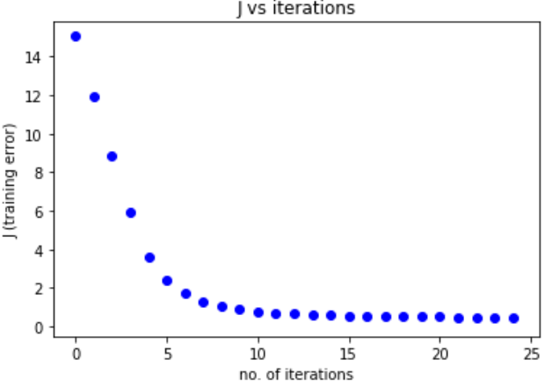
Algorithms and Model
Binary Classification using kNN algorithm:
Binary Classification using Logistic Regression algorithm:

Slide 5
Description for train, test and validation methods
The dataset was split in a 80:20 ratio
Train set: 1097
Test set: 275
Feature Scaling: Normalization/Scaling was applied to match the scales on all the features.
Cross Validation: 5 fold cross validation was used in kNN algorithm along with train test split and normalization.

Slide 6
Evaluation of Results
kNN
Our Algorithm | Sklearn Algorithm
Best k-value: 7 | Best k-value: 16 | For k-value = 7
TP, FP, TN, FN: 27 0 247 1 | TP, FP, TN, FN: 149 0 126 0 | TP, FP, TN, FN: 148 1 126 0
Accuracy: 0.996 | Accuracy: 1.0 | Accuracy: 0.9963
Recall: 1.0 | Recall: 1.0 | Recall: 1.0
Precision: 0.964 | Precision: 1.0 | Precision: 0.9921
F1 Score: 0.982 | F1 Score: 1.0 | F1 Score: 0.9960
Logistic Regression
Our Algorithm | Sklearn Algorithm
TP, FP, TN, FN: 27 4 230 14 | TP, FP, TN, FN: 148 1 125 1
Accuracy: 0.935 | Accuracy: 0.9927
Recall: 0.659 | Recall: 0.992
Precision: 0.871 | Precision: 0.992
F1 Score: 0.753 | F1 Score: 0.992

