Slide 1

Seasonal Agriculture Performance Analysis
Netraja
Babu Banarasi Das University Lucknow
AICTE STU ID : STU692813db584da1764234203

Slide 2

PROBLEM STATEMENT
Nearly 49% of Indian farms run at a loss — systemic crisis with no data-driven guidance
Farmers have no reliable way to identify which crop + season = maximum profit
Zaid season averages -₹24,805 profit/farm — yet farmers still cultivate it blindly
Rice, Wheat & Maize (staple crops grown by majority) are loss-making on average
Water wastage is highest in Zaid — least efficient season, highest cost
No comprehensive analysis existed across 8 states, 3 seasons, 8 crops, 4,000 farms

Slide 3
Project Description
This project presents a comprehensive analysis of seasonal agricultural performance across India using a dataset of 4,000 farm records, 28 features, 8 states, 3 seasons (Kharif, Rabi, Zaid), and 8 crop types.
What We Analyzed:
1. Seasonal yield, profit & revenue comparison (Kharif vs Rabi vs Zaid)
2. Crop-wise profitability — which crops win, which lose
3. Environmental factors — rainfall, temperature, humidity impact on yield
3. Irrigation methods & water efficiency across seasons
4. State-wise regional performance & best crop-region combos
5. Why 49% farms are loss-making — pattern investigation
Key Tools: Python | Pandas | NumPy | Matplotlib | Seaborn | SciPy
Dataset: 4,000 rows × 28 columns | Missing values handled via season-wise median imputation | Outliers retained (represent real farm variation) | 4 new features engineered
Outcome: 8 actionable findings with targeted recommendations for farmers, government, scientists, investors, NGOs, and insurance companies.

Slide 4

WHO ARE THE END USERS?
Farmers — Decide which crop & season maximizes their profit
Government / Agriculture Ministry — Evidence-based policy making & MSP reform
Agricultural Scientists — Study seasonal environmental impact on yield
NGOs & Rural Development Bodies — Support sustainable farming practices
Agri-business Investors — Identify high-return crop-region combinations
Insurance Companies — Crop risk assessment & premium planning

Slide 5

Technology Used
Python 3.x — Core programming language
Pandas — Data cleaning, manipulation & groupby analysis
NumPy — Numerical computing & array operations
Matplotlib & Seaborn — Data visualization & statistical plots
SciPy — Hypothesis testing (One-Way ANOVA)
Jupyter Notebook — Development & presentation environment
CSV Dataset — 4,000 rows × 28 columns

Slide 6
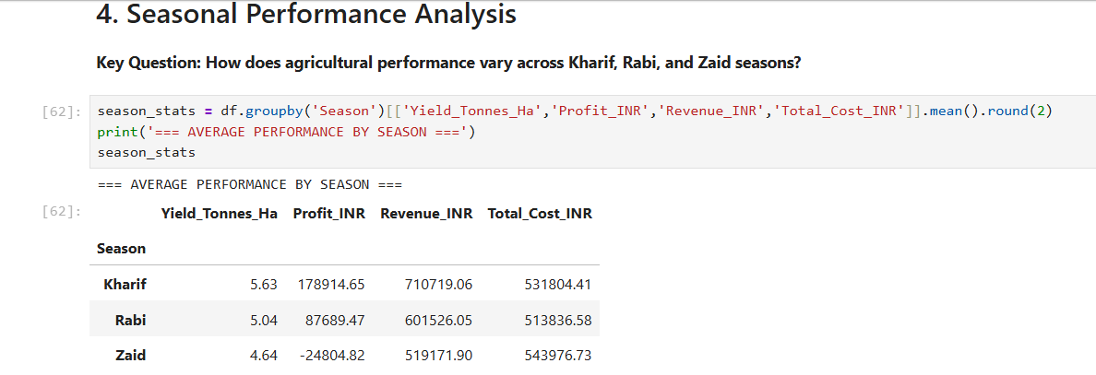
RESULTS

Slide 7
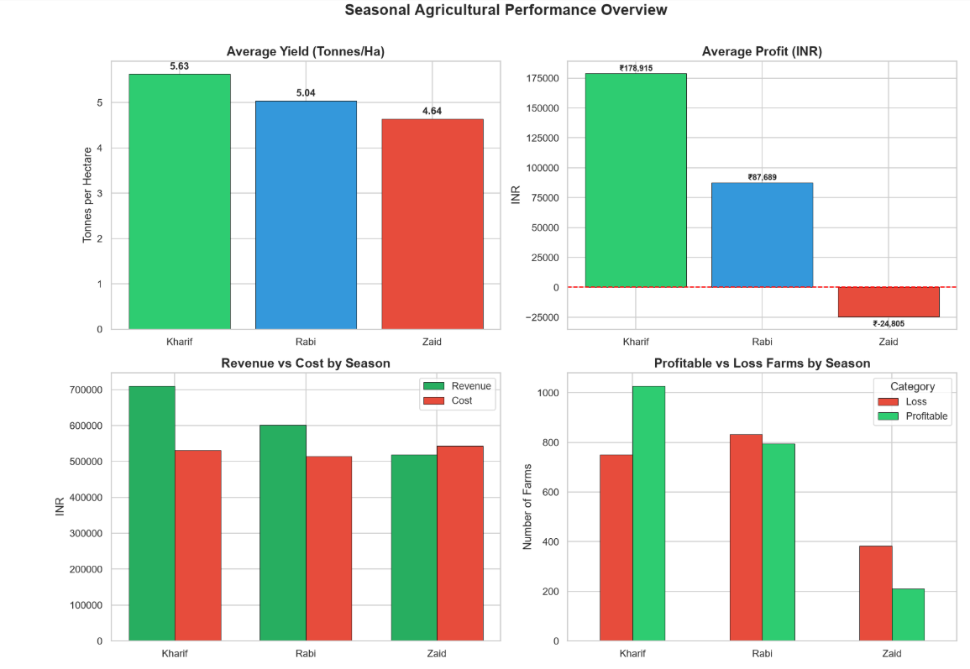
RESULTS
[Ad screen shots of your code ]

Slide 8
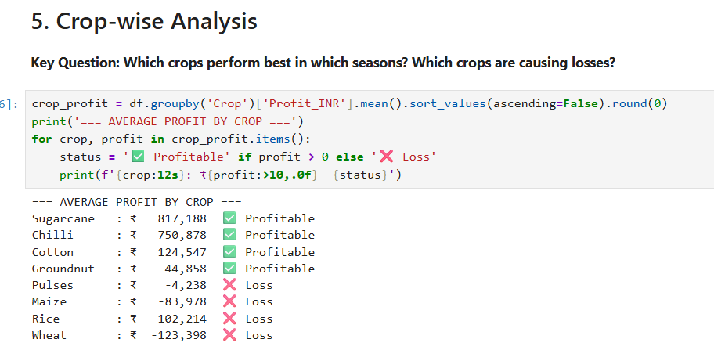
RESULTS

Slide 9
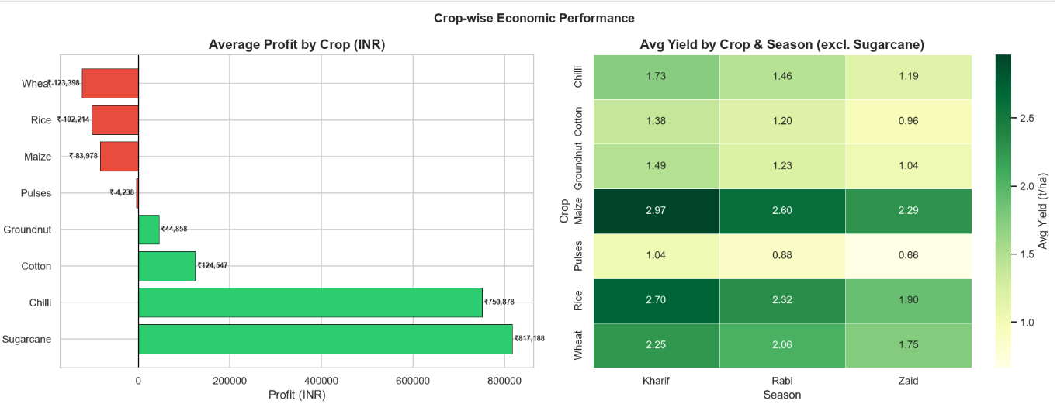
RESULTS

Slide 10
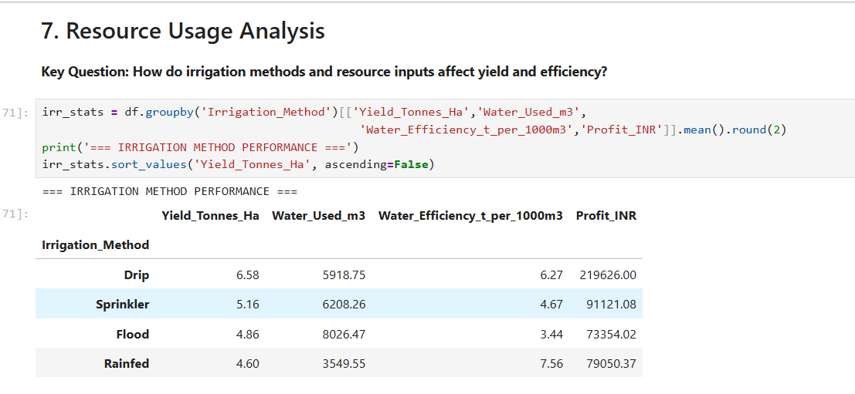
RESULTS

Slide 11
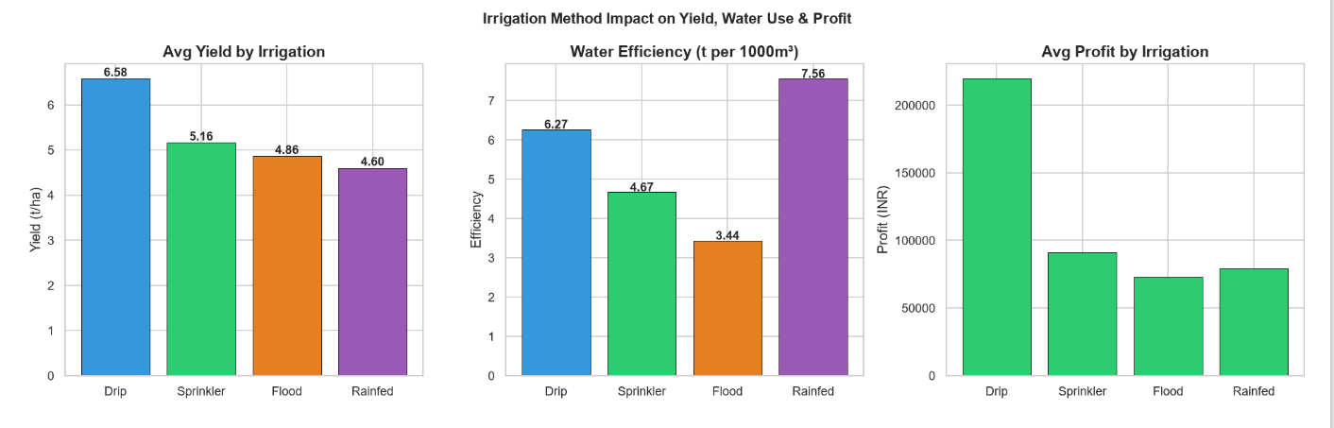
RESULTS

Slide 12
Future scope
1. ML Prediction Model — Predict crop yield & profit using Random Forest / XGBoost.
2. Interactive Dashboard — Real-time web app using Streamlit for farmers & policymakers.
3. Satellite & Soil Data Integration — NDVI, live weather APIs for real-time predictions.
4. Crop Recommendation System — AI-based advisory per district, season & soil type.
5. Zaid Risk Alert System — Automated warning to prevent summer farming losses.
6. Multi-country Expansion — Extend analysis to other South Asian agricultural regions.

Slide 13
GitHub Link
https://github.com/Netraja-swami/Seasonal-Agriculture-Performance-Analysis

Slide 14

VOIS Course completion certificate - Course name- Data Visualization

Slide 15
Thank you

