Slide 1
Provothon Real Time tracking of student’s academic performance
Team : PitchAI
Team Leader: Neha Tripathi
Link to Github: https://github.com/Netri-100224/ProvothonML
(Please copy and paste the link on your web browser)

Slide 2
Problem statement:
As the project title suggests, we have to track the performance of students in real time. Effective teachers do not just deliver quality educational opportunities — they also diligently track student progress to measure results. Tracking progress benefits both students and teachers. Students can see how they’re doing in various subjects, and teachers can see which of their teaching approaches are working and where they might need to make adjustments.
Of course, tracking is necessary to ensure you meet state standards, but checking off whether you have covered curriculum requirements does not necessarily mean that your students are learning the required skills. Tracking student growth lets you know how and when to adjust information as you teach to make sure students are actually learning.

Slide 3
Technical Approach:
Gathering the data: I have searched for the data available among various websites. The best suited for problem statement is available at Kaggle dataset. The dataset consists of:
Data Set Characteristics: Multivariate
Number of Instances: 480
Area: E-learning, Education, Predictive models, Educational Data Mining
Attribute Characteristics: Integer/Categorical
Number of Attributes: 16
Associated Tasks: Classification

Slide 4
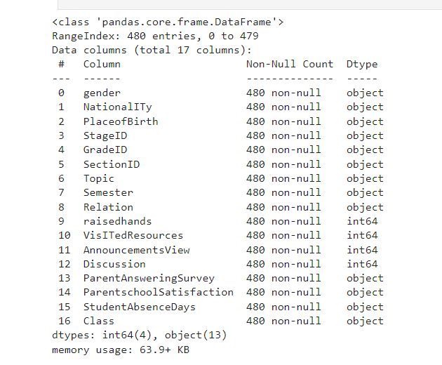
2 Cleaning data:
Data cleaning is done by removing null values and NaN values.
This works by removing rows with null values or substituting them with median values.

Slide 5
3 Data Preprocessing:
Converting data into machine readable value is an important step.
I have used StandardScaler() method to scale the data.
I have used LabelEncoder() method to encode various alphabetical values into numerical values.
Pandas dataframe is used to concatenate these columns with changed values.
NumPy library is used to perform numerical operations.

Slide 6
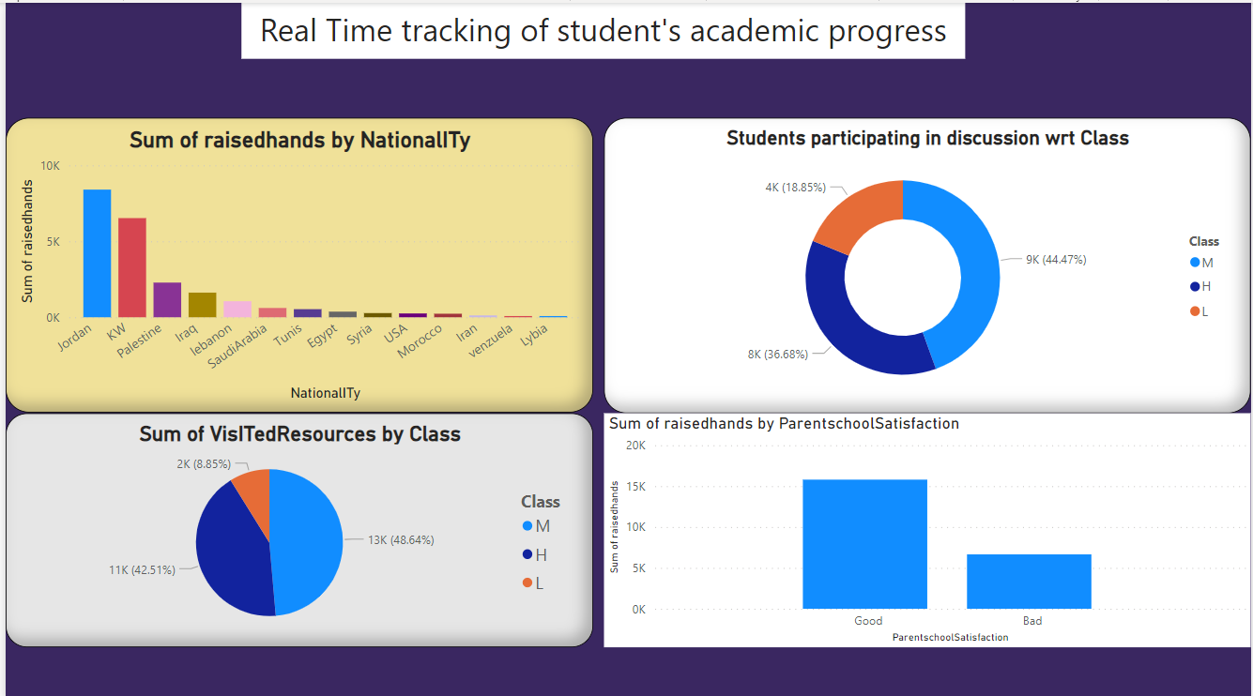
Data Analysis using PowerBI Dashboard

Slide 7
4 Selecting Model:
This is one of the most important step as selecting best model for our data would give better accuracy in prediction.
This problem is a classification problem which is multivariate in nature.
So I have used 3 classifiers:
Random Forest Classifier
Support Vector Classifier
Decision Tree Classifier

Slide 8
4 These three classifiers are compared with each other to determine:
Train Set Prediction
Test Set Prediction
Confusion Matrix
The outputs of them are as follows:
Random Forest Classifier and Support Vector Classifier are Overfitted.
Decision Tree Classifier is fitted perfectly.

Slide 9
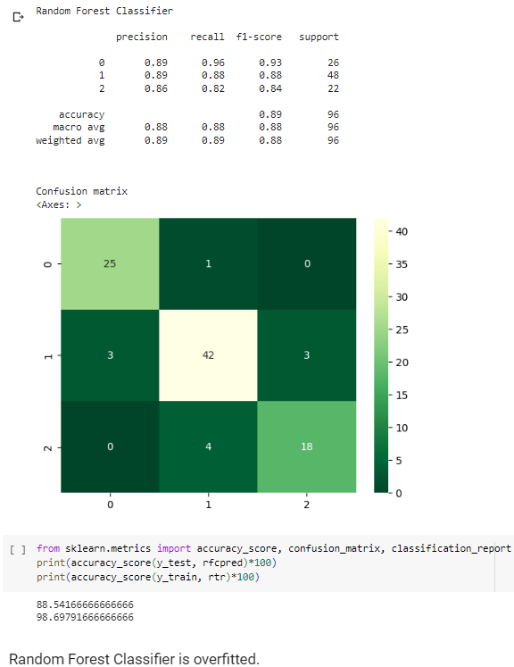
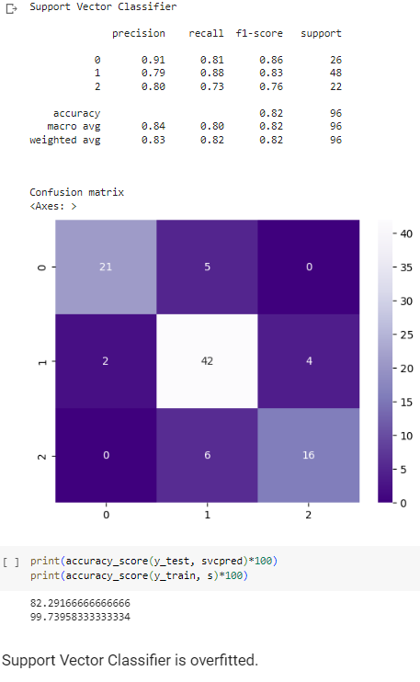

Slide 10
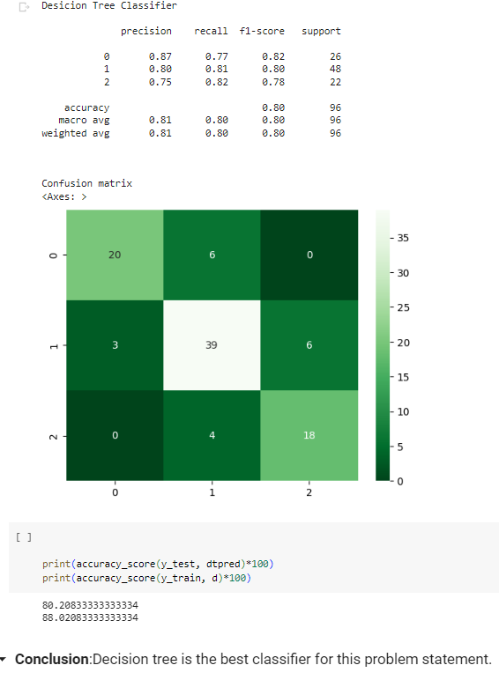
Decision Tree Classifier is the best model.

Slide 11
Conclusion:
Since the Decision tree classifier predicts best accuracy and no overfitting so I have chosen it to be the best model for this problem statement.
This project focuses on working with real time data so more focus is made on conducting quiz, assignments all online and promote academic tutors and students to get familiar with the same so as to prevent any discrepancies. The motive is to get insights on academic patterns of students .Thus monitor them and help them enhance their performance and results. Instructors need to periodically update the data to achieve best and accurate results from the model.

