Slide 1

Formula 1 Safety
The Evolution of Safety Regulations

Slide 2
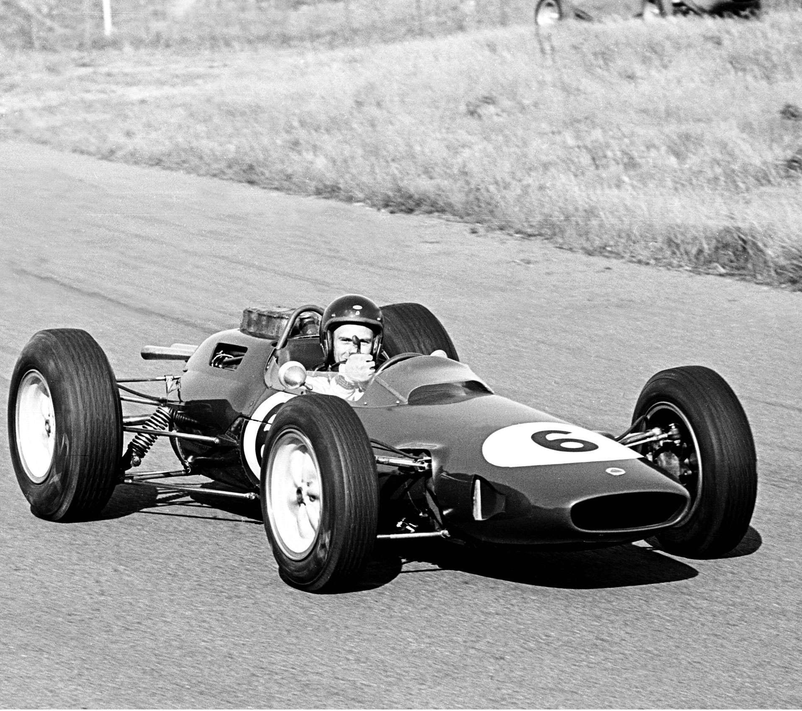
The Dark Days
The 1960s: Death Was Expected
2 drivers died every year on average
Fuel tanks next to drivers' legs
Cotton overalls and thin leather helmets
No barriers - just hay bales
Short-sleeved shirts, minimal protection
1960s F1 Car: Minimal Safety Features

Slide 3
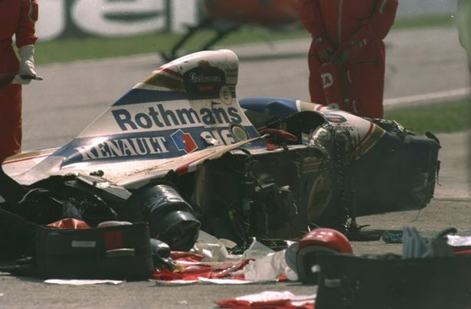
The Wake-Up Calls
1994: Senna's Death Changed Everything
Mandatory crash tests introduced
Raised cockpit sides for protection
Improved helmet standards
FIA finally said "enough"
Change came slowly, usually after tragedy.
Ayrton Senna: His tragic death prompted major safety reforms

Slide 4
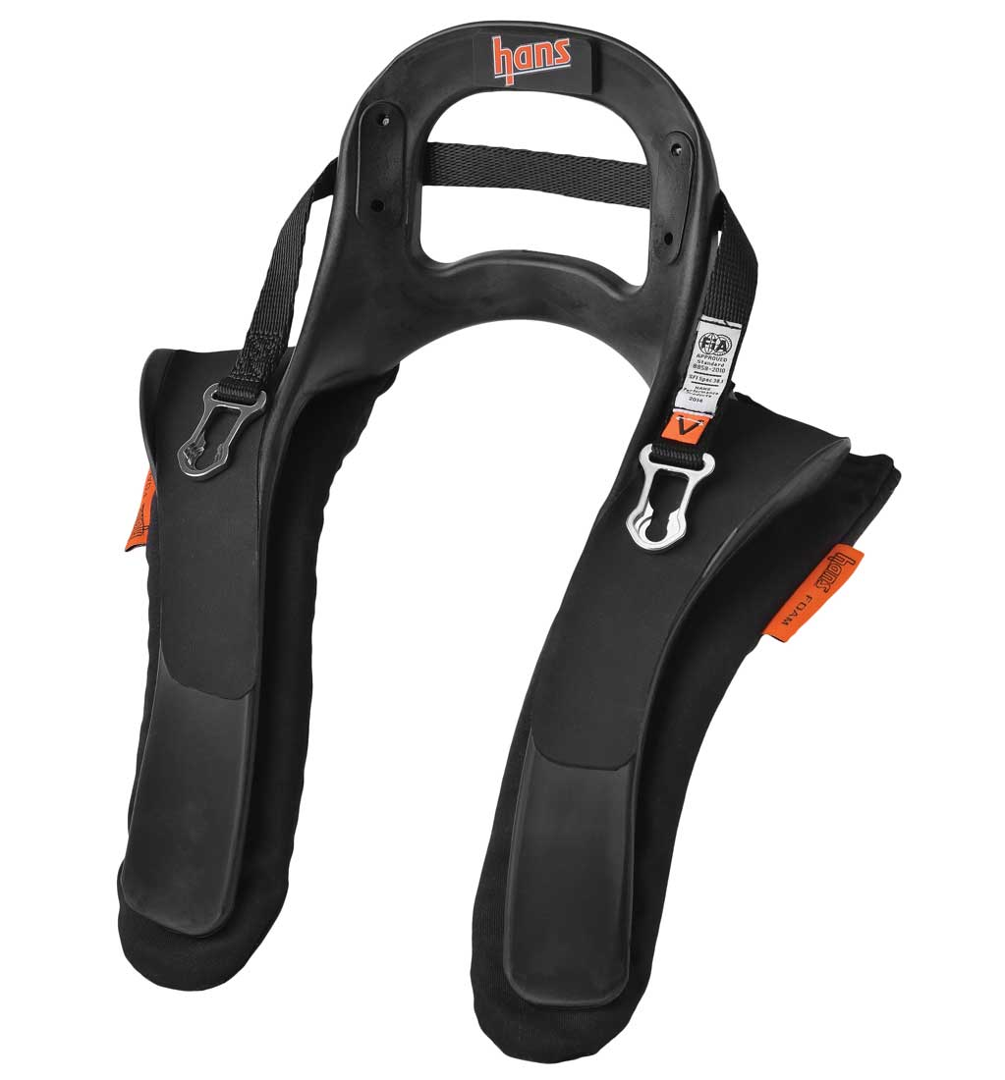
Innovation #1: HANS Device (2003)
The Simple Collar That Saves Lives
Stops head from snapping forward in crashes
Prevents serious neck injuries
Mandatory since 2003
Countless lives saved
HANS Device: Head and Neck Support

Slide 5
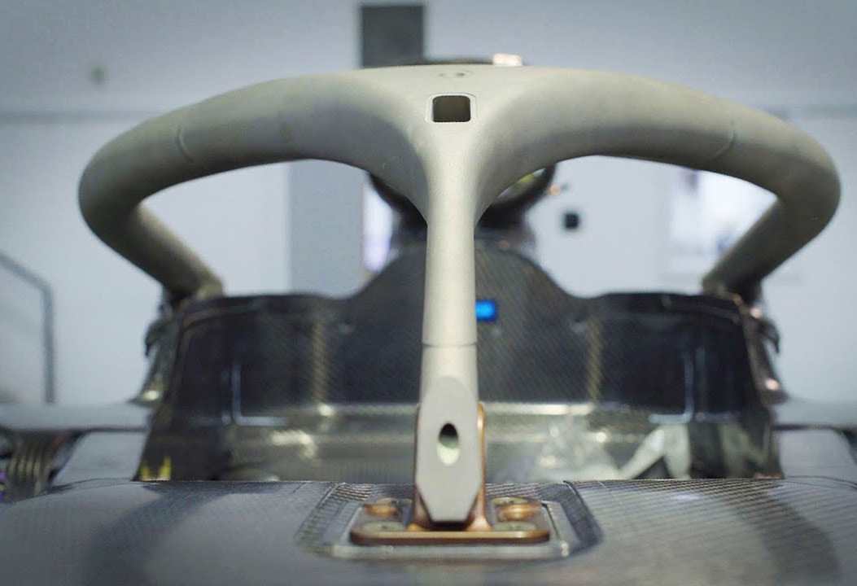
Innovation #2: The Halo (2018)
The Titanium Bar Above the Driver
Controversial at first - called "ugly"
Saved Romain Grosjean's life in 2020
Car split in half and burst into flames
He walked away - halo deflected the barrier
"Without it I wouldn't be able to speak with you today" - Grosjean
The Halo: Life-Saving Titanium Structure

Slide 6
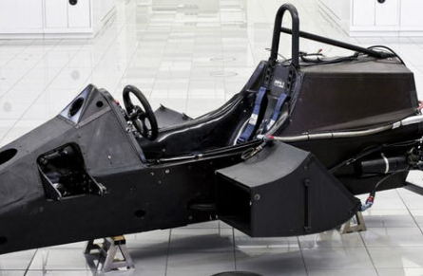
Innovation #3: The Survival Cell
Carbon Fiber Cocoon of Protection
Incredibly strong carbon fiber monocoque
Car can disintegrate around it
Driver stays protected inside
Rigorous crash testing before approval
Carbon Fiber Monocoque: The Driver's Protective Shell

Slide 7
Modern F1 Safety
Today's Safety Features
Equipment
Track Safety
Testing
Fireproof suits (withstand flames)
Advanced helmets
Safer fuel formulations
Energy-absorbing barriers
Medical teams on-site
Immediate crash response
Extreme crash tests
Safety simulations
Millions spent on safety R&D

