Slide 1
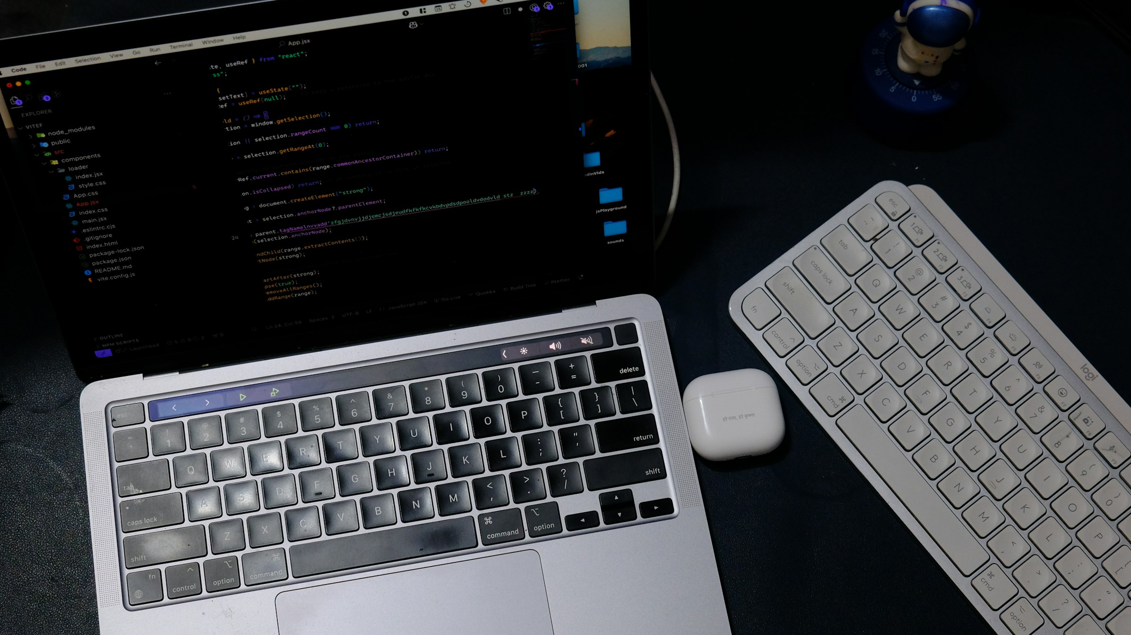
WILL AI BE
COMPLETELY FREE?
(SOON)
Local models, open weights, and the costs that remain
Notes:
When people say AI will become free, they usually mean the price of asking a model a question will approach zero. Local language models make that idea feel believable. We can now download model weights, run them on consumer hardware, and avoid a meter that charges for every token. But completely free is a much bigger claim. Over the next ten minutes, I want to separate four ideas that often get bundled together: price, openness, privacy, and unlimited use. Local AI moves all four, but it does not solve all four. My conclusion is optimistic, with an important caveat: many everyday uses may feel free very soon, while the real costs simply move somewhere else.
Sources and image credits:
• Stock photo: Rahul Mishra, Unsplash, https://unsplash.com/photos/laptop-and-keyboard-on-a-dark-desk-BA2ELfOTqJ4

Slide 2
Free has four meanings
$0
OPEN
LOCAL
NO LIMITS
PRICE
RIGHTS
LOCATION
USAGE
One word. Four different promises.
Notes:
The word free creates confusion because it can describe four different things. First, zero price: no subscription and no charge per token. Second, open rights: permission to inspect, modify, or redistribute a model, depending on its license. Third, local location: the computation happens on hardware you control. Fourth, unlimited usage: you can run as many requests as your machine can handle. These promises overlap, but none guarantees the others. A model can be free to download and expensive to operate. It can have downloadable weights under a restrictive license. It can run locally while the surrounding app still calls external services. And it can have no usage fee while remaining limited by memory, speed, or battery life. The rest of the talk uses these four meanings as a scorecard.
Sources and image credits:
• Hugging Face model card and license metadata guidance: https://huggingface.co/docs/hub/en/model-cards

Slide 3
What makes a model local
MODEL WEIGHTS
4-bit
+ RUNTIME
Quantization cuts the footprint.
Quality may drop.
+ MEMORY
Notes:
A local LLM needs three pieces. The model weights contain the learned parameters. A runtime such as llama.cpp, Ollama, or MLX LM loads those weights and performs inference. Then the device needs enough memory and compute for the model plus its working context. Quantization is one reason this suddenly feels practical. Instead of storing every weight at high precision, a quantized model represents weights with fewer bits. A rough lower-bound calculation is parameters multiplied by bits, divided by eight. So seven billion parameters at four bits is about three and a half gigabytes for weights alone. Real memory use is higher because the runtime, context cache, and other components also need space. Quantization improves fit and often speed, but compression can reduce quality. Local AI is therefore an engineering trade, not a magic download button.
Sources and image credits:
• llama.cpp supports multiple quantization levels and many hardware backends: https://github.com/ggml-org/llama.cpp
• MLX LM supports local generation and quantization on Apple silicon: https://github.com/ml-explore/mlx-lm

Slide 4



Open weights and local inference
MODEL FAMILIES
LOCAL RUNTIMES
llama.cpp
QWEN
KIMI
OLLAMA
A downloadable model may still be far too large for a laptop.
Notes:
This ecosystem slide separates models from runtimes. Qwen and Kimi are model families. Ollama and llama.cpp are tools that help run compatible models. The distinction matters because open weights do not automatically mean laptop friendly. Some families include compact models that fit on a personal computer after quantization. Others push frontier capability with enormous parameter counts and require servers or clusters. Kimi K3, for example, is open weight but its published scale is measured in trillions of total parameters. That is an important warning against treating “open” as a synonym for “small.” Runtimes also matter because they translate model formats into usable local applications. Ollama offers a simple cross-platform path. llama.cpp targets efficient inference across CPUs and several GPU backends. The future depends on both layers: model makers lowering capability per byte, and runtimes making the hardware easier to use.
Sources and image credits:
• Qwen official project: https://qwenlm.github.io/
• Moonshot AI official GitHub organization: https://github.com/MoonshotAI
• Kimi K3 model repository and published architecture: https://github.com/MoonshotAI/Kimi-K3
• Ollama official site: https://ollama.com/
• llama.cpp official repository: https://github.com/ggml-org/llama.cpp
• Logos from the official GitHub organization avatars for QwenLM, MoonshotAI, and Ollama.

Slide 5
CLOUD
LOCAL
Usage fees
Hardware
Current models
Electricity
Scale on demand
Maintenance
Local shifts cost into hardware and operations.
Notes:
Local models change the shape of the bill. Cloud services charge for usage and include the provider’s hardware, operations, model updates, and scaling. That is convenient when demand is unpredictable or when you need a frontier model for a difficult task. Local inference replaces much of the variable usage fee with fixed and operational costs. You buy the device or server. You pay for electricity. Someone manages model files, updates, security, and failures. If the hardware already exists and the workload is steady, the marginal price of another short response can become extremely low. At small scale, however, cloud access may remain cheaper than buying specialized hardware. At large scale, local can win only if utilization stays high enough. So “free AI” often means the meter disappears from the interface, while costs move into capital, energy, and labor.
Sources and image credits:
• Ollama describes local execution and memory behavior: https://docs.ollama.com/faq
• llama.cpp hardware and backend support: https://github.com/ggml-org/llama.cpp

Slide 6
Where local already fits
GOOD
FIT
Private drafts
Sensitive text stays close
Offline assistance
No connection required after setup
Code completion
Fast, repeated, narrow tasks
High-volume routines
No token meter per request
Notes:
Local models are strongest when the task is frequent, bounded, and does not require the newest world knowledge. Private drafting is the obvious example: summarizing internal notes, cleaning text, or extracting structure from documents without sending content to a hosted model. Offline assistance also matters in travel, field work, factories, and unreliable networks. Code completion can work well because the task is repeated, the feedback loop is immediate, and a developer can reject bad suggestions. High-volume routine work is another fit when a team already owns suitable hardware and can keep it busy. The common pattern is not “replace every cloud model.” It is “find a stable task where a smaller model is good enough.” That quality threshold matters more than benchmark prestige. If the local model clears it reliably, low marginal cost and control become real advantages.
Sources and image credits:
• Ollama local-only mode and prompt handling: https://docs.ollama.com/faq
• MLX LM local generation on Apple silicon: https://github.com/ml-explore/mlx-lm

Slide 7
The limits show up fast
QUALITY
MEMORY
FRESHNESS
OPS
Complex reasoning
Long context
Current facts
Setup and updates
Success requires more than fit.
Notes:
The bad side appears quickly. First is quality. Small, compressed models can be excellent on narrow tasks but less reliable on deep reasoning, difficult coding, or ambiguous instructions. Second is memory. Longer context increases the working cache, so a model that loads comfortably may struggle when you add large documents or parallel users. Third is freshness. A local model knows what was in its training data unless you add retrieval, tools, or updates. It cannot answer today’s news from memory. Fourth is operations. Someone has to choose model versions, confirm licenses, test regressions, patch runtimes, and protect the endpoint. None of those problems makes local AI a bad idea. They explain why the cheapest-looking model can become expensive in production. The correct comparison includes the cost of errors and the human time needed to keep quality acceptable.
Sources and image credits:
• MLX LM documents memory and quality tradeoffs for key-value cache size: https://github.com/ml-explore/mlx-lm
• Ollama documents context size, parallelism, and memory scaling: https://docs.ollama.com/faq
• Hugging Face model cards describe intended uses, limitations, and evaluation results: https://huggingface.co/docs/hub/en/model-cards

Slide 8
*
PRIVACY
HAS AN ASTERISK
Local prompts can stay local.
Tools, logs, and files can still leak.
Notes:
Privacy is one of the best reasons to run locally, but the promise needs an asterisk. Ollama states that prompts and data are not sent back when you run locally, and it provides a mode that disables its cloud features. That is a meaningful control. Yet the model is only one component. The surrounding application may send telemetry. A web search tool may transmit the query. A document connector may upload files. Logs and backups may copy sensitive text. A malicious document can also attempt prompt injection, especially when the model has tools or permission to act. Local execution reduces one major route of data exposure; it does not replace access control, sandboxing, audit logs, or review. The safer design gives the model the minimum permissions it needs and treats external content as untrusted, even when inference stays on the device.
Sources and image credits:
• Ollama prompt handling and local-only configuration: https://docs.ollama.com/faq
• OWASP GenAI security risks, including prompt injection and excessive agency: https://genai.owasp.org/llm-top-10/

Slide 9
My 2030 bet: hybrid
LOCAL DEFAULT
CLOUD ESCALATION
Routine
Private
Offline
Hardest
Freshest
Largest
Software picks the smallest model that clears the quality bar.
Notes:
My 2030 prediction is a hybrid system, not a complete local takeover. Routine requests will default to a model on the phone, laptop, vehicle, or company server. Sensitive and offline tasks will benefit from that local path. Harder requests will escalate to larger hosted models. Questions that need current information will use cloud tools or retrieval. Bursty workloads will still benefit from rented infrastructure. Users may not even see this routing. Software can estimate task difficulty, privacy sensitivity, latency, and cost, then choose the smallest model likely to meet the quality bar. This is an inference from current trends, not a guaranteed forecast. Model efficiency and consumer hardware keep improving, but frontier training and large-scale inference remain concentrated. Hybrid routing captures the economic advantage of local models without pretending that one small model can handle every job.
Sources and image credits:
• Inference based on current local runtime capabilities documented by llama.cpp: https://github.com/ggml-org/llama.cpp
• Inference based on local and cloud modes documented by Ollama: https://docs.ollama.com/quickstart

Slide 10
SO, WILL AI
BE FREE?
ALMOST.
Zero marginal price for many tasks.
Real costs remain.
Notes:
So, will AI be completely free soon? My answer is almost, at the point of use, for many ordinary tasks. Local models can remove the visible token meter. Open weights can widen access. Better hardware can make useful intelligence feel like a built-in feature rather than a rented service. But the full system still consumes hardware, electricity, engineering time, and human judgment. Licenses still shape what people can do. Security and mistakes still carry costs. The most realistic future is abundant AI with a near-zero marginal price, supported by infrastructure that someone still has to pay for. That is less dramatic than “completely free,” but it may change everyday computing just as much.
Sources and image credits:
• NIST AI Risk Management Framework overview: https://www.nist.gov/itl/ai-risk-management-framework

