Slide 1




BioPortal Concept Centric View
Let’s forget a bit about ontologies
Marcos Martinez-Romero Michael Dorf Attila Egyedi Clement Jonquet

Slide 2
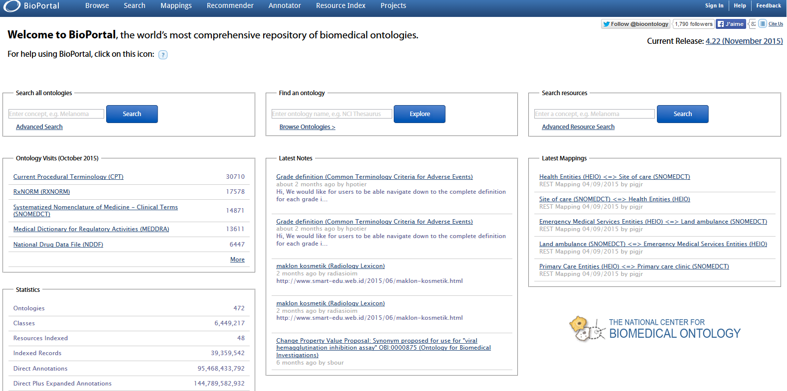
NCBO BioPortal is certainly the biggest resource about biomedical terms in the world

Slide 3

What if we want to learn about a biomedical concept, while not being interested that much in ontologies

Slide 4
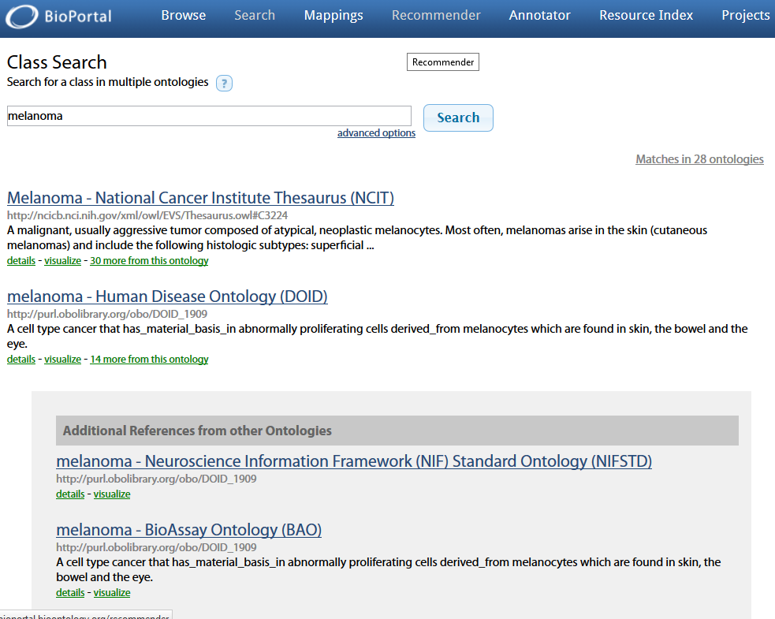
As of now searching for
“melanoma”
will retrieve all the occurrences of melanoma in each ontology of the portal
As if the user is interested in ontologies

Slide 5

Let’s build a new concept centered web application, that will enable the user to get clues about concepts while still using data from ontologies

Slide 6

But the data is still (mainly) in BioPortal
…. that fortunately has a nice and simple API

Slide 7
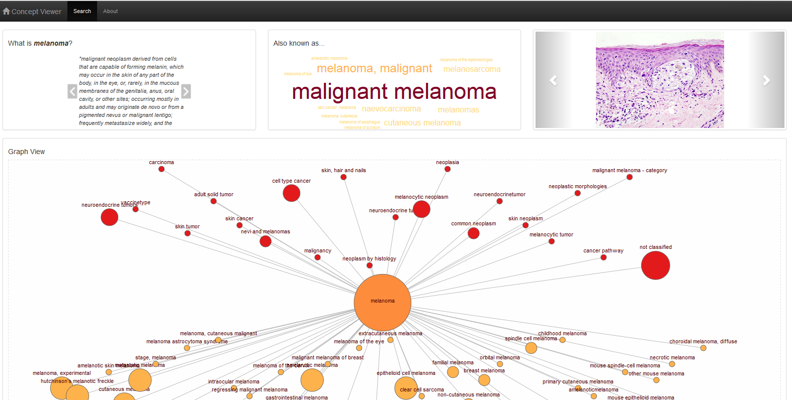

Brand new user interface

Slide 8
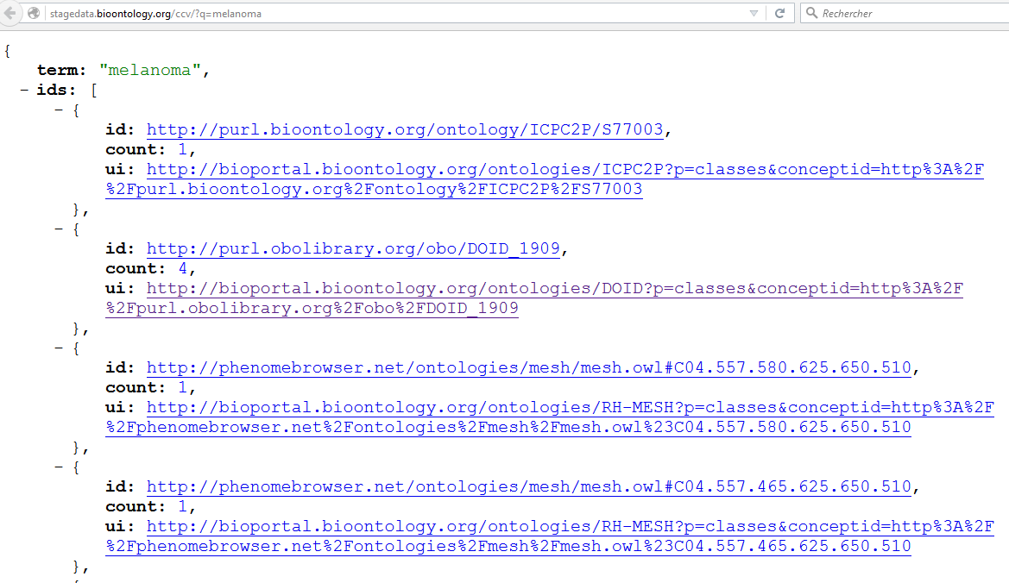

New web service endpoint

Slide 9
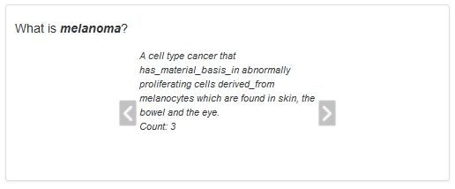
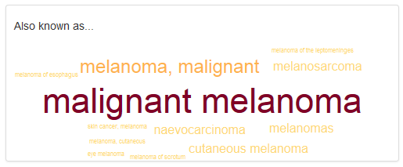
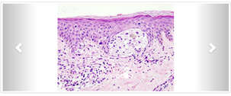
Definitions
Synonyms
Images

Slide 10
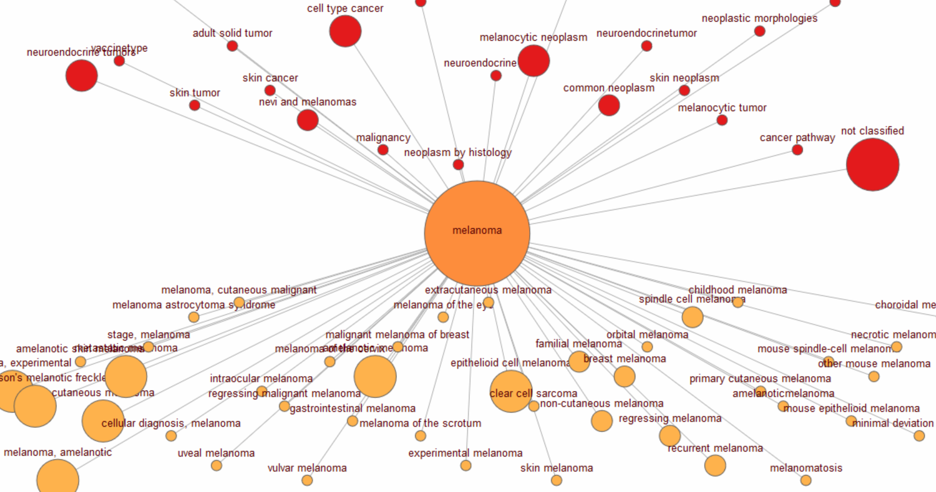
Broader/ Narrower concepts relations

Slide 11
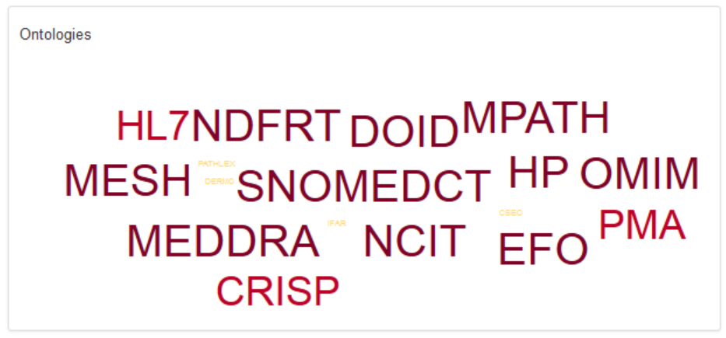
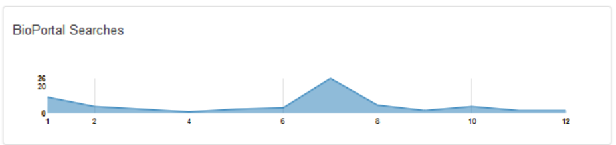
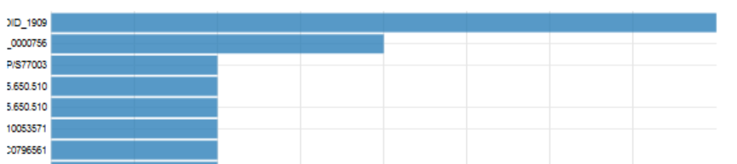
Link to ontologies
12-month -popularity
Most used URIs

Slide 12
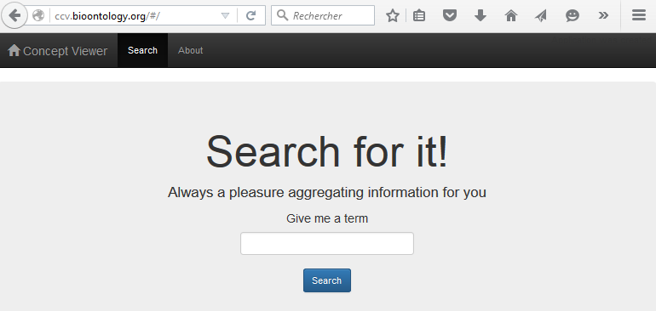




New concept centric view endpoint
BioPortal /search endpoint
Outside information e.g., images
Concept-centered aggregation of data

Slide 13




Amicalement votre… Thank you.

