Slide 1
TCP FTP Programming
Network programming Team No.3

Slide 2
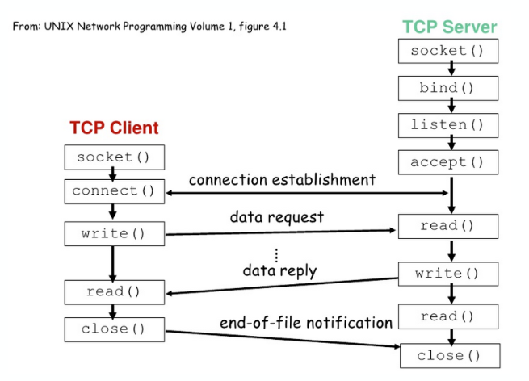
TCP Server and Clients

Slide 3
TCP Client

Slide 4
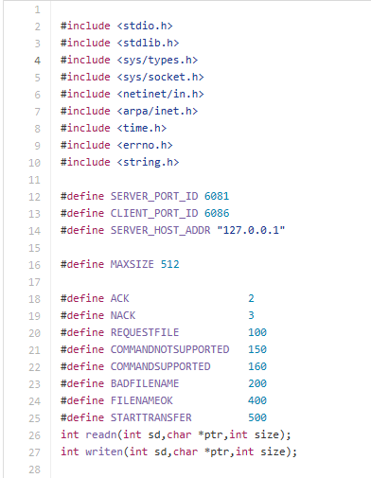
Header Files and Defines

Slide 5
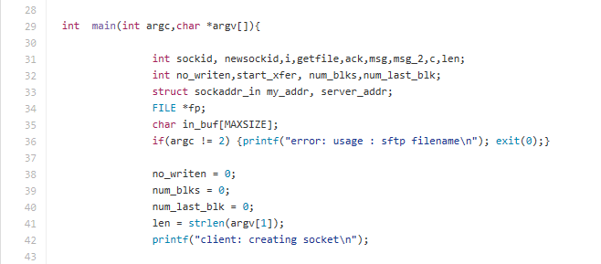
Argument Setup

Slide 6

socket()

Slide 7
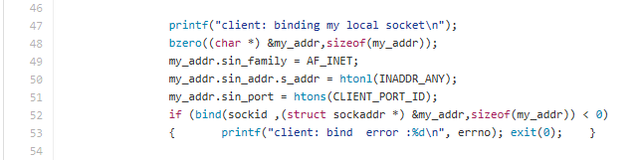
bind()

Slide 8
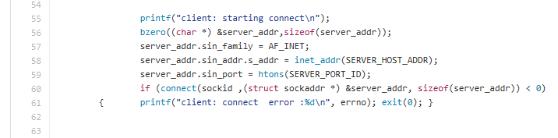
connect()

Slide 9
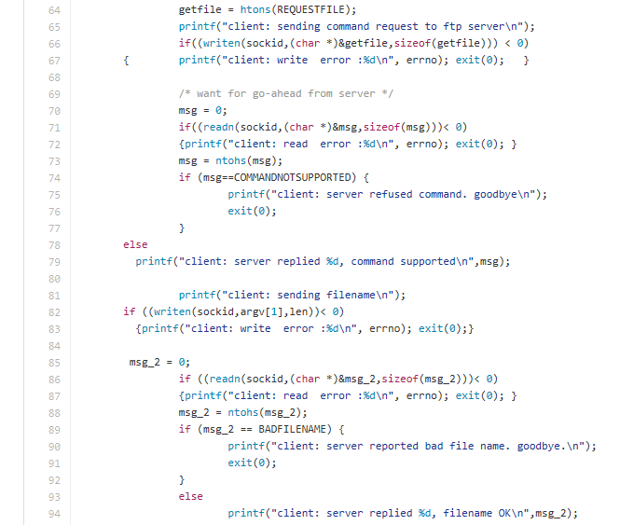
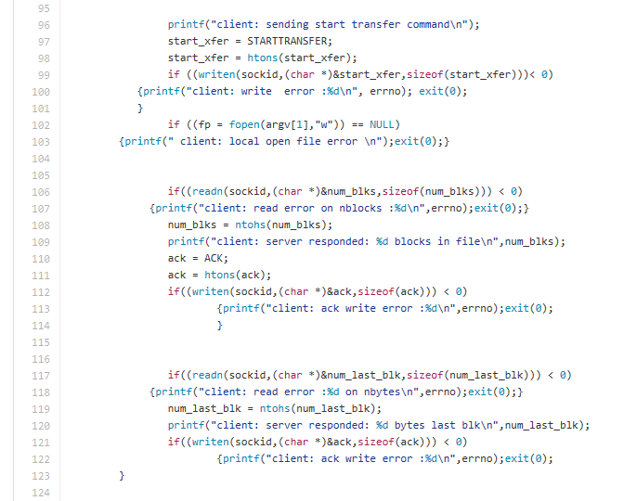
Sending & Receiving data using writen() & readn() instead of write() & read()

Slide 10
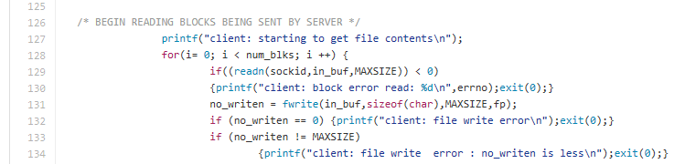
Begin reading blocks sent by server

Slide 11
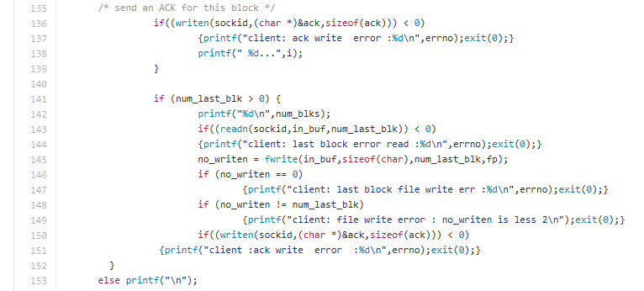
Send an ACK for a block

Slide 12

close()

Slide 13
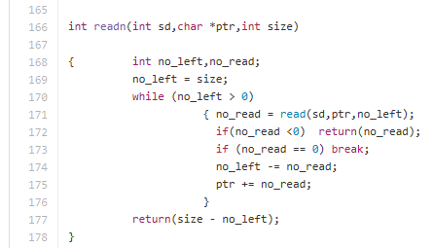
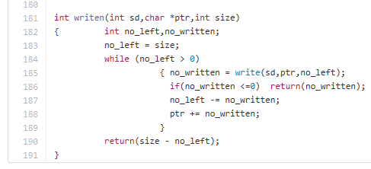
readn() & writen()
readn()
writen()

Slide 14
TCP Server

Slide 15
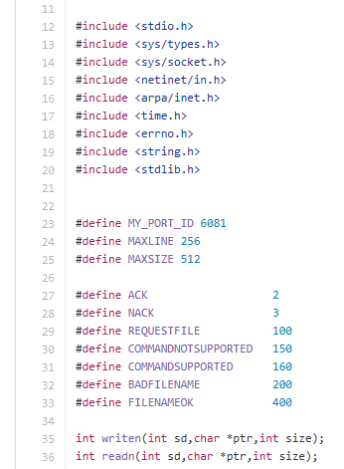
Header Files and Defines

Slide 16

Argument Setup

Slide 17

socket()

Slide 18
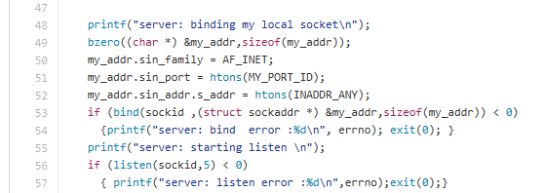
bind() & listen()

Slide 19
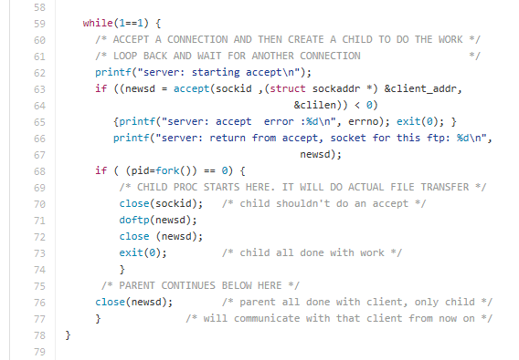
accept()

Slide 20
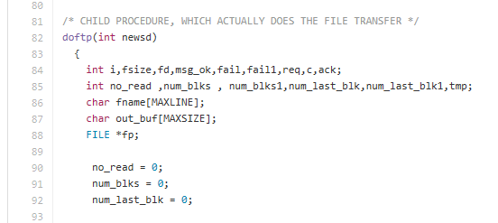
doftp() argument setup

Slide 21
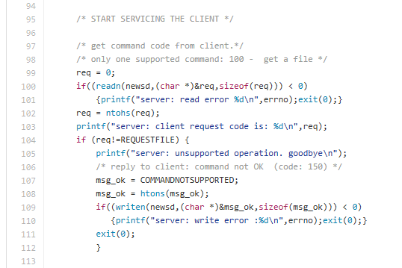
Starting servicing the client Part

Slide 22
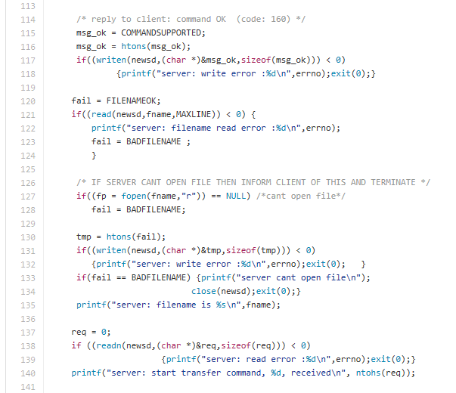
Reply to client Part

Slide 23
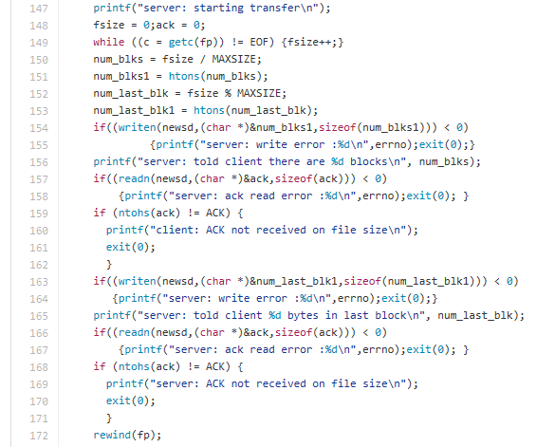
Sending info to client and receiving ACKs

Slide 24
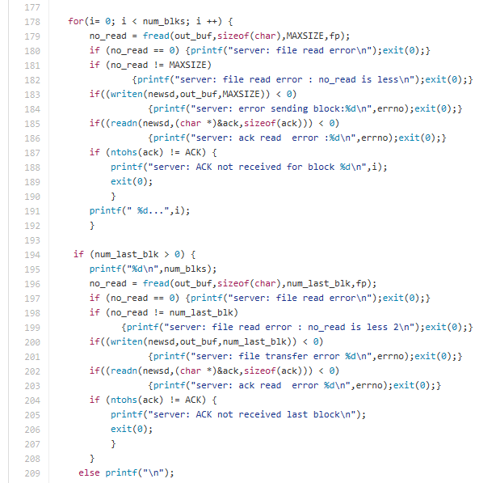
File transfer Part(block by block)

Slide 25
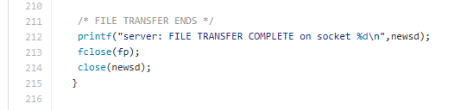
File transfer end Part

Slide 26
readn() & writen()
readn()
writen()

Slide 27
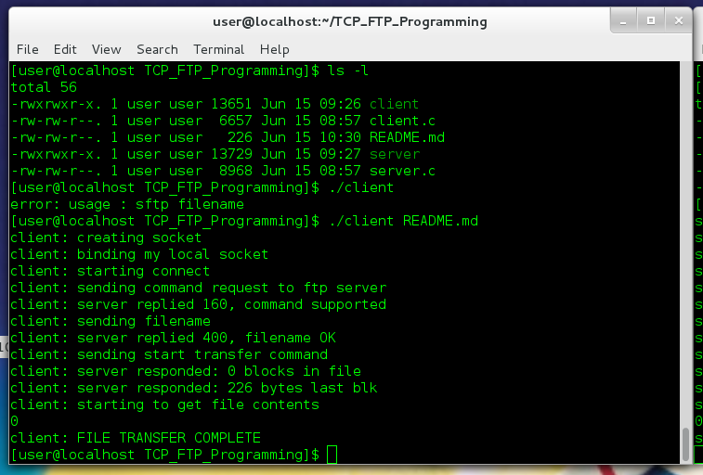
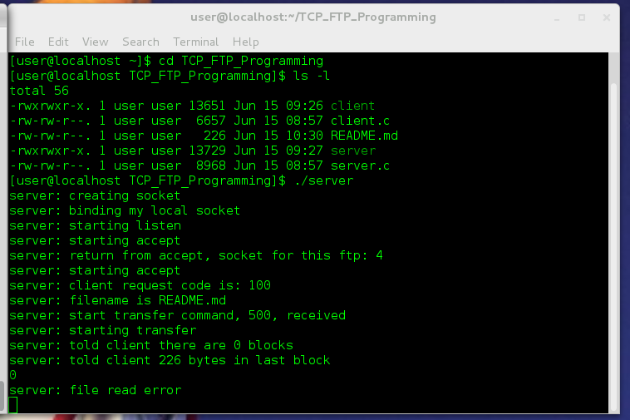
Result
Client
Server

Slide 28
Contributions
Woong Lee: programming and discussion
Jiman Jung: programming as leader
Soryung Lee: PPT for report
Junyoung Huh: discussion
Odiljon: discussion

