Slide 1
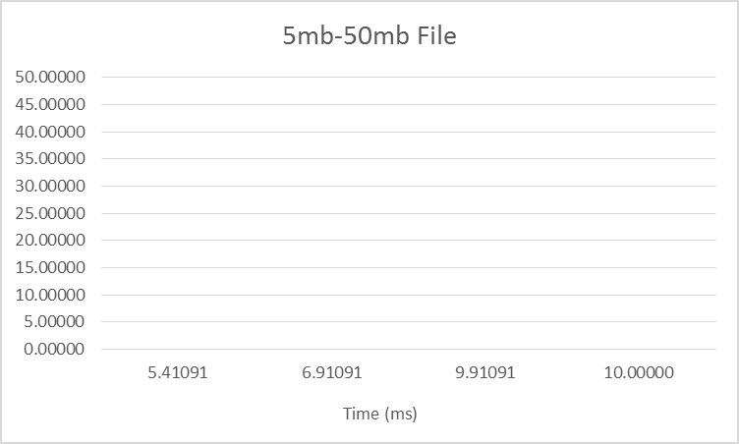
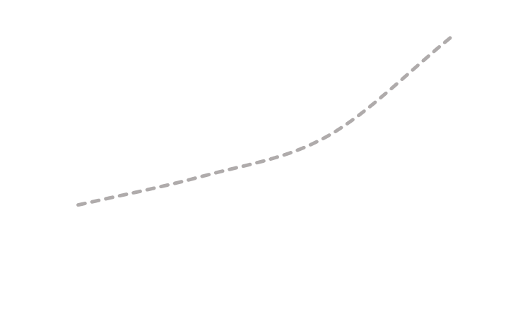
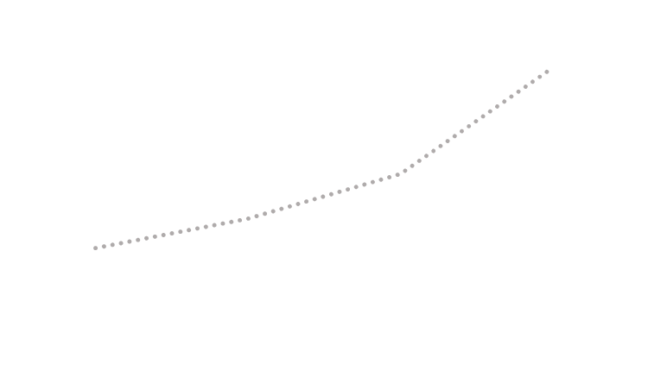
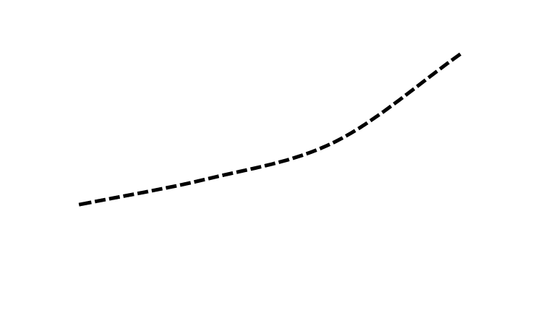
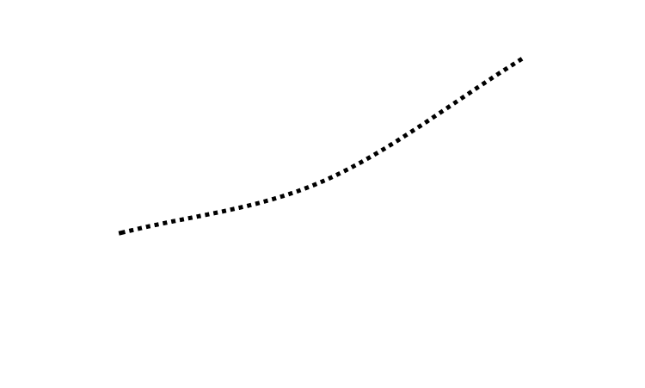

Slide 2
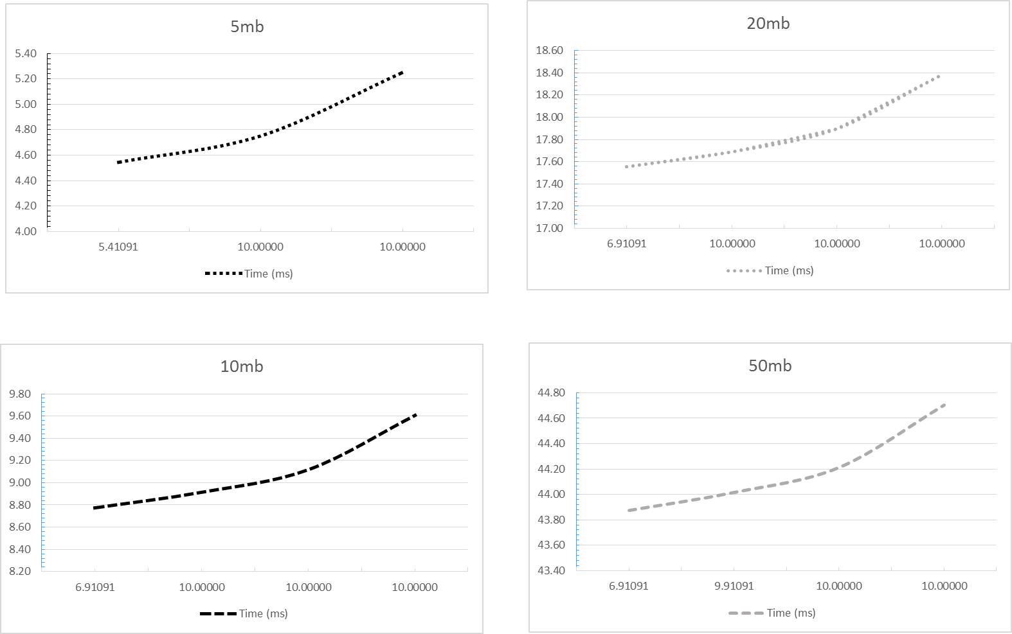
Flow Duration (5Mb w/ delay)
Flow Duration (10Mb w/ delay)
Time (ms)
Time (ms)
5.411 7.750 10.000
High Moderate Low
Confidence Analysis
6.912 8.750 10.000
High Moderate Low
Confidence Analysis
Time (ms)
Time (ms)
Flow Duration (20Mb w/ delay)
Flow Duration (50Mb w/ delay)
Time (ms)
Time (ms)
6.912 8.750 10.000
High Moderate Low
Confidence Analysis
6.912 8.750 10.000
High Moderate Low
Confidence Analysis
Time (ms)
Time (ms)

Slide 3
