Slide 1


Human-Centric Machine Learning
Seminar Winter Semester 2023

Slide 2

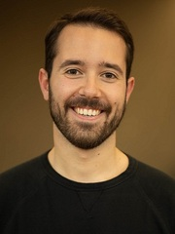




Who are we?
Suhas
Stratis
Nastaran
Eleni
Nina
Manuel
more information about the seminar:
https://github.com/Networks-Learning/hcml-seminar-2023

Slide 3
Human-Centric Machine Learning
Human-Centric Machine Learning seeks to minimize the harm, risks & burdens of machine learning systems
&
maximize their societal benefits

Slide 4
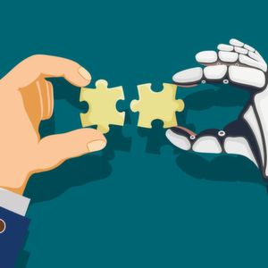



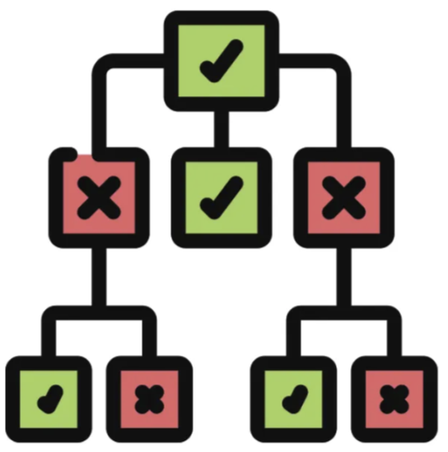
Developing Human-Centric Machine Learning
Human-Centric ML requires conceptual innovations and technical breakthroughs in multiple areas:
Human-AI Collaboration
Uncertainty Quantification
Causality
Bias Fairness
Interpretability

Slide 5
What? When? Where?
What?
You will have to
present one paper in an area of human-centric ML
ask questions during the presentation of another paper in the same area
When?
Where?
One “test presentation” in January & one “final presentation” in Feb-March
MPI-SWS 111

Slide 6
Important dates
Oct 30
Nov 2
Nov 24
Dec 1
Jan 8
Jan 31
Feb 12
Mar 29
Registration deadline
Acceptance notification
Deadline to rank topics
Paper assignment Presentation dates
Test presentations
Final presentations
Human-AI Collaboration
In front of the instructors
Bias & Fairness
Interpretability
Instructors provide feedback
Causality
Uncertainty Quantification
In front of the instructors & students
Questions by students

