Slide 1
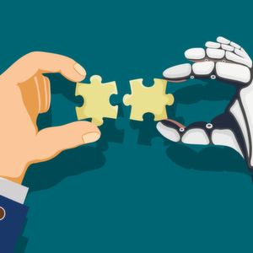


Human-Centric Machine Learning
Seminar Winter Semester 2022

Slide 2

Machine learning… for automation
Machine learning has been mostly
developed for automation
Take decisions autonomously on the basis of passively collected data
In a way, to replace humans

Slide 3
Human-Centric Machine Learning
Human-Centric Machine Learning seeks to develop models & algorithms
to
understand and assist Humans

Slide 4
Developing Human-Centric Machine Learning
Human-Centric ML requires conceptual innovations and technical breakthroughs along three different dimensions:
1. Accurate models of human behavior in specific domains
2. Scalable algorithms that use these models to assist humans
3. Robust computational metrics to evaluate such models and algorithms in real-world applications

Slide 5
What? When? Where?
What?
You will present an overview of one topic in human-centric machine learning
When?
Presentations will take place on 3-4 days throughout the Winter semester
Where?
MPI-SWS 112

Slide 6
How does it work?
How does it work?
Interpretable ML
Bias & Fairness
Strategic ML
Rank topics by Dec 2. Available topics
Causality in ML
Uncertainty Quantification
Human-AI Collaboration
Rank-based topic assignments and presentation dates released on Dec 9
An instructor will be assigned to provide advise for your presentation
Attend all presentations and please ask questions! 🤓

Slide 7
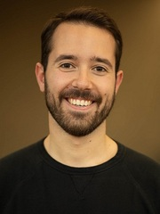



Who are we?
Stratis
Nastaran
Eleni
Manuel
more information at:
https://github.com/Networks-Learning/hcml-seminar-ws22

