Slide 1
MongoDB
Class 2

Slide 2
Topics
Data model design
Operations – (Create, drop)
Hands-on
Data types

Slide 3
MongoDB hierarchy
Database
Collections
Documents

Slide 4
Data model design
There are two types of data models
Embedded data model
Normalized data model

Slide 5
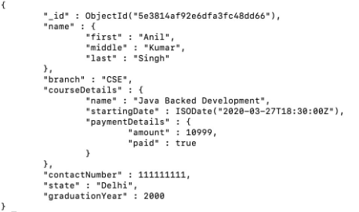
Embedded data model
This is the de-normalized data model in which all the related data is embedded in a single document.

Slide 6
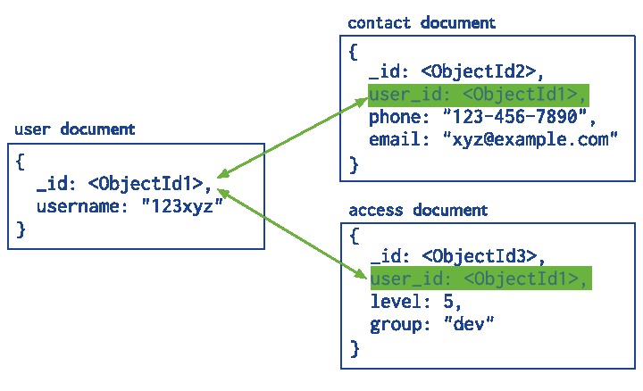
Normalized data model
Create sub-documents from a single document, using references.

Slide 7

MongoDB operation – Create database
‘Use’ is the command to create a new database in the mongoDB server.
If the database exists then the existing database is returned, if the database does not exist then it creates a new database.
Example: ‘use student’ creates a database named ‘student’

Slide 8
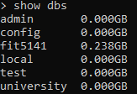
MongoDB operation – show database
To list out all the existing databases, use the command ‘show’.

Slide 9

MongoDB operation – Drop database
To delete a database, use the command db.dropDatabase().
Make sure to switch to the database you want to delete before using this command.
If successfully dropped then it returns {‘ok’ : 1}

Slide 10

MongoDB operation – create collection
To create collection in a database use the command
db.createCollection(name, options)
Options can include memory size and indexing if you want to specify the memory usage of database.
If successfully created then it returns {‘ok’ : 1}

Slide 11

MongoDB operation – show collections
To list all the collections created in a database, use ‘show collections’
Switch to database you want to see collections.

Slide 12

MongoDB operation – drop collection
Make sure in the same db where you have created collection.
Use ‘db.COLLECTION_NAME.drop()’
Returns true if successfully deleted

Slide 13
Hands on – starting server
Start Mongod server
To start the server
Copy the path of bin folder where mongod compass is installed example:‘C:\Program Files\MongoDB\Server\4.2\bin’ (Copy your bin path)
Open command prompt
Type cd ‘C:\Program Files\MongoDB\Server\4.2\bin’ and hit enter
Type mongod and hit enter (You should see a message as below)
If you are getting error try adding a folder in c drive
Create a folder data
Under folder data create another sub folder db
Note: Don’t close this command prompt, open a new command prompt

Slide 14
Hands on – start shell
Open a new command prompt
Switch to same bin path
cd ‘C:\Program Files\MongoDB\Server\4.2\bin’ and hit enter
Type mongo and hit enter
Mongo shell will start

Slide 15
DataTypes
String
Integer
Boolean
Double
Arrays
Timestamp
Date

Slide 16
Assignment
Create a database named ‘University’
Create collections ‘student’, ‘units’, ‘grades’, ‘faculty’ under it.
Delete collection ‘faculty’
Add a new collection ‘staff’
Show collections
Delete the database ‘University’
Take screenshot of each operation and its result, save it in a document and submit it by Sunday 11Pm.

