Slide 1
Netzwerk Academy
SQL – class2

Slide 2
Topics
ANSI/SPARC architecture
Database lifecycle
ER modelling
Types of attributes
Relationships

Slide 3
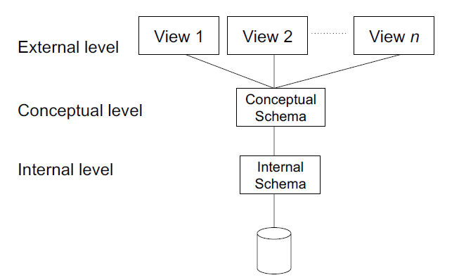
ANSI/SPARC architecture
Views are based on what an user should
be able to access/see.

Slide 4
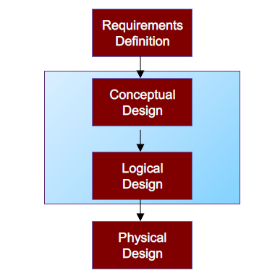
Database Lifecycle

Slide 5
Requirements definition
Identify and analyse user views.
A 'user view' may be a report to be produced or a particular type of transaction that should be supported.
Example; A student has a different view and has limited access to the database, while an admin has different view and has different set of permissions to the database.

Slide 6
Conceptual design
Develop the enterprise data model.
Independent of all physical implementation considerations.

Slide 7
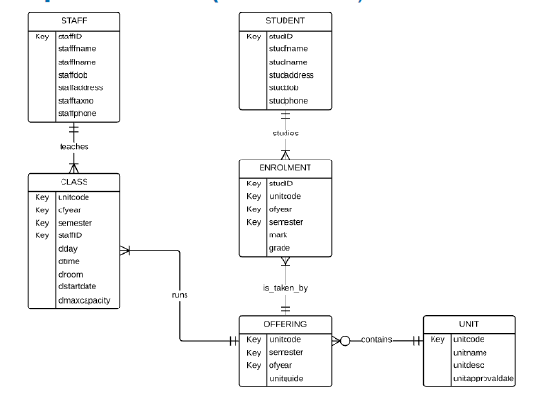
Conceptual design

Slide 8
Logical design
Develop a data model which targets a particular database model.
Normalization technique is used to test the correctness of the logical model.

Slide 9
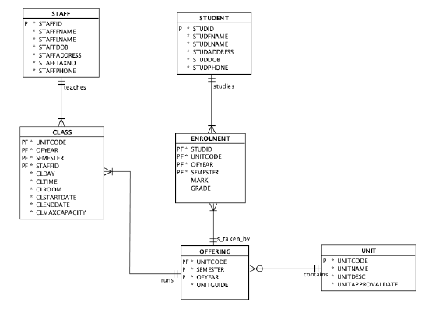
Logical design

Slide 10
Physical design
Creating the database tables, establishing the relationships, defining the constraints, etc.
Physical design phase is dependent on the particular DBMS environment in use.

Slide 11
ER diagram(Entity-relationship)
There are two types of notations for ERD
Chen’s notation
Information engineering

Slide 12
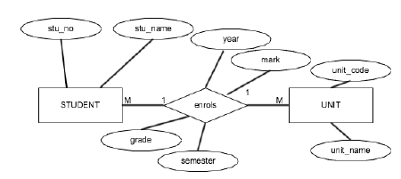
Chen’s notation

Slide 13
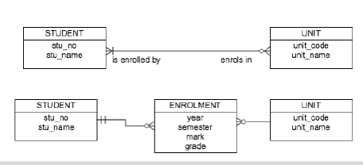
Information engineering

Slide 14
Terminologies
Entity – A table representing particular details
Attribute – Column present in an entity
Relationship – The relation between two entities

Slide 15
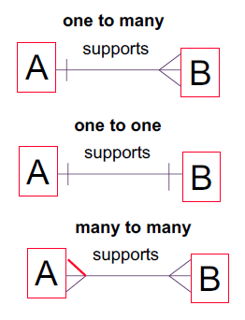
Types of relationships

Slide 16

Identify the type

Slide 17
Types of attributes
Simple
– Cannot be subdivided
– Age, sex, marital status
Composite
– Can be subdivided into additional attributes
– Address into street, city, zip
Single-valued
– Can have only a single value
– Person has one Aadhar number
Multi-valued
– Can have many values
– Person may have several college degrees
Derived
– Can be derived with algorithm
– Age can be derived from date of birth

