Slide 1
Netzwerk Academy
SQL

Slide 2
Topics
Database
RDMS
Terminologies
Properties

Slide 3
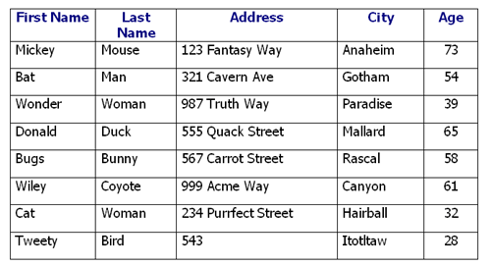
What is Database?
A structured set of data held in computer, especially one that is accessible in many ways.

Slide 4
Why don’t we use excel?
Can we fetch the values as per the queries?
Is data integrity possible? when other files which are integrated with this excel files are updated, can we ensure data integrity?
Can we ensure data redundancy?
Can we perform updation, deletion, insertion easily?

Slide 5
Data Redundancy
Data redundancy is a condition created within a database or data storage technology in which the same piece of data is held in two separate places

Slide 6
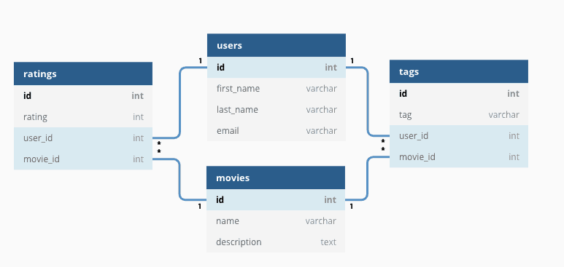
Relational database

Slide 7
Terminologies in database
Cell – Intersection of a row and a column
Column – is also called field or attribute
Record – also called as row or tuple
A table is also called as an entity or relation

Slide 8
Fundamental properties
Each row is unique, no two tuples can be same
Each column must have a meaningful name
All the values in a column are values of a single attribute
The order of attributes is immaterial
The order of tuples is immaterial.
The entries are single-valued - each cell contains a single entry
Any value is addressable by specifying the name of the
table, the primary key value for the relevant row, and the name of the column.

Slide 9
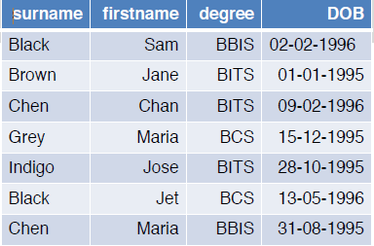
Lets test your understanding
Which of the following is/are true?
a. Surname determines firstname.
b. (surname and firstname) determine degree.
c. DOB determines surname.
d. degree determines surname.
e. (firstname and degree) determine surname.
f. More than one statement is TRUE.

Slide 10
Primary key
A Primary Key is defined as “A candidate key that is selected to identify tuples uniquely within a relation”.

Slide 11
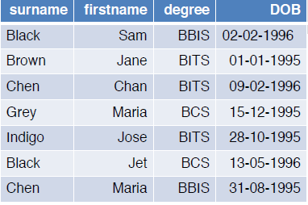
Try this
What attribute (column) or combination of columns that can be used to uniquely identify each row in the STUDENT table (relation).
a. Combination of surname, firstname, degree, DOB.
b. Combination of surname and firstname
c. Combination of surname, firstname and degree
d. All of them.

Slide 12
Foreign keys
A foreign key is an attribute or a set of attributes within one relation defined over the same domain as the primary key of another (possibly the same) relation.
Foreign keys implement relationships between tables (relations).

Slide 13
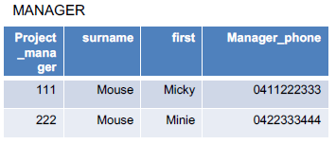
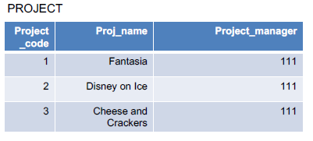
Try this
In which table would you assign FK (and what attribute?) if the above two tables are to be created in a relational database?

Slide 14
ACID property
Atomicity
A transaction is completely done or nothing happens.
Consistency
Valid data gets into database.
Isolation
Transactions do not affect each other.
Durability
Committed data will not be lost even after power failure.

Slide 15
Data Integrity
Entity integrity
Primary Key should not be NULL.
Referential integrity
The values of FK should match the value of the PK in another relation (possibly the same) or be NULL.
Column/Domain integrity
All values in a given column has to come from the same domain (the same data type and range).

